Slide 1
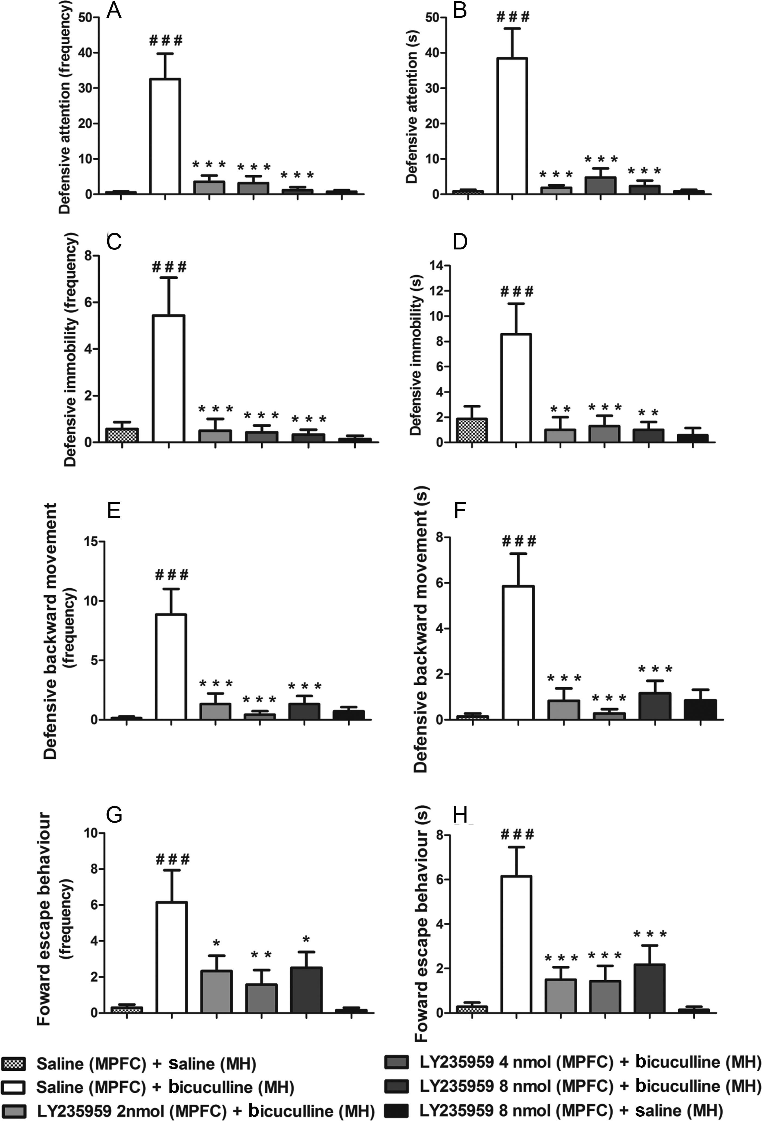
Figure 1. Effect of the microinjection of 200 nL of LY235959 (at 2.0, 4.0, and 8.0 nmol) or saline (NaCl 0.9%/200 nL) ...
Notes:
Figure 1. Effect of the microinjection of 200 nL of LY235959 (at 2.0, 4.0, and 8.0 nmol) or saline (NaCl 0.9%/200 nL) into the prelimbic (PL) division of the medial prefrontal cortex (MPFC) followed by the microinjection of bicuculline (40 ng/200 nL) into the medial hypothalamus (MH) on the frequency and duration of defensive attention (A and B), defensive immobility (C and D), defensive backward movements (E and F), and forward escape behaviors (G and H) (N = 6–8). The columns represent the means, and the bars represent the standard errors of the means. *P < 0.05, **P < 0.01, and ***P < 0.001 compared with the saline (MPFC) + bicuculline (MH)-treated group; ###P < 0.001 compared with the saline (MPFC) + saline (MH)-treated group according to a one-way ANOVA, followed by Newman–Keuls' post hoc tests.
Unless provided in the caption above, the following copyright applies to the content of this slide: © The Author 2013. Published by Oxford University Press. All rights reserved. For Permissions, please e-mail: journals.permissions@oup.com

Slide 2
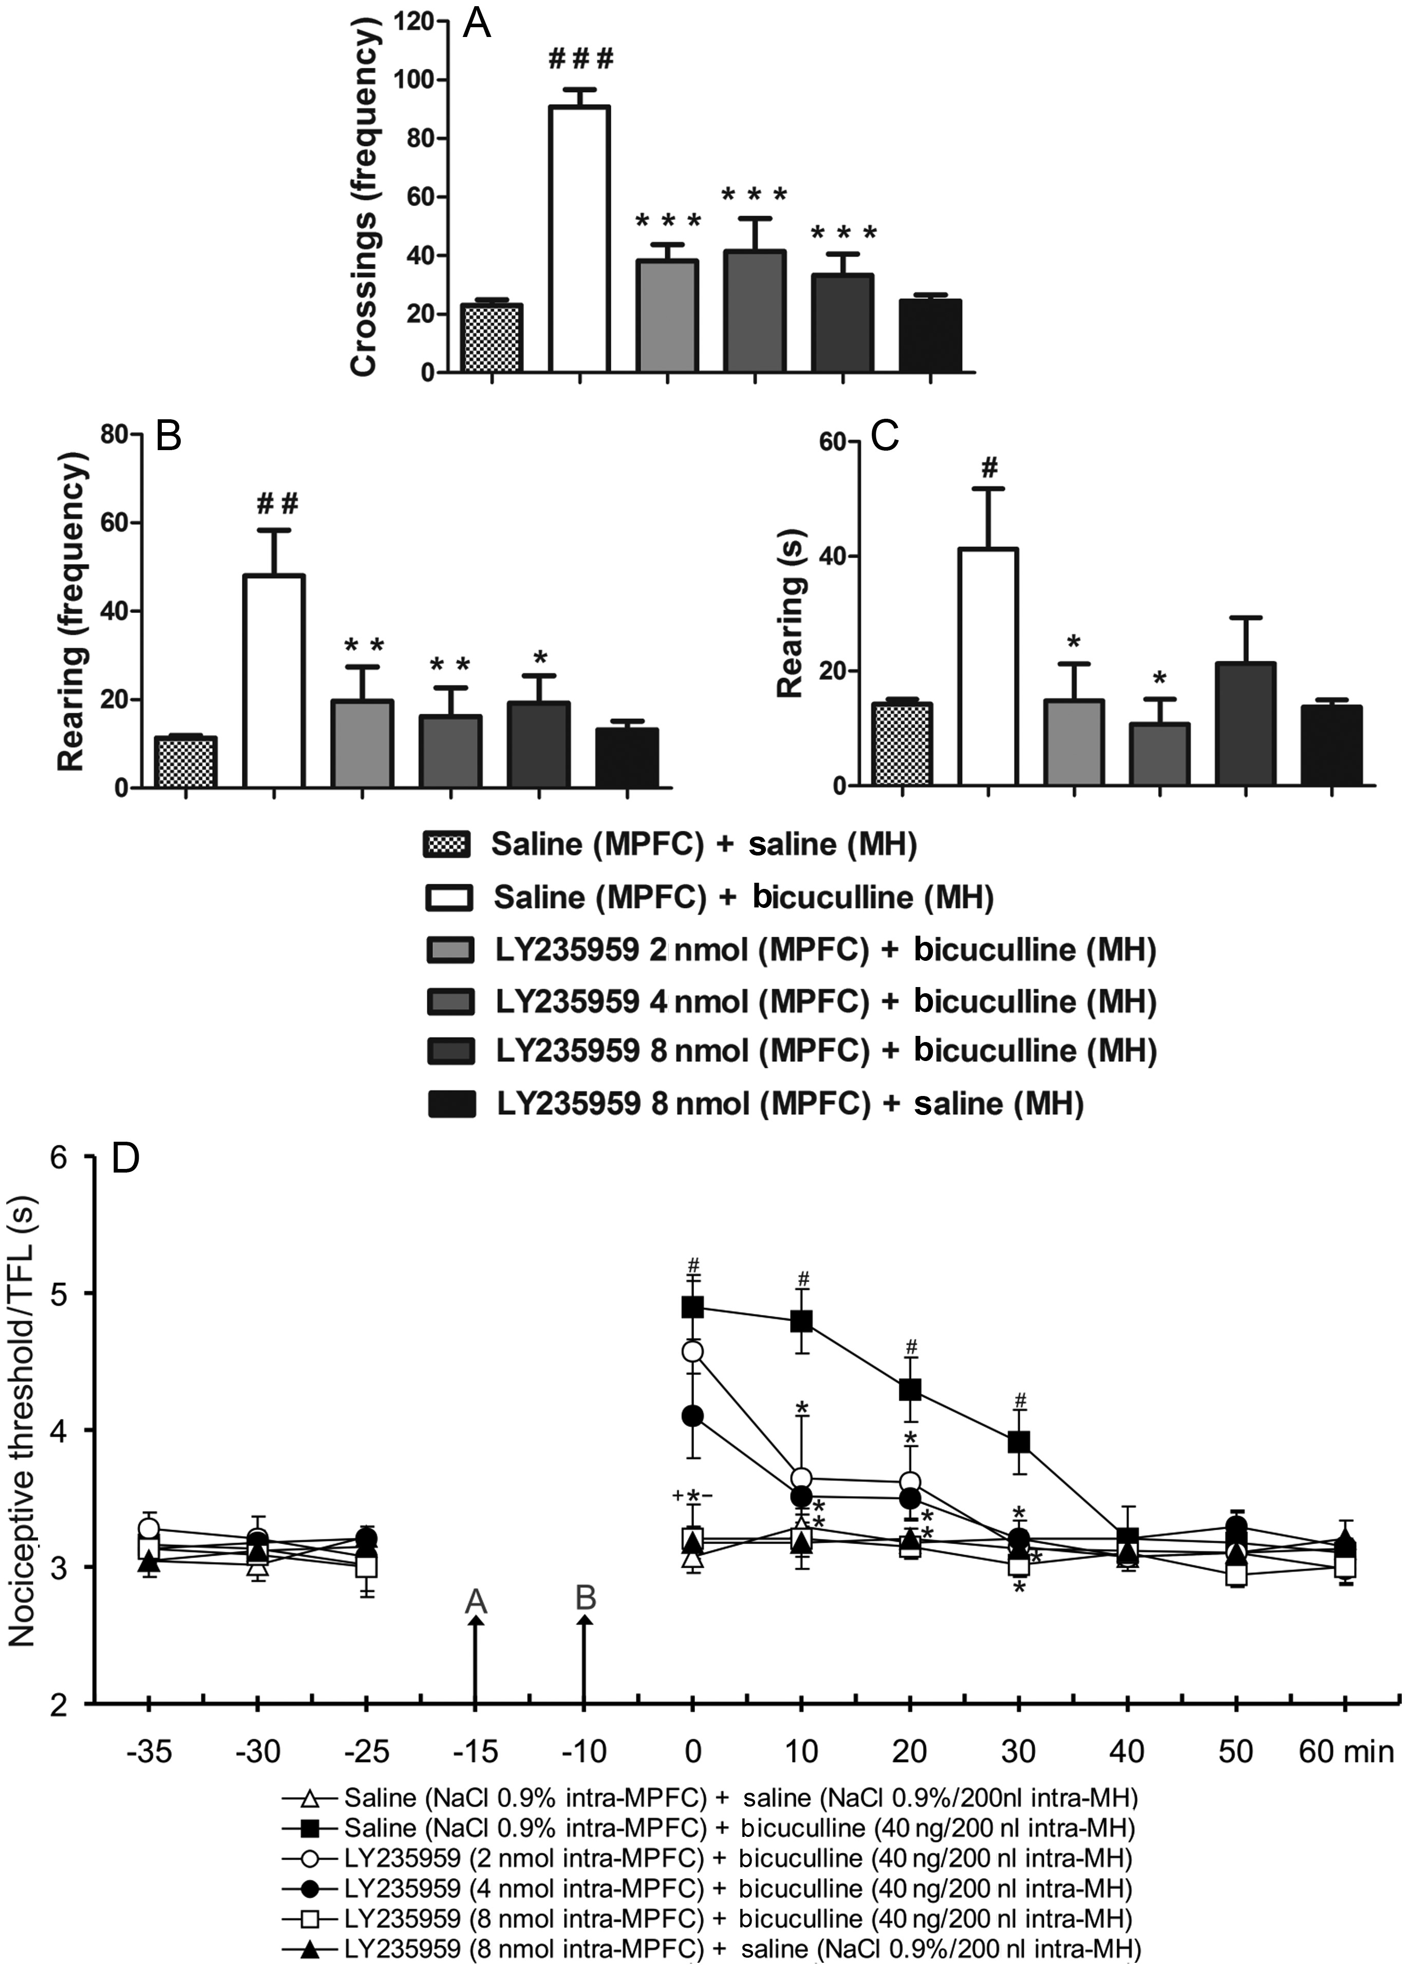
Figure 2. (A–C) Effect of the microinjection of 200 nL of LY235959 (at 2.0, 4.0, and 8.0 nmol) or saline (NaCl 0.9%) ...
Notes:
Figure 2. (A–C) Effect of the microinjection of 200 nL of LY235959 (at 2.0, 4.0, and 8.0 nmol) or saline (NaCl 0.9%) into the prelimbic (PL) division of the medial prefrontal cortex (MPFC) followed by the microinjection of bicuculline (at 40 ng/200 nL) into the MH on the frequency of crossing (A) and the frequency and duration of rearing (B and C) during elaborated escape behavior (N = 6–8). The columns represent the means, and the bars represent the standard errors of the means. *P < 0.05 and ***P < 0.001 compared with the saline (MPFC) + bicuculline (MH)-treated group; #P < 0.05; ##P < 0.01, and ###P < 0.001 compared with the saline (MPFC) + saline (MH)-treated group according to one-way ANOVA followed by Newman–Keuls' post hoc tests. (D) Effect of the microinjection of LY235959 (at 3 different concentrations) or saline (NaCl 0.9%) into the prelimbic (PL) medial prefrontal cortex (MPFC) followed by the microinjection of bicuculline (at 40 ng/200 nL) into the MH on nociceptive thresholds measured with the tail-flick test (TFL) (N = 6–8). *P < 0.05 compared with the saline (MPFC) + bicuculline (MH) group; #P < 0.05 compared with the saline (MPFC) + saline (MH) group; −, P < 0.05 compared with the LY235959 2 nmol (MPFC) + bicuculline (MH) group; +, P < 0.05 compared with the LY235959 4 nmol (MPFC) + bicuculline (MH) group according to a repeated-measures ANOVA followed by Duncan's post hoc tests.
Unless provided in the caption above, the following copyright applies to the content of this slide: © The Author 2013. Published by Oxford University Press. All rights reserved. For Permissions, please e-mail: journals.permissions@oup.com

Slide 3
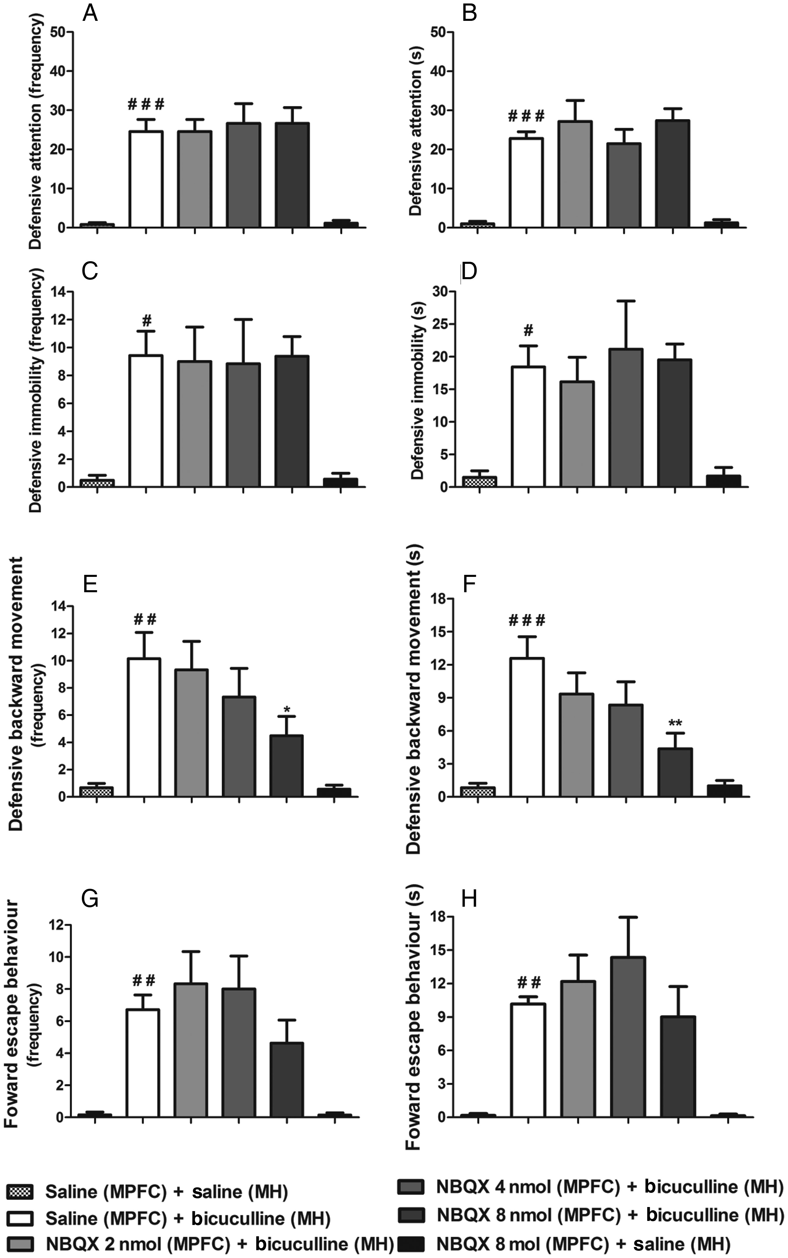
Figure 3. Effect of the microinjection of 200 nL of NBQX (at 2.0, 4.0, and 8.0 nmol) or saline (NaCl 0.9%) into the ...
Notes:
Figure 3. Effect of the microinjection of 200 nL of NBQX (at 2.0, 4.0, and 8.0 nmol) or saline (NaCl 0.9%) into the prelimbic (PL) division of the medial prefrontal cortex (MPFC) followed by the microinjection of bicuculline (40 ng/200 nL) into the MH on the frequency and duration of defensive attention (A and B), defensive immobility (C and D), defensive backward movement (E and F), and forward escape behavior (G and H) (N = 6–8). The columns represent the means, and the bars represent the standard errors of the means. *P < 0.05 and **P < 0.01 compared with the saline (MPFC) + bicuculline (MH)-treated group; #P < 0.05; ##P < 0.01, and ###P < 0.001 compared with the saline (MPFC) + saline (MH)-treated group according to a one-way ANOVA followed by Newman–Keuls post hoc tests.
Unless provided in the caption above, the following copyright applies to the content of this slide: © The Author 2013. Published by Oxford University Press. All rights reserved. For Permissions, please e-mail: journals.permissions@oup.com

Slide 4
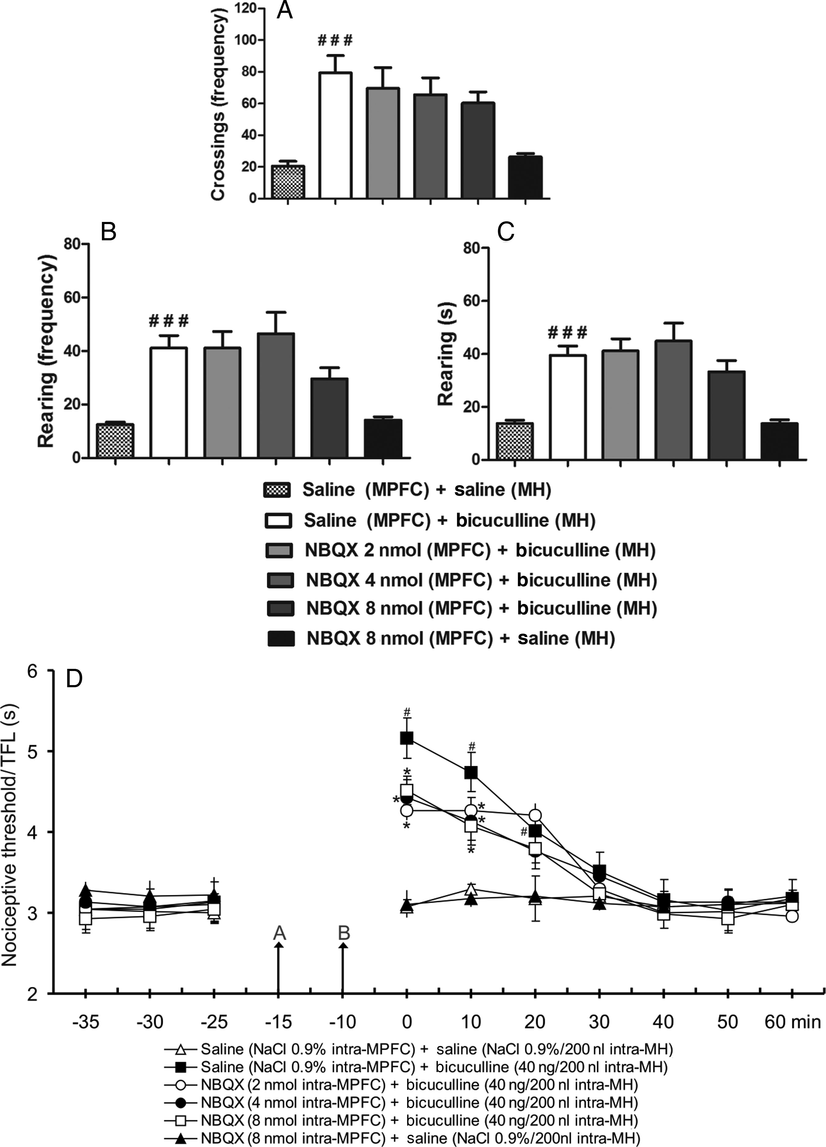
Figure 4. (A–C) Lack of the effect of the microinjection of 200 nL of NBQX (at 2.0, 4.0, and 8.0 nmol) or saline (NaCl ...
Notes:
Figure 4. (A–C) Lack of the effect of the microinjection of 200 nL of NBQX (at 2.0, 4.0, and 8.0 nmol) or saline (NaCl 0.9%) into the prelimbic (PL) medial prefrontal cortex (MPFC) followed by the microinjection of bicuculline (at 40 ng/200 nL) into the MH on the frequency of crossing (A) and the frequency and duration of rearing (B and C) during elaborated escape behavior (N = 6–8). The columns represent the means, and the bars represent the standard errors of the means. ###P < 0.001 compared with the saline (MPFC) + saline (MH)-treated group according to a one-way ANOVA followed by Newman–Keuls post hoc tests. (D) The effects of the microinjection of NBQX (at 3 different concentrations) or saline (NaCl 0.9%/200 nL) into the prelimbic (PL) medial prefrontal cortex (MPFC) followed by the microinjection of bicuculline (at 40 ng/200 nL) into the MH on nociceptive thresholds as measured by the tail-flick test (TFL) (N = 6–8). *P < 0.05 compared with the saline (MPFC) + bicuculline (MH) group; #P < 0.05 compared with the saline (MPFC) + saline (MH) group according to a repeated-measures ANOVA followed by Duncan's post hoc tests.
Unless provided in the caption above, the following copyright applies to the content of this slide: © The Author 2013. Published by Oxford University Press. All rights reserved. For Permissions, please e-mail: journals.permissions@oup.com

Slide 5
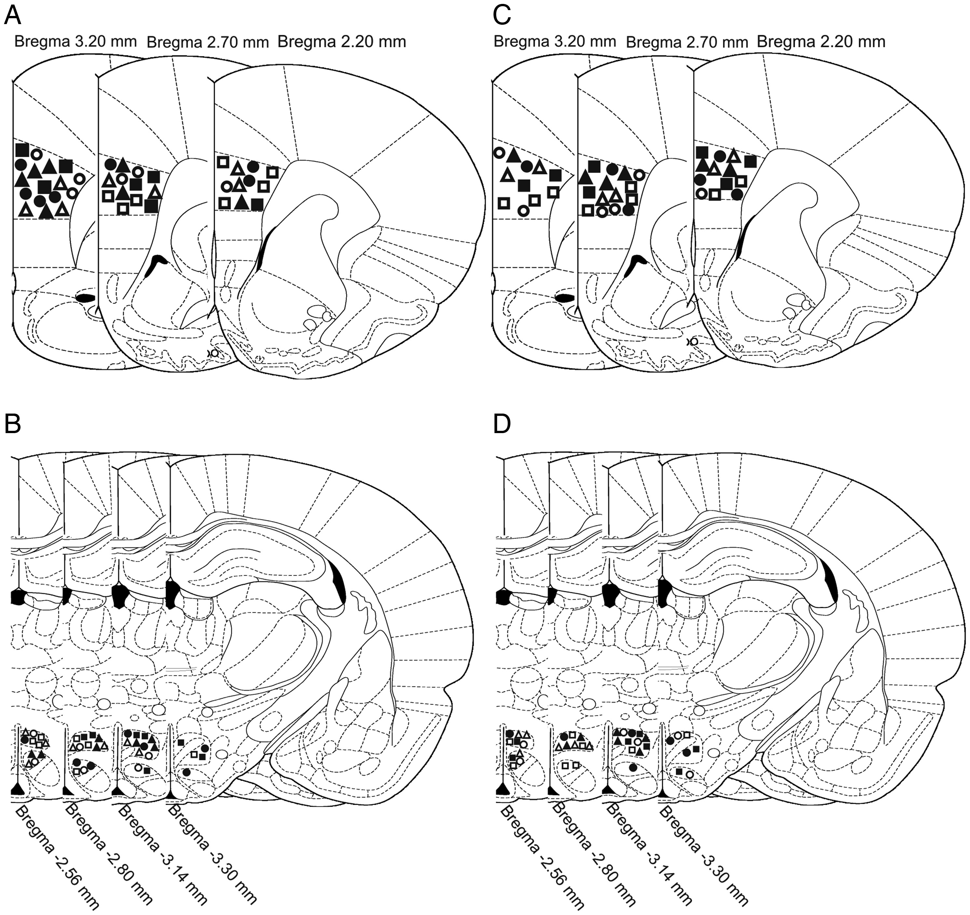
Figure 5. (A–B) Schematic coronal section of the brain of R. norvegicus showing the sites of central administrations in ...
Notes:
Figure 5. (A–B) Schematic coronal section of the brain of R. norvegicus showing the sites of central administrations in the prelimbic (PL) division of the medial prefrontal cortex (A) and medial hypothalamus (MH) (B) of the (open triangles) saline intra-PL cortex + saline intra-MH, (filled squares) saline intra-PL cortex + bicuculline intra-MH, (open circles) LY235959 (2.0 nmol) intra-PL cortex + bicuculline intra-MH, (closed circles) LY235959 (4.0 nmol) intra-PL cortex + bicuculline intra-MH, (open squares) LY235959 (8.0 nmol) intra-PL cortex + bicuculline intra-MH, (filled triangles) LY235959 (8.0 nmol) intra-PL cortex + saline intra-MH groups depicted on illustrations from Paxinos and Watson's stereotaxic atlas (1997). (C and D) Schematic coronal section of the brain of R. norvegicus showing the sites of central administrations in the PL cortex (A) and MH (B) of the (open triangles) saline intra-PL cortex + saline intra-MH, (filled squares) saline intra-PL cortex + bicuculline intra-MH, (open circles) NBQX (2.0 nmol) intra-PL cortex + bicuculline intra-MH, (filled circles) NBQX (4.0 nmol) intra-PL cortex + bicuculline intra-MH, (open squares) NBQX (8.0 nmol) intra-PL cortex + bicuculline intra-MH, (filled triangles) NBQX (8.0 nmol) intra-PL cortex + saline intra-MH groups depicted on illustrations from Paxinos and Watson's stereotaxic atlas (1997).
Unless provided in the caption above, the following copyright applies to the content of this slide: © The Author 2013. Published by Oxford University Press. All rights reserved. For Permissions, please e-mail: journals.permissions@oup.com

