Slide 1
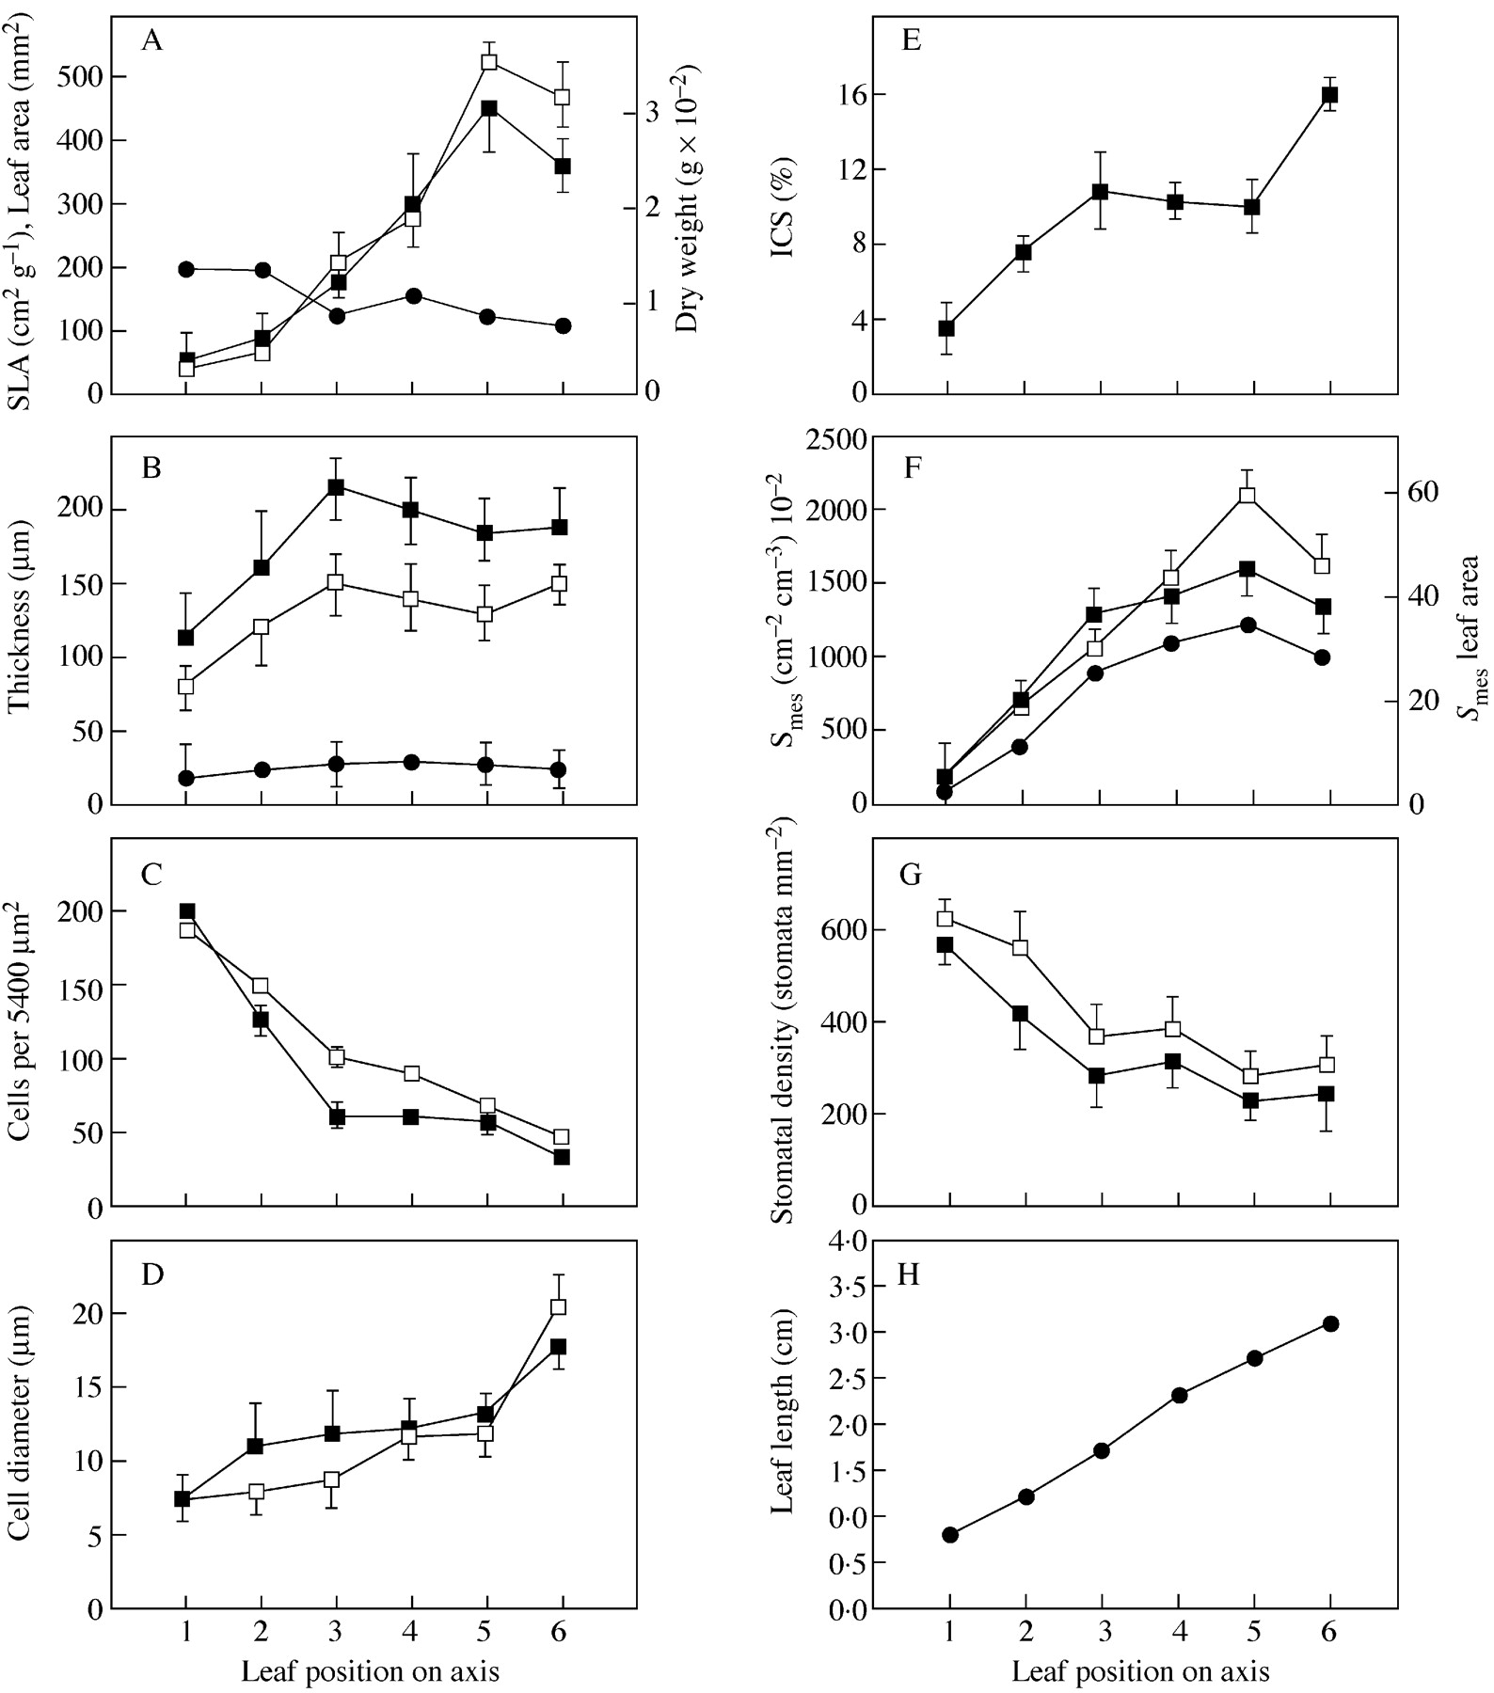
Fig. 1. Morphometric features of successive leaves of Capparis spinosa: A, leaf area (filled squares), dry ...
Notes:
Fig. 1. Morphometric features of successive leaves of Capparis spinosa: A, leaf area (filled squares), dry weight (open squares) and specific leaf area (circles); B, leaf thickness (filled squares), mesophyll thickness (open squares), epidermis thickness (circles); C, number of cells per unit of leaf surface (5400 µm2) in adaxial (open squares) and abaxial (filled squares) mesophyll; D, mesophyll cell diameter in adaxial (open squares) and abaxial (filled squares) leaf sites; E, intercellular space (ICS) of the mesophyll (filled squares); F, free surface (Smes) in the adaxial (open squares) and abaxial (filled squares) mesophyll per leaf volume [(cm2 cm–3) 10–2] and Smes per leaf area (circles); G, stomatal density (number of stomata per mm2) on the adaxial (open squares) and abaxial (filled squares) epidermis; H, leaf length (cm) is the mean of 31 measurements.Variation is described by standard error bars.
Unless provided in the caption above, the following copyright applies to the content of this slide:

Slide 2
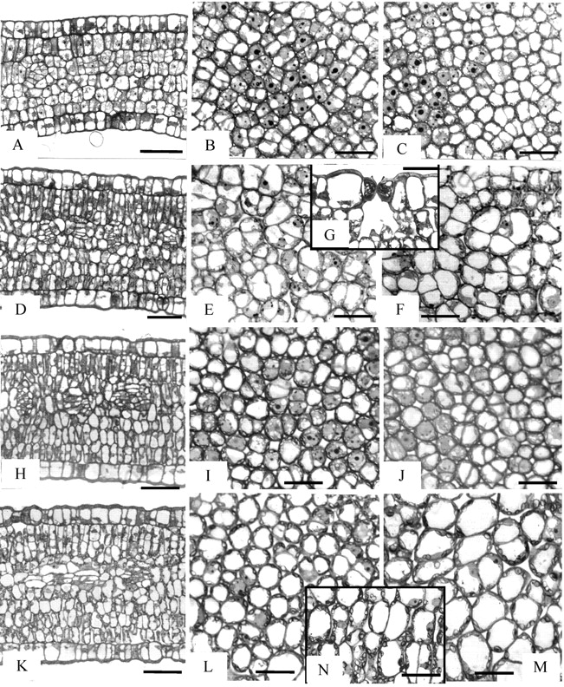
Fig. 2. Anatomy of expanding leaves (L1–L4) of Capparis spinosa. A, D, H and K, Cross‐sections of L1, L2, L3 ...
Notes:
Fig. 2. Anatomy of expanding leaves (L1–L4) of Capparis spinosa. A, D, H and K, Cross‐sections of L1, L2, L3 and L4, respectively; B, E, I and L, paradermal sections through adaxial mesophyll of the corresponding leaves; C, F, J and M, similar sections through abaxial mesophyll. In L1 (A–C) mesophyll cells are highly meristematic. In L2 (D–G) small ICS are shown (D–F). A mature stoma of the adaxial epidermis is shown in G. L3 possesses small, cylindrical mesophyll cells (H–J). In L4 (K–N) mesophyll is composed of highly vacuolated cells (K–M). This is also evident in the cross‐sectioned leaf shown in detail in N. Bars represent 50 µm (A, D, H and K) or 20 µm (all other micrographs).
Unless provided in the caption above, the following copyright applies to the content of this slide:

Slide 3
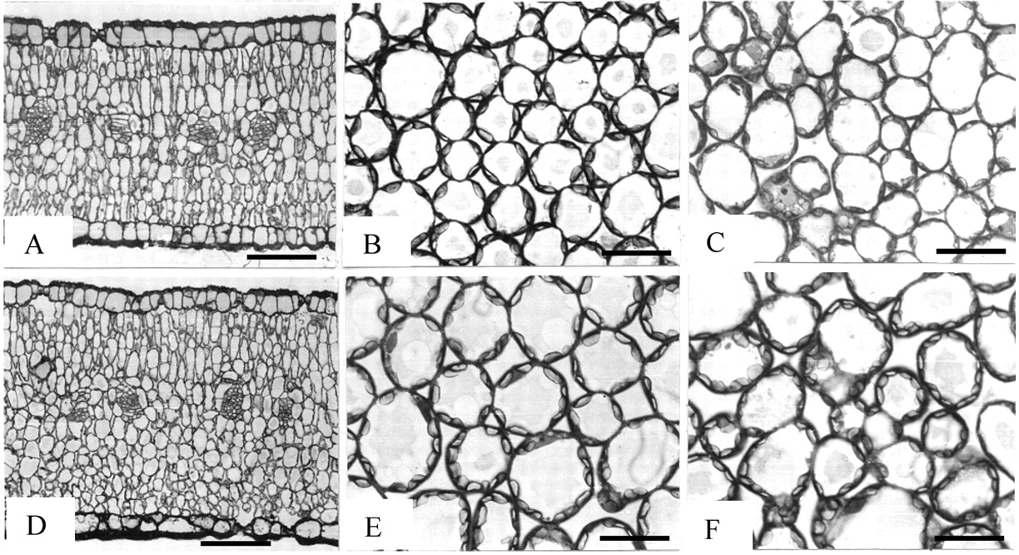
Fig. 3. Anatomy of mature leaves of C. spinosa (L5 and L6): A and D, cross‐sectioned leaves; B and E, ...
Notes:
Fig. 3. Anatomy of mature leaves of C. spinosa (L5 and L6): A and D, cross‐sectioned leaves; B and E, paradermal sections through adaxial mesophyll of L5; C and F, paradermal sections through abaxial mesophyll of L6. Cylindrical, densely packed mesophyll cells expose most of their surface to ICS. Bars represent 50 µm (A and D) or 20 µm (all other micrographs).
Unless provided in the caption above, the following copyright applies to the content of this slide:

Slide 4
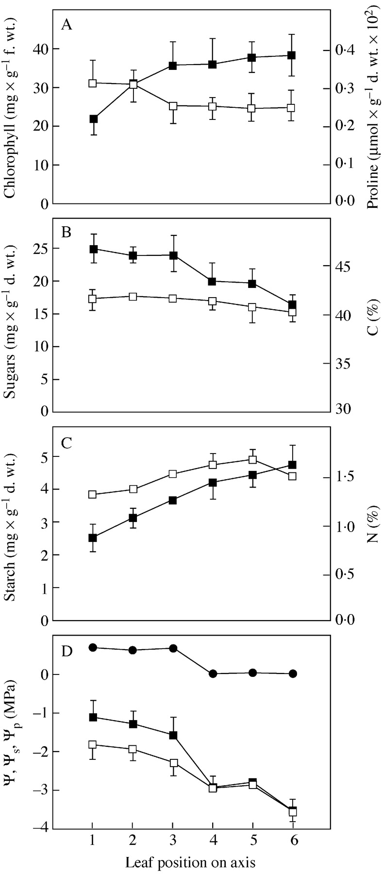
Fig. 4. A, Total chlorophyll (filled squares) and proline content (open squares); B, soluble sugars (filled ...
Notes:
Fig. 4. A, Total chlorophyll (filled squares) and proline content (open squares); B, soluble sugars (filled squares) and carbon (open squares); C, starch (filled squares) and nitrogen (open squares); D, water potential (ψ, filled squares), osmotic potential (ψs, open squares) and turgor potential (ψp, filled circles) of successive leaves along a shoot. Standard error bars describe variation.
Unless provided in the caption above, the following copyright applies to the content of this slide:

