Slide 1
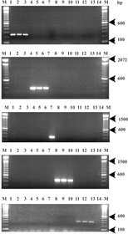
1 Rapid identification of Fusarium species using PCR primers designed from ITS sequences of nrDNA. Lanes: 1–3: ...
Notes:
1 Rapid identification of Fusarium species using PCR primers designed from ITS sequences of nrDNA. Lanes: 1–3: Fusarium culmorum isolates; 4–6: Fusarium sambucinum; 7: Fusarium oxysporum; 8–10: Fusarium equiseti; 11–13: Fusarium avenaceum; 14: negative control without DNA; M: 100 bp DNA marker (Gibco BRL, UK).
Unless provided in the caption above, the following copyright applies to the content of this slide: © 2002 Federation of European Microbiological Societies

Slide 2
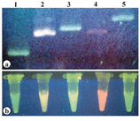
2 Rapid identification of Fusarium species using fluorescent-labelled PCR-based assay. Lanes 1–5 represent ...
Notes:
2 Rapid identification of Fusarium species using fluorescent-labelled PCR-based assay. Lanes 1–5 represent Fusarium culmorum, Fusarium sambucinum, Fusarium oxysporum, Fusarium avenaceum and Fusarium equiseti isolates, respectively. Panel a shows the gel of PCR products amplified by respective species-specific primers and run on 2% metaphor agarose gel, and panel b represents the amplified DNA in Eppendorf tubes after purification.
Unless provided in the caption above, the following copyright applies to the content of this slide: © 2002 Federation of European Microbiological Societies

