Slide 1
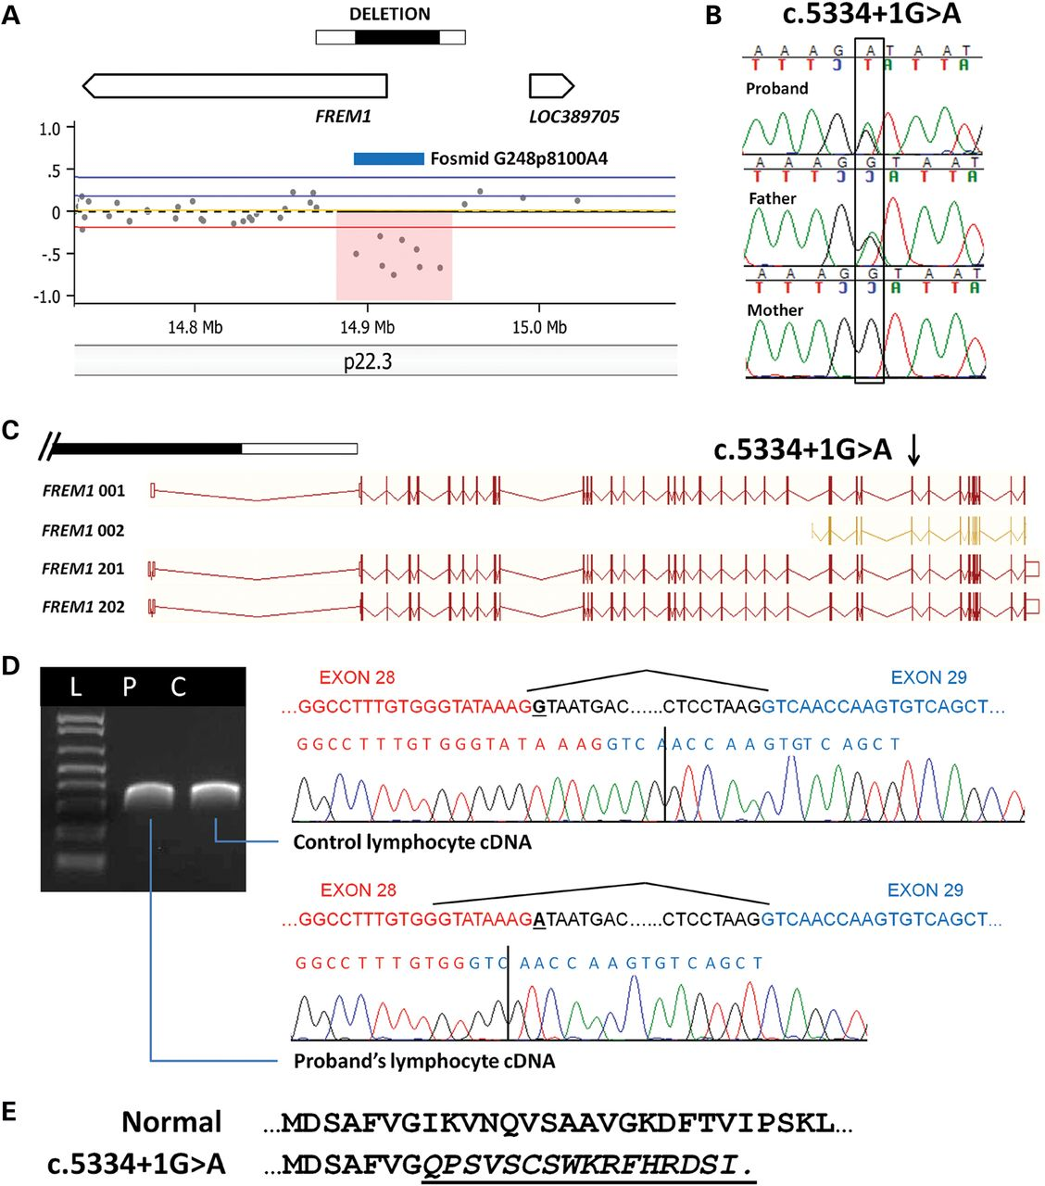
Figure 1. Recessive changes affecting FREM1 are responsible for the development of CDH in the proband. (A) Array data ...
Notes:
Figure 1. Recessive changes affecting FREM1 are responsible for the development of CDH in the proband. (A) Array data from the proband showing the ∼86 kb FREM1 deletion inherited from her unaffected mother. The minimal and maximal deleted regions are represented by a black (minimal) and white (maximal) bar. The approximate locations of FREM1 and LOC389705 are represented by open block arrows. The approximate location of fosmid clone G248p8100A4, which was used for FISH confirmation, is represented by a blue bar. (B) Chromatograms show the heterozygous point mutation in an invariant base of the splice donor site of FREM1 intron 28 (c.5334 + 1G > A) that the proband inherited from her unaffected father. (C) A schematic showing the approximate locations of the FREM1 deletion (black and white bar) and the 5334 + 1G > A point mutation in relation to the exons (vertical bars) and introns (horizontal bars) of each of the protein-coding transcripts of FREM1 (www.ensembl.org). (D) Sequencing analysis of cDNA made from EBV-transformed lymphocytes from the proband (P) and a control individual (C) reveals the activation of a cryptic splice site in the patient's sample and deletion of 8 bp from the end of exon 28 (based on FREM1 transcript 001). No wild-type sequence is seen in the proband's sample, indicating that FREM1 transcripts originating from the maternal allele are below the level of detection in the proband's lymphocytes. (E) The amino acid sequences of a normal human FREM1 protein (top) and the predicted amino acid sequence of the FREM1 protein translated from the paternal allele (bottom) are shown with variant amino acids italicized and underlined. The 5334 + 1G > A point mutation causes a shift in the reading frame leading to an altered amino acid sequence starting at position 1777 and premature termination at amino acid 1793 which affects all of FREM1's protein products. L, ladder.
Unless provided in the caption above, the following copyright applies to the content of this slide: © The Author 2012. Published by Oxford University Press. All rights reserved. For Permissions, please email: journals.permissions@oup.comThis article is published and distributed under the terms of the Oxford University Press, Standard Journals Publication Model (https://academic.oup.com/journals/pages/open_access/funder_policies/chorus/standard_publication_model)

Slide 2
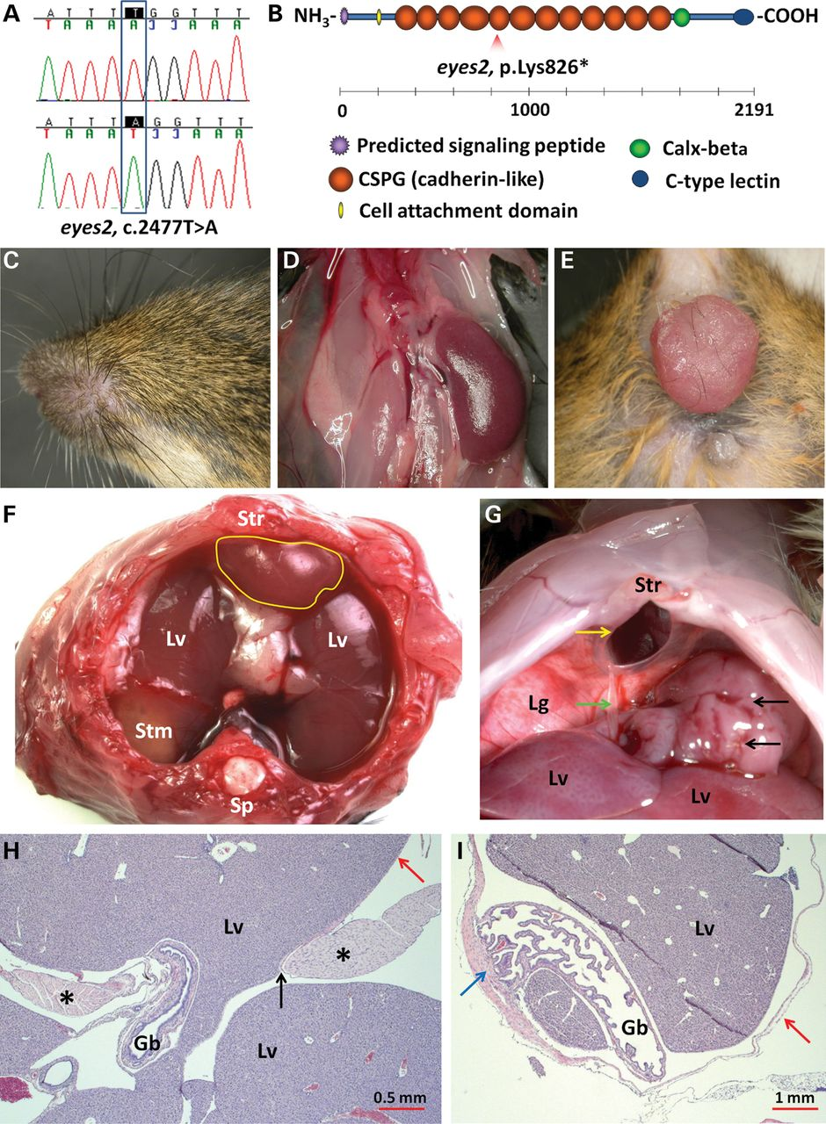
Figure 2. A homozygous truncating mutation in Frem1 is responsible for the eye, kidney, anal, and diaphragmatic defects ...
Notes:
Figure 2. A homozygous truncating mutation in Frem1 is responsible for the eye, kidney, anal, and diaphragmatic defects seen in eyes2 mice. (A) Chromatograms of a wild-type mouse (top) and an eyes2 mouse (bottom). The eyes2 mouse carries a homozygous c.2477T > A point mutation which creates a premature stop codon (p.Leu826*). (B) Schematic representation of the mouse FREM1 protein showing the approximate location of the p.Lys826* change in relation to various protein motifs. (C–E) Frem1eyes2 mice have anomalies previously described in other FREM1-deficient mouse strains including cryptophthalmos (C), unilateral kidney agenesis (D) and a propensity to develop anal prolapse in adulthood (E). (F) A retrosternal diaphragmatic hernia in a Frem1eyes2 mouse as viewed from the thorax. The herniated viscera are covered by a membranous sac (yellow outline). The liver (Lv) and stomach (Stm) are visible through the transparent diaphragm. (G) A retrosternal diaphragmatic hernia (yellow arrow) in a Frem1eyes2 mouse as viewed from the abdomen. The gallbladder (green arrow) is visible along with a mass of liver tissue (black arrows) which has been reduced into the abdomen. In this example, the gallbladder is abnormally attached to the hernial sac which has not been reduced into the abdomen, (H and I) H&E-stained sections through hernial sacs revealed herniated liver tissue (Lv) and the gallbladder (Gb) surrounded by a thin membrane (red arrows). There is a sharp demarcation between the diaphragmatic musculature and the membrane (black arrow) and evidence of muscular thickening at the edge of the diaphragmatic defect (H, *). In one case, the gallbladder was abnormally fused to the hernia sac (I, blue arrow). Gb, gallbladder; Lv, liver; Lg, lung; Sp, spine; Stm, stomach; Str, sternum.
Unless provided in the caption above, the following copyright applies to the content of this slide: © The Author 2012. Published by Oxford University Press. All rights reserved. For Permissions, please email: journals.permissions@oup.comThis article is published and distributed under the terms of the Oxford University Press, Standard Journals Publication Model (https://academic.oup.com/journals/pages/open_access/funder_policies/chorus/standard_publication_model)

Slide 3
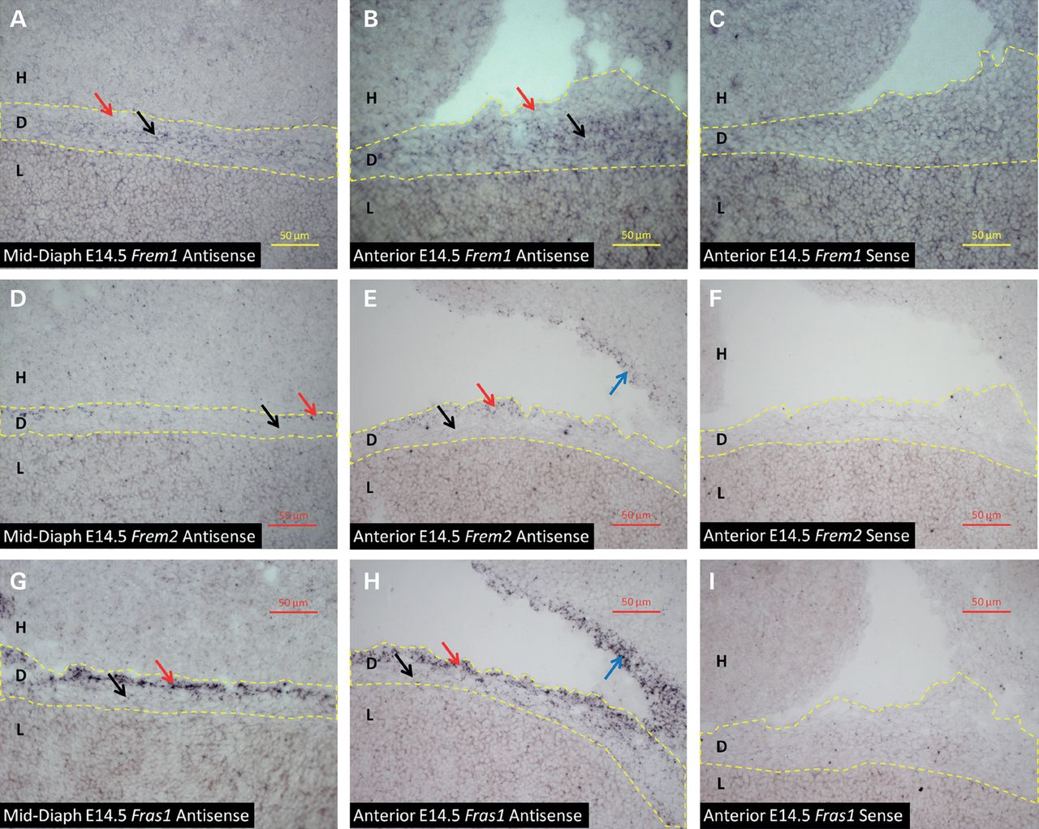
Figure 3. Frem1, Frem2 and Fras1 are expressed in the mid-diaphragm and anterior diaphragm at E14.5. The expression of ...
Notes:
Figure 3. Frem1, Frem2 and Fras1 are expressed in the mid-diaphragm and anterior diaphragm at E14.5. The expression of Frem1, Frem2 and Fras1 was verified in sagittal sections from E14.5 embryos using in situ hybridization. In each case, a sense probe was used as a negative control. Dashed yellow lines outline the diaphragm in all panels. (A–C) Expression of Frem1 is seen primarily in the inner, mesenchymal cell layers of the diaphragm (black arrows) and is not detected in the upper, mesothelial layer of the diaphragm (red arrows). (D–I) Frem2 (D–F) and Fras1 (G–I) are not expressed in the inner, mesenchymal cell layers of the diaphragm (black arrows) but are expressed in the upper, mesothelial layer of the diaphragm (red arrows) and in the mesothelial lining of the thorax (blue arrows). H, heart; D, diaphragm; L, liver.
Unless provided in the caption above, the following copyright applies to the content of this slide: © The Author 2012. Published by Oxford University Press. All rights reserved. For Permissions, please email: journals.permissions@oup.comThis article is published and distributed under the terms of the Oxford University Press, Standard Journals Publication Model (https://academic.oup.com/journals/pages/open_access/funder_policies/chorus/standard_publication_model)

Slide 4
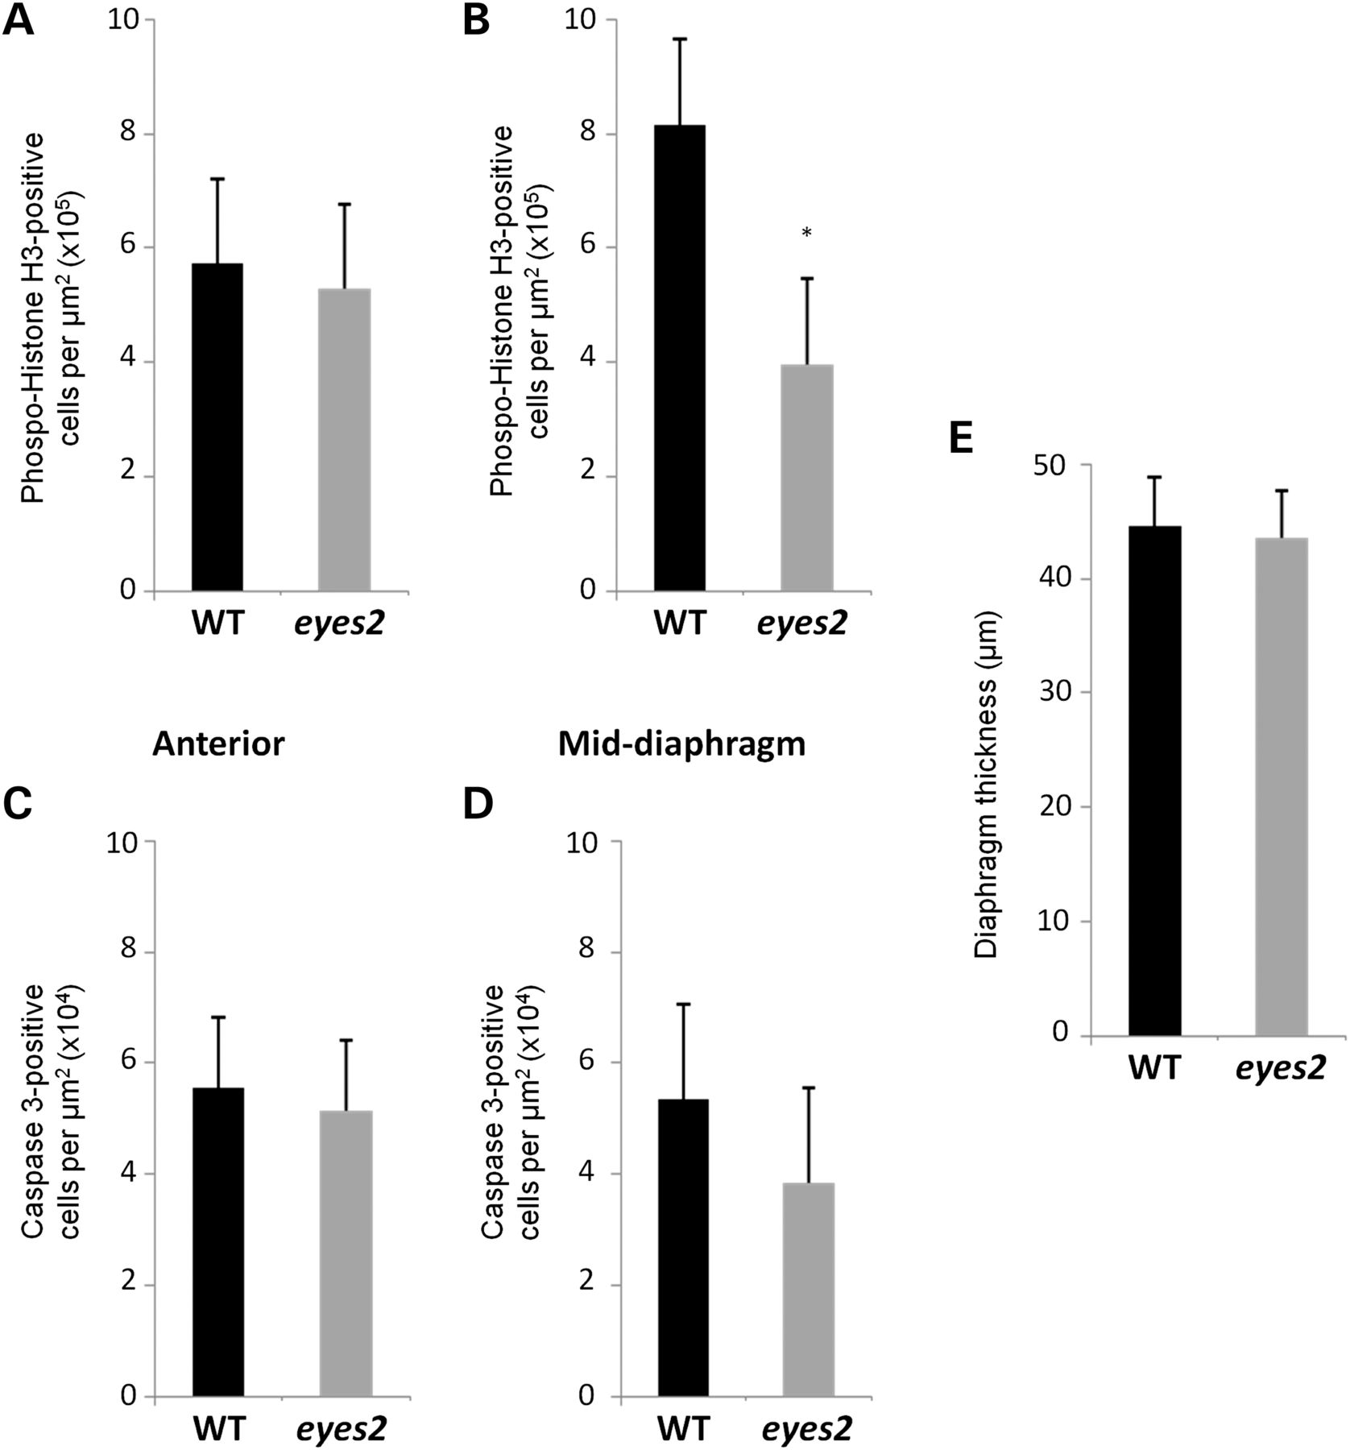
Figure 4. Frem1^{eyes2} embryos have decreased levels of cell proliferation in the mid-diaphragm at E14.5. (A ...
Notes:
Figure 4. Frem1eyes2 embryos have decreased levels of cell proliferation in the mid-diaphragm at E14.5. (A and B) The level of cell proliferation in the developing diaphragms of wild-type and eyes2 embryos was measured by calculating the number of Phospo-Histone H3-positive cells/µm2 in midline sagittal sections of the anterior (A) and mid-diaphragm (B). While the level of cell proliferation was similar between wild-type and eyes2 embryos in the anterior diaphragm (P= 0.729), decreased levels of cell proliferation were seen in the mid-diaphragms of eyes2 embryos (P=0.006). (C and D) The level of apoptosis in the developing diaphragms of wild-type and eyes2 embryos was measured by calculating the number of cleaved-Caspase 3-positive cells/µm2 in midline sagittal sections of the anterior (C) and mid-diaphragm (D). No differences were seen in the level of apoptosis in the anterior diaphragms (P= 0.703) or mid-diaphragms (P= 0.292) between wild-type and eyes2 embryos. (E) No differences were seen in the average thickness of the mid-diaphragms of wild-type and eyes2 embryos (P= 0.221).
Unless provided in the caption above, the following copyright applies to the content of this slide: © The Author 2012. Published by Oxford University Press. All rights reserved. For Permissions, please email: journals.permissions@oup.comThis article is published and distributed under the terms of the Oxford University Press, Standard Journals Publication Model (https://academic.oup.com/journals/pages/open_access/funder_policies/chorus/standard_publication_model)

