Slide 1
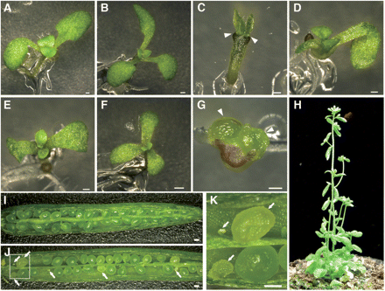
Fig. 1 Morphological defects in mab2-1 mutants. (A–G) Seven-day-old seedlings of the wild type (A), pid-2 (B), ...
Notes:
Fig. 1 Morphological defects in mab2-1 mutants. (A–G) Seven-day-old seedlings of the wild type (A), pid-2 (B), mab2-1 pid-2 (C) and mab2-1 (D–G). Arrowheads in C and G indicate the absence of cotyledons. (H) mab2-1 adult plant at 70 d post-germination. (I–K) Open siliques of the wild type (I) and mab2-1/+ (J). (K) An enlarged image of the region enclosed within the white square in J. White arrows indicate pale green and shriveled seeds. The red arrow in H indicates the leaf-like structure at the basis of the pedicel. Scale bars = 250 μm.
Unless provided in the caption above, the following copyright applies to the content of this slide: © The Author 2011. Published by Oxford University Press on behalf of Japanese Society of Plant Physiologists. All rights reserved. For permissions, please email: journals.permissions@oup.com

Slide 2
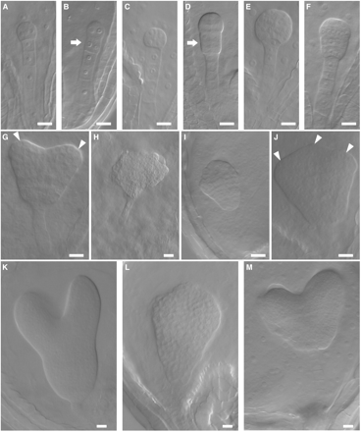
Fig. 2 Defects in embryogenesis in mab2-1 mutants. Wild type or heterozygous mutant embryos (A, C, E, G, K) and ...
Notes:
Fig. 2 Defects in embryogenesis in mab2-1 mutants. Wild type or heterozygous mutant embryos (A, C, E, G, K) and homozygous mab2-1 mutants (B, D, F, H–J, L, M). (A, B) Four-cell stage, (C, D) 8-cell stage, (E, F) globular stage, (G–J) heart stage, (K–M) torpedo stage. Arrows indicate cells that have undergone abnormal division. Arrowheads mark the positions of cotyledon primordia. Scale bars = 20 μm.
Unless provided in the caption above, the following copyright applies to the content of this slide: © The Author 2011. Published by Oxford University Press on behalf of Japanese Society of Plant Physiologists. All rights reserved. For permissions, please email: journals.permissions@oup.com

Slide 3
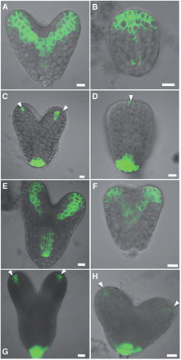
Fig. 3 Auxin response is altered in mab2-1 embryos. (A, B, E, F) PIN1:GFP localization in wild-type (A, E) and ...
Notes:
Fig. 3 Auxin response is altered in mab2-1 embryos. (A, B, E, F) PIN1:GFP localization in wild-type (A, E) and mab2-1 embryos (B, F). (C, D, G, H) DR5rev::GFP expression in wild type (C, G) and mab2-1 embryos (D, H). (A–D) Heart stage embryos. (E–H) Torpedo stage embryos. White arrowheads indicate the positions of auxin response. Scale bars = 10 μm.
Unless provided in the caption above, the following copyright applies to the content of this slide: © The Author 2011. Published by Oxford University Press on behalf of Japanese Society of Plant Physiologists. All rights reserved. For permissions, please email: journals.permissions@oup.com

Slide 4
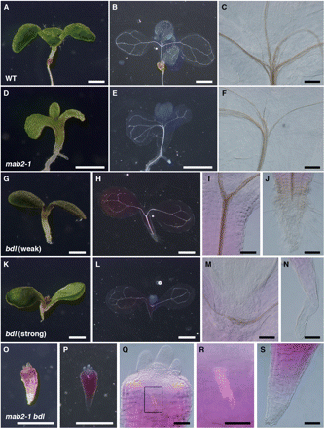
Fig. 4 Synergistic interaction of the mab2-1 bdl mutations. Seven-day-old seedlings of the wild type (A–C), mab2-1 ...
Notes:
Fig. 4 Synergistic interaction of the mab2-1 bdl mutations. Seven-day-old seedlings of the wild type (A–C), mab2-1 (D–F), bdl with the weaker phenotype (G–J), bdl with the stronger phenotype (K–N) and mab2-1 bdl (O–S). (C, F, I, M, Q) Vascular strands at the basal end of cotyledons in wild type (C), mab2-1 (F), bdl (I, M) and mab2-1 bdl (Q). (R) An enlarged image of the region enclosed within the black square in Q. (J, N) The basal end of seedlings with or without vascular strands and root hair in bdl. (S) The basal peg in mab2-1 bdl. (A, D, G, K, O) Live seedlings. (B, E, H, L, P) Dark-field images of cleared seedlings. Scale bars = 0.5 mm. (C, F, I, J, M, N, Q–S) Nomarski images of cleared seedlings. Scale bars = 50 μm.
Unless provided in the caption above, the following copyright applies to the content of this slide: © The Author 2011. Published by Oxford University Press on behalf of Japanese Society of Plant Physiologists. All rights reserved. For permissions, please email: journals.permissions@oup.com

Slide 5
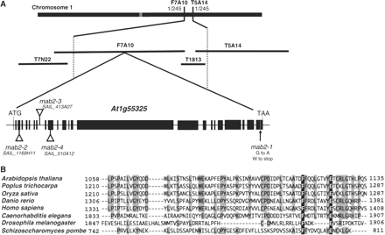
Fig. 5 The MAB2 gene encodes MED13. (A) Map-based cloning of the MAB2 gene. The MAB2 locus was mapped to the region ...
Notes:
Fig. 5 The MAB2 gene encodes MED13. (A) Map-based cloning of the MAB2 gene. The MAB2 locus was mapped to the region between the F7A10 and T5A14 markers on chromosome 1. The mab2-1 mutation is a single base substitution in At1g55325. T-DNA in mab2-2, 2-3, 2-4 mutants was inserted into the third exon, the eighth intron and the tenth exon, respectively. (B) Comparison of the deduced protein sequence of the TRAP240 domain of MAB2, OsMED13 (GenBank accession No. EAZ34492), PtMED13 (GenBank accession No. EEE79832), HsMED13/TRAP240 (GenBank accession No. EAW51438), DrMed13 (GenBank accession No. AAI29033), DmMED13/Skuld (GenBank accession No. AAG48327), CeTRAP240/LET-19 (GenBank accession No. BAE16563) and SSN9 (GenBank accession No. Q9HE02). Alignment was carried out with the DDBJ program (CLUSTAL W, version 1.83).
Unless provided in the caption above, the following copyright applies to the content of this slide: © The Author 2011. Published by Oxford University Press on behalf of Japanese Society of Plant Physiologists. All rights reserved. For permissions, please email: journals.permissions@oup.com

Slide 6
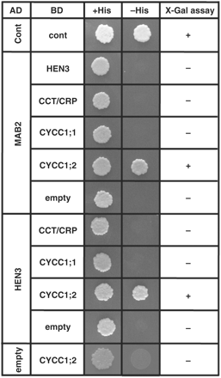
Fig. 6 MAB2 interacts with CYCC1;2. MAB2 and HEN3 were expressed as fusion proteins with a transcriptional activator ...
Notes:
Fig. 6 MAB2 interacts with CYCC1;2. MAB2 and HEN3 were expressed as fusion proteins with a transcriptional activator domain (AD), and HEN3, CCT/CRP, CYCC1;1 and CYCC1;2 were expressed as fusion proteins with a DNA-binding domain (BD). Interaction between two proteins was tested using the HIS3 reporter gene and the lacZ reporter gene, respectively. The presence of β-galactosidase activity in LacZ+ colonies was detected 1 h after incubation at 30°C in this experiment. pBD-wt and pAD-wt were used as positive controls (cont).
Unless provided in the caption above, the following copyright applies to the content of this slide: © The Author 2011. Published by Oxford University Press on behalf of Japanese Society of Plant Physiologists. All rights reserved. For permissions, please email: journals.permissions@oup.com

Slide 7
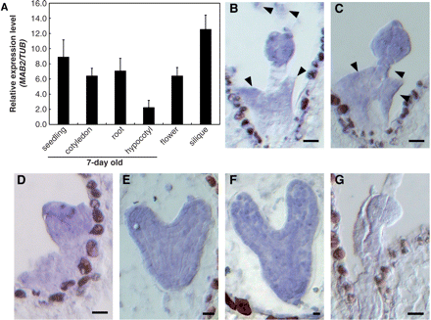
Fig. 7 Expression analysis of MAB2. (A) Expression levels of MAB2 in various tissues. The expression levels were ...
Notes:
Fig. 7 Expression analysis of MAB2. (A) Expression levels of MAB2 in various tissues. The expression levels were normalized against β-tubulin. Data shown are means of three independent samples, with error bars representing the SD. (B–G) MAB2 mRNA accumulation in wild-type embryos at the 8-cell stage (B), 16-cell stage (C, G), globular stage (D), heart stage (E) and late heart stage (F). (G) No hybridization was detected with the sense control probe. Arrowheads indicate endosperm expressing MAB2 mRNA. Scale bars = 10 μm.
Unless provided in the caption above, the following copyright applies to the content of this slide: © The Author 2011. Published by Oxford University Press on behalf of Japanese Society of Plant Physiologists. All rights reserved. For permissions, please email: journals.permissions@oup.com

