Slide 1
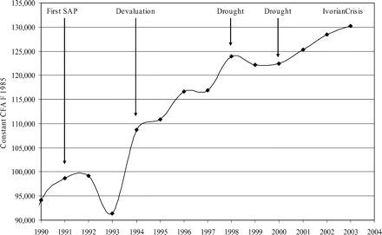
Figure 1: Real GDP Per Captia (Constant CFA Francs 1985). Source: IAP (see Footnote 1)
Notes:
Figure 1: Real GDP Per Captia (Constant CFA Francs 1985). Source: IAP (see Footnote 1)
Unless provided in the caption above, the following copyright applies to the content of this slide: © The author 2006. Published by Oxford University Press on behalf of the Centre for the Study of African Economies. All rights reserved. For permissions, please email: journals.permissions@oxfordjournals.org

Slide 2
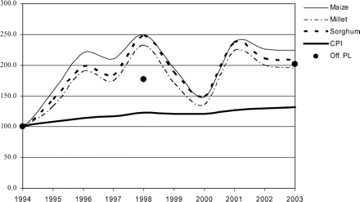
Figure 2: Official Poverty Line, Variations of Cereal Prices and the CPI. Note: Prices are indexed to 1994=100; Cereal ...
Notes:
Figure 2: Official Poverty Line, Variations of Cereal Prices and the CPI. Note: Prices are indexed to 1994=100; Cereal prices are annual averages; PL: Inflation of the official poverty line. Source: CPI: IAP (see Footnote 1); Cereal prices: Grain Market Price Surveillance System, Burkina Faso, Ministry of Trade; Official Poverty Line: INSD (2003)
Unless provided in the caption above, the following copyright applies to the content of this slide: © The author 2006. Published by Oxford University Press on behalf of the Centre for the Study of African Economies. All rights reserved. For permissions, please email: journals.permissions@oxfordjournals.org

Slide 3
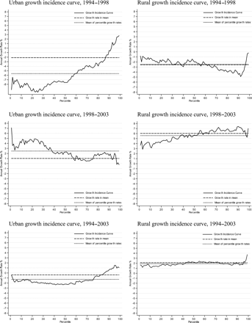
Figure 3: Growth Incidence Curves, 1994–2003. Notes: Percentile and urban/rural specific price deflators used for ...
Notes:
Figure 3: Growth Incidence Curves, 1994–2003. Notes: Percentile and urban/rural specific price deflators used for computation. Source: EPI, EPII, EPIII; computations by the authors
Unless provided in the caption above, the following copyright applies to the content of this slide: © The author 2006. Published by Oxford University Press on behalf of the Centre for the Study of African Economies. All rights reserved. For permissions, please email: journals.permissions@oxfordjournals.org

