Slide 1
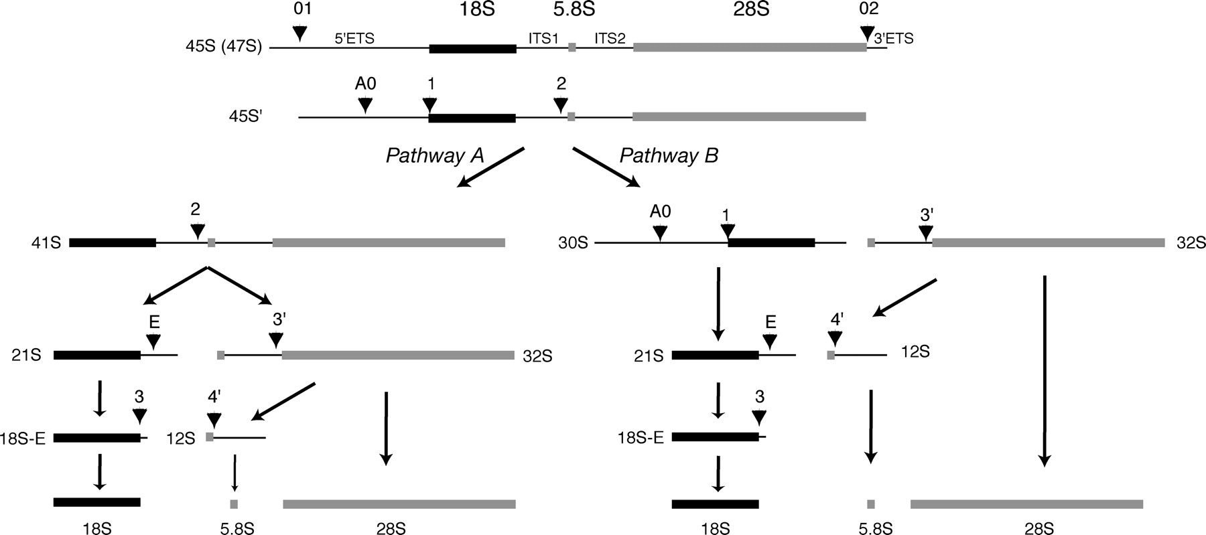
Figure 1. Pre-rRNA processing pathways in human cells. Within the primary transcript, the mature 18S, 5.8S and 28S ...
Notes:
Figure 1. Pre-rRNA processing pathways in human cells. Within the primary transcript, the mature 18S, 5.8S and 28S rRNAs are flanked by external transcribed spacers (5′- and 3′-ETS) and separated by internal transcribed spacers (ITS1 and ITS2). Numbers and arrowheads above the 45S pre-rRNA indicate cleavage sites. Two alternative processing pathways are defined by the order of cleavage at sites 1 and 2. Early removal of the 5′-ETS in pathway A yields the 41S precursor. This RNA is then cleaved within the ITS1 to generate the 21S and 32S species that are precursors to the RNA components of the large and small ribosomal subunits, respectively. In pathway B, cleavage within the ITS1 comes first, leading to the formation of 30S and 32S pre-rRNAs. Adapted from Hadjiolova et al. (55) and Rouquette et al. (30).
Unless provided in the caption above, the following copyright applies to the content of this slide: © The Author 2008. Published by Oxford University Press. All rights reserved. For Permissions, please email: journals.permissions@oxfordjournals.org

Slide 2
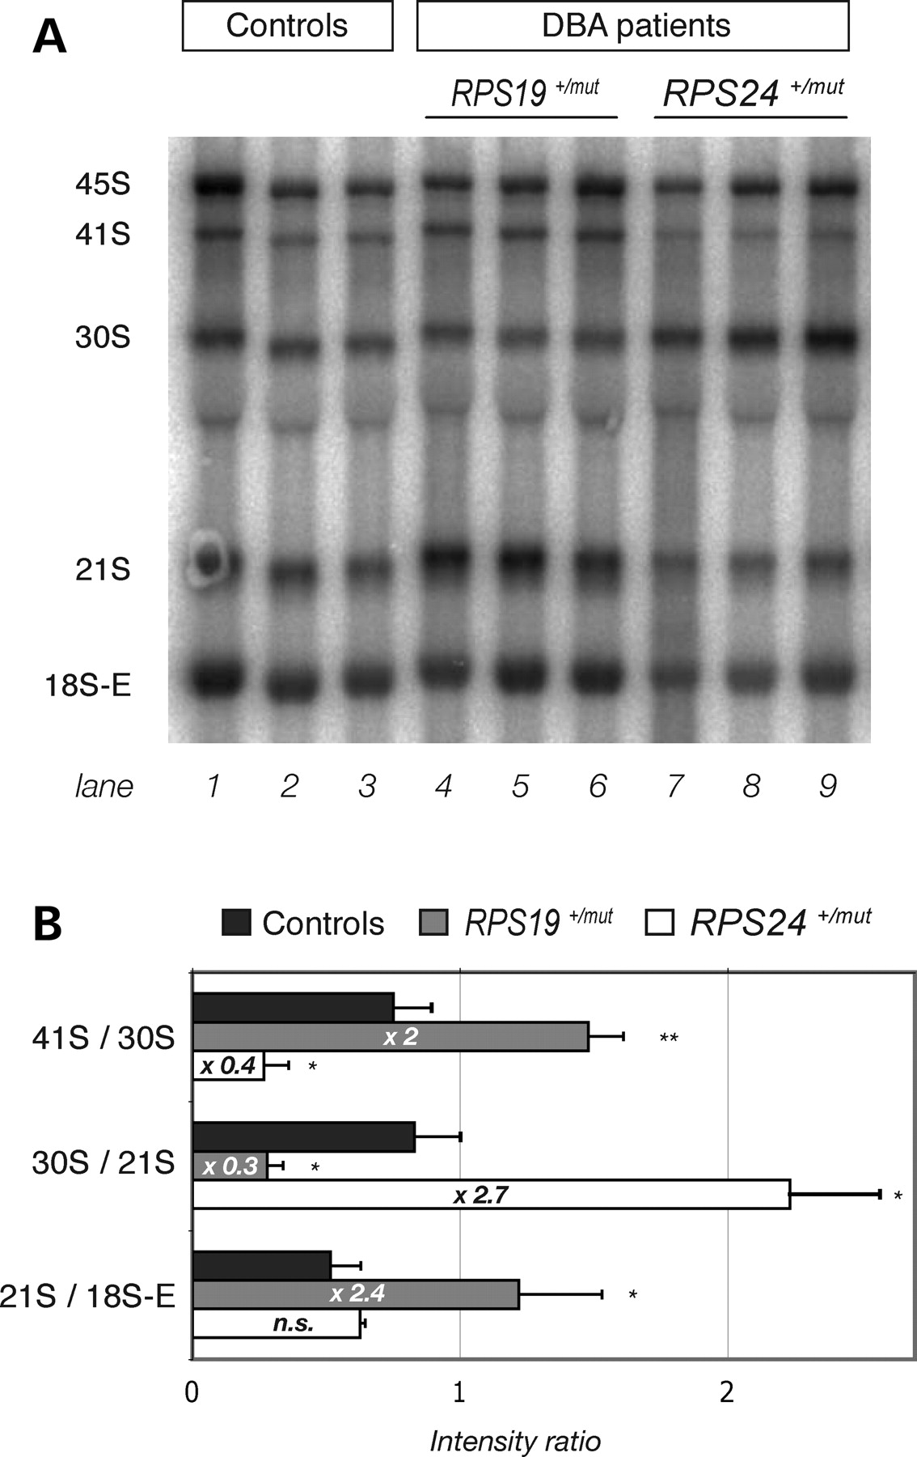
Figure 2. Alteration of pre-rRNA processing in lymphoblastoid cells derived from Diamond-Blackfan anemia (DBA) patients ...
Notes:
Figure 2. Alteration of pre-rRNA processing in lymphoblastoid cells derived from Diamond-Blackfan anemia (DBA) patients with mutations in RPS24 and RPS19. (A) RNAs from lymphoblastoid cells derived from control individuals and DBA patients were analyzed by northern blot with a probe hybridizing to the 5′ extremity of the internal transcribed spacer 1 (5′-ITS1) to detect the precursors to the 18S rRNA. (B) Ratios between different pre-rRNAs were evaluated for each lane by phosphorimaging. Each bar represents the average (±SD) of the values determined for the three corresponding lymphoblastoid cell lines. Variations of these ratios in cells from DBA patients relative to control cells are indicated on the bars. The results were analyzed with Student’s t-test (*P < 0.05; **P < 0.01; n.s., not significant). This experiment was performed twice with similar results.
Unless provided in the caption above, the following copyright applies to the content of this slide: © The Author 2008. Published by Oxford University Press. All rights reserved. For Permissions, please email: journals.permissions@oxfordjournals.org

Slide 3
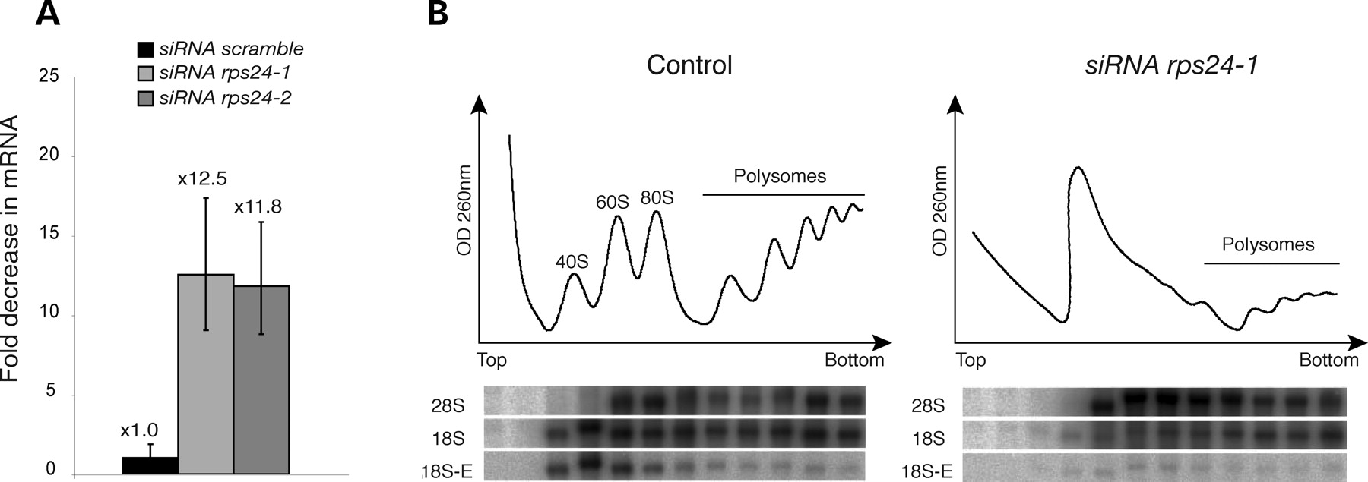
Figure 3. RPS24 expression knockdown by siRNAs strongly affects the translational apparatus. (A) Knockdown of RPS24 ...
Notes:
Figure 3. RPS24 expression knockdown by siRNAs strongly affects the translational apparatus. (A) Knockdown of RPS24 mRNA level in HeLa cells upon transfection with siRNAs rps24-1 and rps24-2 was measured by quantitative reverse transcriptase-polymerase chain reaction. (B) Analysis on sucrose gradient of the ribosomal subunits from HeLa cells 48 h after transfection with the rps24-1 siRNA shows a strong imbalance between free 60S and 40S subunits, reflecting a specific defect of the 40S subunit production. The 18S, 28S and 18S-E rRNAs were detected in the gradient fractions by northern blot with probes 18S, 28S and 5′-ITS1, respectively (30). Control cells were treated according to the transfection protocol, but without siRNAs.
Unless provided in the caption above, the following copyright applies to the content of this slide: © The Author 2008. Published by Oxford University Press. All rights reserved. For Permissions, please email: journals.permissions@oxfordjournals.org

Slide 4
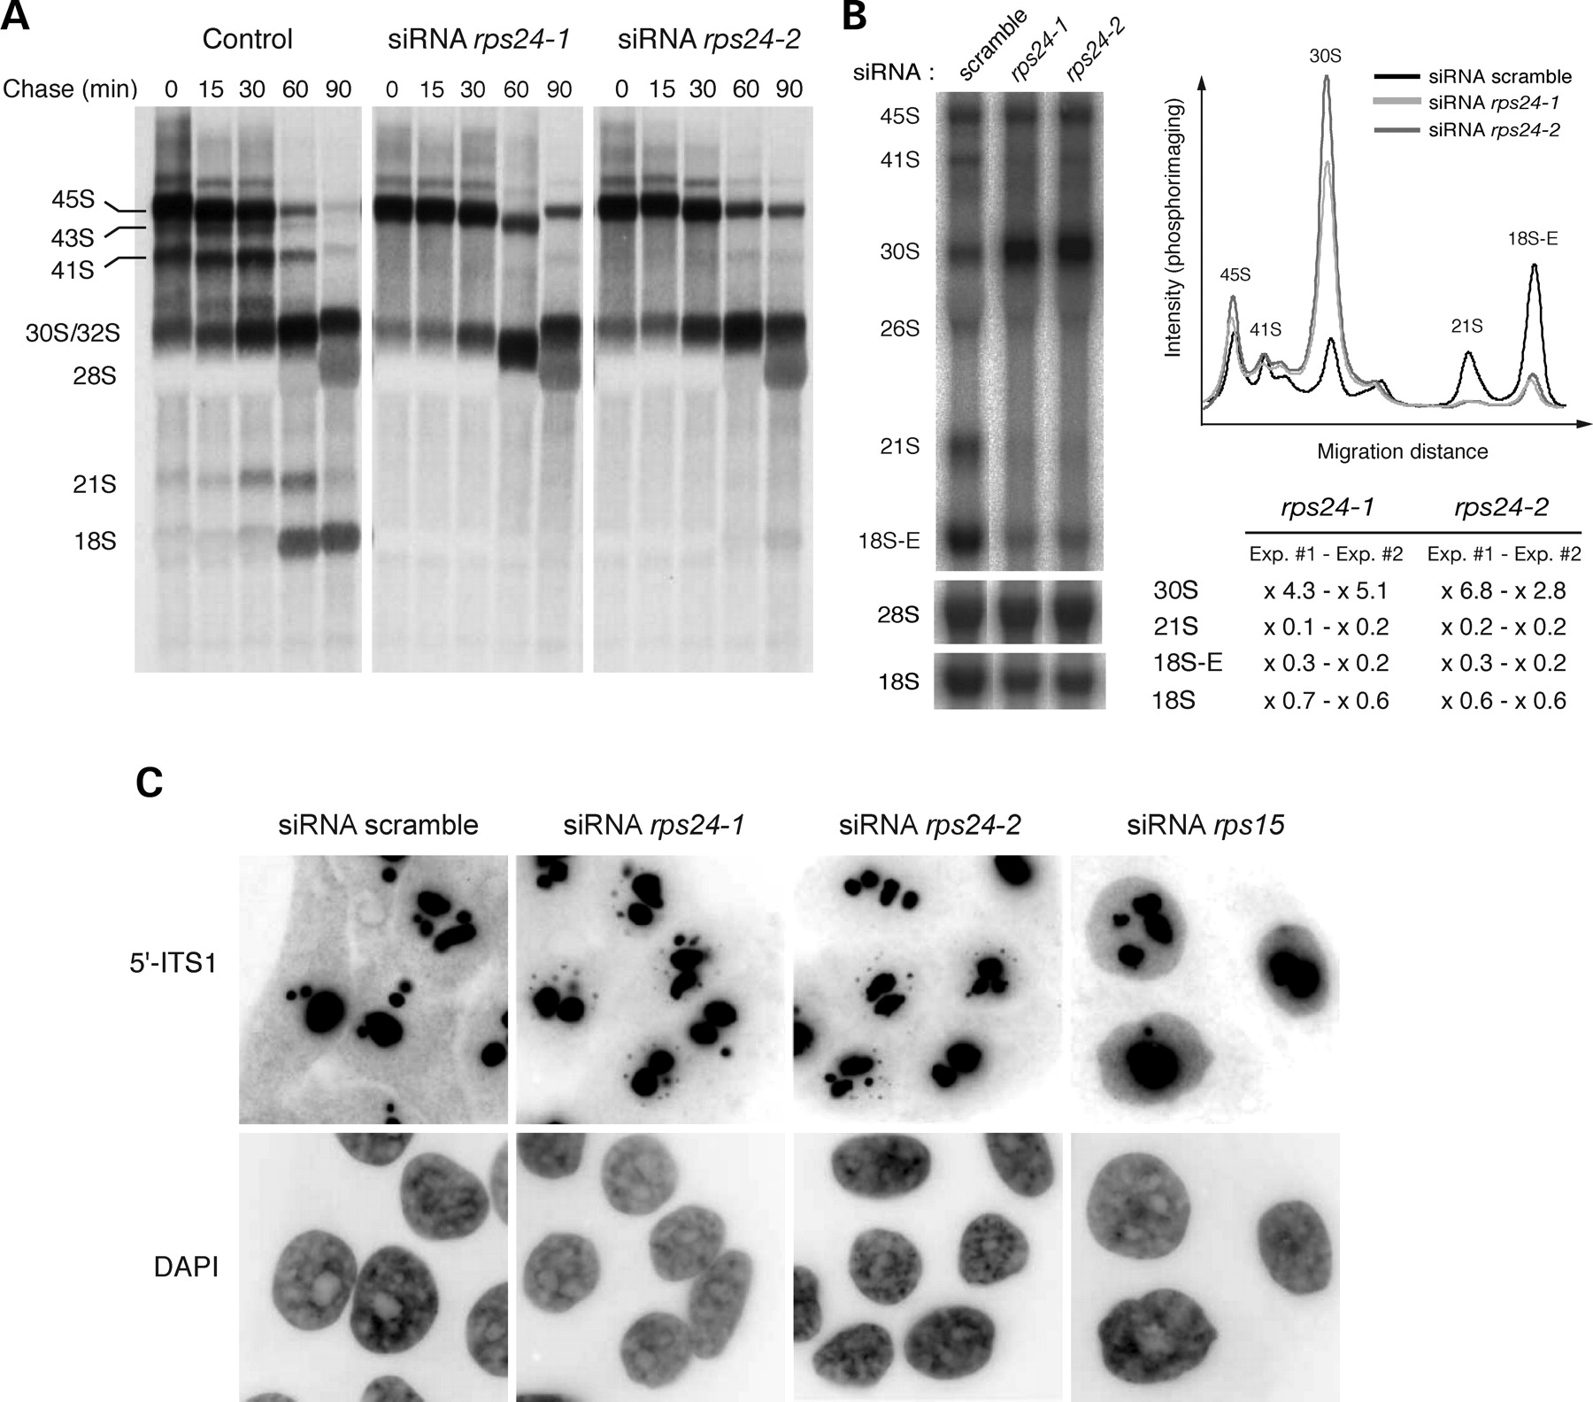
Figure 4. Depletion of RPS24 blocks processing of the 5′-external transcribed spacer (5′-ETS). (A) Pulse-chase analysis ...
Notes:
Figure 4. Depletion of RPS24 blocks processing of the 5′-external transcribed spacer (5′-ETS). (A) Pulse-chase analysis of rRNA synthesis with L-[methyl-3H]methionine in HeLa cells 48 h after transfection with rps24 siRNAs. Formation of the 43S, 41S, 21S pre-rRNAs is blocked and no 18S mature rRNA is produced. (B) Detection of the precursors to the 18S rRNA by northern blot with probe 5′-ITS1. The graph shows the intensity profiles for each lane as measured by phosphorimaging. The table contains the variations of the levels of different RNAs in the RPS24-depleted cells relative to the cells transfected with the scramble siRNA, in two independent experiments. The intensity profiles and the amount of the pre-rRNAs reported in the table were normalized with respect to the amount of 28S rRNA. (C) Detection by fluorescence in situ hybridization (FISH) of pre-18S RNAs in RPS24-depleted cells shows reduced cytoplasmic labeling and small nucleoplasmic dots. Cells treated with siRNAs targeting RPS15 synthesis display a different phenotype, characterized by nucleoplasmic retention of 18S-E pre-rRNA (30). The FISH pictures are displayed with inverted contrast and high saturation of the dark gray levels to enhance the cytoplasmic signal (gamma = 0.7). These experiments were performed at least three times with similar results.
Unless provided in the caption above, the following copyright applies to the content of this slide: © The Author 2008. Published by Oxford University Press. All rights reserved. For Permissions, please email: journals.permissions@oxfordjournals.org

Slide 5
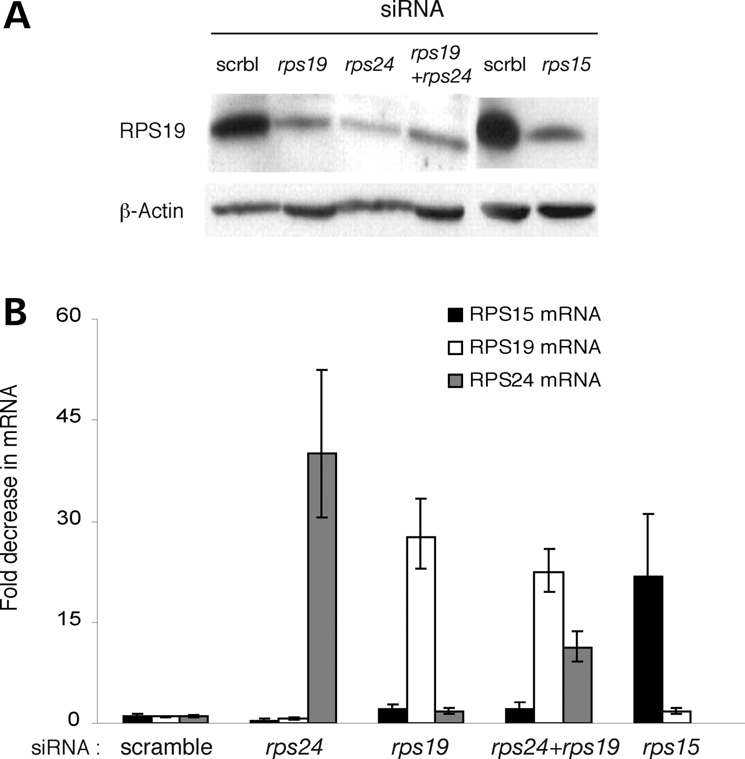
Figure 5. Low level of RPS19 in RPS24-depleted cells. (A) Western blot analysis of RPS19 level in HeLa cells ...
Notes:
Figure 5. Low level of RPS19 in RPS24-depleted cells. (A) Western blot analysis of RPS19 level in HeLa cells transfected with siRNAs targeting expression of RPS19, RPS24 or RPS15. A marked diminution of RPS19 is observed in all three cases. (B) Measurement by qRT-PCR of the decrease in the ribosomal protein mRNA levels in the same cells as in (A). This experiment was repeated twice with similar results.
Unless provided in the caption above, the following copyright applies to the content of this slide: © The Author 2008. Published by Oxford University Press. All rights reserved. For Permissions, please email: journals.permissions@oxfordjournals.org

Slide 6
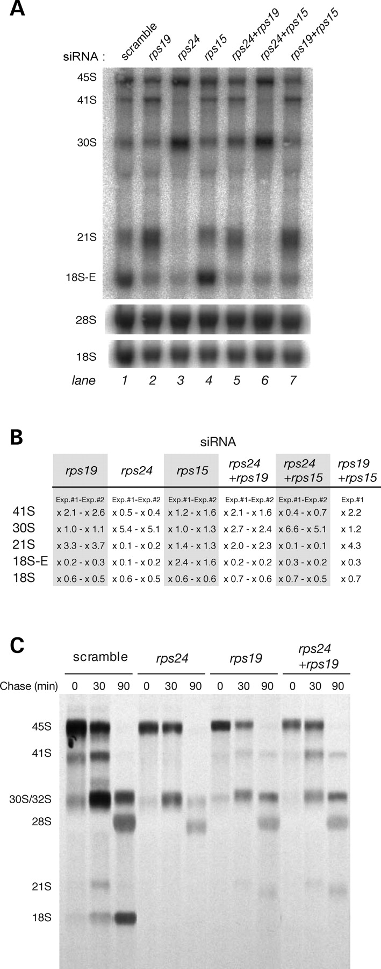
Figure 6. Co-depletion of RPS19 suppresses the 5′-external transcribed spacer (5′-ETS) processing defect observed in ...
Notes:
Figure 6. Co-depletion of RPS19 suppresses the 5′-external transcribed spacer (5′-ETS) processing defect observed in RPS24-depleted cells. (A) Northern blot analysis of pre-rRNAs with the 5′-internal transcribed spacer 1 (ITS1) probe in HeLa cells transfected with siRNAs targeting expression of RPS19, RPS24 or RPS15. (B) Variations of the pre-rRNA levels in these cells relative to cells transfected with the scramble siRNA were measured by phosphorimaging on the Northern blot. Measurements in each lane were normalized with respect to the amount of 28S rRNA. Results of two independent experiments are reported. (C) Pulse-chase experiment with L-[methyl-3H]methionine shows 41S pre-rRNA synthesis in cells depleted of both RPS19 and RPS24, when compared with RPS24 knockdown only, indicating restoration of 5′-ETS processing.
Unless provided in the caption above, the following copyright applies to the content of this slide: © The Author 2008. Published by Oxford University Press. All rights reserved. For Permissions, please email: journals.permissions@oxfordjournals.org

Slide 7
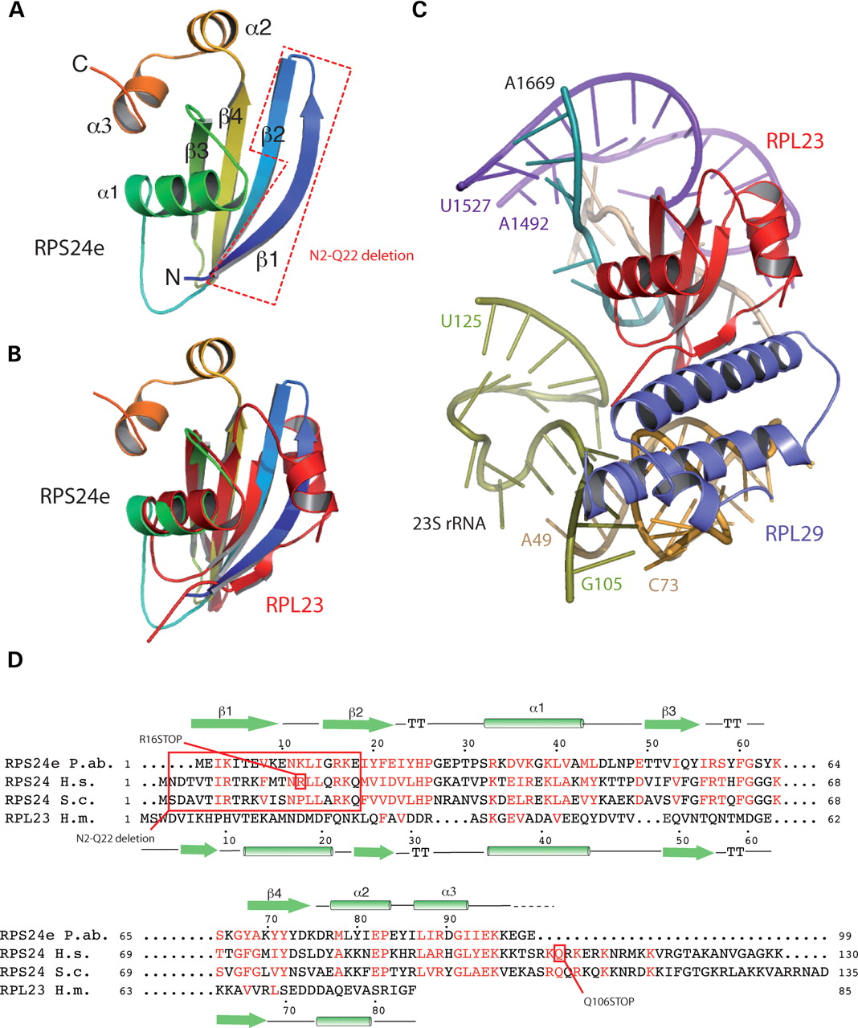
Figure 7. Structure of RPS24e from Pyrococcus abyssi. (A) The structure of P. abyssi RPS24e is displayed with rainbow ...
Notes:
Figure 7. Structure of RPS24e from Pyrococcus abyssi. (A) The structure of P. abyssi RPS24e is displayed with rainbow colors from blue for N-terminus to red for C-terminus. Secondary structure elements are labeled. The position of mutation R16stop and deletion of N2-Q22 found in human RPS24 are shown in red. (B) Superposition of ribbon models of P. abyssi RPS24e (rainbow) and Haloarcula marismortui L23 (red). (C) Structural environment of L23 in the large subunit of the ribosome from H. marismortui as described in Klein et al. (33). (D) Sequence alignment of RPS24e and its orthologues was performed using the PipeAlign suite (56). The sequences of P. abyssi RPS24e and H. marismortui RPL23 were aligned according to the structural alignment. Secondary structure elements for RPS24e and RPL23 are above and below the alignment, respectively. The mutations found in human RPS24 in Diamond-Blackfan anemia patients are shown in red.
Unless provided in the caption above, the following copyright applies to the content of this slide: © The Author 2008. Published by Oxford University Press. All rights reserved. For Permissions, please email: journals.permissions@oxfordjournals.org

