Slide 1
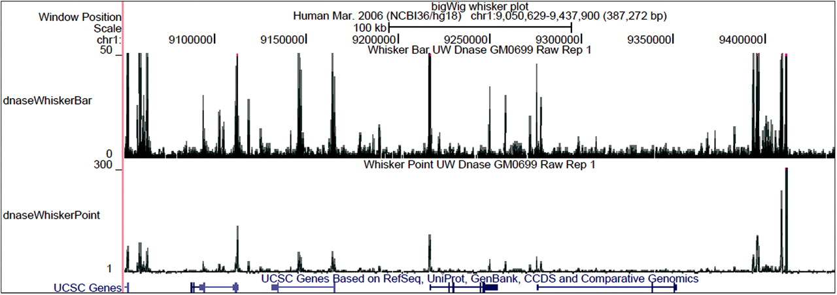
Fig. 1. Genome Browser image of BigWig annotation tracks. The top track is displayed as a bar graph, the bottom track ...
Notes:
Fig. 1. Genome Browser image of BigWig annotation tracks. The top track is displayed as a bar graph, the bottom track as a point graph. Shading is used to distinguish the mean (dark), one standard deviation above the mean (medium) and the maximum (light). Peaks with clipped tops are colored magenta.
Unless provided in the caption above, the following copyright applies to the content of this slide: © The Author(s) 2010. Published by Oxford University Press.This is an Open Access article distributed under the terms of the Creative Commons Attribution Non-Commercial License (http://creativecommons.org/licenses/by-nc/2.5), which permits unrestricted non-commercial use, distribution, and reproduction in any medium, provided the original work is properly cited.

