Slide 1
Figure 1. Photomicrographs of coronal sections of owl monkey thalamus cut at 40 μm and stained for AChE. Representative ...
Notes:
Figure 1. Photomicrographs of coronal sections of owl monkey thalamus cut at 40 μm and stained for AChE. Representative sections were selected to show nuclei pertinent to cell labeling from tracers injections. Organization is from rostral (top) to caudal (bottom). Section numbers are in the bottom left corner of each panel. Scale bar = 1 mm.
Unless provided in the caption above, the following copyright applies to the content of this slide: © The Author 2010. Published by Oxford University Press. All rights reserved. For permissions, please e-mail: journals.permissions@oxfordjournals.org

Slide 2
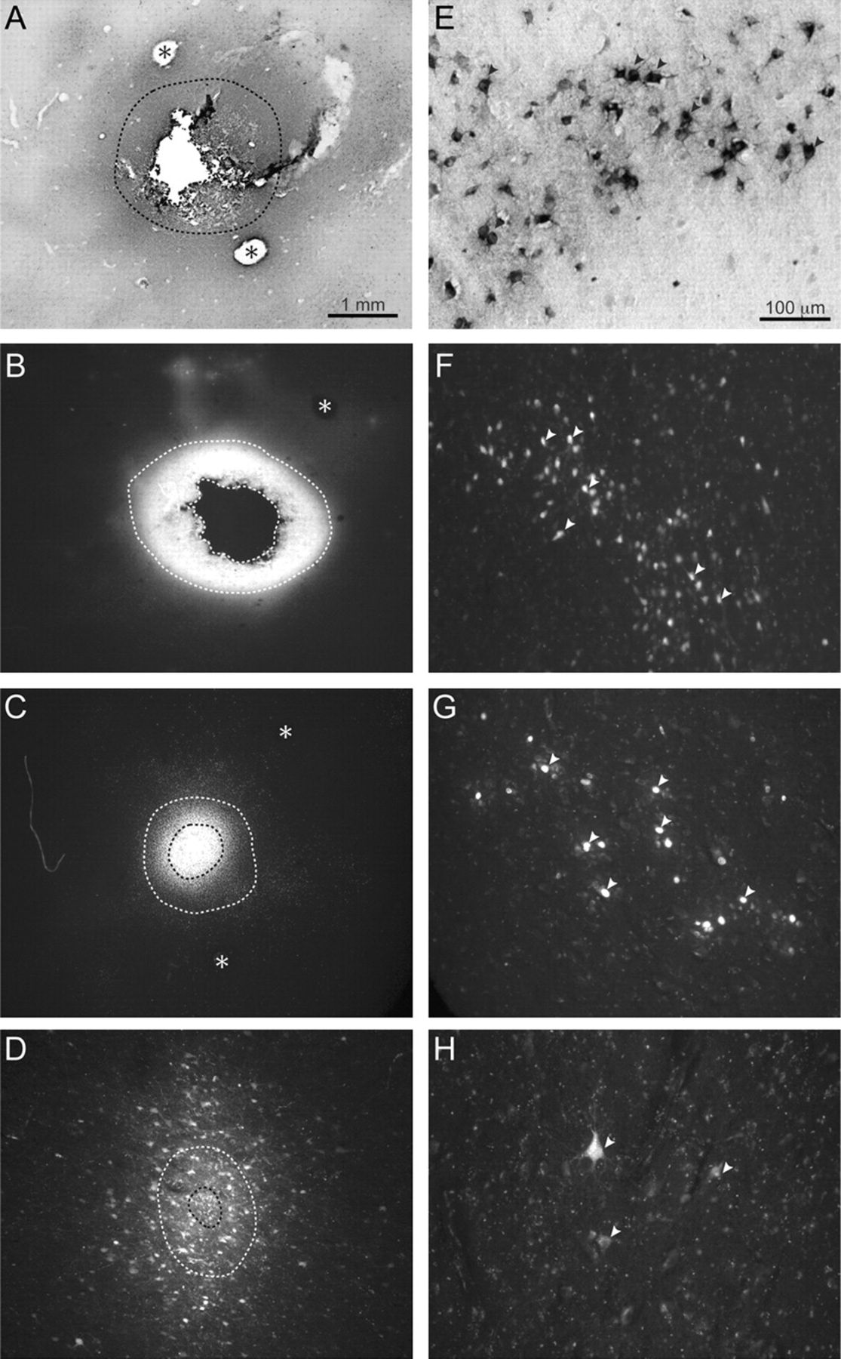
Figure 2. Photomicrographs of tracer injection sites in the cortex (left panels) and examples of the corresponding ...
Notes:
Figure 2. Photomicrographs of tracer injection sites in the cortex (left panels) and examples of the corresponding cells labeled in the thalamus (right panels). Examples are from squirrel monkey case 08-09 shown in more detail in Figure 3. Sections of cortex were flattened and cut parallel to the surface at 40 μm. Photomicrographs were captured using a light microscope to show (A) CTB or using a fluorescent microscope to show (B) FB, (C) DY, and (D) FR. The inner outline marks the core of each tracer injection, whereas the surrounding outline marks a halo of intense tracer diffusion. Electrolytic lesions—delivered at the end of motor mapping to mark the boundaries of specific zones identified with electrical stimulation—are indicated with asterisks. The medial and lateral borders of the M1/PM grasp zone are marked with asterisks in (A). The caudomedial border of the PPC reach zone is marked in (B). The medial and lateral borders of PPC grasp zone are marked in (C). One-millimeter scale bar applies to all panels showing tracer injections. Cells labeled from corresponding injections to show (E) CTB-labeled cells in VLx, (F) FB-labeled cells in VLd/LP, (G) DY-labeled nuclei in VLx, (H) FR-labeled cells in VLx. Arrows point to examples of clearly labeled cells. Contrast was digitally enhanced for FR- and DY-labeled cells to improve illustration. Photomicrographs of labeled cells were captured from thalamic section 59 in Figure 3. Hundred-micrometer scale bar applies to all panels showing labeled cells.
Unless provided in the caption above, the following copyright applies to the content of this slide: © The Author 2010. Published by Oxford University Press. All rights reserved. For permissions, please e-mail: journals.permissions@oxfordjournals.org

Slide 3
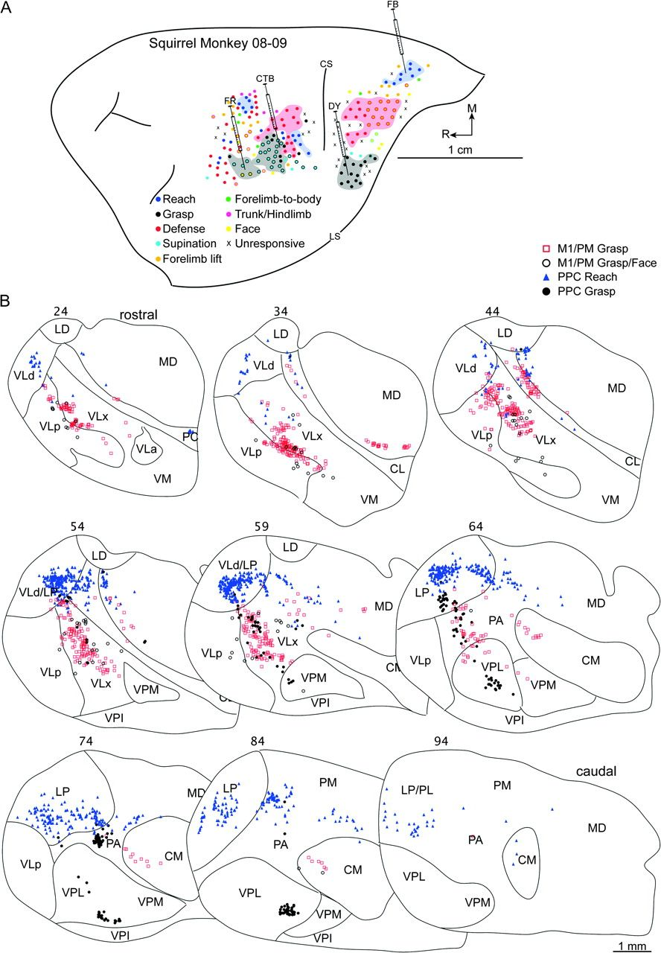
Figure 3. (A) Map of multijoint forelimb movements evoked with intracortical electrical stimulation (0.2-ms biphasic ...
Notes:
Figure 3. (A) Map of multijoint forelimb movements evoked with intracortical electrical stimulation (0.2-ms biphasic current trains delivered at 300 Hz for 500 ms) from squirrel monkey case 08-09. Microelectrode penetration sites are color coded to reflect evoked movements. Sites that evoked dual movements are represented in 2 colors derived from the color code in the figure legend. Major functional zones are highlighted. M1/PM was mostly characterized by reach, defense, grasp/wrist supination zones, organized from caudal to rostral. The 3 zones shared borders. Rostral and medial to M1 was another reach zone. At the same rostral extent, but lateral, was another grasp zone that included sites of concurrent wrist supination or mouth opening. In PPC, zones of reach, defense, and grasp were organized in a caudomedial to rostrolateral progression. The defense zone involved forelimb movements, but aggressive face gesturers were evoked from the caudal half of this functional zone. Reach and defense zones were separated by sites that evoked forelimb-lift responses, whereas the defense and grasp zones were separated by sites that evoked forelimb supination, face movements, and unresponsive sites. Four retrograde tracers were injected: CTB into M1/PM grasp zone, FR into M1/PM near sites that evoked concurrent grasping and mouth opening, FB into PPC reach zone, and DY into the PPC grasp zone. Major landmarks include lateral sulcus (LS) and central sulcus (CS). (B) Distributions of labeled cells in a series of coronal thalamic sections from the same case. Sections were cut at 40 μm, and the ascending section numbers are organized from rostral to caudal. Each symbol represents a single cell labeled by 1 of the 4 retrograde tracers. Borders of thalamic nuclei were identified from architectonic analysis in adjacent sections.
Unless provided in the caption above, the following copyright applies to the content of this slide: © The Author 2010. Published by Oxford University Press. All rights reserved. For permissions, please e-mail: journals.permissions@oxfordjournals.org

Slide 4
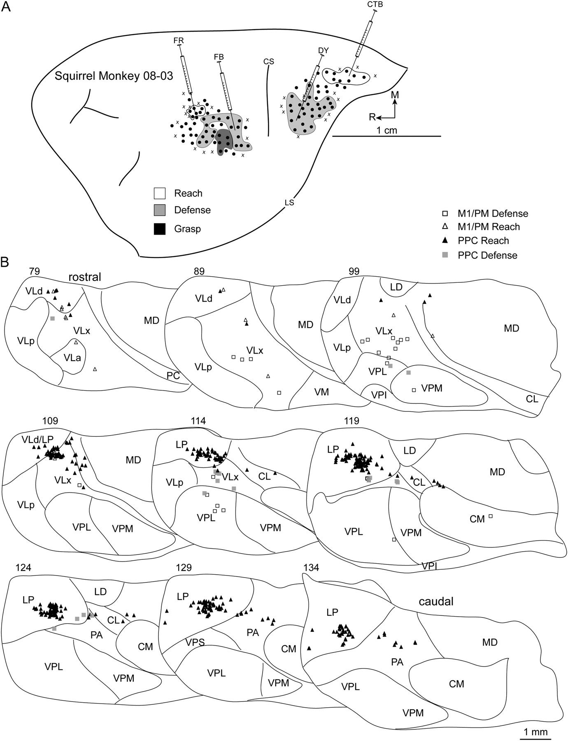
Figure 4. (A) Map of multijoint forelimb movements evoked with intracortical electrical stimulation from squirrel ...
Notes:
Figure 4. (A) Map of multijoint forelimb movements evoked with intracortical electrical stimulation from squirrel monkey case 08-03. Four retrograde tracers were injected: FB into M1/PM defense zone, FR into M1/PM reach zone, CTB into PPC reach zone, and DY into PPC defense zone. (B) Distributions of labeled cells in a series of coronal thalamic sections from the same case. A brief survival period limited tracer transport for at least 3 injections. The adequate number of labeled cells from tracer injection in the PPC reach zone was likely due to rapid CTB transport. Borders of thalamic nuclei were identified from architectonic analysis in adjacent sections.
Unless provided in the caption above, the following copyright applies to the content of this slide: © The Author 2010. Published by Oxford University Press. All rights reserved. For permissions, please e-mail: journals.permissions@oxfordjournals.org

Slide 5
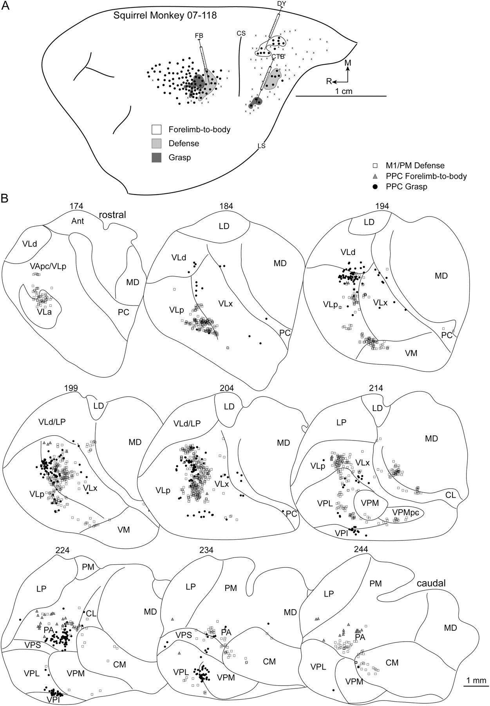
Figure 5. (A) Map of multijoint forelimb movements evoked with intracortical electrical stimulation from squirrel ...
Notes:
Figure 5. (A) Map of multijoint forelimb movements evoked with intracortical electrical stimulation from squirrel monkey case 07-118. Three retrograde tracers were injected: FB into M1/PM defense zone, DY into PPC forelimb-to-body representation, and CTB into PPC grasp zone. (B) Distributions of labeled cells in a series of coronal thalamic sections from the same case.
Unless provided in the caption above, the following copyright applies to the content of this slide: © The Author 2010. Published by Oxford University Press. All rights reserved. For permissions, please e-mail: journals.permissions@oxfordjournals.org

Slide 6
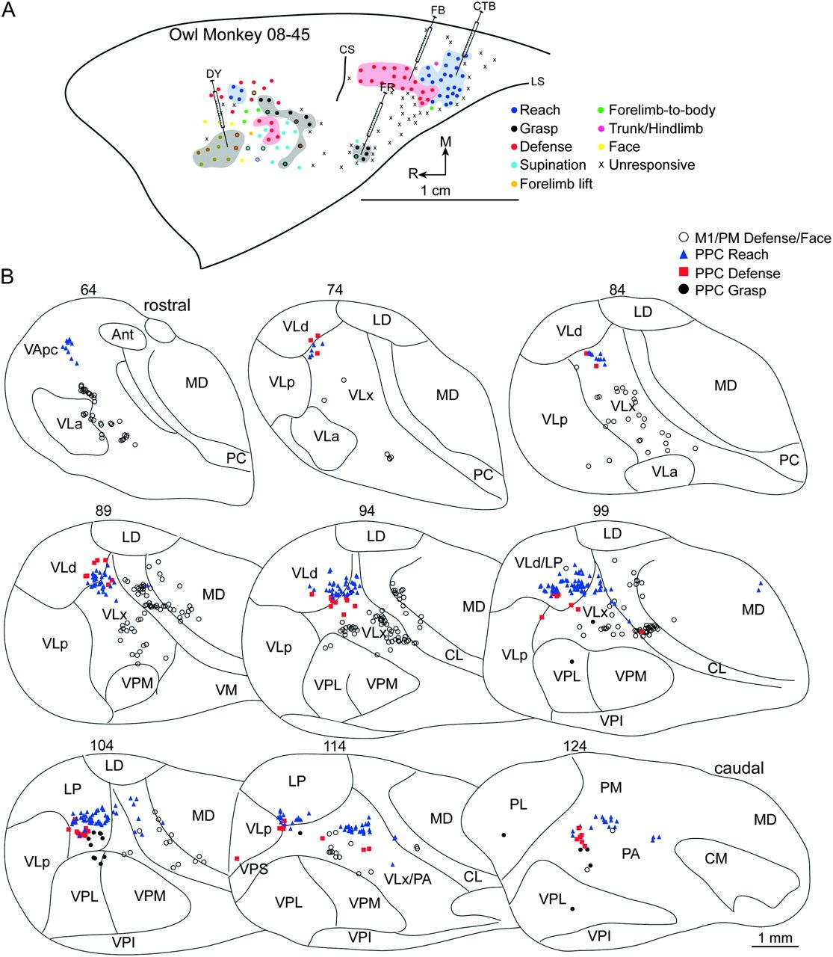
Figure 6. (A) Map of multijoint forelimb movements evoked with intracortical electrical stimulation from owl monkey ...
Notes:
Figure 6. (A) Map of multijoint forelimb movements evoked with intracortical electrical stimulation from owl monkey case 08-45. Microelectrode penetration sites are color coded to reflect evoked movements. Sites that evoked dual movements are represented in 2 colors derived from the color code in the figure legend. Major functional zones are highlighted. M1/PM was primarily characterized by grasp, wrist supination, and defense zones. A reach zone was rostral and medial in M1/PM, whereas concurrent face and forelimb movements were evoked from the same approximate rostral extent but lateral. In PPC, reach, defense, and grasp zones were organized in a caudomedial to rostrolateral progression. Reach and defense zones bordered one another, whereas unresponsive sites separated the defense and grasp zones of PPC. Four retrograde tracers were injected: DY into M1/PM near sites that evoked concurrent defensive forelimb movements and aggressive face gestures, CTB into PPC reach zone, FB into PPC defense zone, FR into PPC grasp zone. (B) Distributions of labeled cells in a series of coronal thalamic sections (40 μm) from the same case. A limited number of cells were labeled from the PPC grasp zone because a small volume of FR was purposely injected to minimize tracer spread beyond this limited target zone.
Unless provided in the caption above, the following copyright applies to the content of this slide: © The Author 2010. Published by Oxford University Press. All rights reserved. For permissions, please e-mail: journals.permissions@oxfordjournals.org

Slide 7
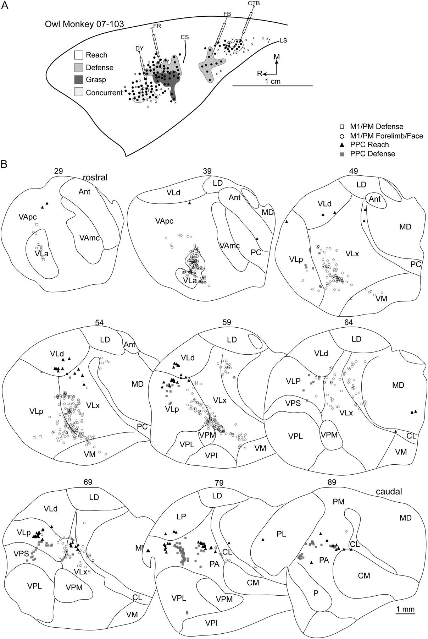
Figure 7. (A) Map of multijoint forelimb movements evoked with intracortical electrical stimulation from owl monkey ...
Notes:
Figure 7. (A) Map of multijoint forelimb movements evoked with intracortical electrical stimulation from owl monkey case 07-103. Four retrograde tracers were injected: FR into the M1/PM defense zone, DY into M1/PM near sites that evoked grasping and mouth opening, CTB into PPC reach zone, and FB into PPC defense zone. (B) Distributions of labeled cells in a series of coronal thalamic sections from the same case. A limited number of cells were labeled from the M1/PM defense zone injection likely because of a small injection volume of FR.
Unless provided in the caption above, the following copyright applies to the content of this slide: © The Author 2010. Published by Oxford University Press. All rights reserved. For permissions, please e-mail: journals.permissions@oxfordjournals.org

Slide 8
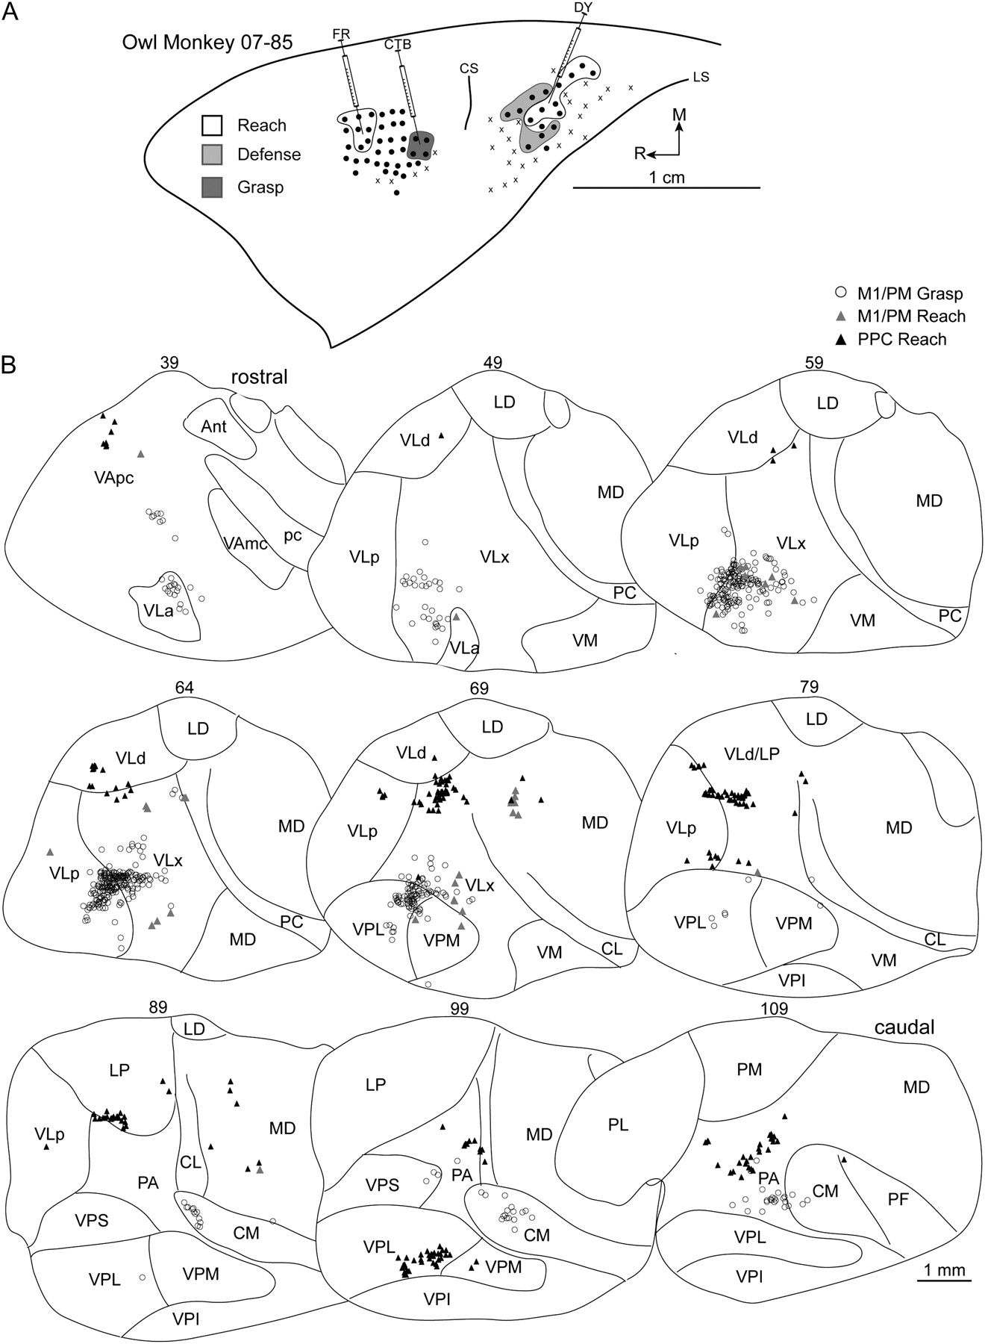
Figure 8. (A) Map of multijoint forelimb movements evoked with intracortical electrical stimulation from owl monkey ...
Notes:
Figure 8. (A) Map of multijoint forelimb movements evoked with intracortical electrical stimulation from owl monkey case 07-85. Three retrograde tracers were injected: CTB into M1/PM grasp zone, FR into M1/PM reach zone, DY into the PPC reach zone. (B) Distributions of labeled cells in a series of coronal thalamic sections from the same case. A limited number of cells were labeled from the M1/PM reach zone injection likely due to a small injection volume of FR. Borders of thalamic nuclei were identified from architectonic analysis in adjacent sections.
Unless provided in the caption above, the following copyright applies to the content of this slide: © The Author 2010. Published by Oxford University Press. All rights reserved. For permissions, please e-mail: journals.permissions@oxfordjournals.org

Slide 9
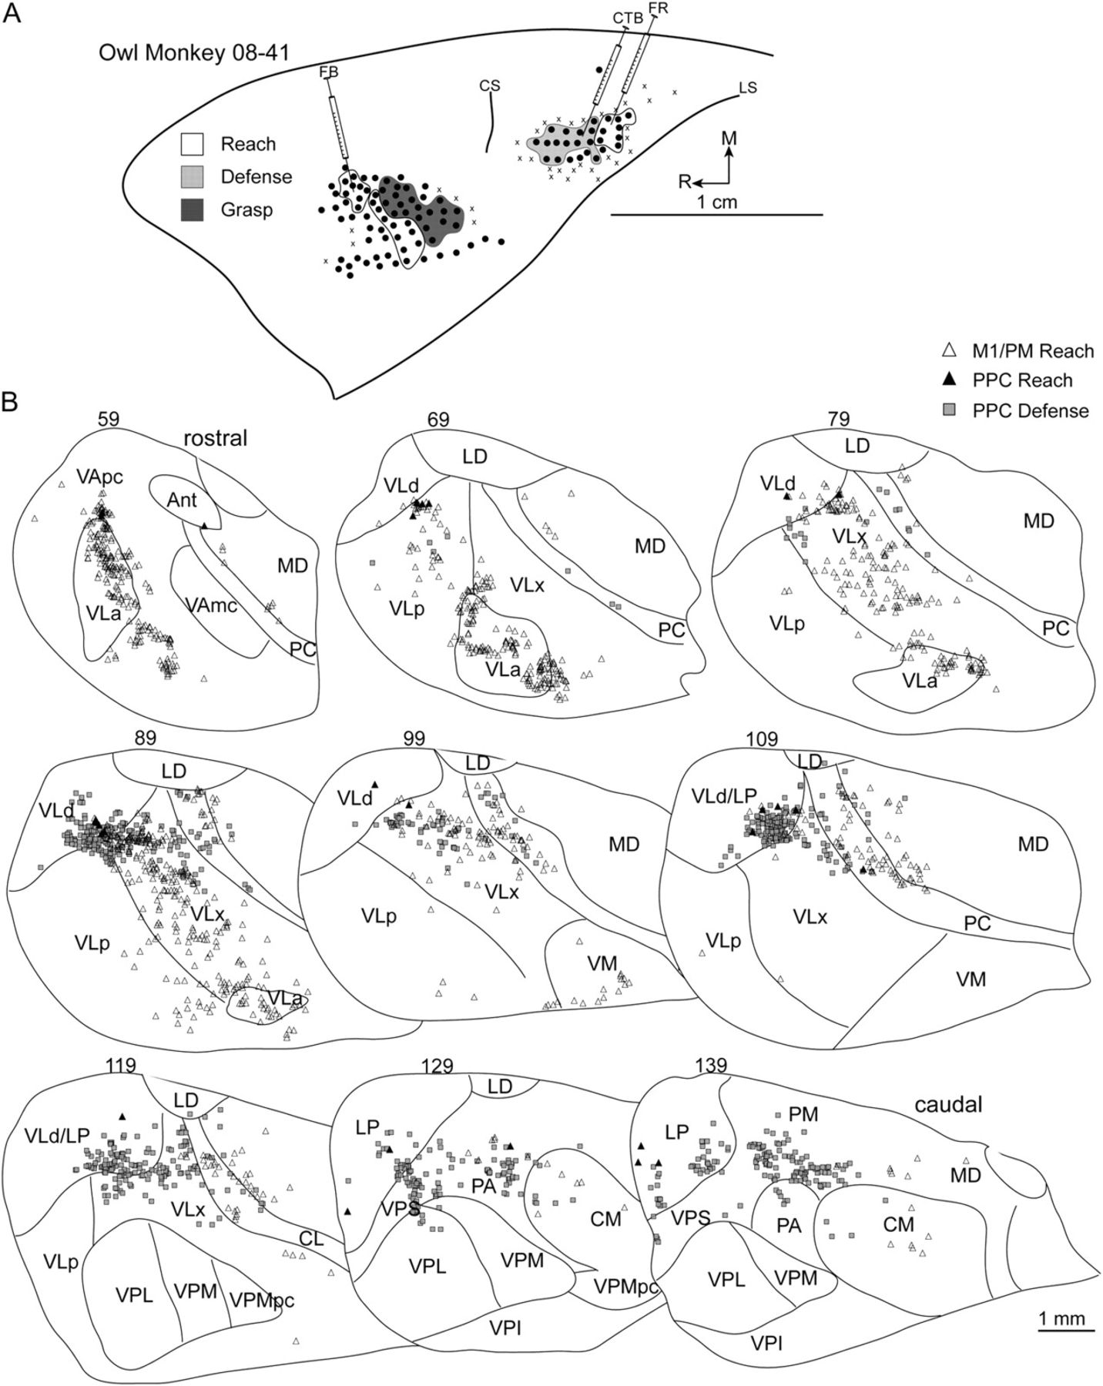
Figure 9. (A) Map of multijoint forelimb movements evoked with intracortical electrical stimulation from owl monkey ...
Notes:
Figure 9. (A) Map of multijoint forelimb movements evoked with intracortical electrical stimulation from owl monkey case 08-41. Three retrograde tracers were injected: FB into M1/PM reach zone, FR into PPC reach zone, and CTB into PPC defense zone. (B) Distributions of labeled cells in a series of coronal thalamic sections from the same case.
Unless provided in the caption above, the following copyright applies to the content of this slide: © The Author 2010. Published by Oxford University Press. All rights reserved. For permissions, please e-mail: journals.permissions@oxfordjournals.org

Slide 10
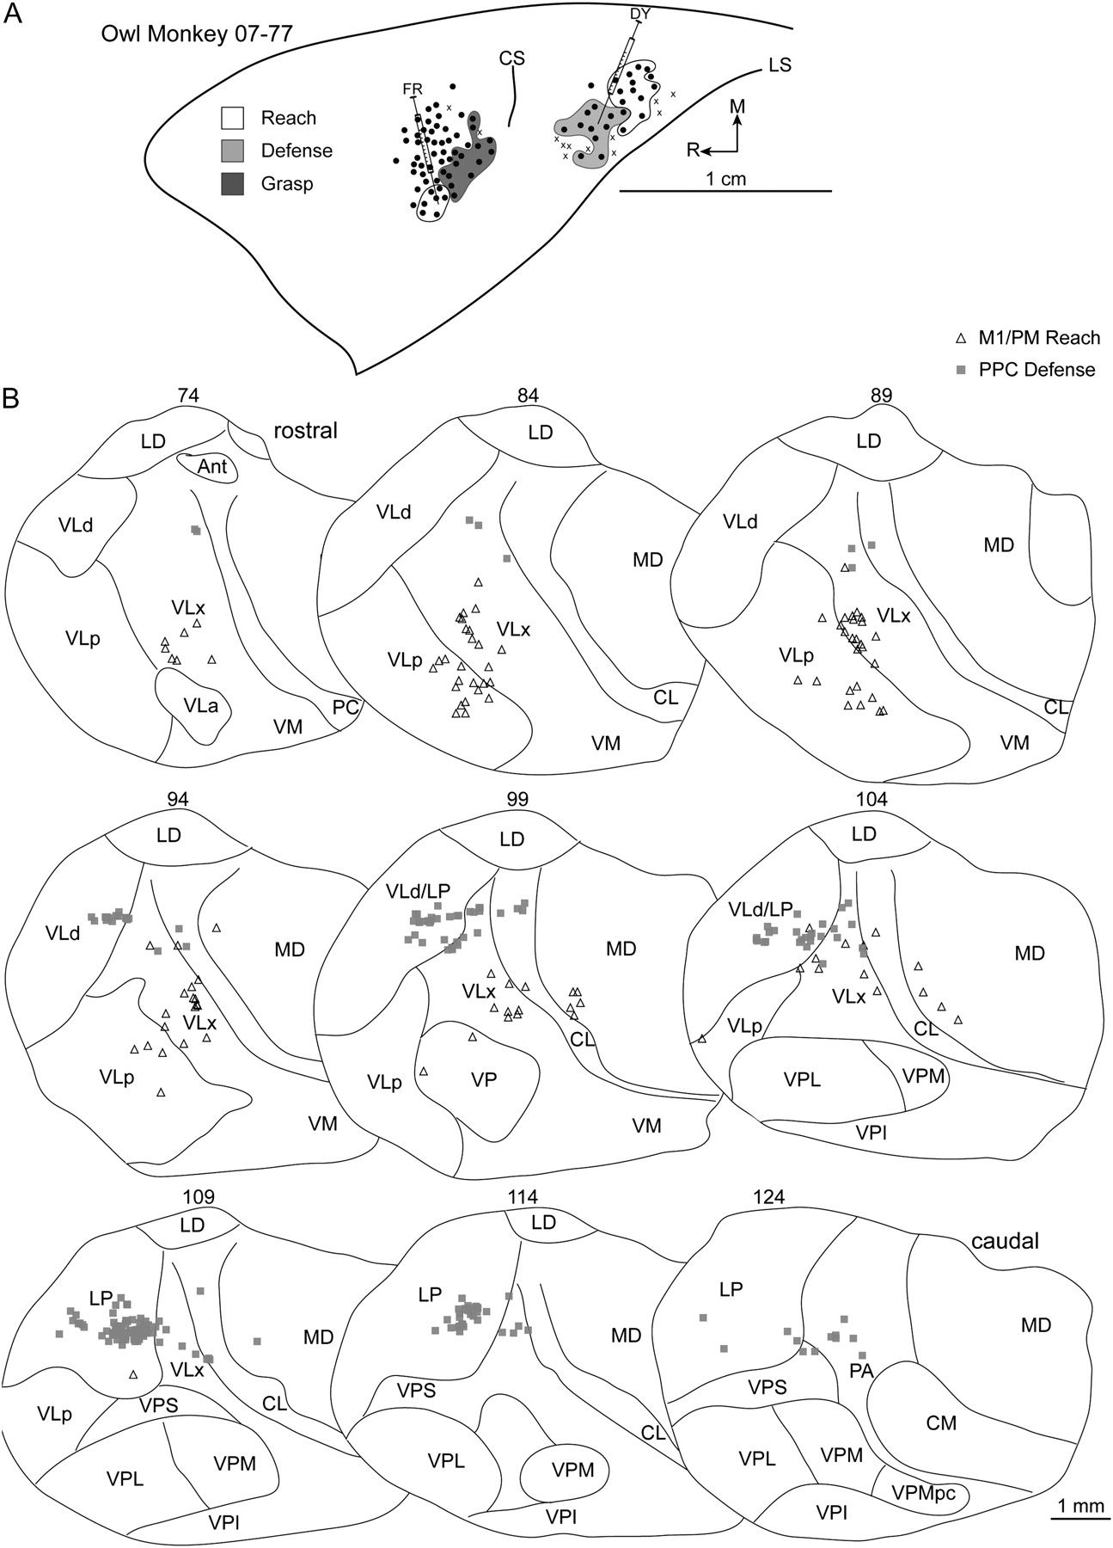
Figure 10. (A) Map of multijoint forelimb movements evoked with intracortical electrical stimulation from owl monkey ...
Notes:
Figure 10. (A) Map of multijoint forelimb movements evoked with intracortical electrical stimulation from owl monkey case 07-77. Two retrograde tracers were injected: FR into M1/PM reach zone and DY into PPC defense zone. (B) Distributions of labeled cells in a series of coronal thalamic sections from the same case.
Unless provided in the caption above, the following copyright applies to the content of this slide: © The Author 2010. Published by Oxford University Press. All rights reserved. For permissions, please e-mail: journals.permissions@oxfordjournals.org

Slide 11
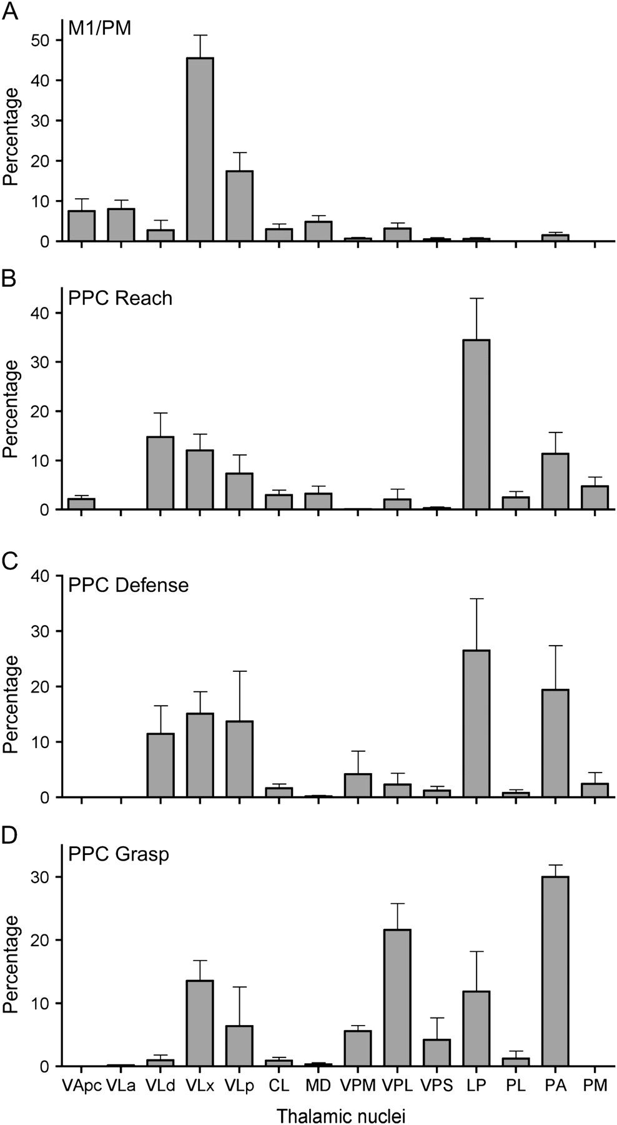
Figure 11. Histogram summaries of the distribution of cells labeled in thalamic nuclei from 3 squirrel monkeys and 5 ...
Notes:
Figure 11. Histogram summaries of the distribution of cells labeled in thalamic nuclei from 3 squirrel monkeys and 5 owl monkeys. The mean percentage of labeled cells and corresponding standard errors of the mean were calculated from the distributions presented in Tables 1 and 2. The number of injections into each functional zone is listed in the same tables. Thalamic nuclei included in the histograms contained at least a mean of 2% of the labeled cells for any given functional zone.
Unless provided in the caption above, the following copyright applies to the content of this slide: © The Author 2010. Published by Oxford University Press. All rights reserved. For permissions, please e-mail: journals.permissions@oxfordjournals.org

