Slide 1
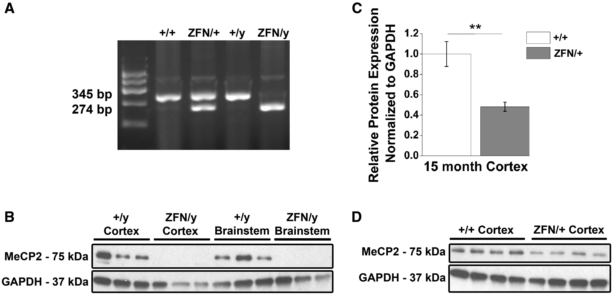
Figure 1. Mecp2^{ZFN/y} male and Mecp2^{ZFN/+} female rats display altered MeCP2 protein expression. ...
Notes:
Figure 1. Mecp2ZFN/y male and Mecp2ZFN/+ female rats display altered MeCP2 protein expression. (A) Representative genotyping gel revealing DNA fragments of different lengths that differentiate WT from Mecp2ZFN/y and Mecp2ZFN/+ rats. (B) Western blotting demonstrates total absence of MeCP2 protein in both cortex and brainstem of PND 60–80 Mecp2ZFN/y rats. (C–D) 15-month-old Mecp2ZFN/+ rats show a ∼52% reduction in MeCP2 protein by western blotting of cortical tissue (WT n = 4 Mecp2ZFN/+n = 4). Data are presented as mean ± SE, with asterisks representing significant genotype differences (**P < 0.01).
Unless provided in the caption above, the following copyright applies to the content of this slide: © The Author 2016. Published by Oxford University Press.This is an Open Access article distributed under the terms of the Creative Commons Attribution License (http://creativecommons.org/licenses/by/4.0/), which permits unrestricted reuse, distribution, and reproduction in any medium, provided the original work is properly cited.

