Slide 1
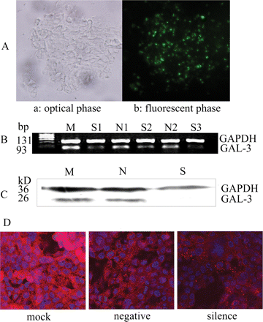
Figure 1 Analysis of gal-3 knock-down in RL95-2 cells. (A) Analysis of transfection efficiency by fluorescent ...
Notes:
Figure 1 Analysis of gal-3 knock-down in RL95-2 cells. (A) Analysis of transfection efficiency by fluorescent microscopy. A 100 nM concentration of fluorescent oligo was transfected into cells and incubated for 4 h then transfection efficiency was analyzed under a fluorescence microscope. More than 80% of cells took up the fluorescent oligo after 4 h. a: the optical image of RL95-2 cells; b: the fluorescent image of RL95-2 cells transfected with fluorescent oligo (green) (×200). Experiments were performed in duplicate. (B) RT–PCR analysis of gal-3 siRNA transfection. Gal-3 mRNA expression was reduced significantly after 24 h transfection (*: P < 0.05). Experiments were performed in triplicate. S1, S2, S3 individually represent the gal-3 siRNA transfected group; N1, N2 represent the negative siRNA transfected cells (Negative control group); M represents cells that were incubated only with lipofectamine 2000 (Mock group). (C) Western Blot analysis of gal-3 siRNA transfection. Gal-3 protein expression was reduced significantly after 24 h transfection (*: P < 0.05). S: gal-3 silenced group; N: negative control group; M: mock group. (D) Distribution of gal-3 examed by confocal microscopy. Cell surface, cytoplasmic and nuclear staining of gal-3 (red fluorescent) was decreased in gal-3 silenced cells (silence) compared with negative control (negative—transfected with negative SiRNA) or mock group (mock—transfected with lipofectamine carrier) (×600).
Unless provided in the caption above, the following copyright applies to the content of this slide: © The Author 2009. Published by Oxford University Press on behalf of the European Society of Human Reproduction and Embryology. All rights reserved. For Permissions, please email: journals.permissions@oxfordjournals.org

Slide 2
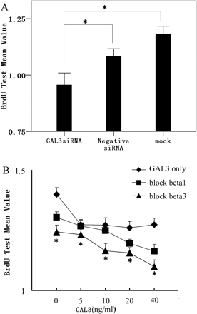
Figure 2 Proliferation analysis of RL95-2 cells. (A) RL95-2 cells were transfected with gal-3 siRNA (GAL3siRNA), ...
Notes:
Figure 2 Proliferation analysis of RL95-2 cells. (A) RL95-2 cells were transfected with gal-3 siRNA (GAL3siRNA), negative siRNA, or incubated with lipofectamine 2000 (mock) for 24 h. The proliferation of RL95-2 cells was significantly reduced in gal-3 silenced cells compared with negative or mock groups after 24 h (*: P < 0.05). (B) RL95-2 cells were treated with function blocking monoclonal integrinβ1/3 antibody (1 ng/ml) in the presence of increasing concentrations of recombinant gal-3 (0, 5, 10, 20, 40 ng/ml) for 24 h. The proliferation rate was significantly reduced in cells treated with function blocking integrinβ3 antibody (block beta3) but not integrinβ1 antibody (block beta1) compared with the corresponding concentration-matched gal-3 treated control group (GAL3 only) (*: P < 0.05). All experiments were performed in triplicate and repeated three times. All data were presented as mean ± SE and were from one of representatives from three similar results. Statistical analyses were performed using One-Way ANOVA and the LSD was applied for post hoc testing using SPSS software 15.0 for windows with P < 0.05 being considered significant.
Unless provided in the caption above, the following copyright applies to the content of this slide: © The Author 2009. Published by Oxford University Press on behalf of the European Society of Human Reproduction and Embryology. All rights reserved. For Permissions, please email: journals.permissions@oxfordjournals.org

Slide 3
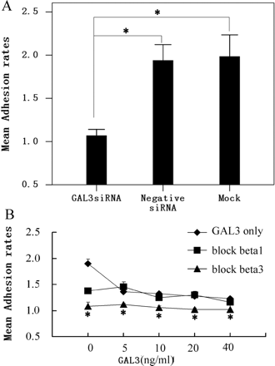
Figure 3 Adhesion of RL95-2 cells to FN. (A) Adherence of gal-3 silenced RL95-2 cells (GAL3siRNA) to FN was ...
Notes:
Figure 3 Adhesion of RL95-2 cells to FN. (A) Adherence of gal-3 silenced RL95-2 cells (GAL3siRNA) to FN was significantly reduced compared with that in the negative siRNA transfection (Negative siRNA) and mock (Mock) groups (*: P < 0.05). (B) The adhesion of RL95-2 cell to FN was significantly inhibited by the treatment of integrinβ3 antibody (block beta3) but not by integrinβ1 antibody (block beta1), when compared with the corresponding concentration-matched gal-3 treated control group (GAL3 only) (*: P < 0.05). All experiments were repeated three times. Data presented is from one of representative from three similar results. Statistical analyses were performed using One-Way ANOVA and the LSD was applied for post hoc testing using SPSS software 15.0 for windows with P < 0.05 being considered significant.
Unless provided in the caption above, the following copyright applies to the content of this slide: © The Author 2009. Published by Oxford University Press on behalf of the European Society of Human Reproduction and Embryology. All rights reserved. For Permissions, please email: journals.permissions@oxfordjournals.org

Slide 4
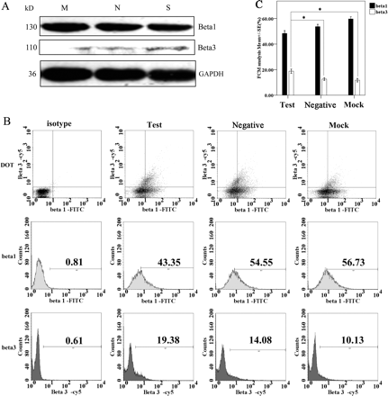
Figure 4 Western blots and flow cytometry analysis of integrins expression on gal-3 siRNA transfected cells. (A) The ...
Notes:
Figure 4 Western blots and flow cytometry analysis of integrins expression on gal-3 siRNA transfected cells. (A) The expression of integrinβ3 was significantly increased in gal-3 silenced cells (S) compared with negative transfected (N) or mock group cells (M) (*: P < 0.05), and the change of expression of integrinβ1 was not significant. (B) Flow cytometry results for integrinβ1/3 expression. Isotype: cells incubated with fluorescein-conjugated IgG1 isotype and Cy5 conjugated IgG2a isotype; Test: gal-3 silenced cells; Negative: negative siRNA transfected cells; Mock: cells incubated only with lipofectamine 2000. (C) Bar graph for the flow cytometry analysis of integrinβ1/3 expression. Test: gal-3 silenced cells; Negative: negative siRNA transfected cells; Mock: cells incubated only with lipofectamine 2000 (*: P < 0.05). Experiments were performed in duplicate and repeated three times. Statistical analyses were performed using One-Way ANOVA and the LSD was applied for post hoc testing using SPSS software 15.0 for windows with P < 0.05 being considered significant.
Unless provided in the caption above, the following copyright applies to the content of this slide: © The Author 2009. Published by Oxford University Press on behalf of the European Society of Human Reproduction and Embryology. All rights reserved. For Permissions, please email: journals.permissions@oxfordjournals.org

Slide 5
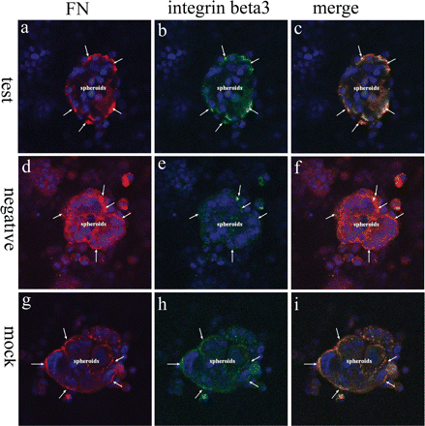
Figure 5 Colocalization of FN and integrinβ3 at the interface of Bewo spheroids and RL95-2 monolayer. Test: gal-3 ...
Notes:
Figure 5 Colocalization of FN and integrinβ3 at the interface of Bewo spheroids and RL95-2 monolayer. Test: gal-3 siRNA treated group; negative: negative siRNA treated group; mock: vehicle treated group. Confocal micrograph demonstrating the intensity of fluorescent of integrinβ3 (green) on silenced RL95-2 cells (b) was increased, however, the colocalization of integrinβ3 and FN (c,f,i, orange after merge, as marked by arrows) at interface of Bewo spheroids and monolayer of RL95-2 cells was not different between gal-3 silenced RL95-3 cells (c) and negative transfected RL95-2 cells (f) or mock groups (i) (×600). Experiments were performed in duplicate and repeated at least three times.
Unless provided in the caption above, the following copyright applies to the content of this slide: © The Author 2009. Published by Oxford University Press on behalf of the European Society of Human Reproduction and Embryology. All rights reserved. For Permissions, please email: journals.permissions@oxfordjournals.org

Slide 6
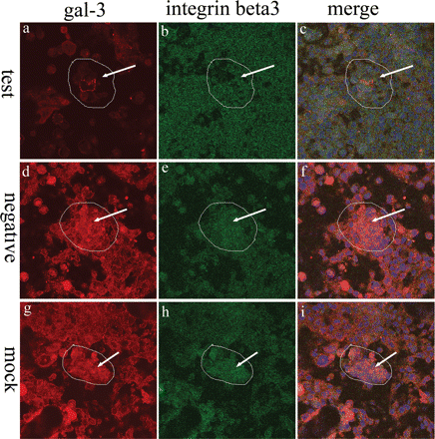
Figure 6 Colocalization of gal-3 and integrinβ3 at the interface of Bewo spheroids and RL95-2 monolayer. Test: gal-3 ...
Notes:
Figure 6 Colocalization of gal-3 and integrinβ3 at the interface of Bewo spheroids and RL95-2 monolayer. Test: gal-3 siRNA treated group; negative: negative siRNA treated group; mock: vehicle treated group. The intensity of fluorescent of integrinβ3 (green) on silenced RL95-2 cells was increased (b), the intensity of fluorescent of gal-3 (red) on silenced RL95-2 cells was decreased (a), and the colocalization of integrinβ3 and gal-3 (c, orange after merge, as marked by arrows) on Bewo spheroid and monolayer of RL95-2 cells was decreased after gal-3 knock-down (×600). Experiments were performed in duplicate and repeated at least three times.
Unless provided in the caption above, the following copyright applies to the content of this slide: © The Author 2009. Published by Oxford University Press on behalf of the European Society of Human Reproduction and Embryology. All rights reserved. For Permissions, please email: journals.permissions@oxfordjournals.org

