Slide 1
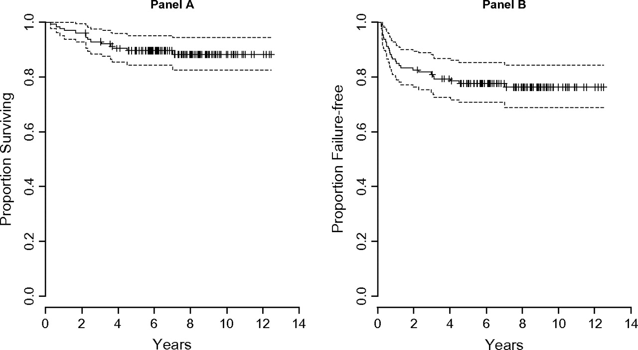
Figure 1. OS and FFS for 126 patients with locally extensive and advanced-stage Hodgkin disease. The 5- and 7-year OS ...
Notes:
Figure 1. OS and FFS for 126 patients with locally extensive and advanced-stage Hodgkin disease. The 5- and 7-year OS and FFS were 90% and 88% and 78% and 76%, respectively. There were no events after 7 years. Panel A: OS for 126 patients; panel B: FFS for 126 patients. OS, overall survival; FFS, failure-free survival.
Unless provided in the caption above, the following copyright applies to the content of this slide: © The Author 2009. Published by Oxford University Press on behalf of the European Society for Medical Oncology. All rights reserved. For permissions, please email: journals.permissions@oxfordjournals.org

Slide 2
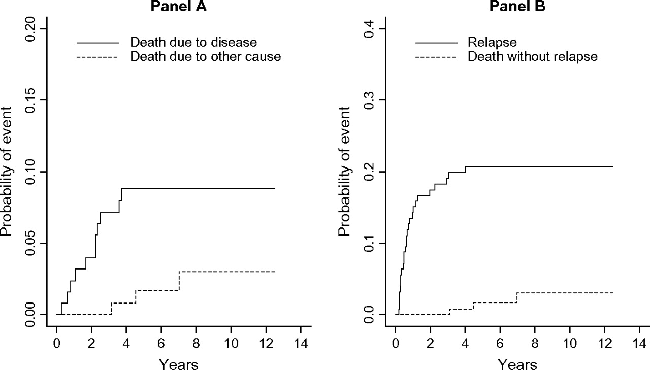
Figure 2. (A) DSS for all 126 patients treated with the Stanford V regimen. Death from other causes is treated as a ...
Notes:
Figure 2. (A) DSS for all 126 patients treated with the Stanford V regimen. Death from other causes is treated as a competing risk. There were no deaths from disease after 4 years. (B) PFS for all 126 patients treated with the Stanford V regimen. Death without relapse is treated as a competing risk. No relapses occurred after 4 years. DSS, disease-specific survival; PFS, progression-free survival.
Unless provided in the caption above, the following copyright applies to the content of this slide: © The Author 2009. Published by Oxford University Press on behalf of the European Society for Medical Oncology. All rights reserved. For permissions, please email: journals.permissions@oxfordjournals.org

Slide 3
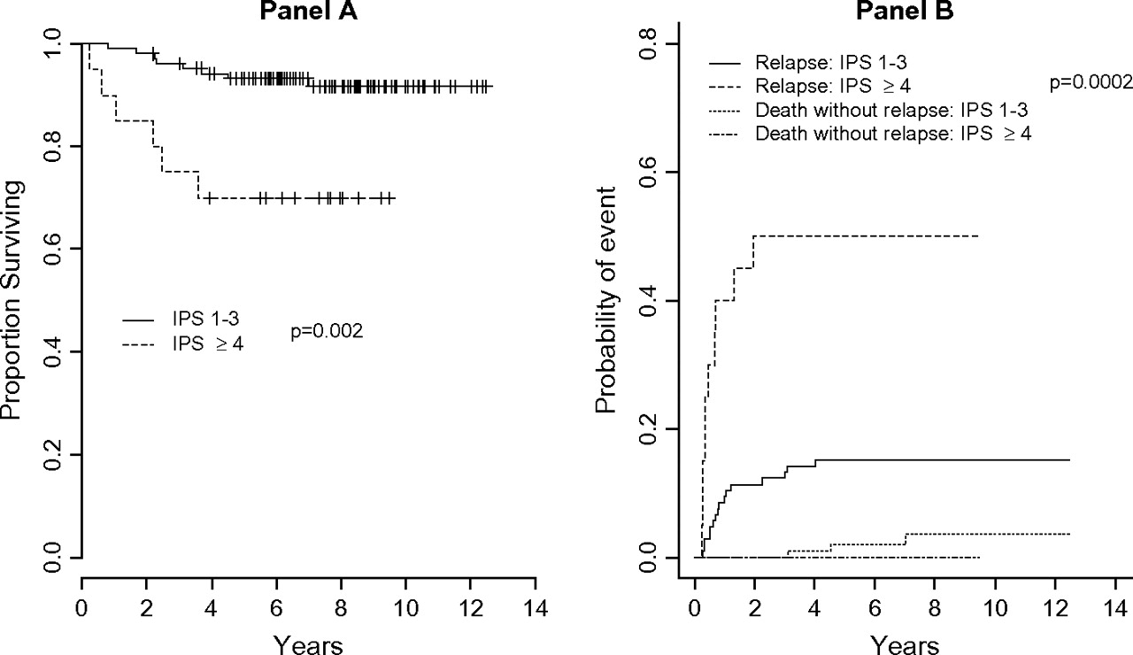
Figure 3. (A) Overall survival for patients with international prognostic score (IPS) <4 versus ≥4. (B) ...
Notes:
Figure 3. (A) Overall survival for patients with international prognostic score (IPS) <4 versus ≥4. (B) Progression-free survival for patients with IPS <4 versus ≥4.
Unless provided in the caption above, the following copyright applies to the content of this slide: © The Author 2009. Published by Oxford University Press on behalf of the European Society for Medical Oncology. All rights reserved. For permissions, please email: journals.permissions@oxfordjournals.org

Slide 4
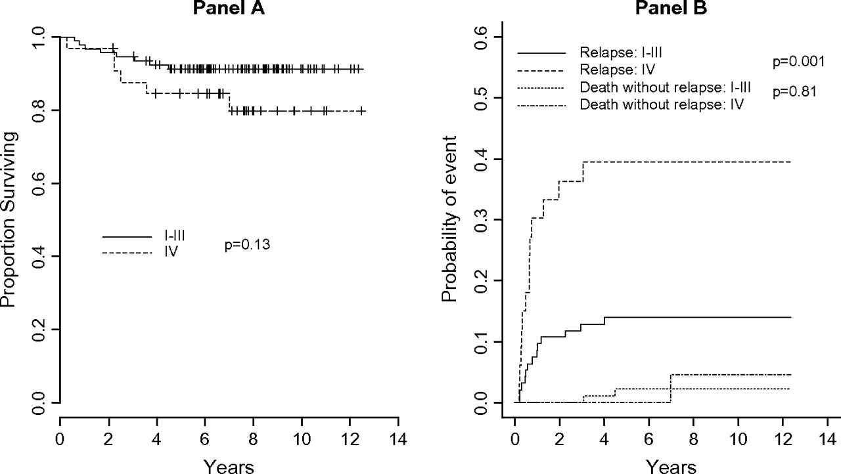
Figure 4. (A) Overall survival for patients with stage I–III versus stage IV disease. (B) Progression-free survival for ...
Notes:
Figure 4. (A) Overall survival for patients with stage I–III versus stage IV disease. (B) Progression-free survival for patients with stage I–III versus stage IV disease.
Unless provided in the caption above, the following copyright applies to the content of this slide: © The Author 2009. Published by Oxford University Press on behalf of the European Society for Medical Oncology. All rights reserved. For permissions, please email: journals.permissions@oxfordjournals.org

Slide 5
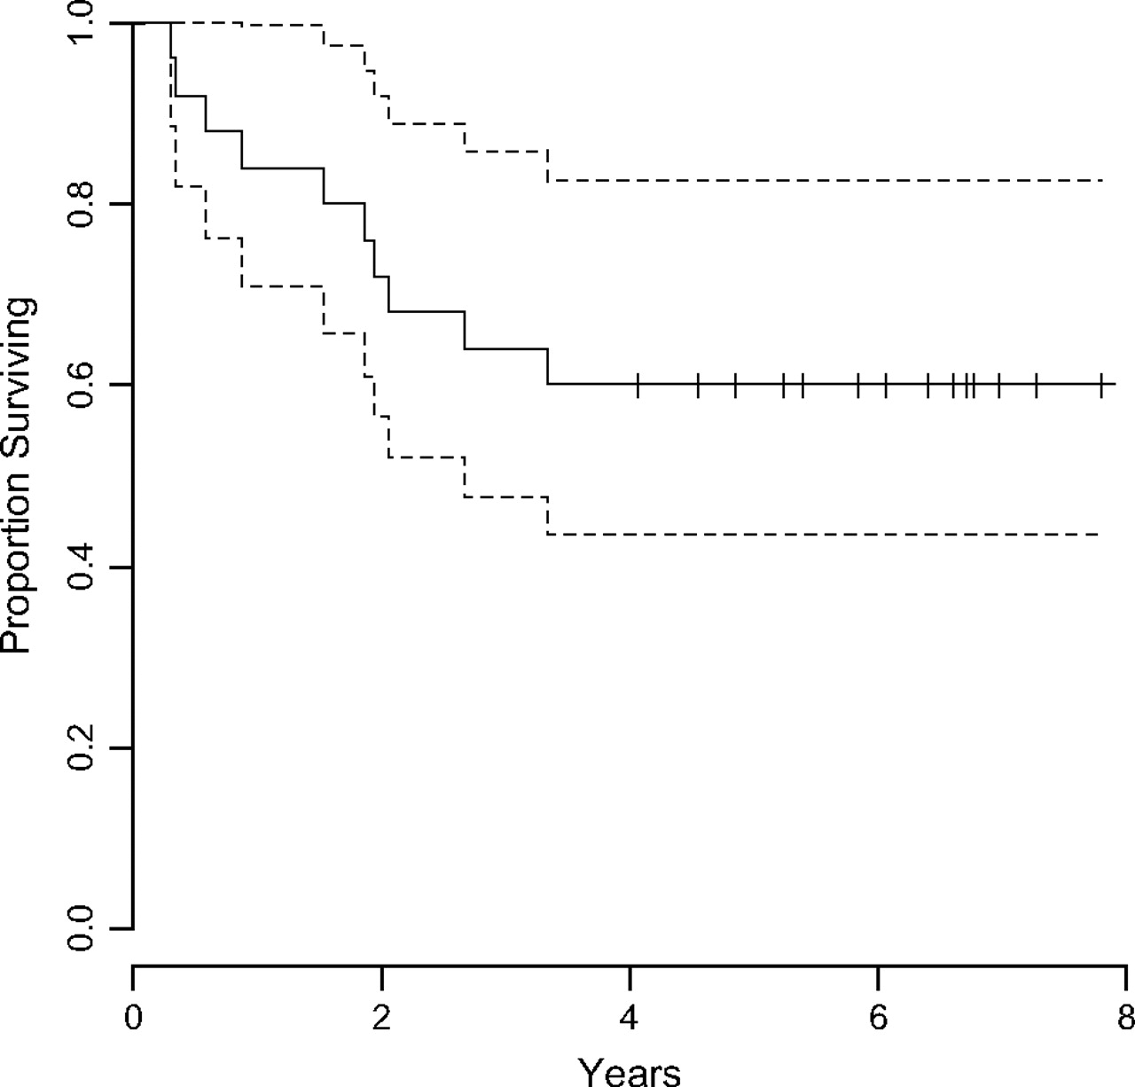
Figure 5. FF2R for 25 patients who underwent salvage therapy. FF2R (freedom from second relapse) is defined as time ...
Notes:
Figure 5. FF2R for 25 patients who underwent salvage therapy. FF2R (freedom from second relapse) is defined as time from start of salvage therapy to second relapse, death from any cause or last follow up.
Unless provided in the caption above, the following copyright applies to the content of this slide: © The Author 2009. Published by Oxford University Press on behalf of the European Society for Medical Oncology. All rights reserved. For permissions, please email: journals.permissions@oxfordjournals.org

