Slide 1
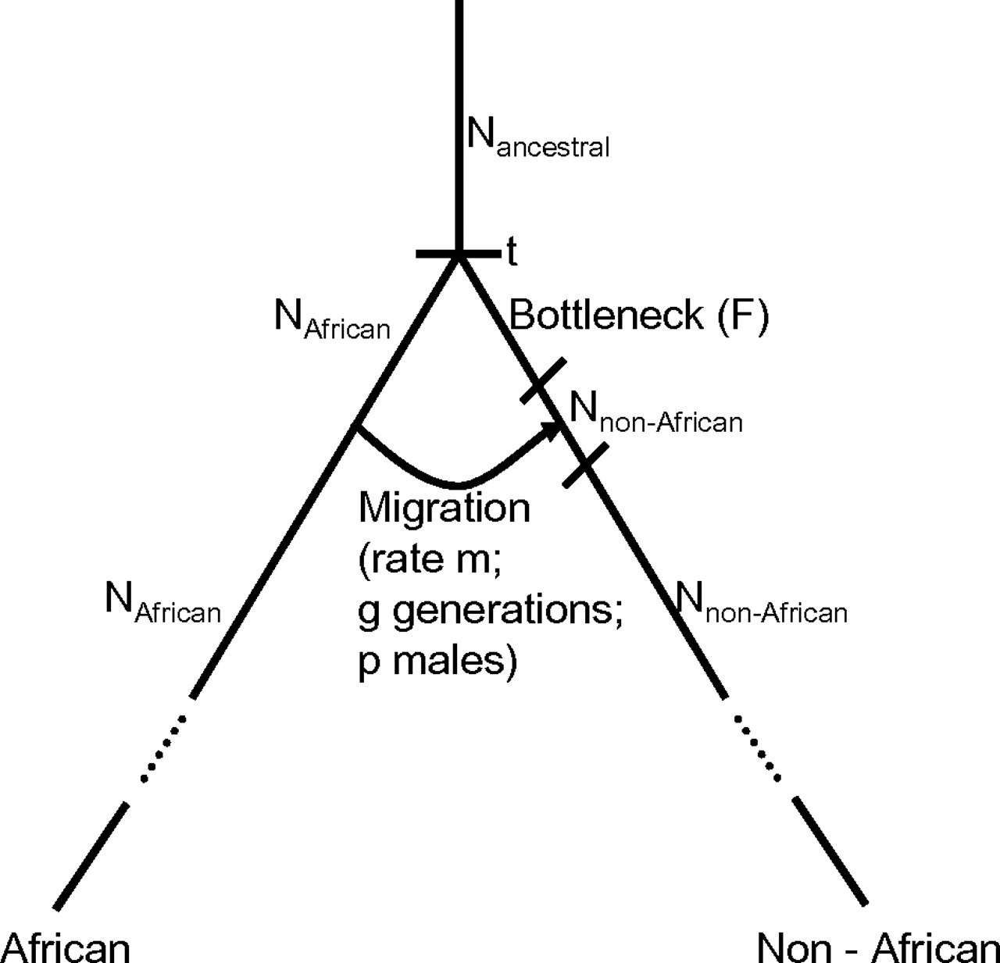
FIG. 1. Model of sex-biased migration during the dispersal of modern humans from Africa. The figure outlines the ...
Notes:
FIG. 1. Model of sex-biased migration during the dispersal of modern humans from Africa. The figure outlines the primarily male migration model, a detailed description of which is provided in Materials and Methods. Nancestral is the ancestral Ne, NAfrican the African Ne, and Nnon-African the Ne of the ancestral population of North Europeans; t is the split time of the African and non-African populations; F is the severity of the out-of-Africa population bottleneck; g denotes the number of generations migration lasted following the bottleneck; m denotes its rate; and p the proportion of migrants who were male.
Unless provided in the caption above, the following copyright applies to the content of this slide: © The Author 2010. Published by Oxford University Press on behalf of the Society for Molecular Biology and Evolution. All rights reserved. For permissions, please e-mail: journals.permissions@oxfordjournals.org

Slide 2
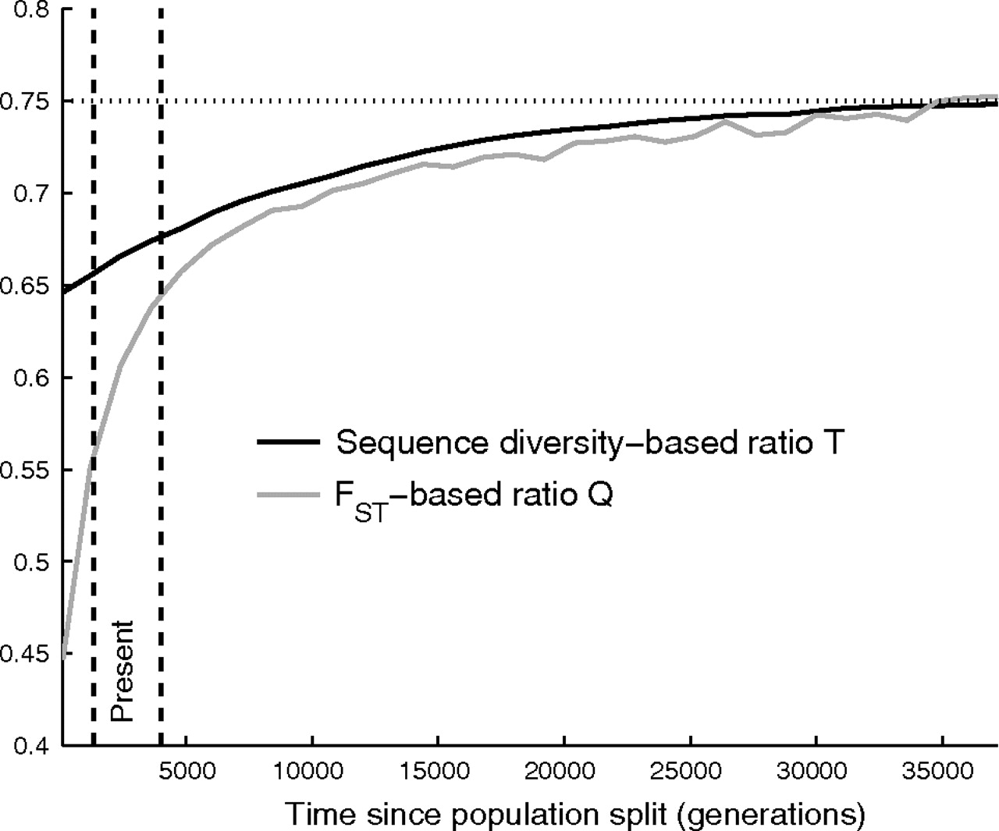
FIG. 2. Signatures of X-autosome asymmetry decay over tens of thousands of generations after primarily male ...
Notes:
FIG. 2. Signatures of X-autosome asymmetry decay over tens of thousands of generations after primarily male migration. The figure shows the Q and T ratios as a function of varying the time since the dispersal out of Africa t within the model of primarily male migration. A range of times consistent with the split of Africans and non-African populations is illustrated by the vertical band (40,000–80,000 years ago of 20–30 years per generation; the baseline model discussed in the main text is at the middle of that range). The signals captured by the two different ratios exhibit different behavior with time, but both are predicted to be very strong at present time and to practically vanish by 35,000 generations (∼875,000 years) after the event. (The horizontal dotted line provides the ¾ prediction of a sex-symmetric history of constant Ne.)
Unless provided in the caption above, the following copyright applies to the content of this slide: © The Author 2010. Published by Oxford University Press on behalf of the Society for Molecular Biology and Evolution. All rights reserved. For permissions, please e-mail: journals.permissions@oxfordjournals.org

