Slide 1
Figure 1. Schematic depictions of experimental design. Beat and nonbeat rhythms were played consecutively, with the ...
Notes:
Figure 1. Schematic depictions of experimental design. Beat and nonbeat rhythms were played consecutively, with the previous rhythm determining how the subsequent rhythm was classified. Absolute rhythm rate is indexed by the smallest rhythmic interval used in the sequence (between 140 and 260 ms, in 30 ms steps). Shorter intervals result in faster rates. The type of beat processing required is indicated in the bottom row (finding of the beat, continuation of the beat at the same rate as the previous rhythm, or adjustment of the beat rate from the previous rhythm).
Unless provided in the caption above, the following copyright applies to the content of this slide: © The Authors 2012. Published by Oxford University Press.This is an Open Access article distributed under the terms of the Creative Commons Attribution Non-Commercial License (http://creativecommons.org/licenses/by-nc/3.0), which permits unrestricted non-commercial use, distribution, and reproduction in any medium, provided the original work is properly cited.

Slide 2
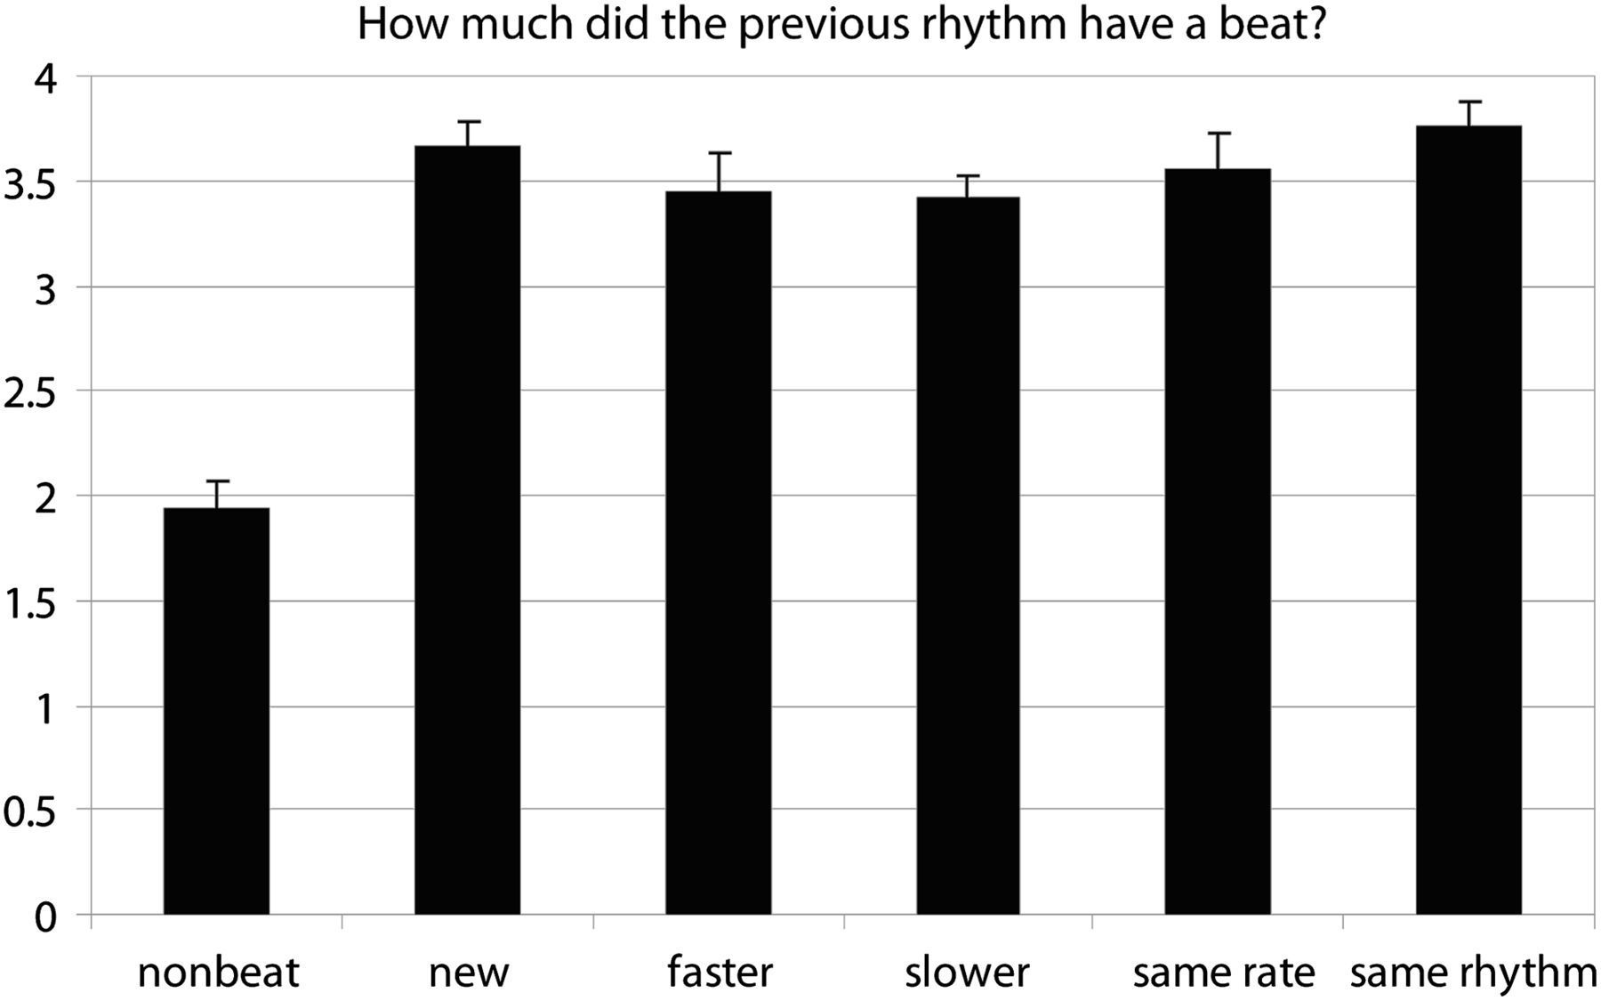
Figure 2. Behavioral ratings. The average beat rating given to each condition when probed during fMRI scanning. Rating ...
Notes:
Figure 2. Behavioral ratings. The average beat rating given to each condition when probed during fMRI scanning. Rating scale is from 1 (no beat) to 4 (beat).
Unless provided in the caption above, the following copyright applies to the content of this slide: © The Authors 2012. Published by Oxford University Press.This is an Open Access article distributed under the terms of the Creative Commons Attribution Non-Commercial License (http://creativecommons.org/licenses/by-nc/3.0), which permits unrestricted non-commercial use, distribution, and reproduction in any medium, provided the original work is properly cited.

Slide 3
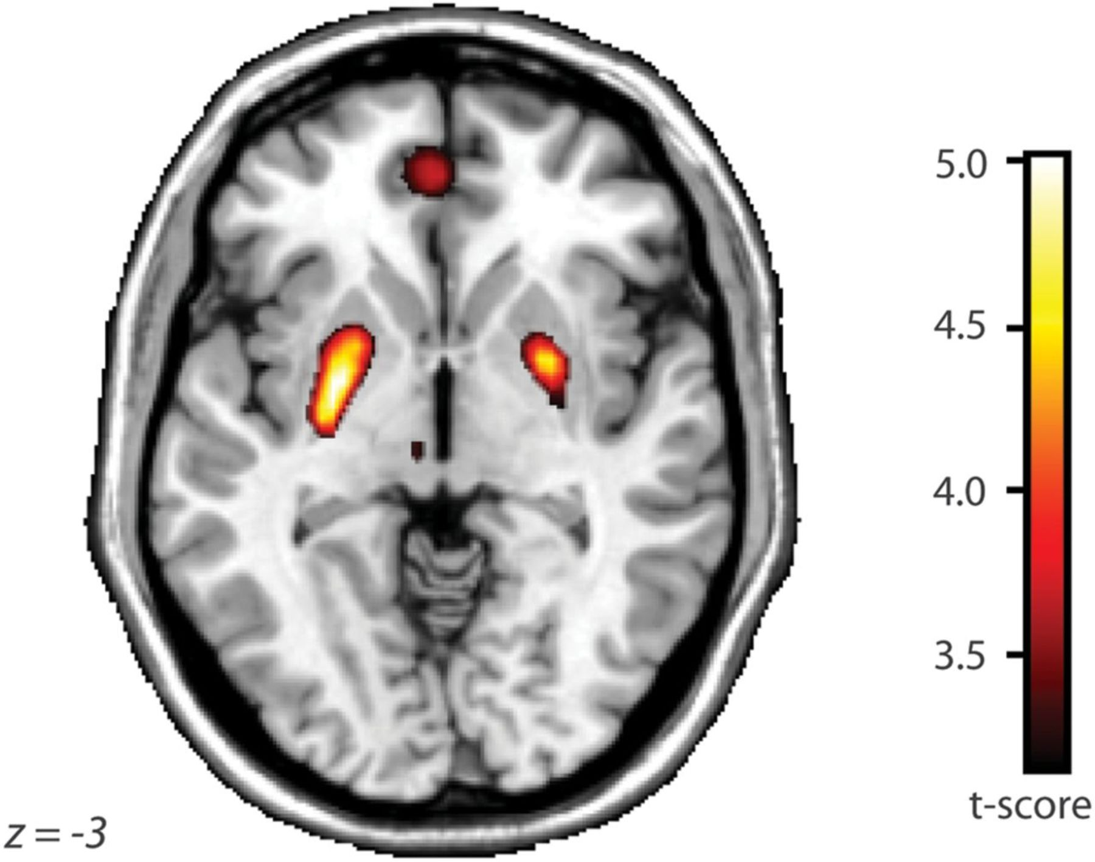
Figure 3. SPM analyses. The beat versus nonbeat activation contrast overlaid on a template brain, thresholded at PFDR < ...
Notes:
Figure 3. SPM analyses. The beat versus nonbeat activation contrast overlaid on a template brain, thresholded at PFDR < 0.05. Z refers to the level of the axial slice shown in stereotaxic Montreal Neurological Institute space.
Unless provided in the caption above, the following copyright applies to the content of this slide: © The Authors 2012. Published by Oxford University Press.This is an Open Access article distributed under the terms of the Creative Commons Attribution Non-Commercial License (http://creativecommons.org/licenses/by-nc/3.0), which permits unrestricted non-commercial use, distribution, and reproduction in any medium, provided the original work is properly cited.

Slide 4
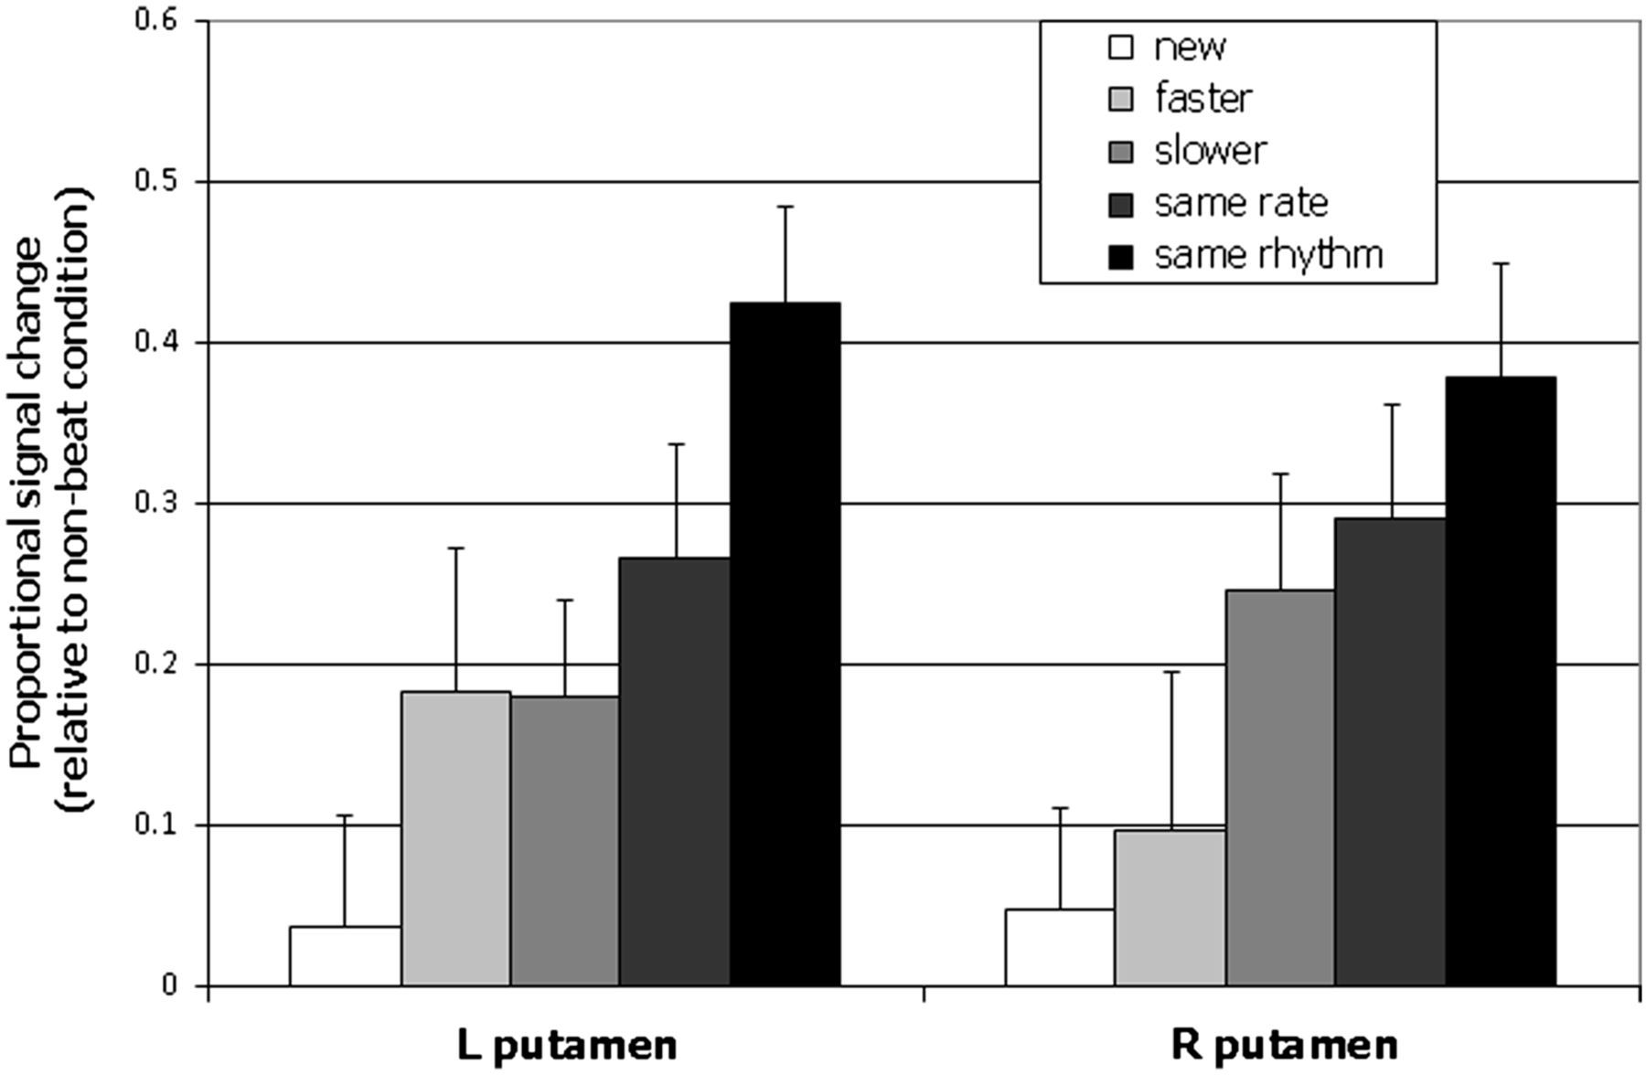
Figure 4. Mean activation from left and right putamen ROIs for each beat condition (relative to the nonbeat control ...
Notes:
Figure 4. Mean activation from left and right putamen ROIs for each beat condition (relative to the nonbeat control condition). A positive value means greater activity for that particular beat condition compared with the nonbeat condition.
Unless provided in the caption above, the following copyright applies to the content of this slide: © The Authors 2012. Published by Oxford University Press.This is an Open Access article distributed under the terms of the Creative Commons Attribution Non-Commercial License (http://creativecommons.org/licenses/by-nc/3.0), which permits unrestricted non-commercial use, distribution, and reproduction in any medium, provided the original work is properly cited.

