Slide 1
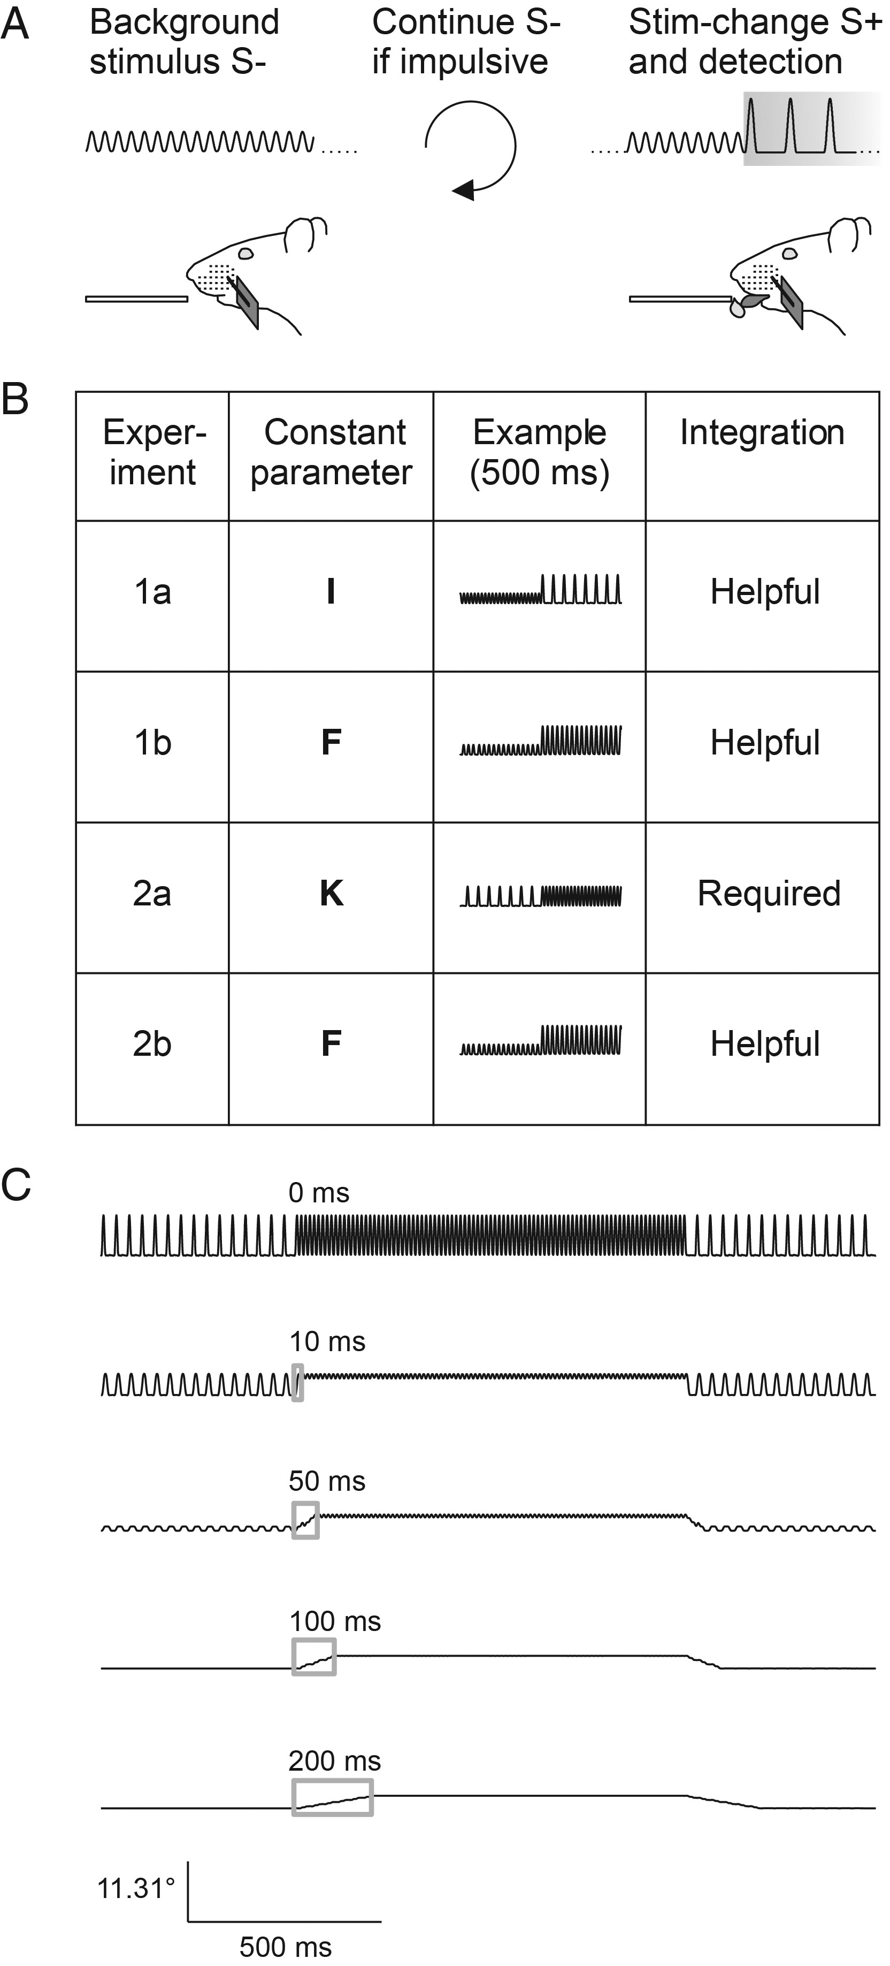
Figure 1. Experimental strategy. (A) Head-fixed rats were trained on a detection of change (DOC) task. Constant ...
Notes:
Figure 1. Experimental strategy. (A) Head-fixed rats were trained on a detection of change (DOC) task. Constant pulsatile stimuli were applied to a single whisker and the animals had to detect a 1-s change (S+, gray box) with a lick response in order to get a water reward. No change served as catch trial (S−). Impulsive licks triggered extra time of background stimulation. (B) Overview of the stimulus sets applied in the different experiments of this study (first column). The general idea was to keep one of the 3 vibrotactile parameters intensity (I), frequency (F), or instantaneous kinematic cues (K) constant between S− and S+ (second column) and only vary the other 2. Schematic stimulus waveforms at the time of stimulus transitions are shown in the third column. Using pulsatile stimuli, an increase of instantaneous kinematic cues (i.e., increase of pulse amplitude) is correlated with intensity but not pulse frequency. Column 4 denotes the role played for temporal integration for successful discrimination in each experiment. (C) In Experiment 2a, the instantaneous kinematic cues are constant; therefore, the observer has to integrate the running stimulus with a minimal time window comprising more than one pulse (>10 ms). Stimulus transitions filtered with integration windows of different size (gray boxes = moving average) demonstrate that perfect discrimination of these stimuli can theoretically be performed very soon after the stimulus onset.
Unless provided in the caption above, the following copyright applies to the content of this slide: © The Author 2013. Published by Oxford University Press.This is an Open Access article distributed under the terms of the Creative Commons Attribution Non-Commercial License (http://creativecommons.org/licenses/by-nc/3.0/), which permits non-commercial re-use, distribution, and reproduction in any medium, provided the original work is properly cited. For commercial re-use, please contact journals.permissions@oup.com

Slide 2
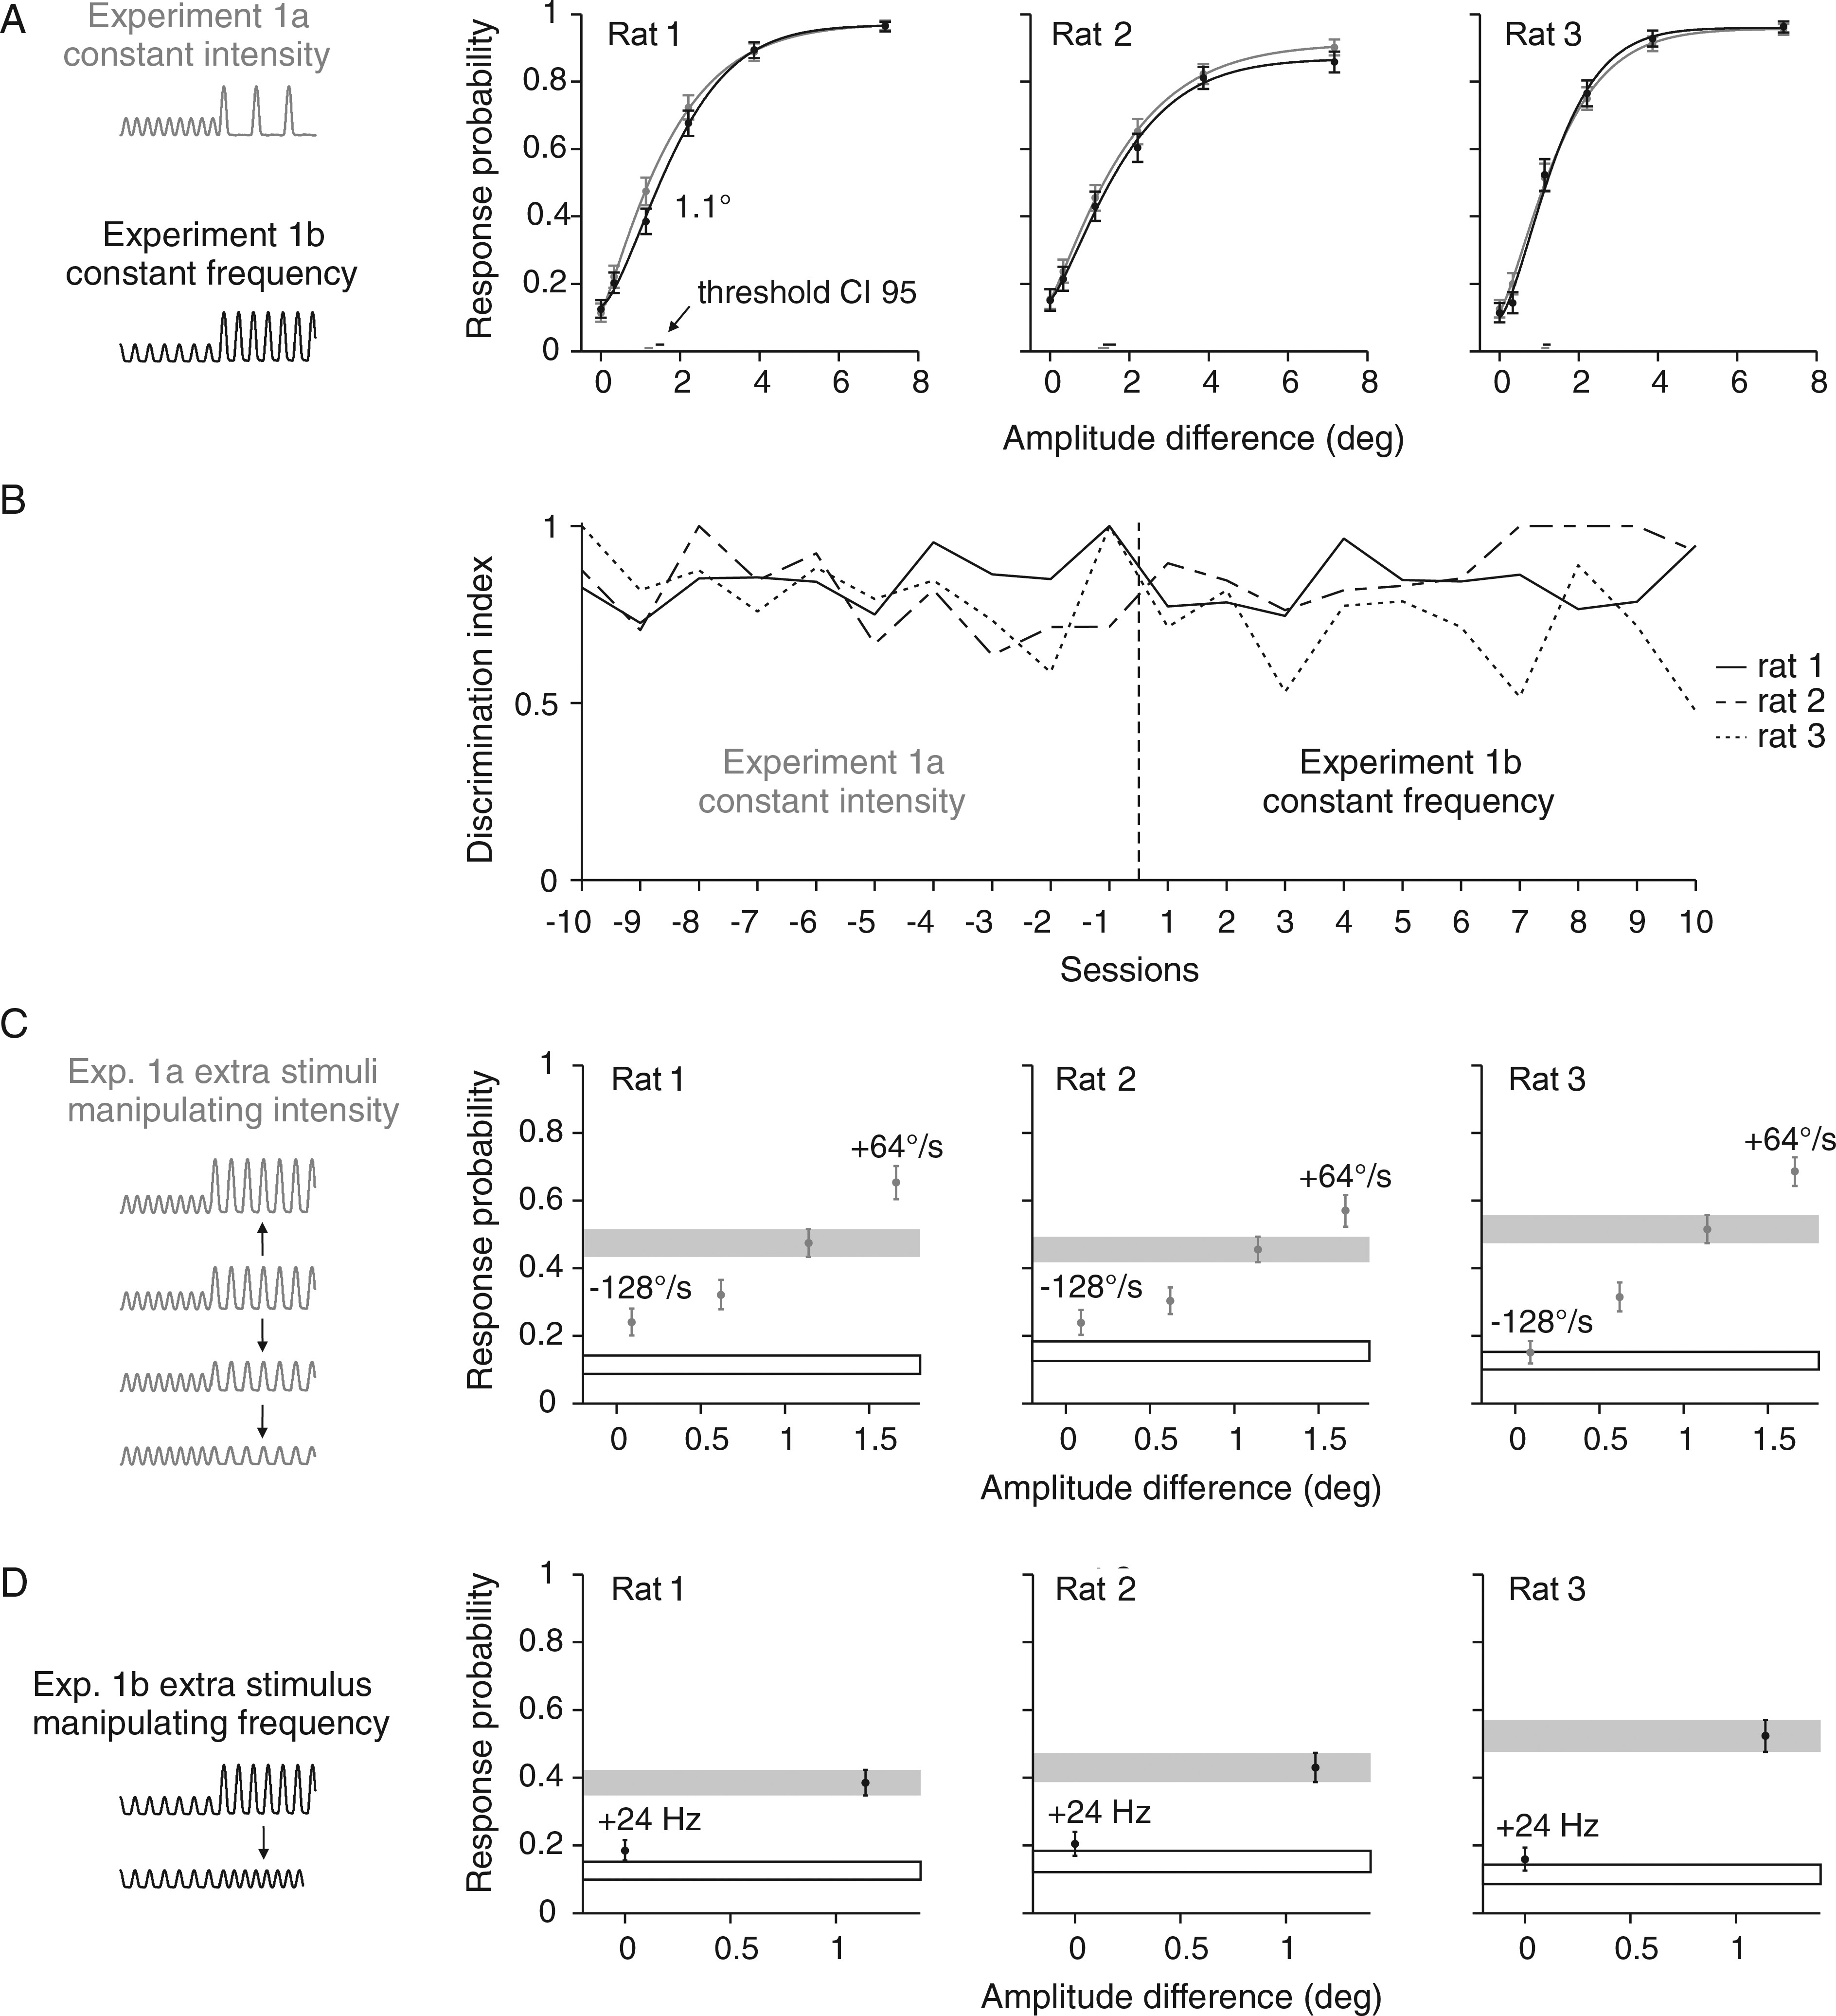
Figure 2. Psychometric performance with 2 stimulus sets that both employed kinematics as discriminative cues. (A) ...
Notes:
Figure 2. Psychometric performance with 2 stimulus sets that both employed kinematics as discriminative cues. (A) Response probabilities of 3 rats are depicted as a function of amplitude differences in gray for Experiment 1a and in black for Experiment 1b. Data points represent means and are based on 447–676 trials. Smooth lines are Weibull fits estimated from a maximum likelihood estimator. Vertical error bars represent 95% confidence intervals. Horizontal bars at the bottom represent 95% confidence intervals of the thresholds. (B) Discrimination index (eq. 3) achieved in the last 10 sessions of the first block of Experiment 1a and the first 10 sessions after switching to Experiment 1b. (C) Additional stimuli with manipulated intensities were introduced to test the animals' sensitivity compared with a stimulus with matched intensity from the psychometric curve (gray bar). (D) Same as in C but additional stimuli that modulated frequency. Performance to catch trials is shown as black outlined box. Schematics of stimulus traces used in each experiment are shown on the left side.
Unless provided in the caption above, the following copyright applies to the content of this slide: © The Author 2013. Published by Oxford University Press.This is an Open Access article distributed under the terms of the Creative Commons Attribution Non-Commercial License (http://creativecommons.org/licenses/by-nc/3.0/), which permits non-commercial re-use, distribution, and reproduction in any medium, provided the original work is properly cited. For commercial re-use, please contact journals.permissions@oup.com

Slide 3
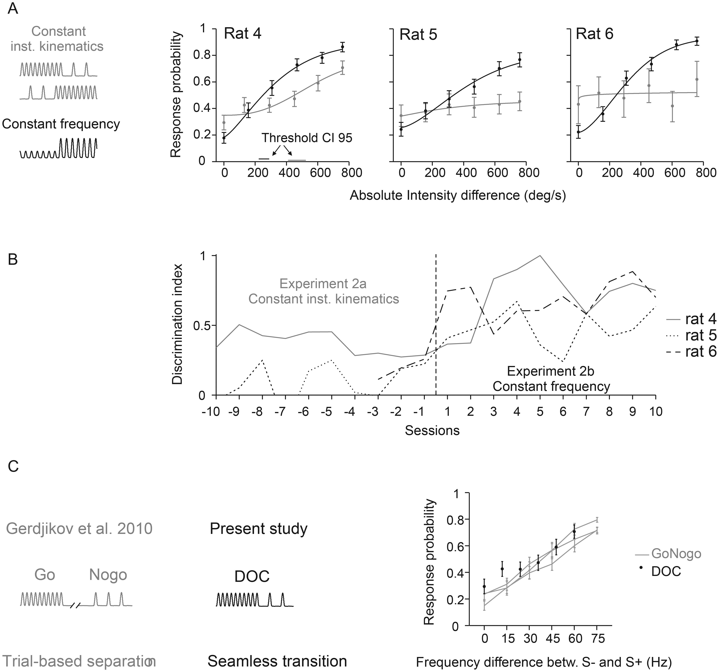
Figure 3. Psychometric performance without kinematic cues. (A) Response probabilities of 3 rats are depicted as a ...
Notes:
Figure 3. Psychometric performance without kinematic cues. (A) Response probabilities of 3 rats are depicted as a function of intensity differences in gray for Experiment 2a and in black for Experiment 2b. Data points represent means and are based on 49–316 trials. Weibull fits and statistics are the same as in Figure 2. 95% confidence intervals of the thresholds (horizontal bars) are only shown if the psychometric curve surpasses the threshold. Rats 4 and 6 experienced negative change (intensity and frequency of S+ was lower than that of S−, upper gray icon), rat 5 worked on the inverted stimulus relationship (intensity/frequency S+ >intensity/frequency S−, lower gray icon, see details in Table 1). Rats were naïve before being trained on stimulus set 2a. (B) Discrimination index (eq. 3) achieved in the last 10 sessions of the first block of Experiment 2a (no kinematic cue) and the first 10 sessions after switching to Experiment 2b (almost identical to 1b, see Table 1). Note that the index in sessions 1–7 before switching to 2b was not plotted for rat 6. This individual was frustrated by stimulus set 2a and thus was presented only with extreme stimuli (S− and strongest S+) in these sessions in an attempt to keep up its motivation. (C) Comparison of psychometric results with an earlier study using the same type of stimuli (Gerdjikov et al. 2010). The earlier study (left) used a classical Go/NoGo paradigm with stimuli separated in time; S+ was the highest frequency stimulus (90 Hz). The present study used a DOC paradigm with seamless presentation of S− and S+ (center). The psychophysical results of rat 4 (the one successfully trained on the DOC task) was obtained with S− being the highest frequency stimulus (90 Hz). Despite the differences in psychophysical design and in stimulus-reward association, the psychophysical results of the 2 experiments are comparable (right). To allow direct comparison of the curves, the absolute stimulus frequencies used in the earlier study, were converted into frequency differences between S+ and S−.
Unless provided in the caption above, the following copyright applies to the content of this slide: © The Author 2013. Published by Oxford University Press.This is an Open Access article distributed under the terms of the Creative Commons Attribution Non-Commercial License (http://creativecommons.org/licenses/by-nc/3.0/), which permits non-commercial re-use, distribution, and reproduction in any medium, provided the original work is properly cited. For commercial re-use, please contact journals.permissions@oup.com

Slide 4
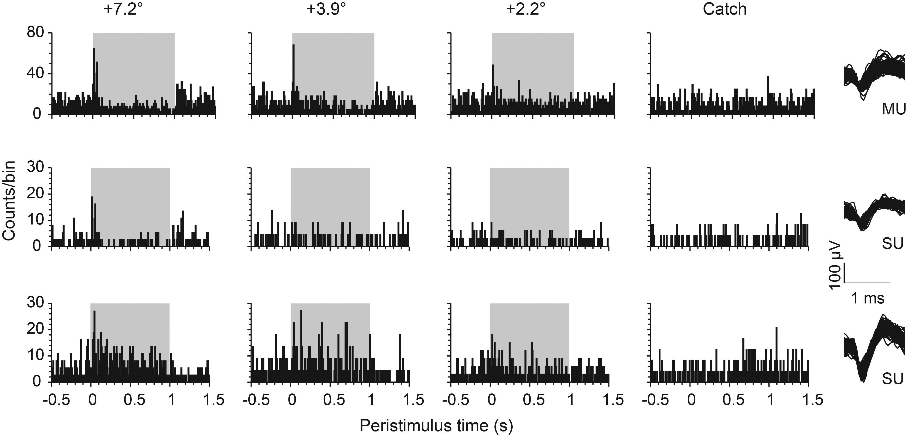
Figure 4. Example responses to DOC stimuli (Experiment 1b). PSTHs of representative barrel cortex units recorded from ...
Notes:
Figure 4. Example responses to DOC stimuli (Experiment 1b). PSTHs of representative barrel cortex units recorded from one animal in one session of Experiment 1b. Spike counts across time (bin width 10 ms) are plotted for 2 single units (SU) and 1 multiunit (MU) (the right column plots a random selection of 100 waveforms for each unit). The other columns plot the response to 3 different S+ amplitudes (label indicates the difference of S+ and S− pulse amplitudes) and the catch trials. The gray area represents the time of stimulus change (S+).
Unless provided in the caption above, the following copyright applies to the content of this slide: © The Author 2013. Published by Oxford University Press.This is an Open Access article distributed under the terms of the Creative Commons Attribution Non-Commercial License (http://creativecommons.org/licenses/by-nc/3.0/), which permits non-commercial re-use, distribution, and reproduction in any medium, provided the original work is properly cited. For commercial re-use, please contact journals.permissions@oup.com

Slide 5
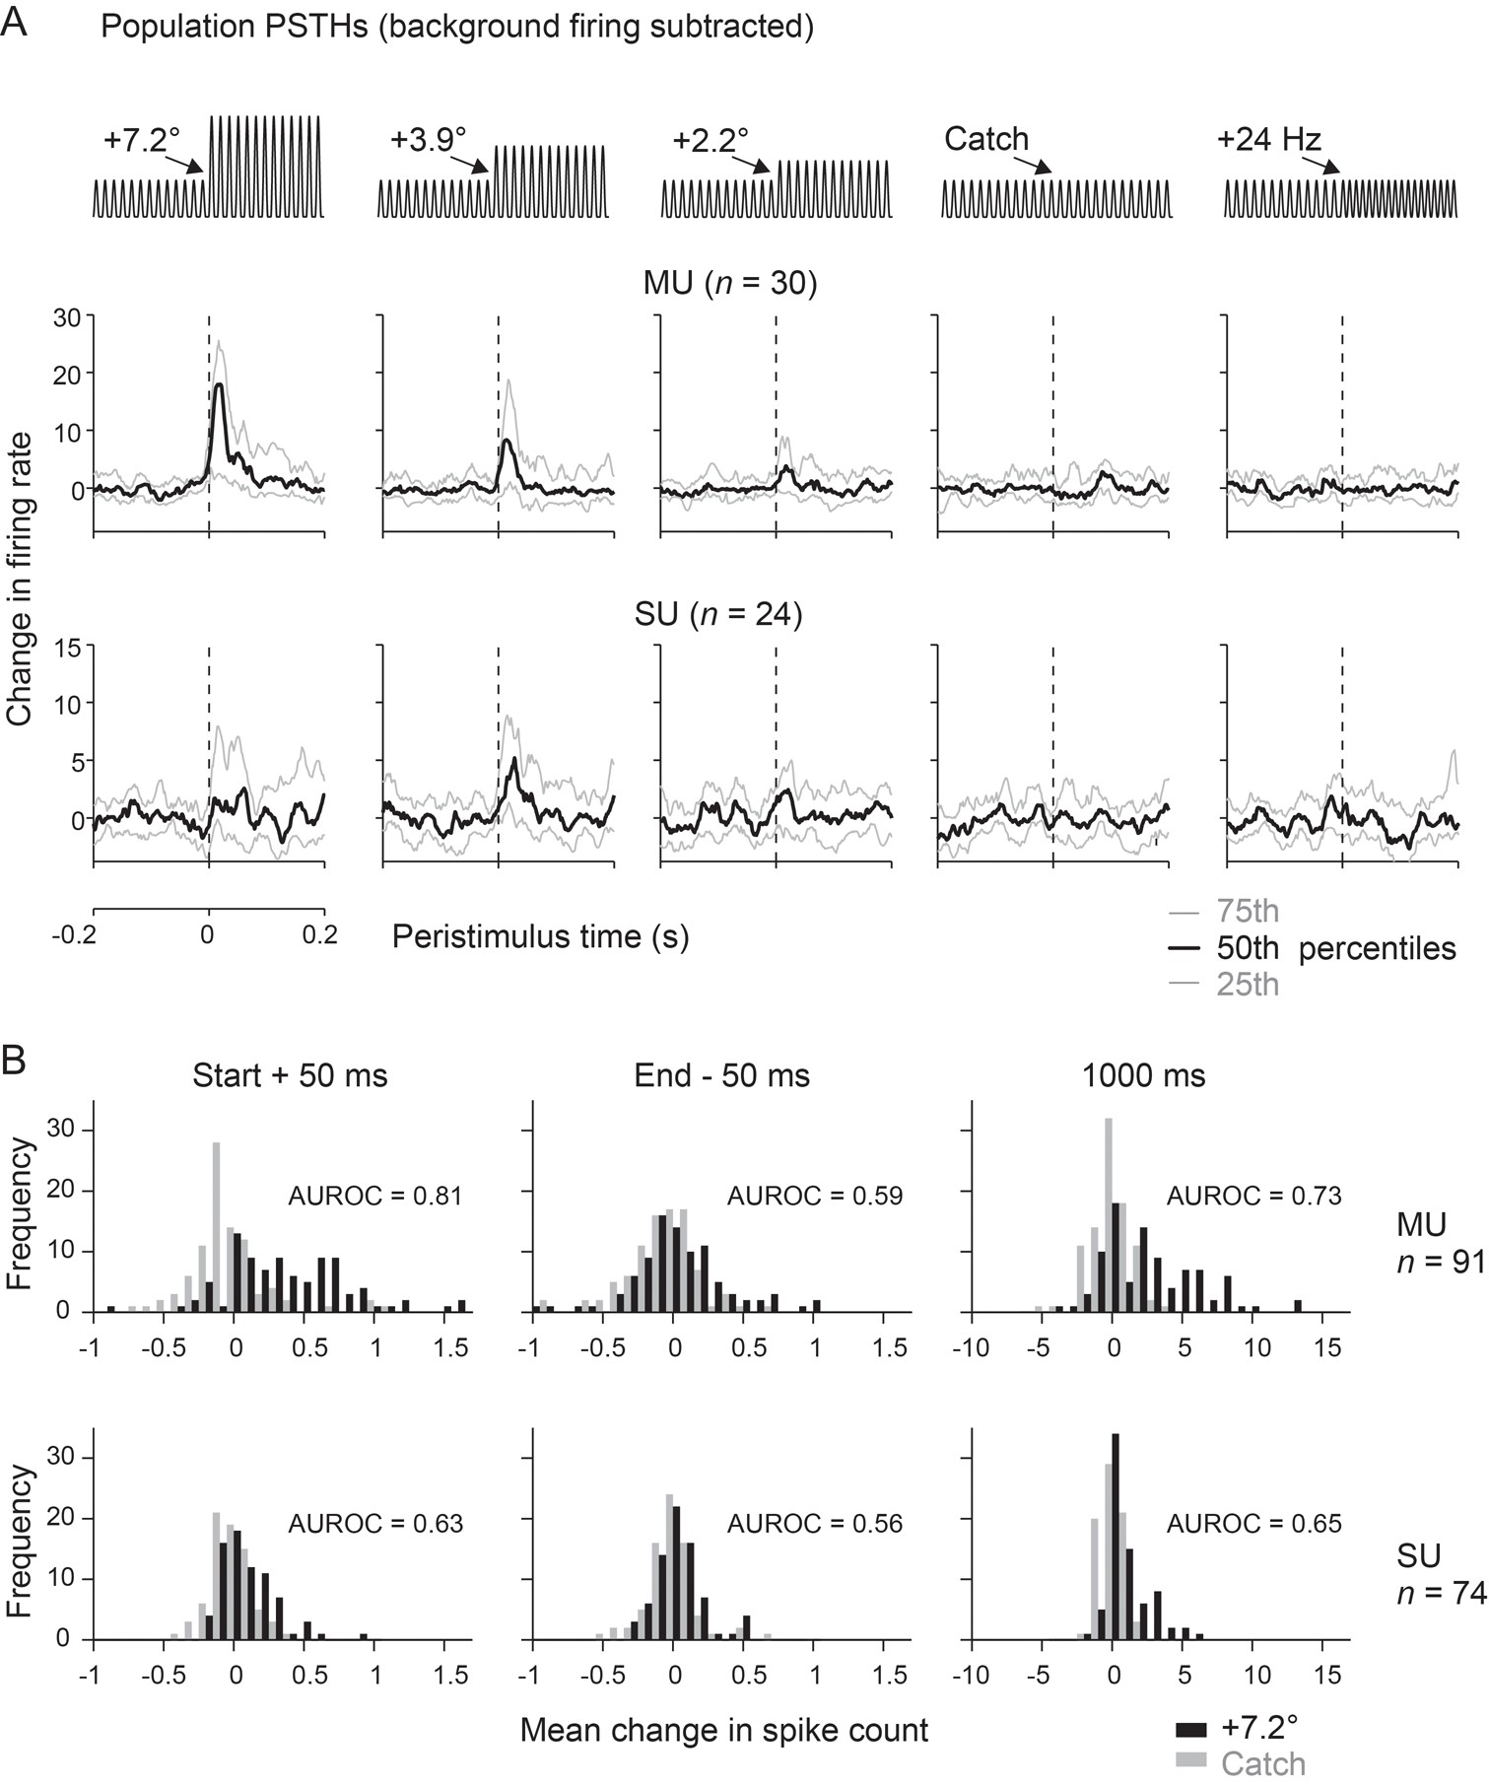
Figure 5. Population analyses of responses to DOC stimuli. (A) Distributions of evoked activity across time (bin width ...
Notes:
Figure 5. Population analyses of responses to DOC stimuli. (A) Distributions of evoked activity across time (bin width 1 ms) for the whole population of units (multiunits, n = 30; single units, n = 24) recorded in Experiment 1b. (Note that the ordinate scales responses as “changes of firing rate” because the sustained firing rate to the S− background stimulus has been subtracted). Each subplot shows the unitary responses to a different S+ stimulus or catch trial (schematized on top). The curves indicate the median (black) and the 75th (top) and 25th (bottom) percentile (gray). Note that the firing rate distributions labeled “+24 Hz” were the ones obtained with the extra stimuli of Experiment 1b, in which frequency was manipulated and waveform kept constant (cf. Fig. 2D). These responses, although obtained in Experiment 1b, in fact belong to the same category of stimuli as the ones used in Experiment 2a. (B) Distributions of neuronal activity evoked by the strongest amplitude change (7.2°, black bars) and catch trials (gray bars) as observed in Experiments 1a and b. The abscissa scales response as spike counts in 3 different intervals. Left: immediately after stimulus onset (0–50 ms peristimulus time). Center: before the stimulus offset (950–1000 ms peristimulus time). Right: the whole stimulus period (0–1000 ms peristimulus time). Multi- (MU, n = 91, top) and single-unit data (SU, n = 74, bottom) are shown.
Unless provided in the caption above, the following copyright applies to the content of this slide: © The Author 2013. Published by Oxford University Press.This is an Open Access article distributed under the terms of the Creative Commons Attribution Non-Commercial License (http://creativecommons.org/licenses/by-nc/3.0/), which permits non-commercial re-use, distribution, and reproduction in any medium, provided the original work is properly cited. For commercial re-use, please contact journals.permissions@oup.com

Slide 6
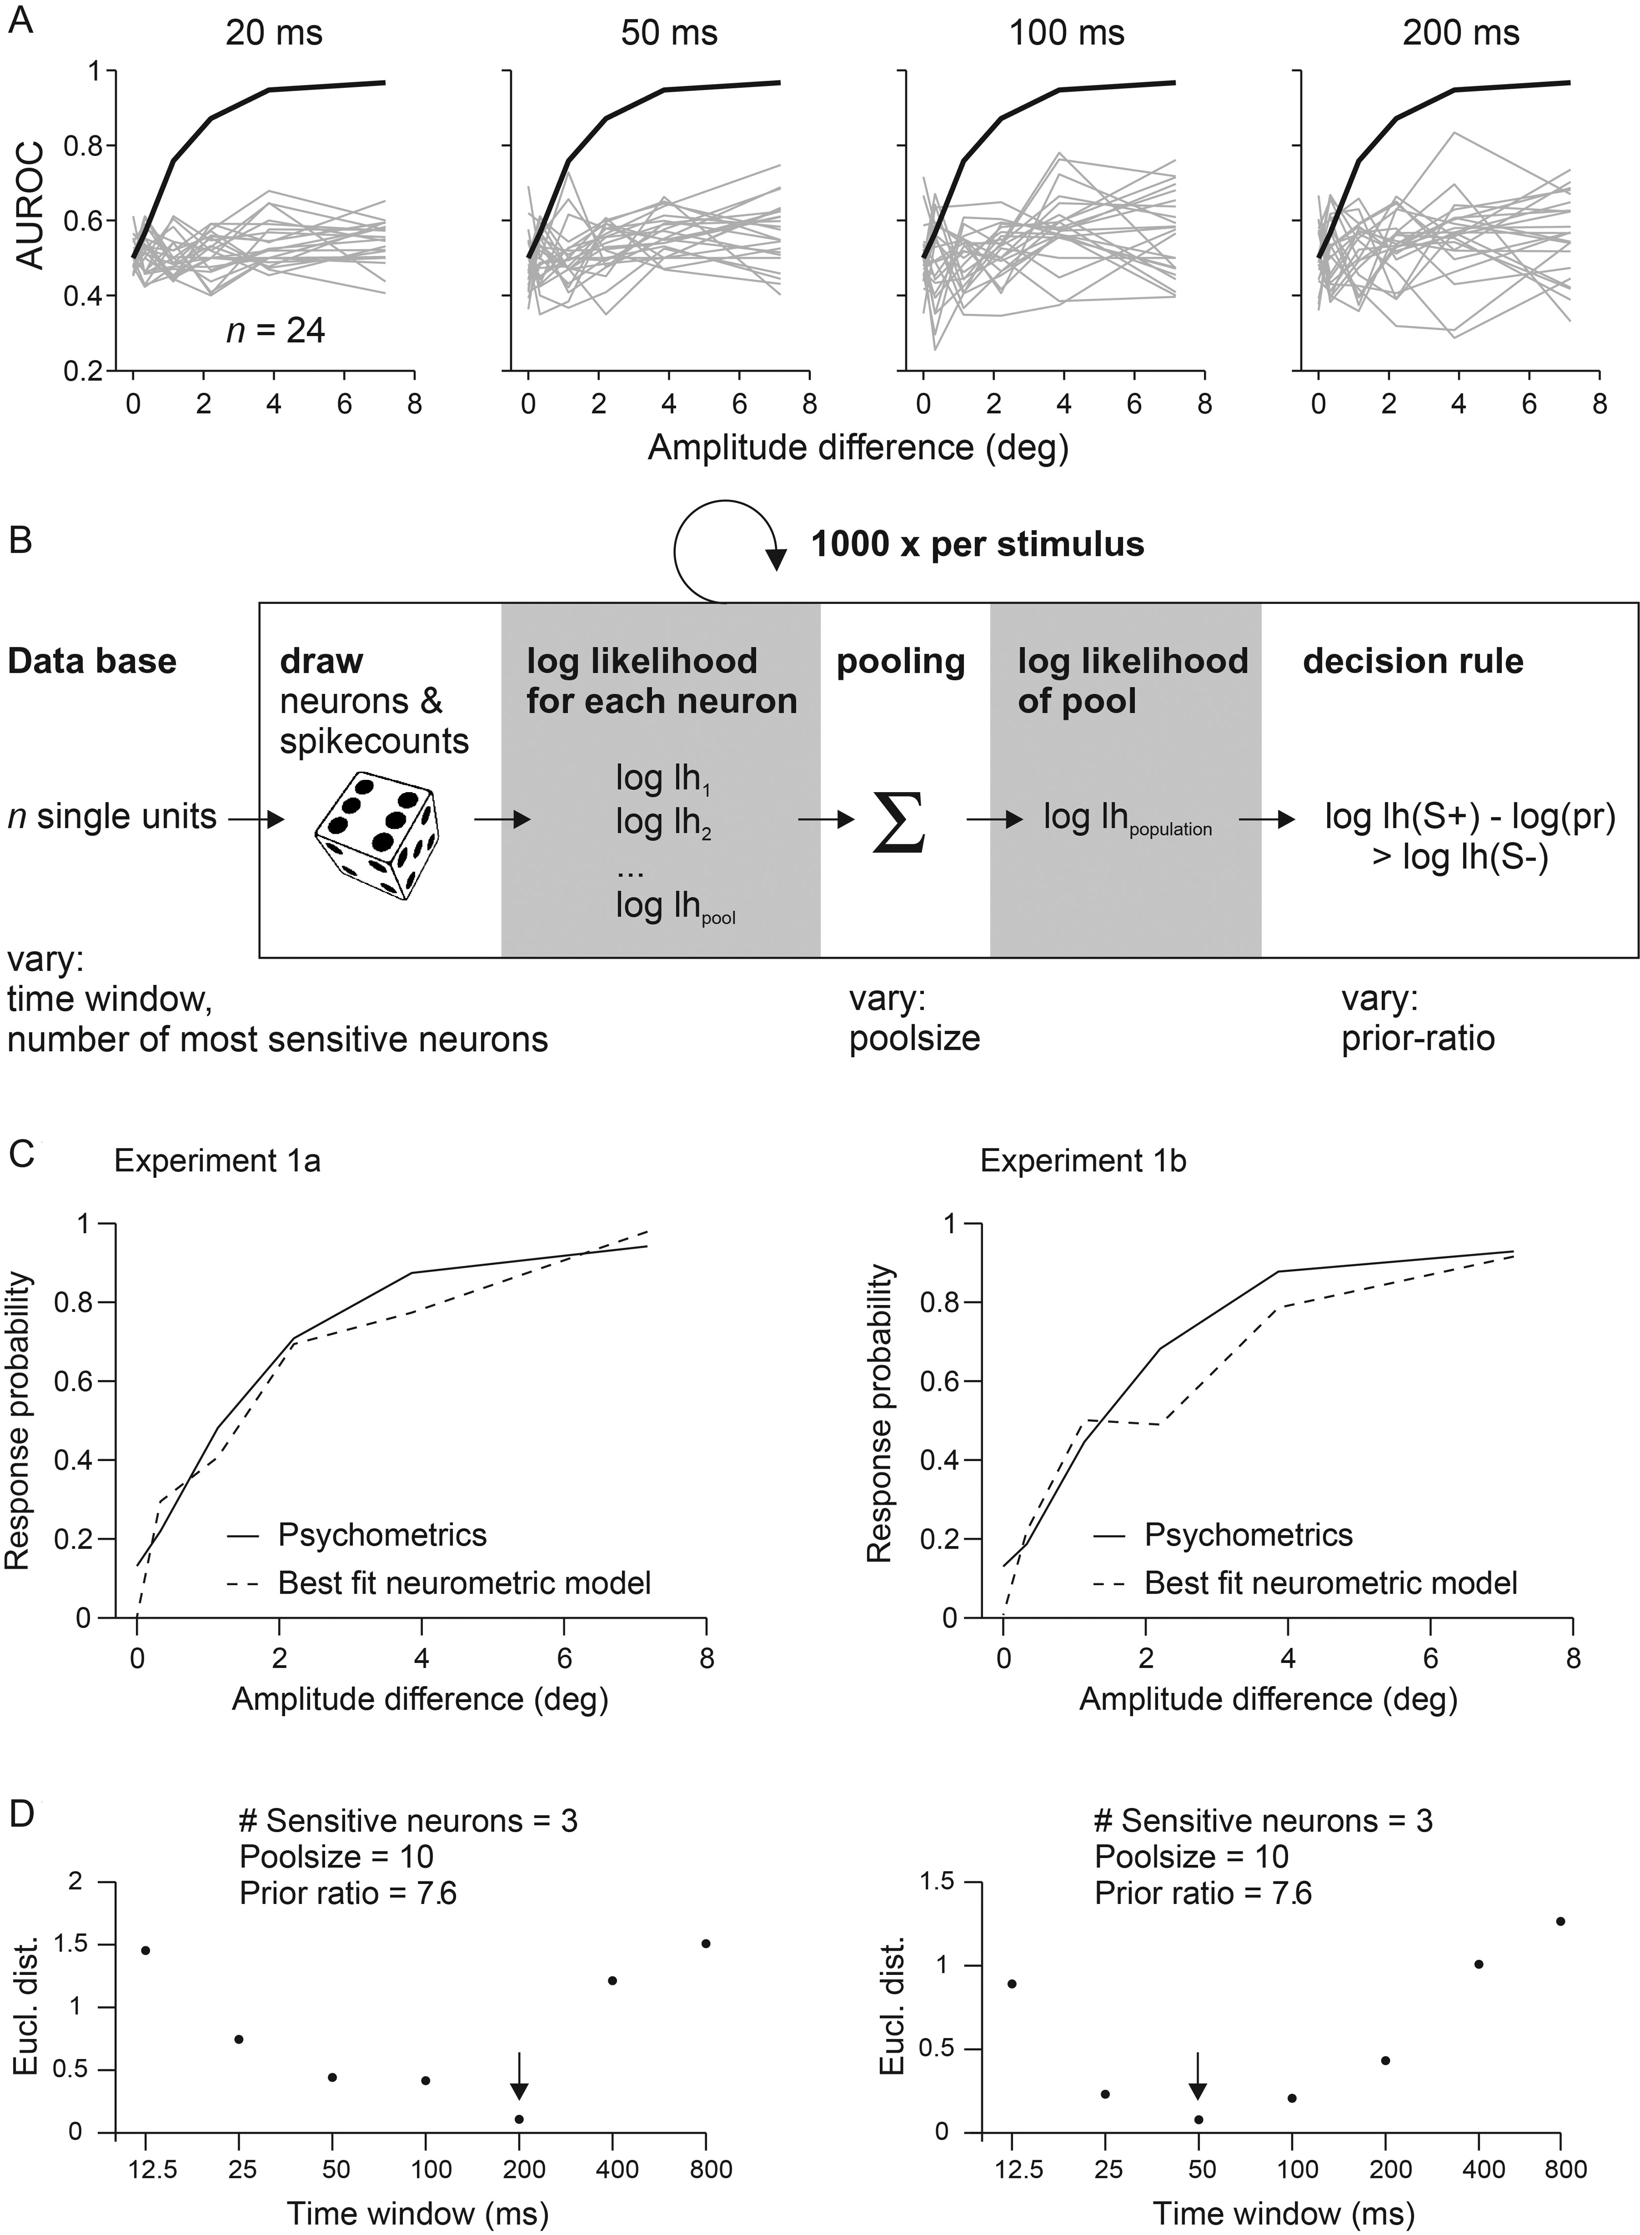
Figure 6. Quantitative comparison of neurometric and psychometric curves to estimate the optimal integration interval ...
Notes:
Figure 6. Quantitative comparison of neurometric and psychometric curves to estimate the optimal integration interval used to generate a percept. (A) Neurometric sensitivity of single neurons. The graphs show neuronal sensitivities based on spike count distributions observed within integration intervals of different durations starting at stimulus onset (top). The neurometric (gray lines) and psychometric (black line) sensitivities are plotted as the function of changes in stimulus amplitude (pairwise comparisons to catch trials) and are expressed as area under the ROC curve (AUROC). The psychometric sensitivity is calculated as the mean across 3 animals subjected to Experiment 1b. Single neuron’s activity cannot explain the animals' performance as none reached the psychometric sensitivity, irrespective of the integration interval used. (B) Performance of neuronal pools. A Monte Carlo procedure was used to fit the neurometric performance of a population of neurons to the psychometric performance. Random picks from the measured spike count distributions of pool neurons, were converted into log likelihood functions and summed up to yield the pooled log likelihood (lh) function and the pool's decision (eq. 5). Repeating the procedure 1000 times yielded the pool's response probability. Four variables were varied to find the best fit of the pool response to the psychometric performance: 1) the duration of the integration interval, 2) the number of neurons in the pool, 3) the number of sensitive neurons chosen for read-out, and 4) the prior belief of the animal. (C) Optimal model performance was assessed by calculating the Euclidean distance between the outcome of each combination of model variables and the psychometric performance in Experiments 1a and b. The best fits of pool neurometric sensitivity (broken lines) are plotted together with the average psychometric curve (solid lines) of the 3 rats. (D) Model performance as a function of the integration interval. The 3 other variables (listed on top) were fixed to their best fits, which were found consistently in Experiments 1a and b. Smallest Euclidean distances (Eucl. dist.) were found for intervals between 50 and 200 ms. The best fits are indicated by arrows. Note the log scale of the abscissae.
Unless provided in the caption above, the following copyright applies to the content of this slide: © The Author 2013. Published by Oxford University Press.This is an Open Access article distributed under the terms of the Creative Commons Attribution Non-Commercial License (http://creativecommons.org/licenses/by-nc/3.0/), which permits non-commercial re-use, distribution, and reproduction in any medium, provided the original work is properly cited. For commercial re-use, please contact journals.permissions@oup.com

