Slide 1
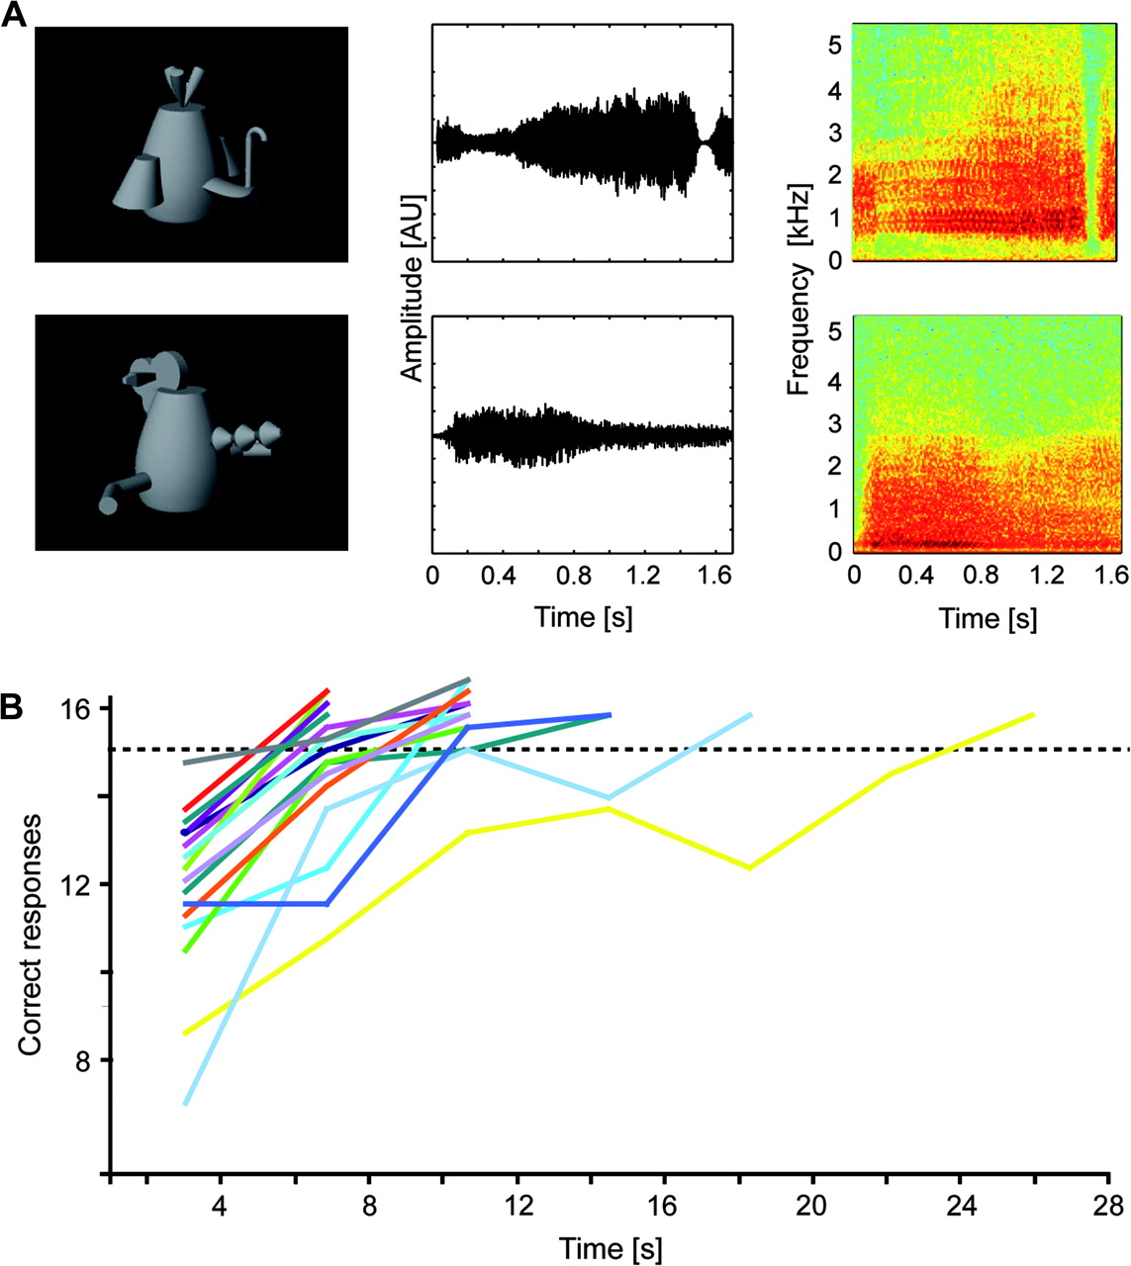
Figure 1. AV stimuli and behavioral data. (A) AV stimuli consisted of combinations of gray-scale photographs (left ...
Notes:
Figure 1. AV stimuli and behavioral data. (A) AV stimuli consisted of combinations of gray-scale photographs (left column) and complex sounds of both natural (i.e., animals) and artificial material (i.e., so-called “fribbles”). AV combinations could be either congruent, that is, corresponding to the learnt associations between the artificial visual and auditory stimuli (upper row in A) or incongruent (lower row in A). Middle and right columns provide the amplitude waveforms and spectrograms for typical exemplars of artificial sounds. (B) Behavioral training data of 17 subjects and interindividual differences in AV learning speed. The dashed horizontal line indicates the criterion of 15 (out of a maximum of 16) correct responses which had to be reached in 4 successive training blocks in order to terminate the training session. AU, arbitrary units.
Unless provided in the caption above, the following copyright applies to the content of this slide: © 2008 The AuthorsThis is an Open Access article distributed under the terms of the Creative Commons Attribution Non-Commercial License (http://creativecommons.org/licenses/by-nc/2.0/uk/) which permits unrestricted non-commercial use, distribution, and reproduction in any medium, provided the original work is properly cited.

Slide 2
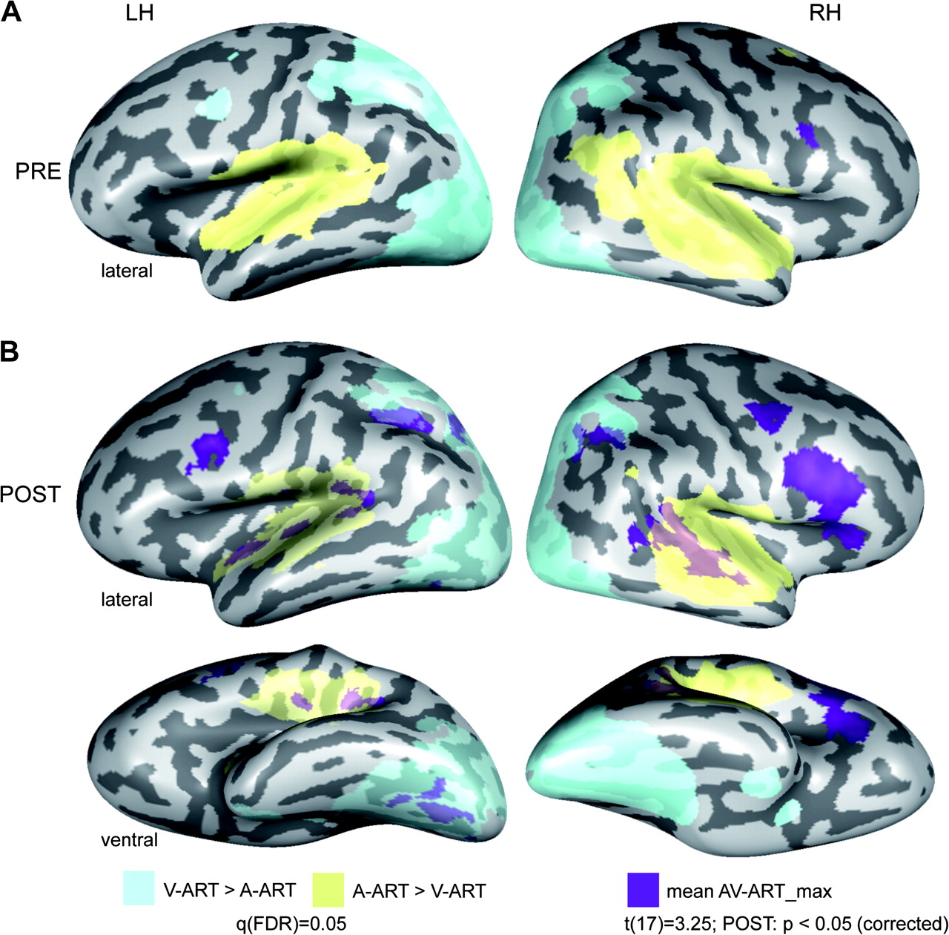
Figure 2. AV integration effects for artificial material. Cortical regions involved in AV integration of artificial ...
Notes:
Figure 2. AV integration effects for artificial material. Cortical regions involved in AV integration of artificial stimuli during the first (A) and the second (B) experimental session were determined by a conjunction analysis comparing the mean BOLD fMRI responses to both (congruent and incongruent) artificial AV conditions to each unimodal condition (MAX-criterion: AV-ART > max[A-ART,V-ART]). Similar to our previous study (Hein et al. 2007) the additional criteria A-ART > 0 and V-ART > 0 were added to this conjunction. Maps were then adjusted to an initial t-value of 3.25 and then submitted to a volume-based cluster-threshold algorithm yielding a new map thresholded at P V-ART (auditory; yellow) and V-ART > A-ART (visual; light blue) were computed and corrected based on the false-discovery rate (FDR) yielding a significance value of q(FDR) < 0.05. LH and RH denote the left and right hemispheres, respectively. PRE and POST refer to the first and second experimental session.
Unless provided in the caption above, the following copyright applies to the content of this slide: © 2008 The AuthorsThis is an Open Access article distributed under the terms of the Creative Commons Attribution Non-Commercial License (http://creativecommons.org/licenses/by-nc/2.0/uk/) which permits unrestricted non-commercial use, distribution, and reproduction in any medium, provided the original work is properly cited.

Slide 3
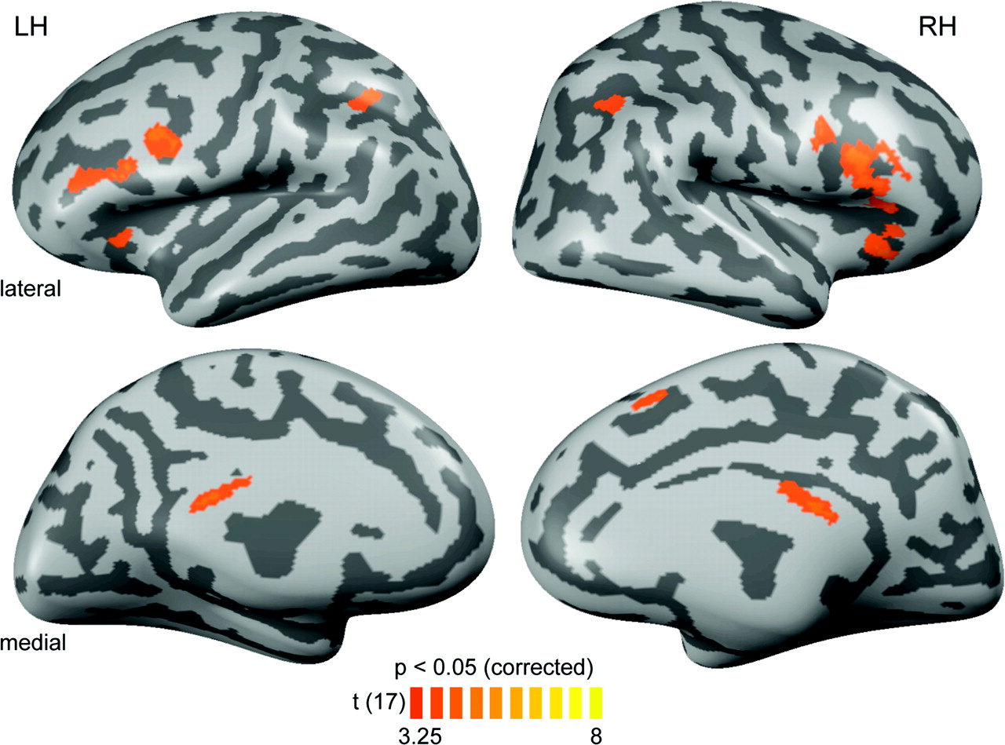
Figure 3. PRE–POST comparison. Results of a contrast investigating effects from the first (PRE) to the second (POST) ...
Notes:
Figure 3. PRE–POST comparison. Results of a contrast investigating effects from the first (PRE) to the second (POST) fMRI session on the basis of beta weights from a whole-brain RFX GLM across both data sets. A conjunction analysis required both significantly stronger responses to bimodal artificial AV conditions compared with both unimodal conditions (A-ART and V-ART) as well as stronger responses to bimodal artificial conditions during the POST versus the PRE session (AV-ART-POST > PRE). Maps were adjusted to an initial t-value of 3.25 and a volume-based cluster-size threshold of 189 voxels (see Fig. 2), resulting in a new map thresholded at P < 0.05 (corrected). These corrected maps were then projected onto inflated reconstructions of both cortical hemispheres of the same subject as in Figure 2. See Table 1B for Talairach coordinates and extents of cortical clusters depicted here.
Unless provided in the caption above, the following copyright applies to the content of this slide: © 2008 The AuthorsThis is an Open Access article distributed under the terms of the Creative Commons Attribution Non-Commercial License (http://creativecommons.org/licenses/by-nc/2.0/uk/) which permits unrestricted non-commercial use, distribution, and reproduction in any medium, provided the original work is properly cited.

Slide 4
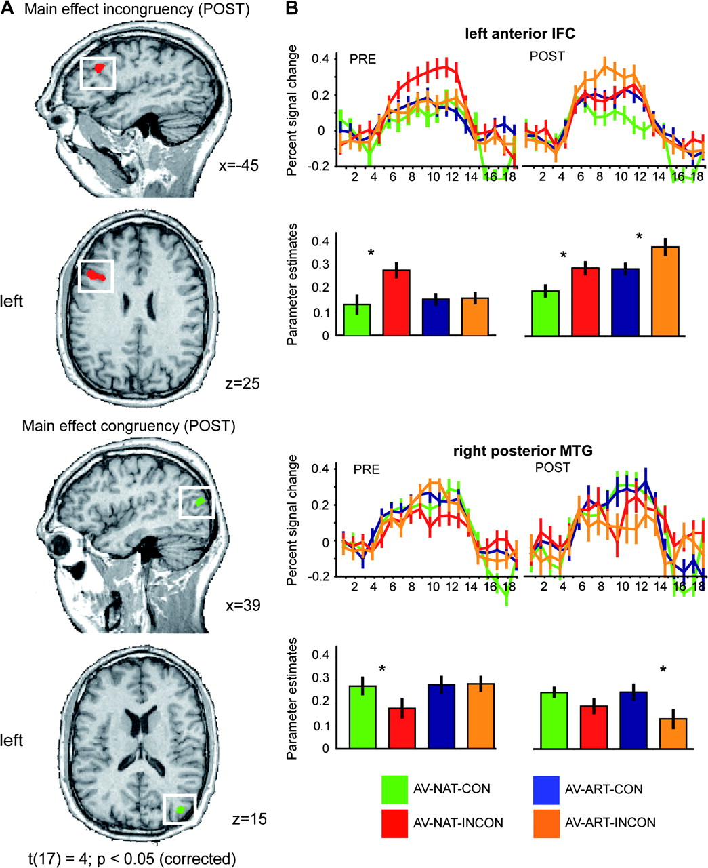
Figure 4. POST-training main effects of incongruency and congruency. Beta weights from the whole-brain RFX GLM of the ...
Notes:
Figure 4. POST-training main effects of incongruency and congruency. Beta weights from the whole-brain RFX GLM of the POST-training session were entered into a 2-factorial ANOVA with the factors stimulus type (NAT, ART) and congruency (CON, INCON). In this model we specified a contrast corresponding to the main effect of congruency because the latter optimally captured the assumed development of congruency and incongruency for artificial AV material in those cortical regions which were similarly sensitive to congruency in natural AV stimuli. (A) Results of the contrasts are shown in the left panel in the direction of incongruency (INCON > CON) and congruency (CON > INCON). Maps were adjusted to an initial t-value of 4 and then submitted to a volume-based cluster-threshold algorithm yielding a new map thresholded at P AV-NAT-CON) were calculated in separate RFX GLMs for both types of stimulus material and for both sessions. Time course information and beta estimate plots are provided for these 2 regions. Error bars represent mean standard errors. Asterisks denote significant effects on a level of P < 0.05. Color coding is provided at the bottom of the figure. Additional statistical information can be found in Table 2.
Unless provided in the caption above, the following copyright applies to the content of this slide: © 2008 The AuthorsThis is an Open Access article distributed under the terms of the Creative Commons Attribution Non-Commercial License (http://creativecommons.org/licenses/by-nc/2.0/uk/) which permits unrestricted non-commercial use, distribution, and reproduction in any medium, provided the original work is properly cited.

Slide 5
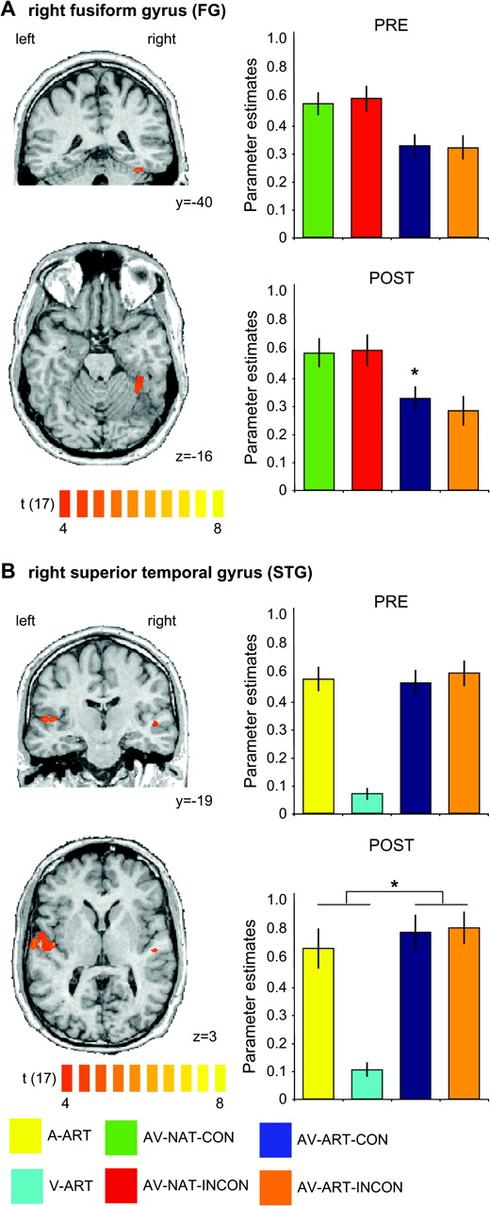
Figure 5. Unimodally defined ROIs: training-induced congruency and multisensory integration effects. Significant voxels ...
Notes:
Figure 5. Unimodally defined ROIs: training-induced congruency and multisensory integration effects. Significant voxels are depicted for unimodal visual (A) and auditory (B) contrasts directly comparing stimulations with natural objects to those with artificial material in the POST fMRI session (i.e., V-NAT > V-ART (POST) and A-NAT > A-ART (POST), respectively). Maps were adjusted to an initial t-value of 4 and then submitted to a volume-based cluster-threshold algorithm yielding a new map thresholded at P < 0.05 (corrected) for the visual (minimum cluster threshold: 271 voxels) and the auditory (minimum cluster threshold: 136 voxels) contrasts, respectively. The panels on the left show coronal (upper rows in A and B) and transversal slices (lower rows in A and B) of the same anatomical dataset used in Figure 4. The same ROI-based analysis as described in Figure 4 was applied to the right FG (A) for all bimodal conditions and for both fMRI sessions. A similar ROI-based analysis was applied to the region in right STG (B), revealing a training-induced AV integration effect (0 < A V > 0) for artificial material. Error bars of the beta estimate plots represent mean standard errors. Asterisks denote significant effects on a level of P < 0.05. Color coding is provided at the bottom of the figure. Additional statistical information for the FG ROI can be found in Table 2.
Unless provided in the caption above, the following copyright applies to the content of this slide: © 2008 The AuthorsThis is an Open Access article distributed under the terms of the Creative Commons Attribution Non-Commercial License (http://creativecommons.org/licenses/by-nc/2.0/uk/) which permits unrestricted non-commercial use, distribution, and reproduction in any medium, provided the original work is properly cited.

Slide 6
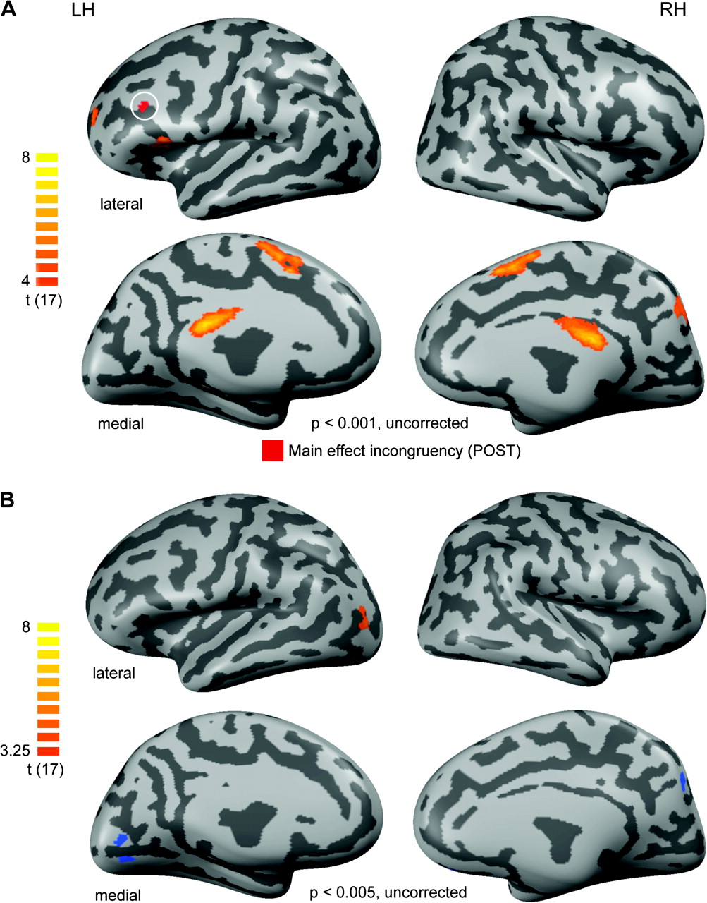
Figure 6. Repetition-related PRE–POST effects. (A) To control for repetition-related effects we contrasted the ...
Notes:
Figure 6. Repetition-related PRE–POST effects. (A) To control for repetition-related effects we contrasted the experimental condition which is arguably most likely to be affected by such effects (AV-ART-CON [POST]) with the experimental condition least likely to be affected by this (AV-ART-INCON [PRE]). Only positive effects (signal increases from PRE to POST) were significant at the chosen threshold. These are shown in an orange-to-yellow color code. Maps are thresholded to a t-value of 4 (uncorrected for multiple comparisons) to increase the sensitivity for potential repetition-related effects and were then projected onto the same cortex reconstructions used in Figure 2 shown in lateral (upper panels) and medial (lower panels) views. Only a minimal surface-based cluster threshold of 25 mm2 was applied. Additionally, the main effect of incongruency as described in Figure 4 is shown (in red and highlighted by a white circle) to evaluate a potential frontal overlap of these maps. LH and RH denote the left and right hemispheres, respectively. (B) To control for stimulus-specific repetition effects we additionally contrasted the unlearned, but also repeated experimental condition comprised of natural AV stimuli. The corresponding contrast can be stated as follows: AV-NAT-CON (POST) > AV-NAT-CON (PRE). Because no effects were present on a statistical t-value of 4, we lowered the threshold to an uncorrected t-value of 3.25. The same anatomical basis as in the previous figures was used for the projection of results.
Unless provided in the caption above, the following copyright applies to the content of this slide: © 2008 The AuthorsThis is an Open Access article distributed under the terms of the Creative Commons Attribution Non-Commercial License (http://creativecommons.org/licenses/by-nc/2.0/uk/) which permits unrestricted non-commercial use, distribution, and reproduction in any medium, provided the original work is properly cited.

