Slide 1
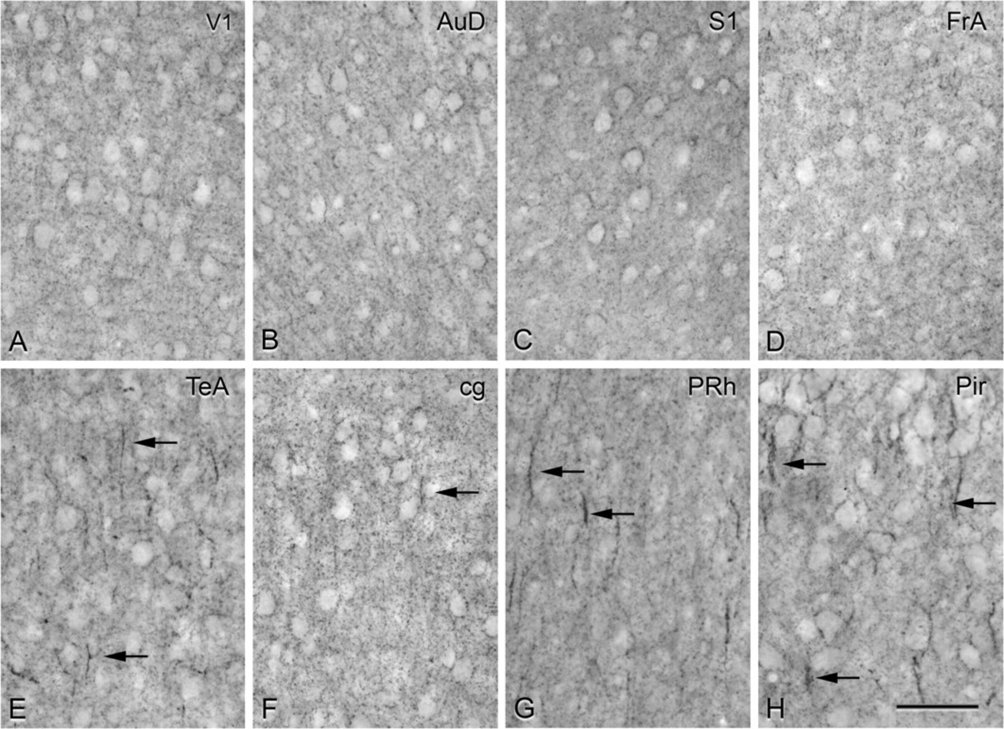
Figure 1. (A–H) Low power photomicrographs from GAT-1-immunostained sections showing the pattern of GAT-1 ...
Notes:
Figure 1. (A–H) Low power photomicrographs from GAT-1-immunostained sections showing the pattern of GAT-1 immunostaining in layers II and III of different regions of the mouse cerebral cortex. In (A–D), note the distribution of GAT-ir perisomatic boutons and the lack of complex Ch terminals in the primary visual (V1), secondary dorsal auditory (AuD), primary somatosensory (S1), and frontal associative (FrA) cortical areas, respectively. (E, F) show the presence of complex GAT-ir Ch-terminals (arrows) in the temporal associative (TeA) and anterior cingulate (cg) neocortical areas, and in the perirhinal cortex (PRh) and piriform cortex (Pir), respectively. Scale bar: 50 μm.
Unless provided in the caption above, the following copyright applies to the content of this slide: © The Author 2008. Published by Oxford University Press. All rights reserved. For permissions, please e-mail: journals.permissions@oxfordjournals.org

Slide 2
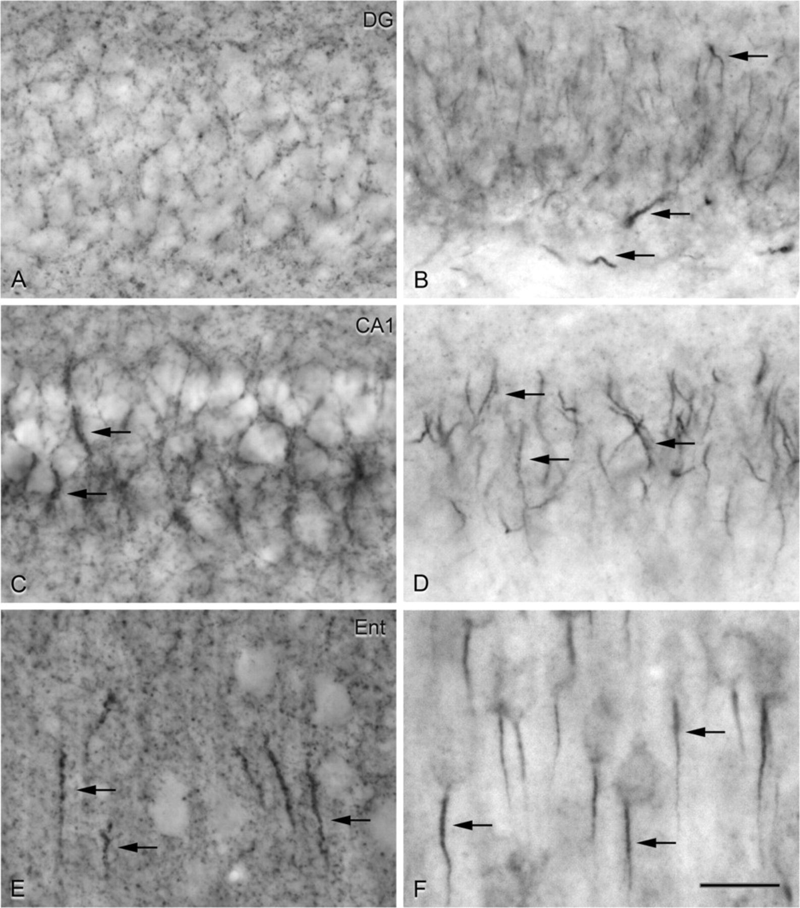
Figure 2. Photomicrographs from adjacent GAT-1-immunostained (A, C, and E) and pIκBα-immunostained (B, D, and F) ...
Notes:
Figure 2. Photomicrographs from adjacent GAT-1-immunostained (A, C, and E) and pIκBα-immunostained (B, D, and F) sections showing the distribution of GAT-ir perisomatic boutons and complex Ch-terminals (arrows in A, C, and E) and pIkBα-ir AIS (arrows in B, D, and F) in derivatives of the medial pallium, including the granule cell layer of the dentate gyrus (A, B), the pyramidal layer of CA1 (C, D), and the entorhinal cortex (E, F). Note the abundance of complex Ch-terminals and the intensity of the GAT-1 immunostaining in the CA1 and entorhinal cortex. Scale bar: 20 μm.
Unless provided in the caption above, the following copyright applies to the content of this slide: © The Author 2008. Published by Oxford University Press. All rights reserved. For permissions, please e-mail: journals.permissions@oxfordjournals.org

Slide 3
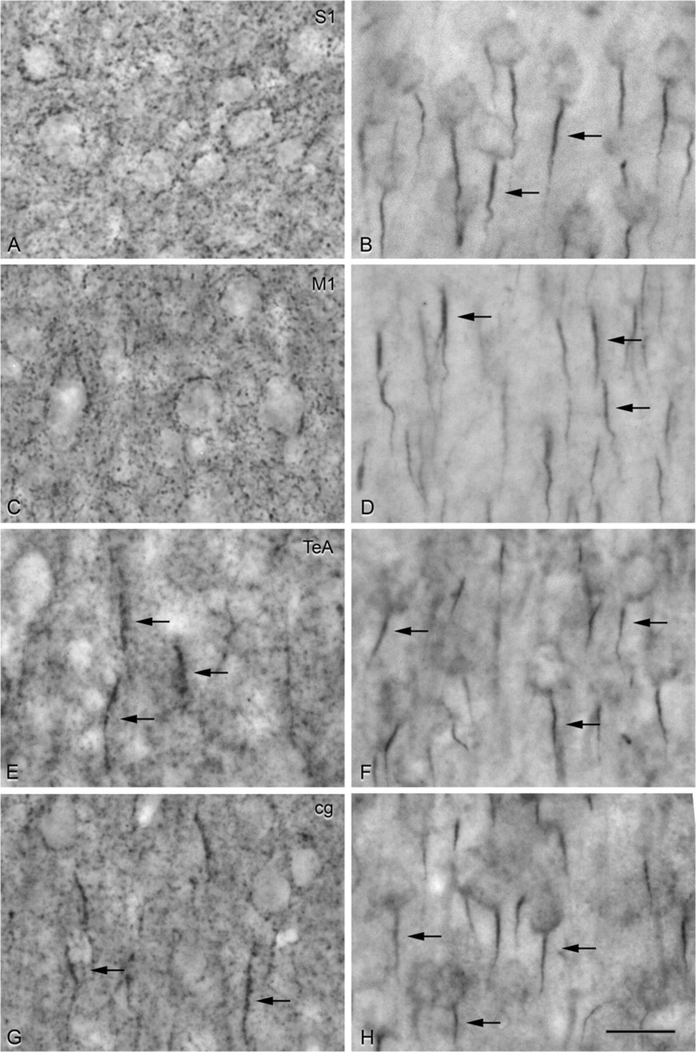
Figure 3. Photomicrographs from adjacent GAT-1-immunostained (A, C, E, and G) and pIκBα-immunostained (B, D, F, and H) ...
Notes:
Figure 3. Photomicrographs from adjacent GAT-1-immunostained (A, C, E, and G) and pIκBα-immunostained (B, D, F, and H) sections taken from the dorsal pallium derived neocortical areas including the primary somatosensory (A, B), primary motor (C, D), temporal associative (E, F), and anterior cingulate (G, H) areas. Note that despite the presence of abundant and radially oriented pIkBα-ir AIS (arrows in B, D, F, and H) and GAT-ir perisomatic boutons in all areas, complex GAT-ir Ch-terminals are absent in sensory (A) and motor (C) areas. In contrast, complex GAT-ir Ch-terminals are present in infragranular layers of temporal associative (E) and supragranular layers of anterior cingulate (G) cortices. Scale bar: 20 μm.
Unless provided in the caption above, the following copyright applies to the content of this slide: © The Author 2008. Published by Oxford University Press. All rights reserved. For permissions, please e-mail: journals.permissions@oxfordjournals.org

Slide 4
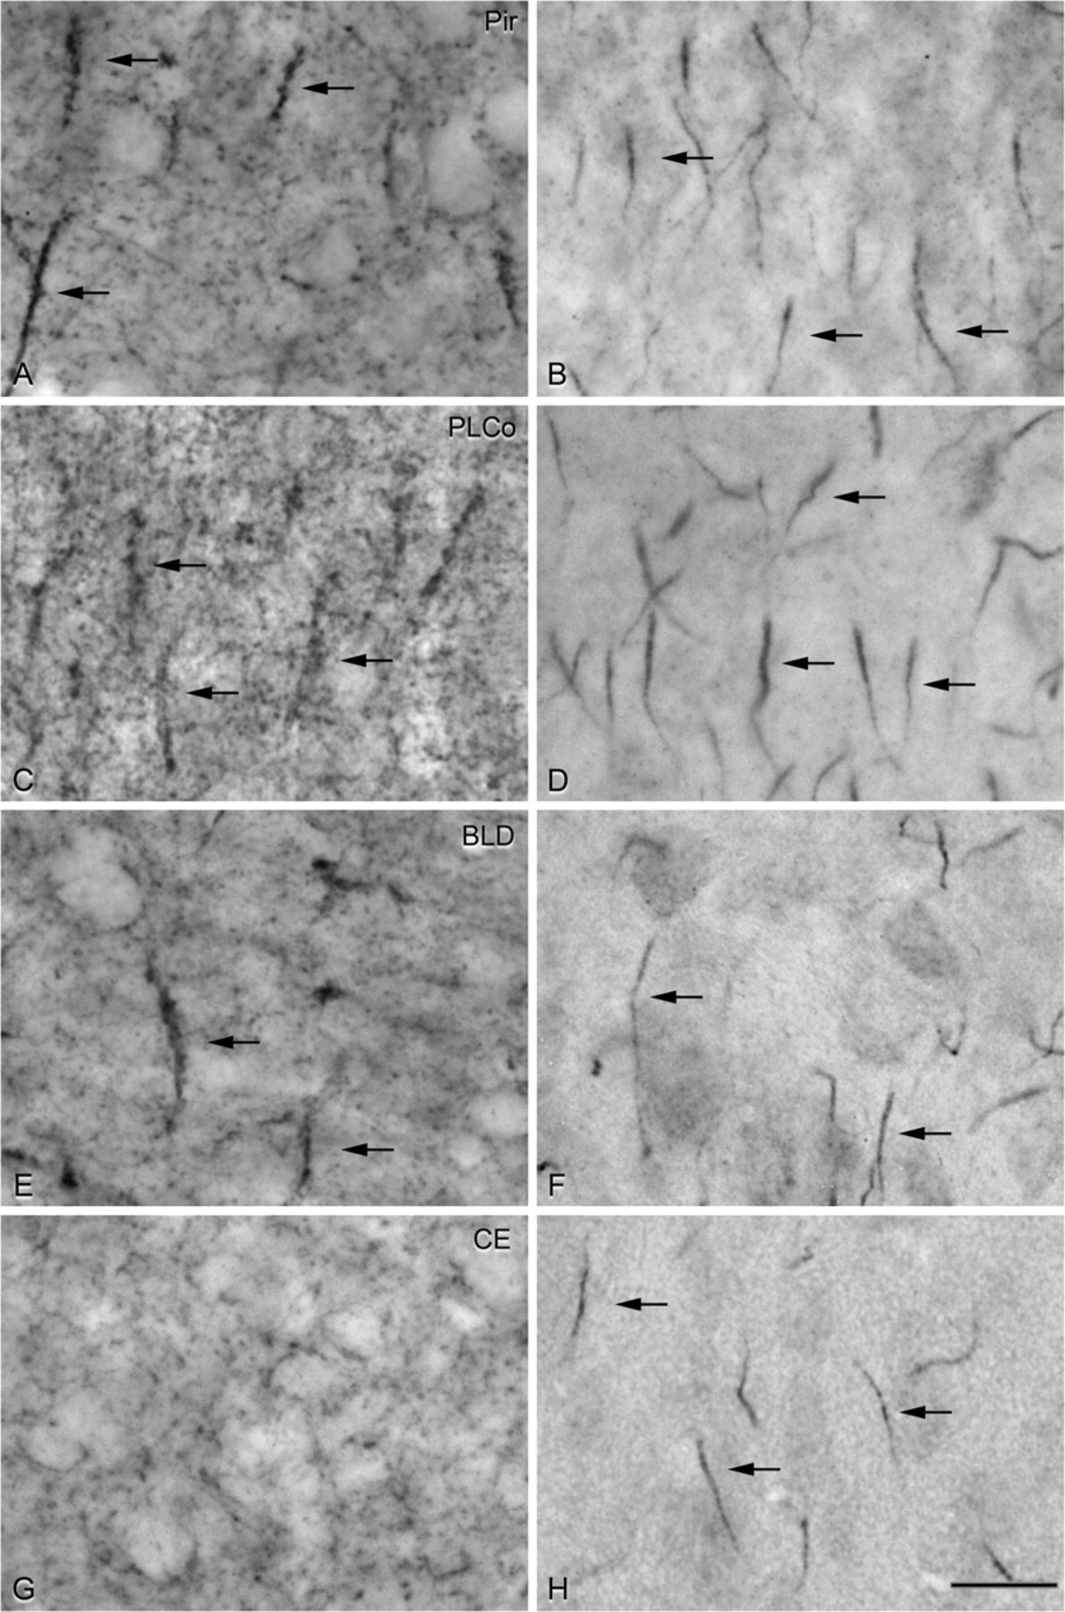
Figure 4. Photomicrographs from adjacent GAT-1-immunostained (A, C, E, and G) and pIκBα-immunostained (B, D, F, and H) ...
Notes:
Figure 4. Photomicrographs from adjacent GAT-1-immunostained (A, C, E, and G) and pIκBα-immunostained (B, D, F, and H) sections from the piriform cortex (A and B) and from different regions of the amygdala (C–H). In the piriform cortex, large and intensely labeled complex GAT-ir Ch-terminals (arrows in A) are present in layers II and III in parallel with the distribution of pIkBα-ir AIS (arrows in B). In the amygdala, note that complex GAT-1-ir Ch-terminals are distributed in structures derived from the lateral and ventral pallium, shown in (C) and (E) (arrows) for the cortical amygdala (posterolateral part, PLCo) and the basolateral nucleus (BLD). In contrast, only GAT-ir perisomatic boutons and no complex GAT-ir Ch-terminals are present in those structures of the amygdala derived from the subpallium, as shown in (G) for the central nucleus. Scale bar: 20 μm.
Unless provided in the caption above, the following copyright applies to the content of this slide: © The Author 2008. Published by Oxford University Press. All rights reserved. For permissions, please e-mail: journals.permissions@oxfordjournals.org

Slide 5
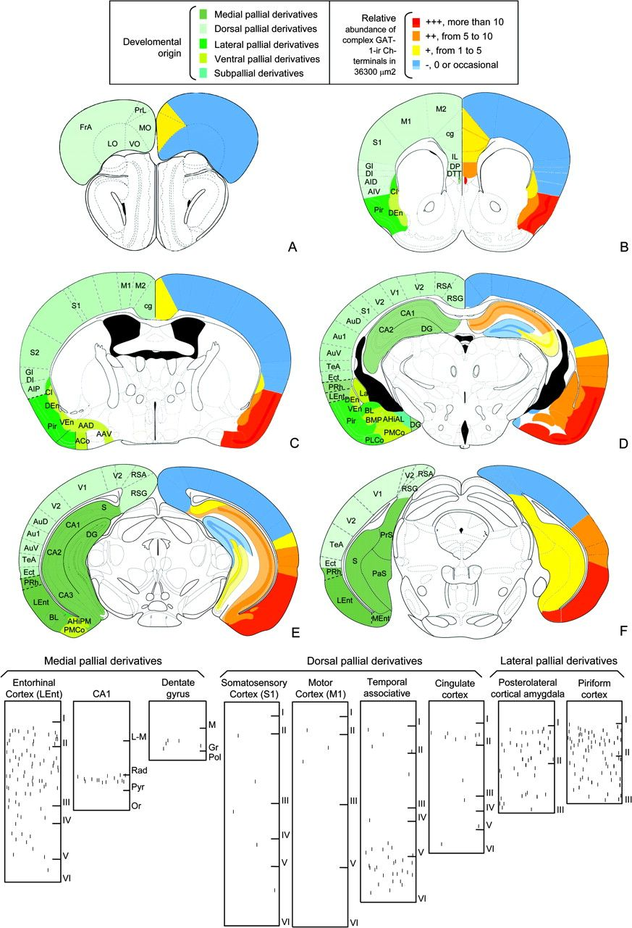
Figure 5. (A–F) Drawings summarizing (based on the atlas of the mouse brain by Paxinos and Franklin 2001) a series of ...
Notes:
Figure 5. (A–F) Drawings summarizing (based on the atlas of the mouse brain by Paxinos and Franklin 2001) a series of rostrocaudal transverse sections (A–F) through the brain of the mouse showing in colors the structures of different pallial developmental origin (left side) and the density of complex GAT-1-ir Ch-terminals (right side). Bottom: Drawings (Neurolucida plots) summarizing the laminar patterns of GAT-1-ir Ch-terminals in structures of the mouse telencephalon derived from the medial, dorsal, and lateral pallium. Note the scarcity of GAT-1-ir Ch-terminals in most neocortical (dorsal pallial) areas, especially in the primary sensory and motor areas when compared with lateral pallial derivates and the entorhinal cortex.
Unless provided in the caption above, the following copyright applies to the content of this slide: © The Author 2008. Published by Oxford University Press. All rights reserved. For permissions, please e-mail: journals.permissions@oxfordjournals.org

Slide 6
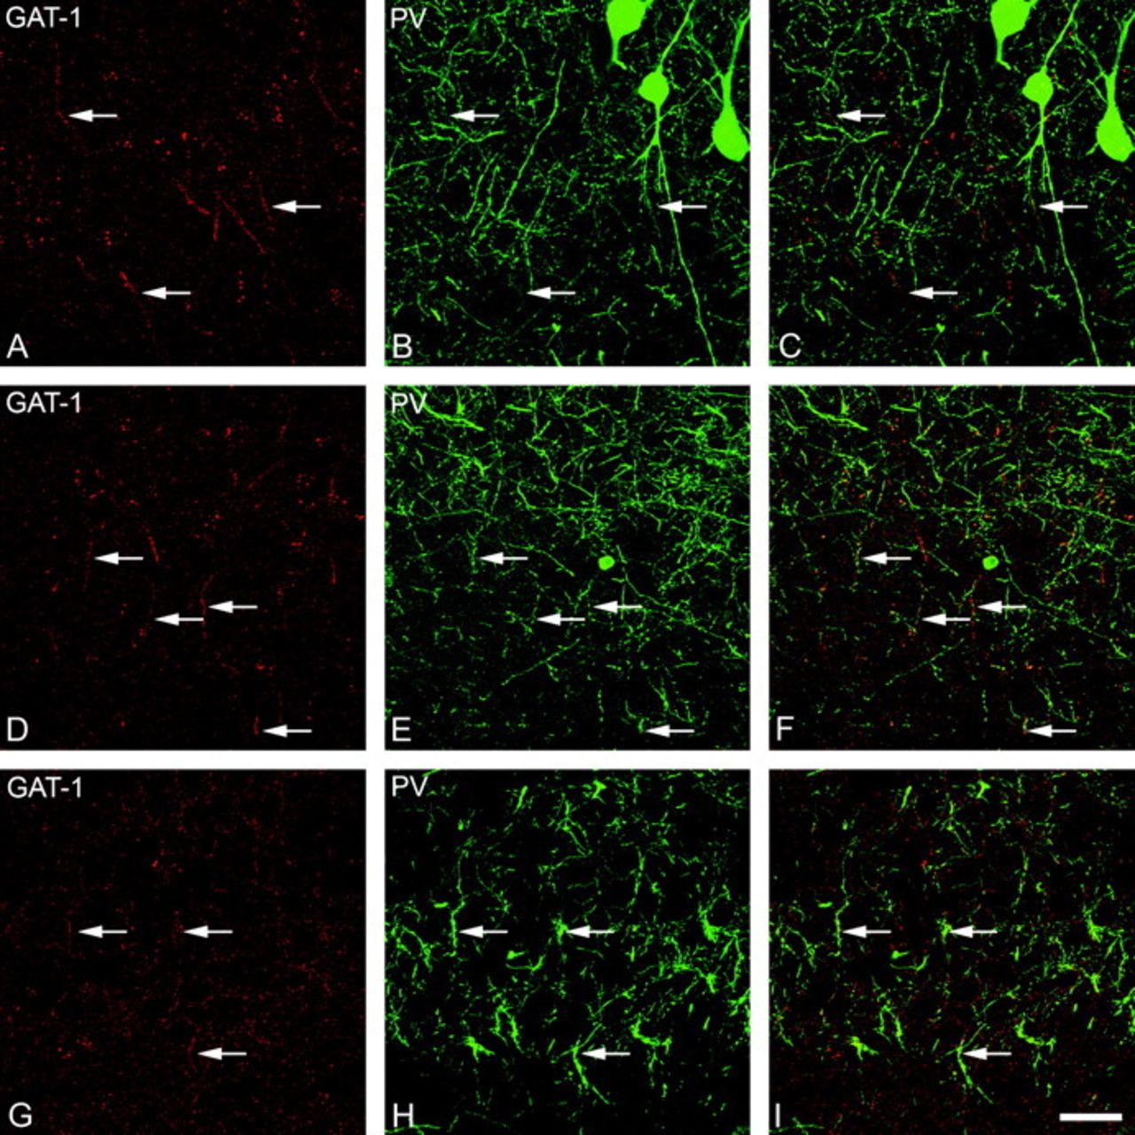
Figure 6. Pairs of confocal images from the same section and field showing the colocalization of GAT-1 (red) and PV ...
Notes:
Figure 6. Pairs of confocal images from the same section and field showing the colocalization of GAT-1 (red) and PV (green) immunostaining in complex Ch terminals (arrows) in the piriform cortex (A, B), enthorinal cortex (D, E), and CA3 field of the hippocampus (G, H). (C, F, and I) were obtained by combining images (A) and (B), (D) and (E), and (G) and (H), respectively. (A–C) represent stacks of 9 optical sections obtained at steps of 0,5 μm in the z-axis (total 4 μm). (D–F) represent stacks of 10 optical sections obtained at steps of 0,5 μm in the z-axis (total 4,5 μm). (G–I) represent stacks of 7 optical sections obtained at steps of 0,32 μm in the z-axis (total 1,9 μm). Scale bar: 30 μm in (A–C), 36 μm in (D–F) and 33 μm in (G–I).
Unless provided in the caption above, the following copyright applies to the content of this slide: © The Author 2008. Published by Oxford University Press. All rights reserved. For permissions, please e-mail: journals.permissions@oxfordjournals.org

Slide 7
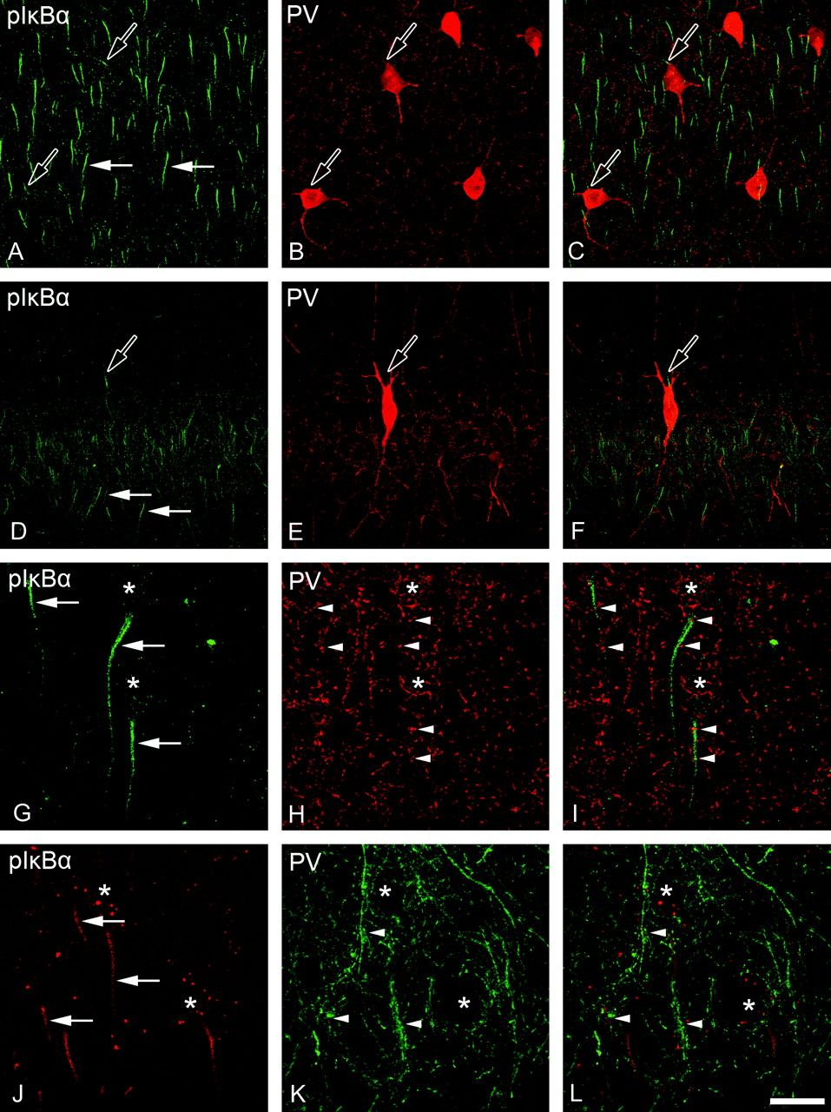
Figure 7. Pairs of confocal images from the same section and field showing the relationship between pIκBα ...
Notes:
Figure 7. Pairs of confocal images from the same section and field showing the relationship between pIκBα immunostaining in the AIS (arrows) and PV-ir GABAergic innervation in somatosensory (A–C), visual (G–I), temporal associative (J–L) neocortical areas, and in the CA1 region of the hippocampus (D–F). (C, F, I, and L) were obtained by combining images (A and B), (D and E), (G and H), and (J and K), respectively. Note that in sensory areas, including the visual cortex (G–I), only a small number of PV-positive boutons (arrowheads in G–I) contact the AIS from pyramidal cells, and they do not form complex Ch-terminals. In contrast, pIκBα-ir AISs of pyramidal cells in other areas are innervated by a large number of PV-positive boutons that form complex Ch-terminals, even in the temporal associative cortex (G–I) and especially at the distal aspect. Asterisks in (G–L) indicate the location of pyramidal cell bodies. Note that in addition to the AISs from pyramidal cells, pIkBα-ir is also present in the AISs from PV-ir interneurons (hollow arrows in A–F). (A–C) represent stacks of 12 optical sections obtained at steps of 1 μm in the z-axis (total 11 μm). (D–F) represent stacks of 11 optical sections obtained at steps of 1 μm in the z-axis (total 10 μm). (G–I) represent stacks of 17 optical sections obtained at steps of 0,5 μm in the z-axis (total 7,5 μm). Images (J–L) represent stacks of 11 optical sections obtained at steps of 0,5 μm in the z-axis (total 5 μm) Scale bar: 33 μm in (A–C), 43 μm in (D–F), 17 μm in (G–I), and 16 μm in (J–L).
Unless provided in the caption above, the following copyright applies to the content of this slide: © The Author 2008. Published by Oxford University Press. All rights reserved. For permissions, please e-mail: journals.permissions@oxfordjournals.org

