Slide 1
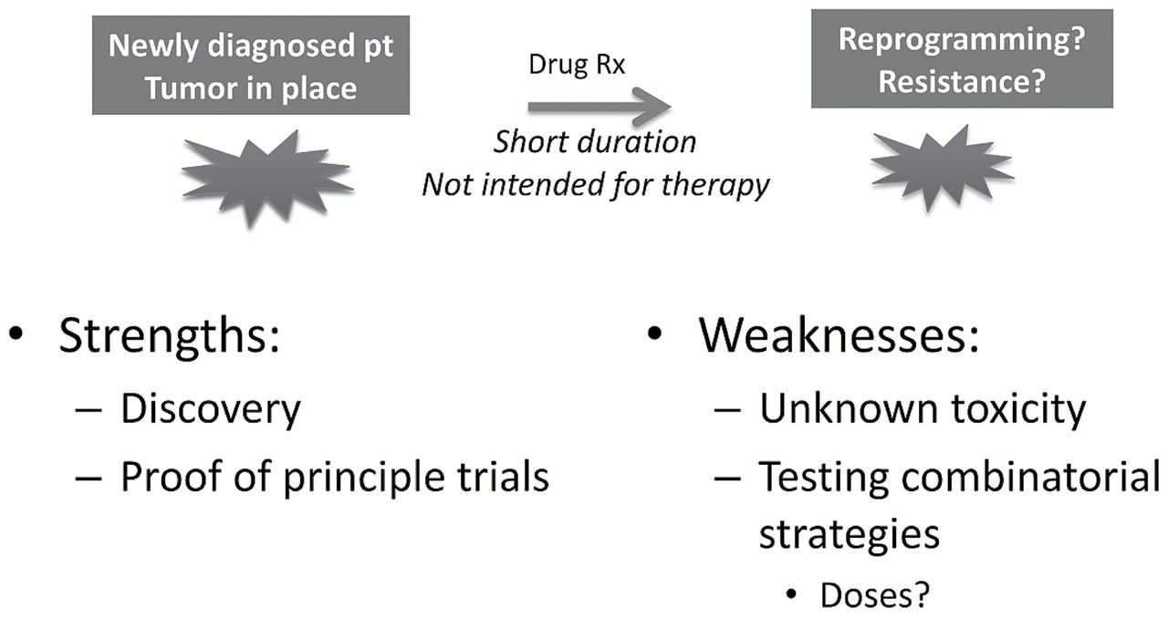
Figure 1. Window-of-opportunity trials.
Notes:
Figure 1. Window-of-opportunity trials.
Unless provided in the caption above, the following copyright applies to the content of this slide: © Crown copyright 2015.

Slide 2
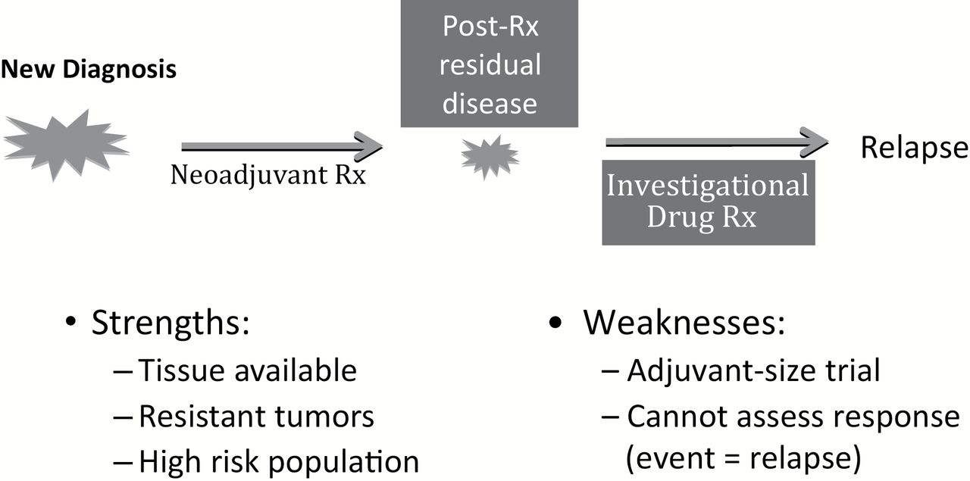
Figure 2. Residual disease trials.
Notes:
Figure 2. Residual disease trials.
Unless provided in the caption above, the following copyright applies to the content of this slide: © Crown copyright 2015.

Slide 3
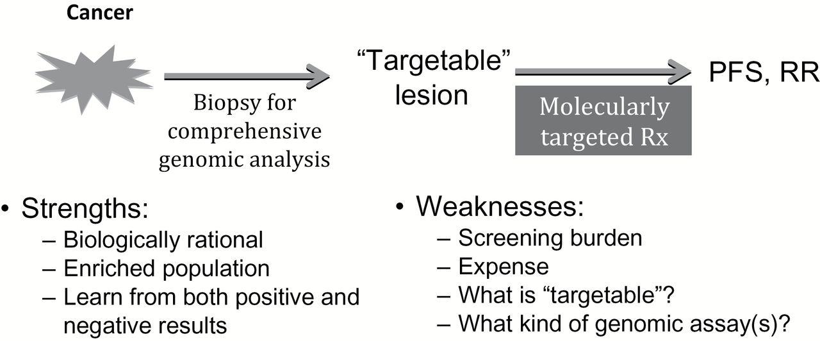
Figure 3. Genome forward trials.
Notes:
Figure 3. Genome forward trials.
Unless provided in the caption above, the following copyright applies to the content of this slide: © Crown copyright 2015.

