Slide 1
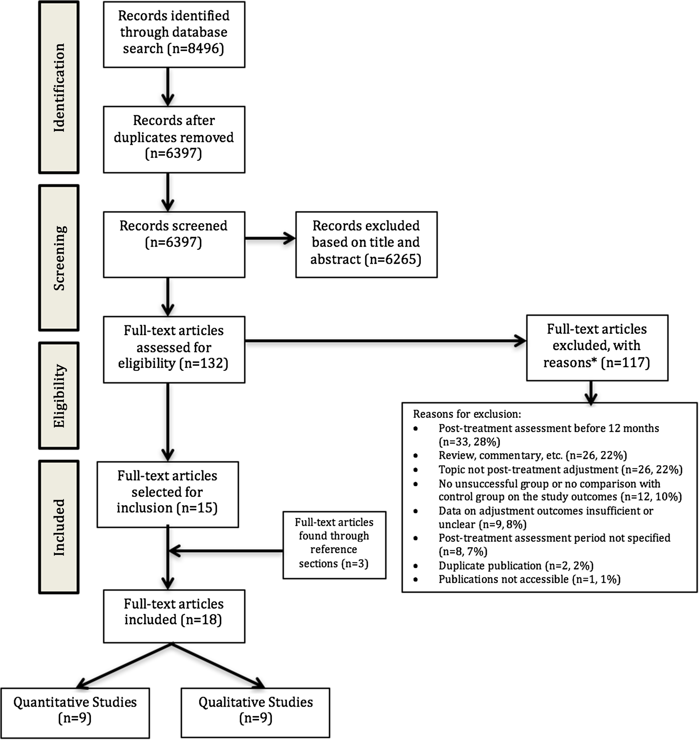
Figure 1 Decision-flow chart for identified studies. *For detailed exclusion strategy, see Supplementary Table 2.
Notes:
Figure 1 Decision-flow chart for identified studies. *For detailed exclusion strategy, see Supplementary Table 2.
Unless provided in the caption above, the following copyright applies to the content of this slide: © The Author 2017. Published by Oxford University Press on behalf of the European Society of Human Reproduction and Embryology. All rights reserved. For Permissions, please email: journals.permissions@oup.com

Slide 2
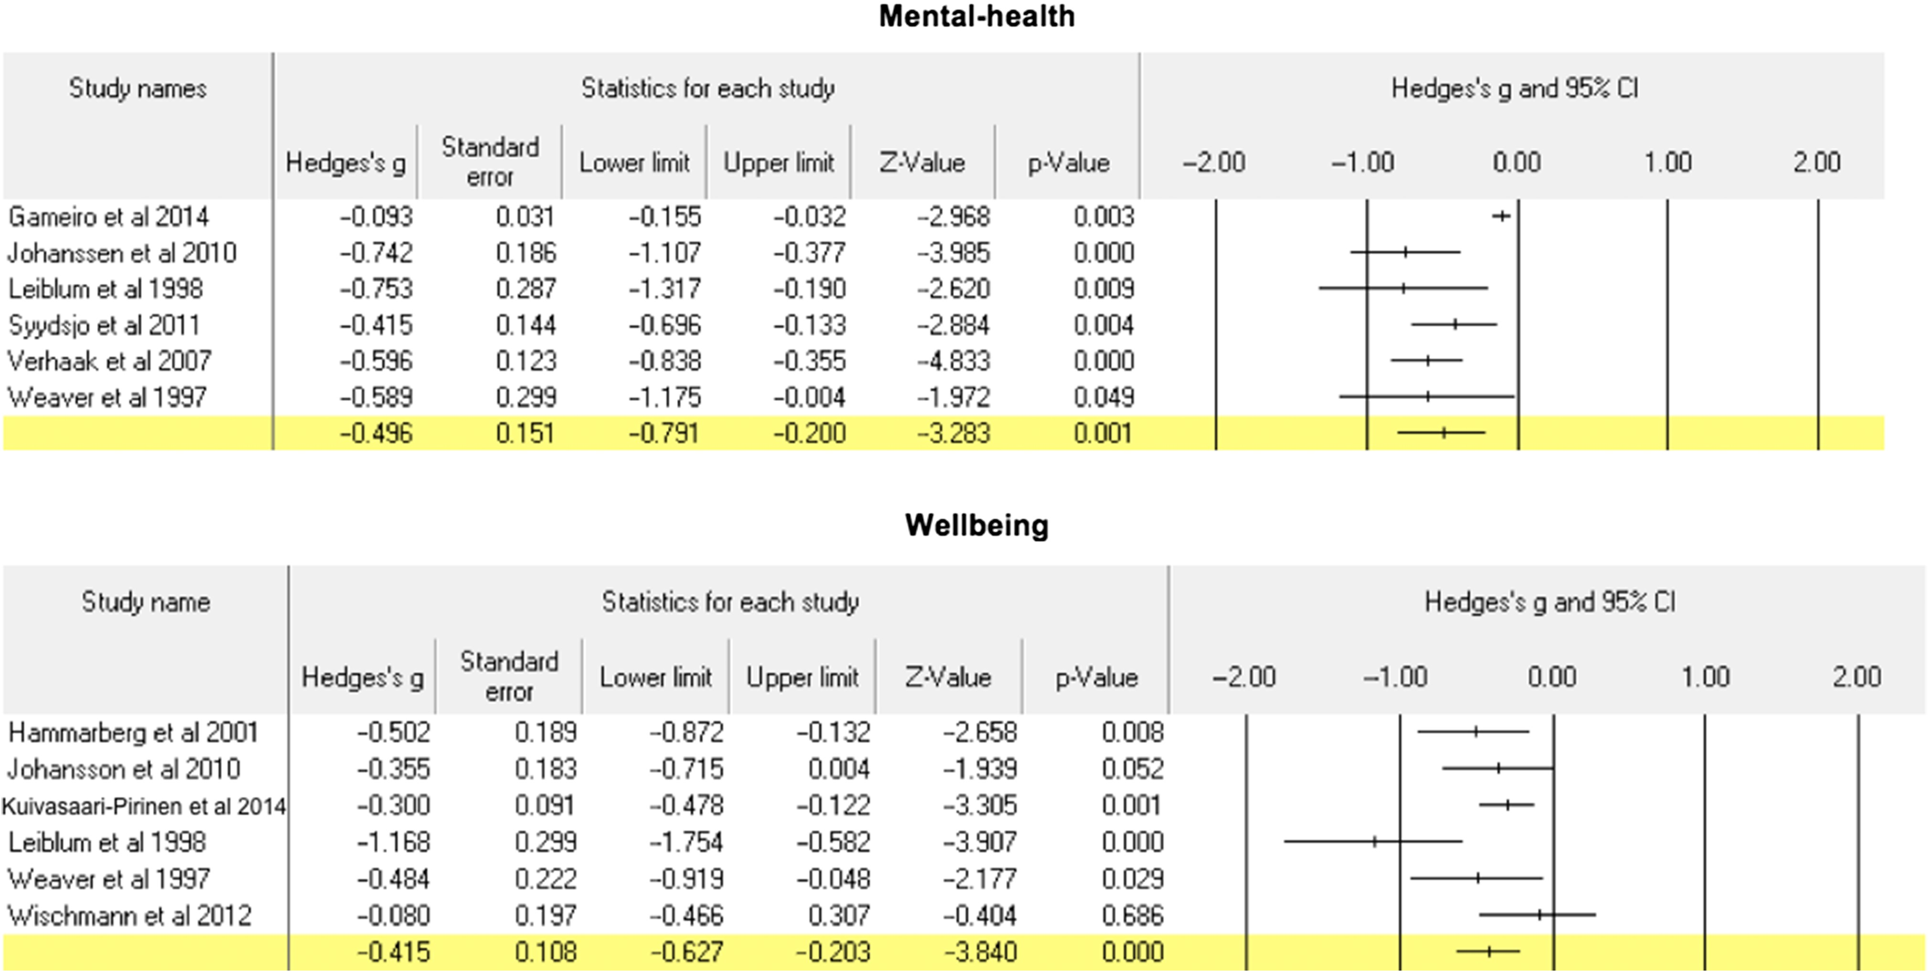
Figure 2 Standardized mean differences (Hedge's g, SE, 95% CIs, Z value and P value) between failed treatment and ...
Notes:
Figure 2 Standardized mean differences (Hedge's g, SE, 95% CIs, Z value and P value) between failed treatment and control groups for mental-health and well-being. Negative Hedge's values indicate worse adjustment for the failed treatment group than the control group.
Unless provided in the caption above, the following copyright applies to the content of this slide: © The Author 2017. Published by Oxford University Press on behalf of the European Society of Human Reproduction and Embryology. All rights reserved. For Permissions, please email: journals.permissions@oup.com

Slide 3
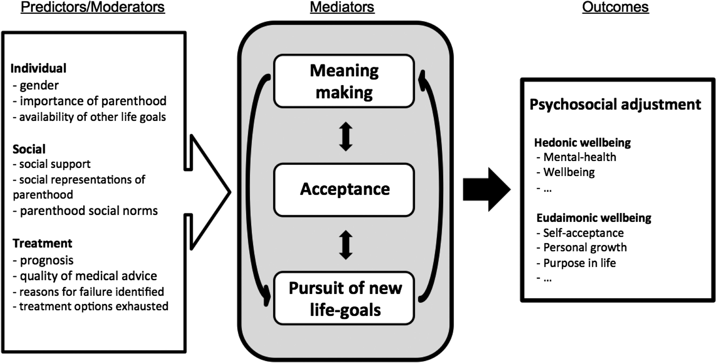
Figure 3 A schematic representation of the Three Tasks Model of Adjustment to Unmet Parenthood Goals.
Notes:
Figure 3 A schematic representation of the Three Tasks Model of Adjustment to Unmet Parenthood Goals.
Unless provided in the caption above, the following copyright applies to the content of this slide: © The Author 2017. Published by Oxford University Press on behalf of the European Society of Human Reproduction and Embryology. All rights reserved. For Permissions, please email: journals.permissions@oup.com

