Slide 1
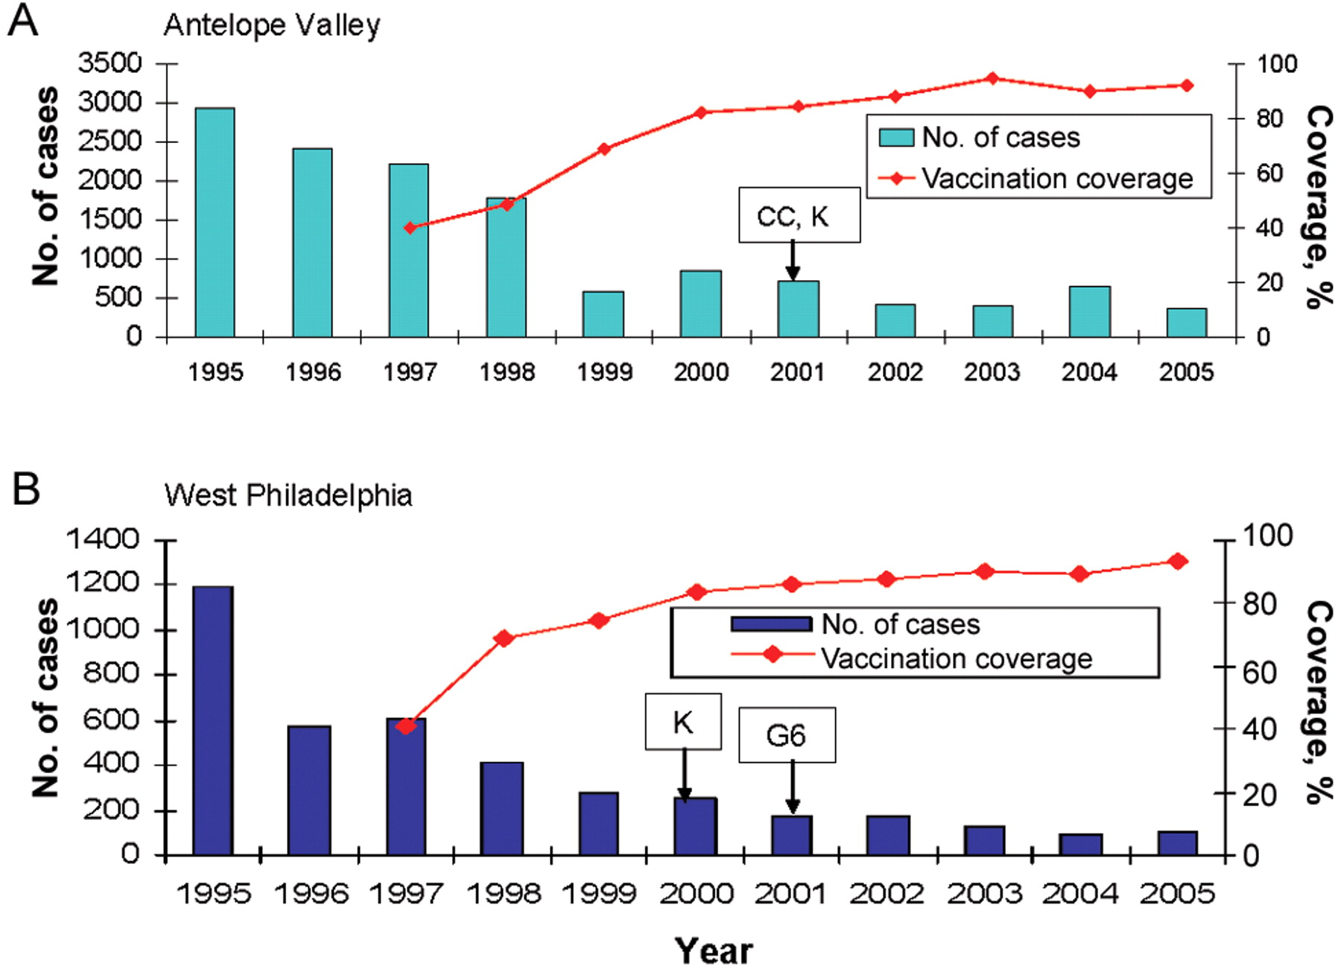
Figure 1 No. of cases and vaccination coverage, Antelope Valley, California (A), and West Philadelphia, Pennsylvania ...
Notes:
Figure 1 No. of cases and vaccination coverage, Antelope Valley, California (A), and West Philadelphia, Pennsylvania (B), 1995–2005. Boxes with arrows indicate when varicella vaccination requirements for child care (CC), kindergarten (K), and sixth grade (G6) entry went into effect.
Unless provided in the caption above, the following copyright applies to the content of this slide: © 2008 by the Infectious Diseases Society of America

Slide 2
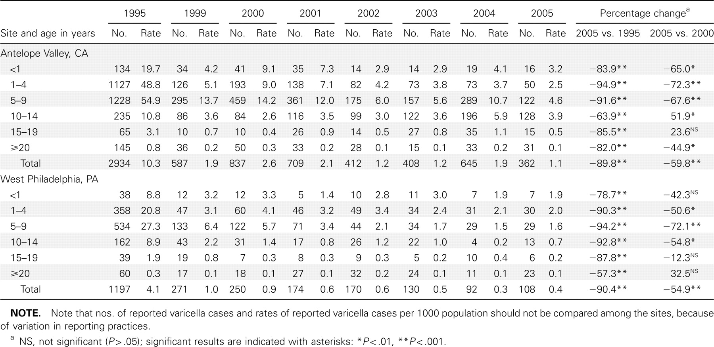
Table 1 Reported nos. of varicella cases and incidence rates (per 1000 population), by age group, in 1995 and ...
Notes:
Table 1 Reported nos. of varicella cases and incidence rates (per 1000 population), by age group, in 1995 and 1999–2005 in Antelope Valley, California, and West Philadelphia, Pennsylvania.
Unless provided in the caption above, the following copyright applies to the content of this slide: © 2008 by the Infectious Diseases Society of America

Slide 3
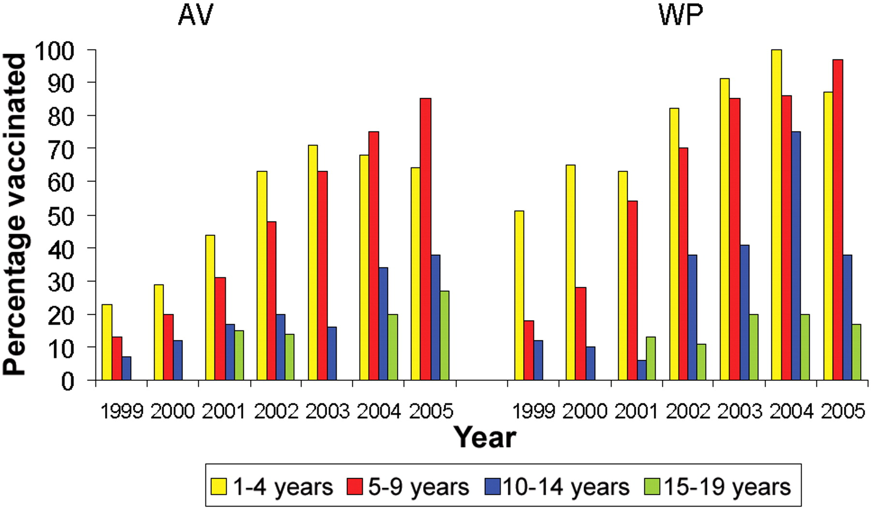
Figure 2 Proportion of vaccinated case patients, by age group, in Antelope Valley, California (AV), and West ...
Notes:
Figure 2 Proportion of vaccinated case patients, by age group, in Antelope Valley, California (AV), and West Philadelphia, Pennsylvania (WP), 1995–2005.
Unless provided in the caption above, the following copyright applies to the content of this slide: © 2008 by the Infectious Diseases Society of America

Slide 4
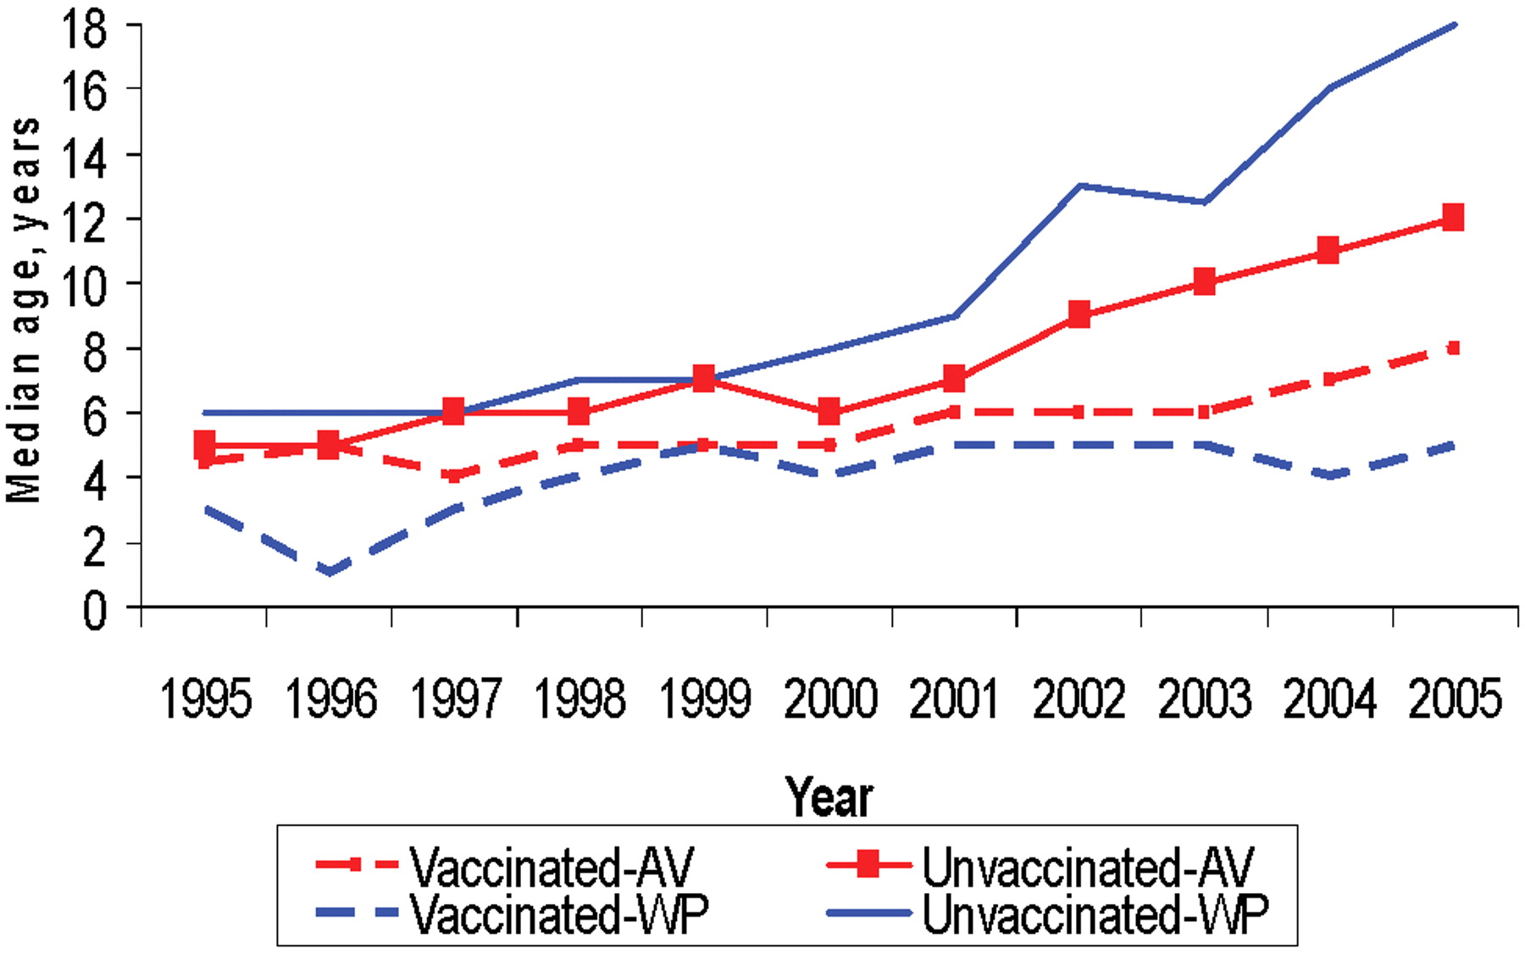
Figure 3 Median ages of both vaccinated and unvaccinated case patients, Antelope Valley, California (AV), and West ...
Notes:
Figure 3 Median ages of both vaccinated and unvaccinated case patients, Antelope Valley, California (AV), and West Philadelphia, Pennsylvania (WP), 1995–2005
Unless provided in the caption above, the following copyright applies to the content of this slide: © 2008 by the Infectious Diseases Society of America

