Slide 1
Figure 1. The self-generated and instructed tasks. The instruction was followed by a varying delay (2–10 s). The task ...
Notes:
Figure 1. The self-generated and instructed tasks. The instruction was followed by a varying delay (2–10 s). The task word appeared for 500 ms after which the participants responded (R1). They then made a second response (R2) reporting which task they had performed.
Unless provided in the caption above, the following copyright applies to the content of this slide: © 2008 The AuthorsThis is an Open Access article distributed under the terms of the Creative Commons Attribution Non-Commercial License (http://creativecommons.org/licenses/by-nc/2.0/uk/) which permits unrestricted non-commercial use, distribution, and reproduction in any medium, provided the original work is properly cited.

Slide 2
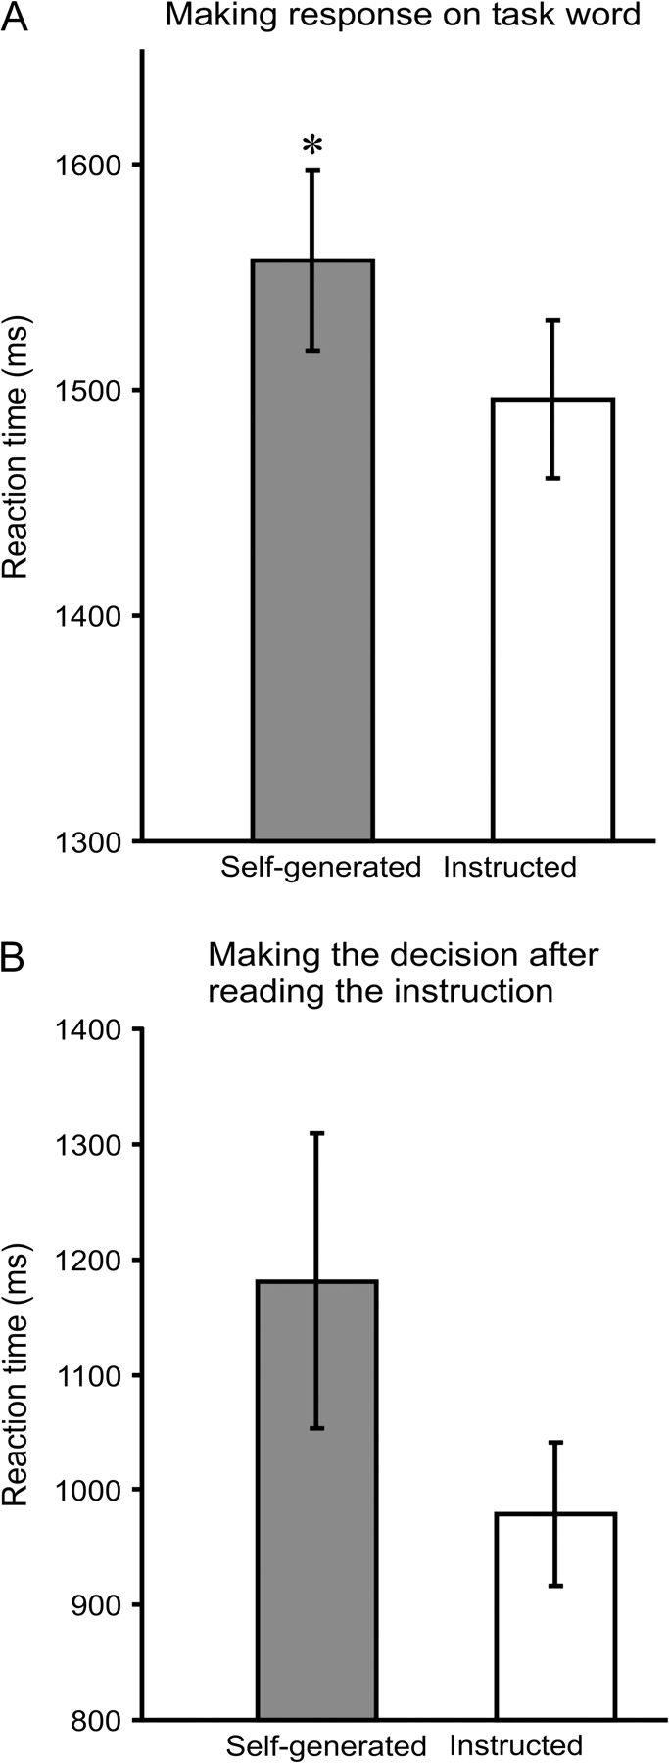
Figure 2. (A) Time to make a decision about the target word in the self-generated and instructed conditions. (B) Time ...
Notes:
Figure 2. (A) Time to make a decision about the target word in the self-generated and instructed conditions. (B) Time to decide on the task (self-generated) or to process the task instruction in session 6.
Unless provided in the caption above, the following copyright applies to the content of this slide: © 2008 The AuthorsThis is an Open Access article distributed under the terms of the Creative Commons Attribution Non-Commercial License (http://creativecommons.org/licenses/by-nc/2.0/uk/) which permits unrestricted non-commercial use, distribution, and reproduction in any medium, provided the original work is properly cited.

Slide 3
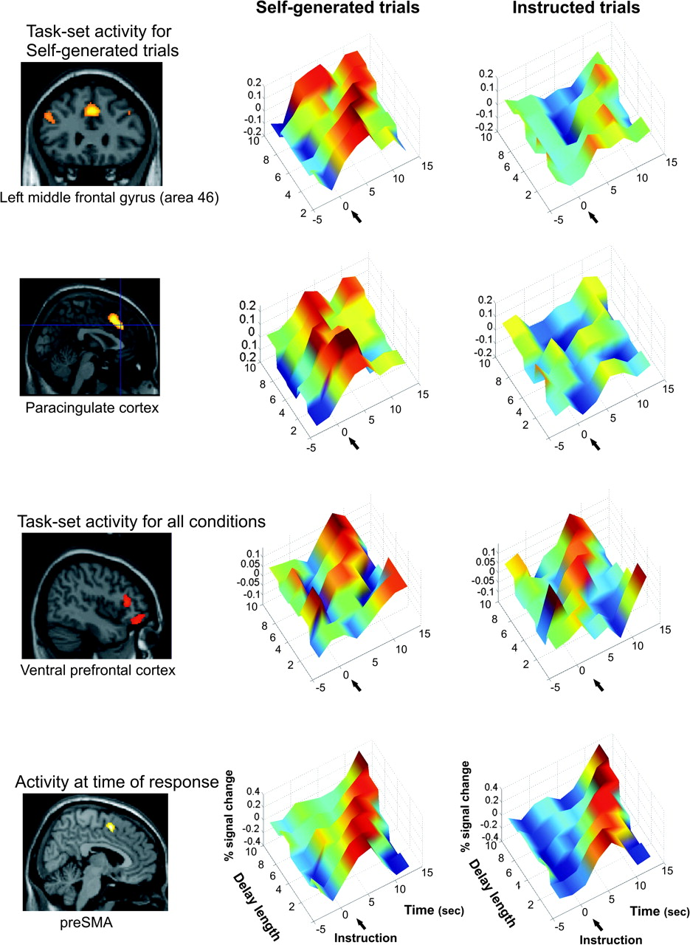
Figure 3. All the plots in Figure 3 show the adjusted data for the BOLD signal (vertical axis), aligned to the time of ...
Notes:
Figure 3. All the plots in Figure 3 show the adjusted data for the BOLD signal (vertical axis), aligned to the time of presentation of the instructing word. Time is shown along the axis in the foreground. The numbers on the x-axis are adjusted to take into account a delay in the peak of the BOLD signal of 5 s. In other words, 0 (arrow) corresponds to 5 s after the instructing word. The data for the different delay lengths are shown along the left-hand receding axis, with the longest delay at the back and the shortest delay at the front.
Unless provided in the caption above, the following copyright applies to the content of this slide: © 2008 The AuthorsThis is an Open Access article distributed under the terms of the Creative Commons Attribution Non-Commercial License (http://creativecommons.org/licenses/by-nc/2.0/uk/) which permits unrestricted non-commercial use, distribution, and reproduction in any medium, provided the original work is properly cited.

Slide 4
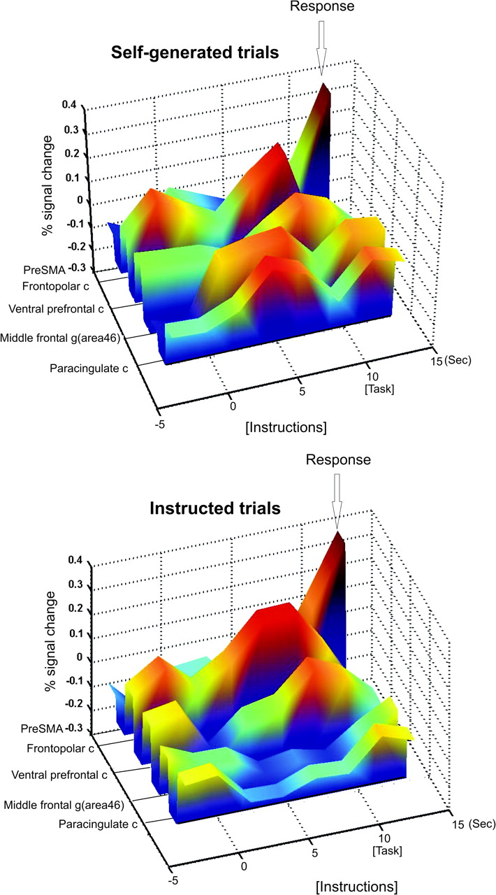
Figure 4. As in the plots in Figure 3, this figure shows the adjusted data for the BOLD signal (vertical axis), aligned ...
Notes:
Figure 4. As in the plots in Figure 3, this figure shows the adjusted data for the BOLD signal (vertical axis), aligned to the time of presentation of the instructing word. Data are plotted for the longest delay only (10 s). Time is shown along the axis in the foreground. The numbers on the x-axis are adjusted to take into account a delay in the peak of the BOLD signal of 5 s. In other words, 0 corresponds to 5 s after the instructing word. The receding axis on the left indicates the 5 areas from which the data were taken. The data for the right-hand side of the BOLD signal for the preSMA are not shown in this figure. c = cortex, g = gyurs.
Unless provided in the caption above, the following copyright applies to the content of this slide: © 2008 The AuthorsThis is an Open Access article distributed under the terms of the Creative Commons Attribution Non-Commercial License (http://creativecommons.org/licenses/by-nc/2.0/uk/) which permits unrestricted non-commercial use, distribution, and reproduction in any medium, provided the original work is properly cited.

Slide 5
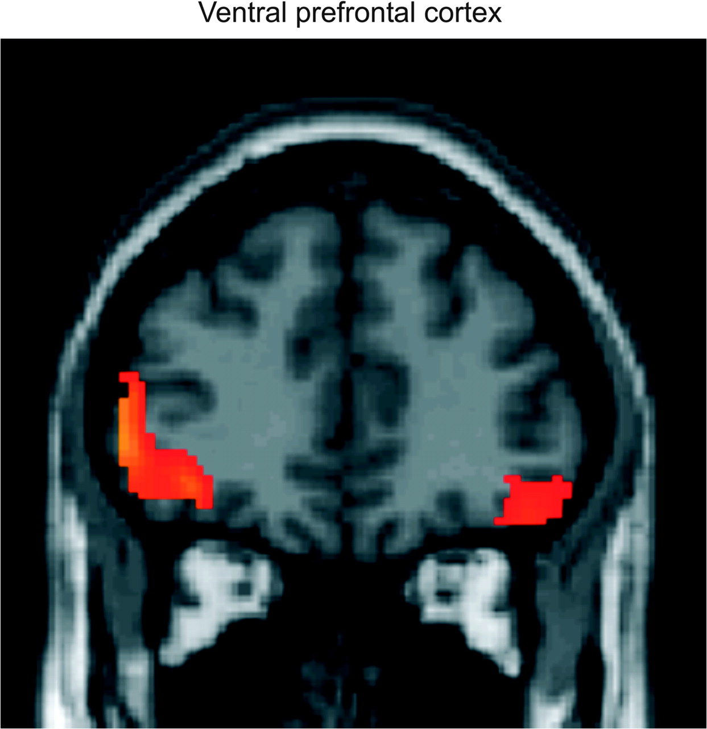
Figure 5. Areas of sustained activation in common, irrespective of whether the rules were self-generated or verbally ...
Notes:
Figure 5. Areas of sustained activation in common, irrespective of whether the rules were self-generated or verbally instructed.
Unless provided in the caption above, the following copyright applies to the content of this slide: © 2008 The AuthorsThis is an Open Access article distributed under the terms of the Creative Commons Attribution Non-Commercial License (http://creativecommons.org/licenses/by-nc/2.0/uk/) which permits unrestricted non-commercial use, distribution, and reproduction in any medium, provided the original work is properly cited.

