Slide 1
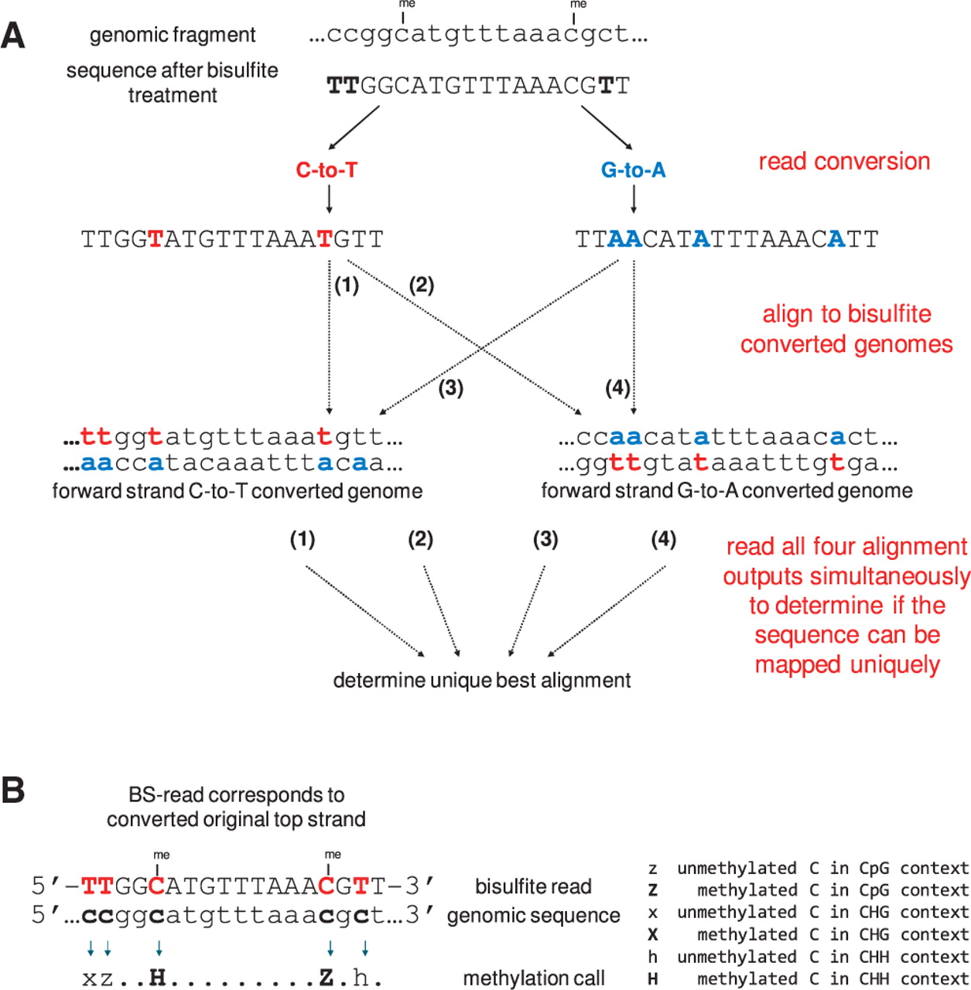
Fig. 1. Bismark's approach to bisulfite mapping and methylation calling. (A) Reads from a BS-Seq experiment are ...
Notes:
Fig. 1. Bismark's approach to bisulfite mapping and methylation calling. (A) Reads from a BS-Seq experiment are converted into a C-to-T and a G-to-A version and are then aligned to equivalently converted versions of the reference genome. A unique best alignment is then determined from the four parallel alignment processes [in this example, the best alignment has no mismatches and comes from thread (1)]. (B) The methylation state of positions involving cytosines is determined by comparing the read sequence with the corresponding genomic sequence. Depending on the strand a read mapped against this can involve looking for C-to-T (as shown here) or G-to-A substitutions.
Unless provided in the caption above, the following copyright applies to the content of this slide: © The Author(s) 2011. Published by Oxford University Press.This is an Open Access article distributed under the terms of the Creative Commons Attribution Non-Commercial License (http://creativecommons.org/licenses/by-nc/2.5), which permits unrestricted non-commercial use, distribution, and reproduction in any medium, provided the original work is properly cited.

