Slide 1
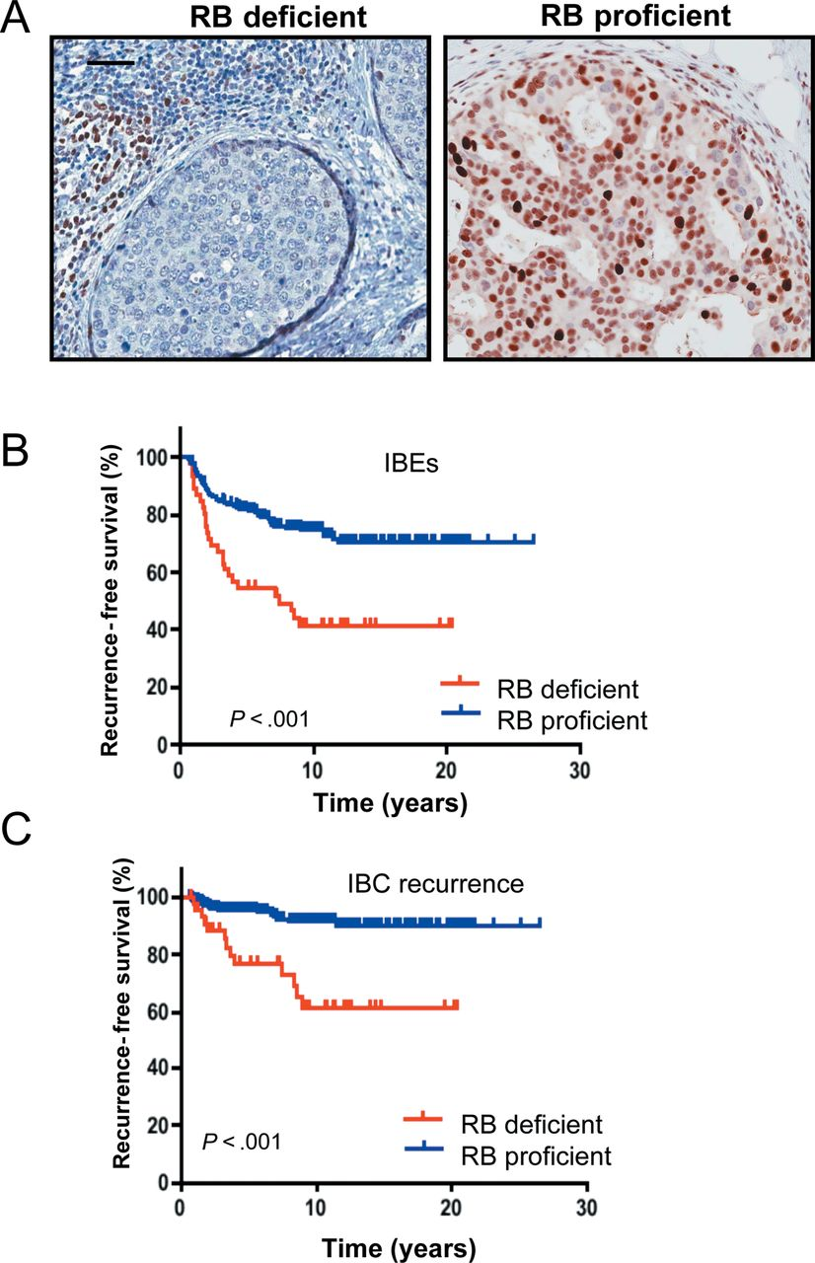
Figure 1. Retinoblastoma (RB) status is associated with ductal carcinoma in situ (DCIS) recurrence and invasive ...
Notes:
Figure 1. Retinoblastoma (RB) status is associated with ductal carcinoma in situ (DCIS) recurrence and invasive progression. A ) RB staining was extensively optimized, and representative images of stained DCIS lesions are shown. Scale bar = 50 μM. B ) Kaplan–Meier analyses were performed to determine the association between RB status and ipsilateral breast events (IBEs) or C ) progression as invasive breast cancer (IBC).
Unless provided in the caption above, the following copyright applies to the content of this slide: © The Author 2012. Published by Oxford University Press. All rights reserved. For Permissions, please e-mail: journals.permissions@oup.com.

Slide 2
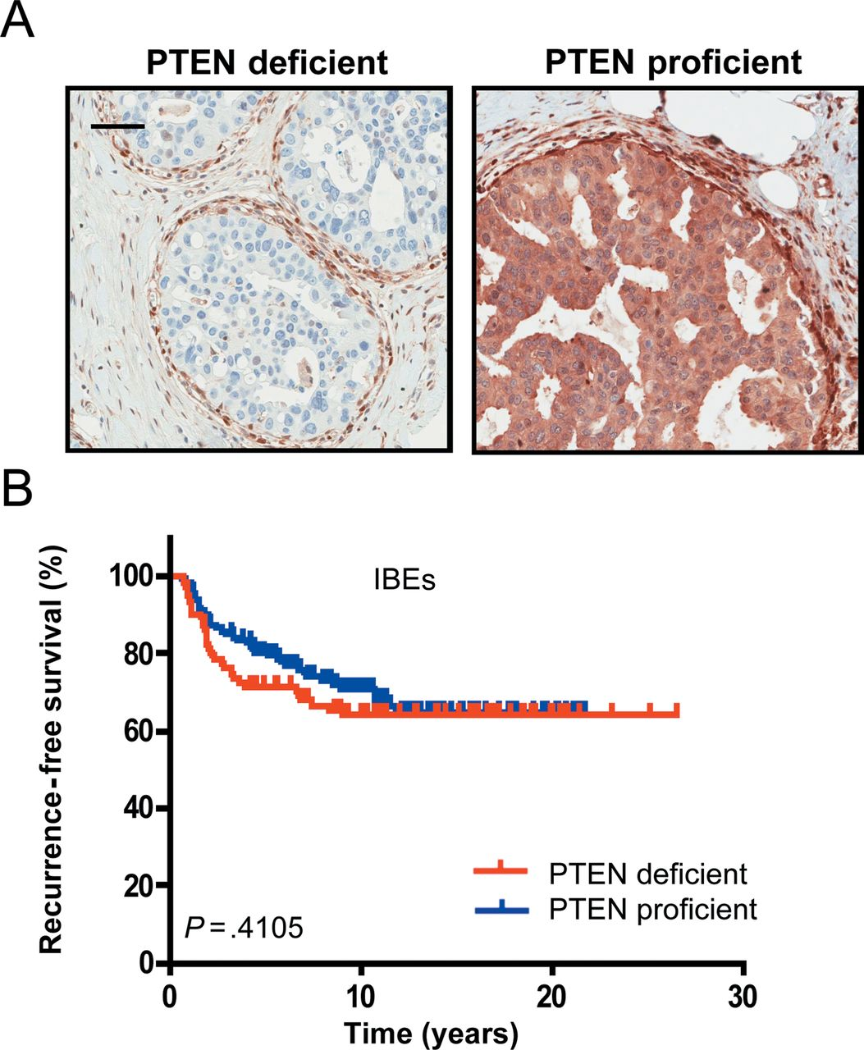
Figure 2. Phosphatase and tensin homolog (PTEN) status is not a prognostic marker in ductal carcinoma in situ (DCIS). ...
Notes:
Figure 2. Phosphatase and tensin homolog (PTEN) status is not a prognostic marker in ductal carcinoma in situ (DCIS). A ) PTEN staining was extensively optimized, and representative images of stained DCIS lesions are shown. Scale bar = 50 μM. B ) Kaplan–Meier analyses were performed to determine the association between PTEN status and subsequent ipsilateral breast events (IBEs).
Unless provided in the caption above, the following copyright applies to the content of this slide: © The Author 2012. Published by Oxford University Press. All rights reserved. For Permissions, please e-mail: journals.permissions@oup.com.

Slide 3
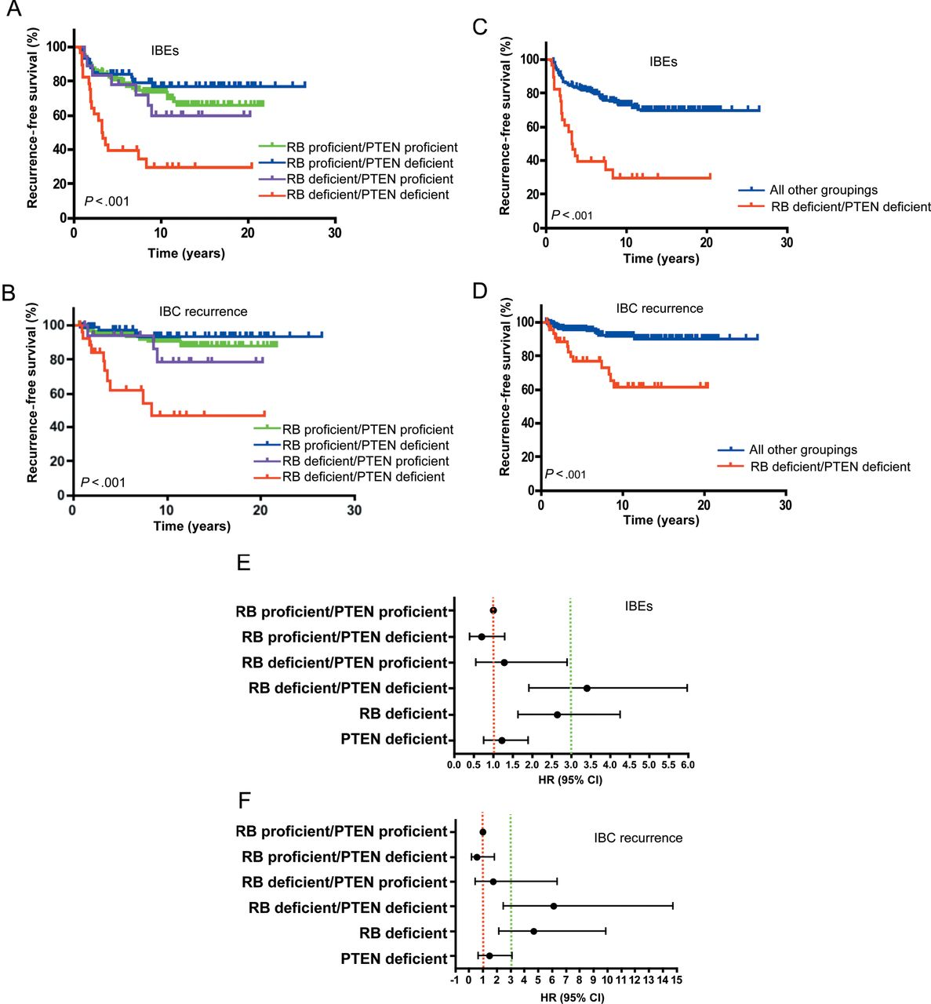
Figure 3. Combined retinoblastoma (RB) and phosphate and tensin homolog (PTEN) deficiency is associated with poor ...
Notes:
Figure 3. Combined retinoblastoma (RB) and phosphate and tensin homolog (PTEN) deficiency is associated with poor outcome in ductal carcinoma in situ (DCIS). A ) Kaplan–Meier analyses of all subgroups based on RB and PTEN staining are shown for ipsilateral breast events (IBEs). B ) Kaplan–Meier analyses of all subgroups based on RB and PTEN staining are shown for invasive breast cancer (IBC) progression. C ) Kaplan–Meier analyses of RB- and PTEN-deficient cases vs all other cases are shown for IBEs. D ) Kaplan–Meier analyses of RB- and PTEN-deficient cases vs all other cases are shown for IBC progression. E ) Forest plots of RB and/or PTEN status in DCIS. Hazard ratio (HR) and 95% confidence interval (CI) for IBEs are shown (red dashed line denotes hazard ratio of 1, and green dashed line denotes hazard ratio of 3). F ) Forest plots of RB and/or PTEN status in DCIS. Hazard ratio and 95% confidence interval for IBC recurrence are shown (red dashed line denotes hazard ratio of 1, and green dashed line denotes hazard ratio of 3).
Unless provided in the caption above, the following copyright applies to the content of this slide: © The Author 2012. Published by Oxford University Press. All rights reserved. For Permissions, please e-mail: journals.permissions@oup.com.

Slide 4
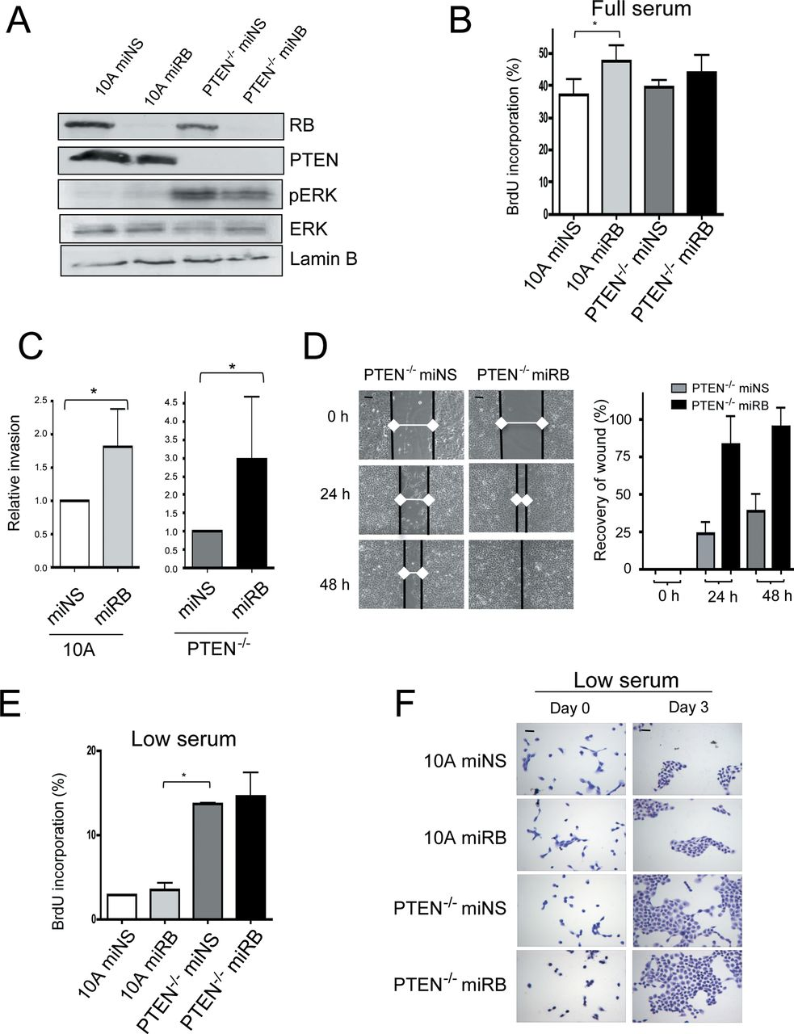
Figure 4. Functional impact of retinoblastoma (RB) and phosphate and tensin homolog (PTEN) deficiency on proliferation ...
Notes:
Figure 4. Functional impact of retinoblastoma (RB) and phosphate and tensin homolog (PTEN) deficiency on proliferation and invasion. A ) MCF10A models deficient for PTEN and RB were characterized by immunoblotting with the indicated antibodies. B ) Cell cycle progression of MCF10A variants was determined by bromodeoxyuridine (BrdU) incorporation detection by flow cytometry. Data shown are from three independent experiments. The mean and 95% confidence interval are shown (* P < .001, two-sided t test). C ) The ability of PTEN-deficient MCF10A cultures to invade through Matrigel in a Boyden chamber assay was evaluated. Data shown are from three independent experiments. The mean and 95% confidence interval are shown (left panel:* P = .02; right panel: P = 0.03, two-sided t test). D ) Representative images of wound-healing assays performed with PTEN-deficient MCF10A cells. Scale bars = 100 μm. Quantification of the wound healing is presented; the increased rate in filling of the wound is statistically significant ( P < .001, two-sided t test). E ) Cell cycle progression under low serum conditions was determined by flow cytometry. Data are from three independent experiments. The mean and 95% confidence interval are shown. The impact of PTEN loss was statistically significant (* P < .001, two-sided t test). F ) Representative crystal violet staining of cells grown for three days under low serum conditions. Scale bars = 100 μm.
Unless provided in the caption above, the following copyright applies to the content of this slide: © The Author 2012. Published by Oxford University Press. All rights reserved. For Permissions, please e-mail: journals.permissions@oup.com.

Slide 5
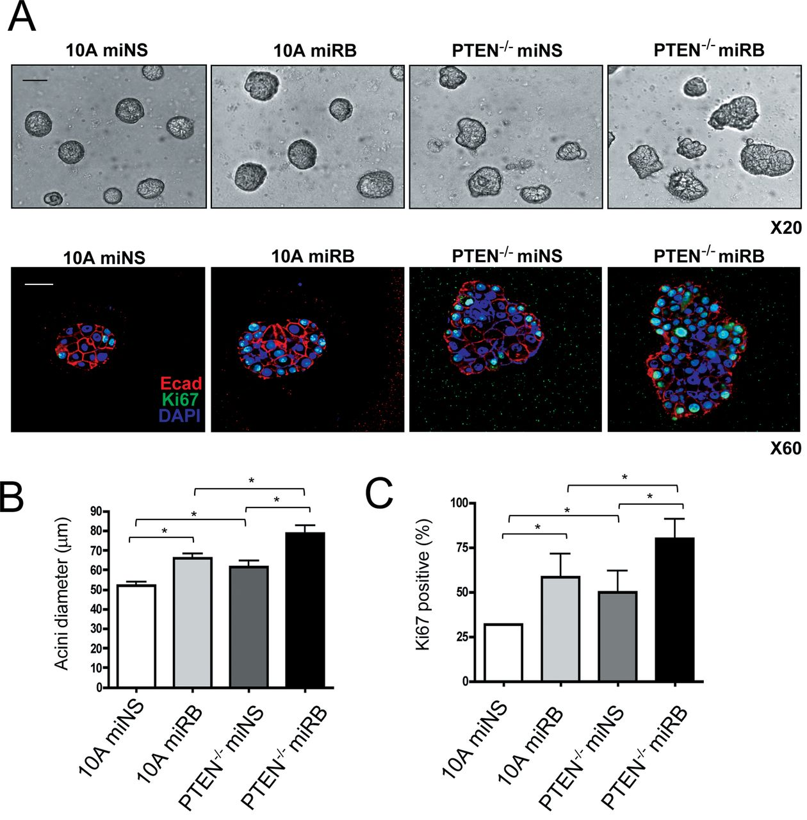
Figure 5. Distinct roles for retinoblastoma (RB) and phosphate and tensin homolog (PTEN) in controlling growth in ...
Notes:
Figure 5. Distinct roles for retinoblastoma (RB) and phosphate and tensin homolog (PTEN) in controlling growth in three dimensions. A ) Representative images of the indicated MCF10A cultures that were grown in three dimensions. Bright field (upper panel) (Scale bar = 100 µM) and immunofluorescent images (lower panel) (Scale bar = 50 μM) are shown, with cells stained for Ki67, E-cadherin (Ecad), and 4,6-diamidino-2-phenylindole (DAPI). B ) Quantitation of acinar size was determined by measuring the acinar diameter. The mean and 95% confidence interval are shown. All differences with RB or PTEN deficiency were statistically significant (* P < .05, two-sided t test). C ) Quantitation of Ki67 index was performed from confocal images. The mean and standard deviation are shown. All differences with RB or PTEN deficiency were statistically significant (* P < .05, two-sided t test)
Unless provided in the caption above, the following copyright applies to the content of this slide: © The Author 2012. Published by Oxford University Press. All rights reserved. For Permissions, please e-mail: journals.permissions@oup.com.

