Slide 1
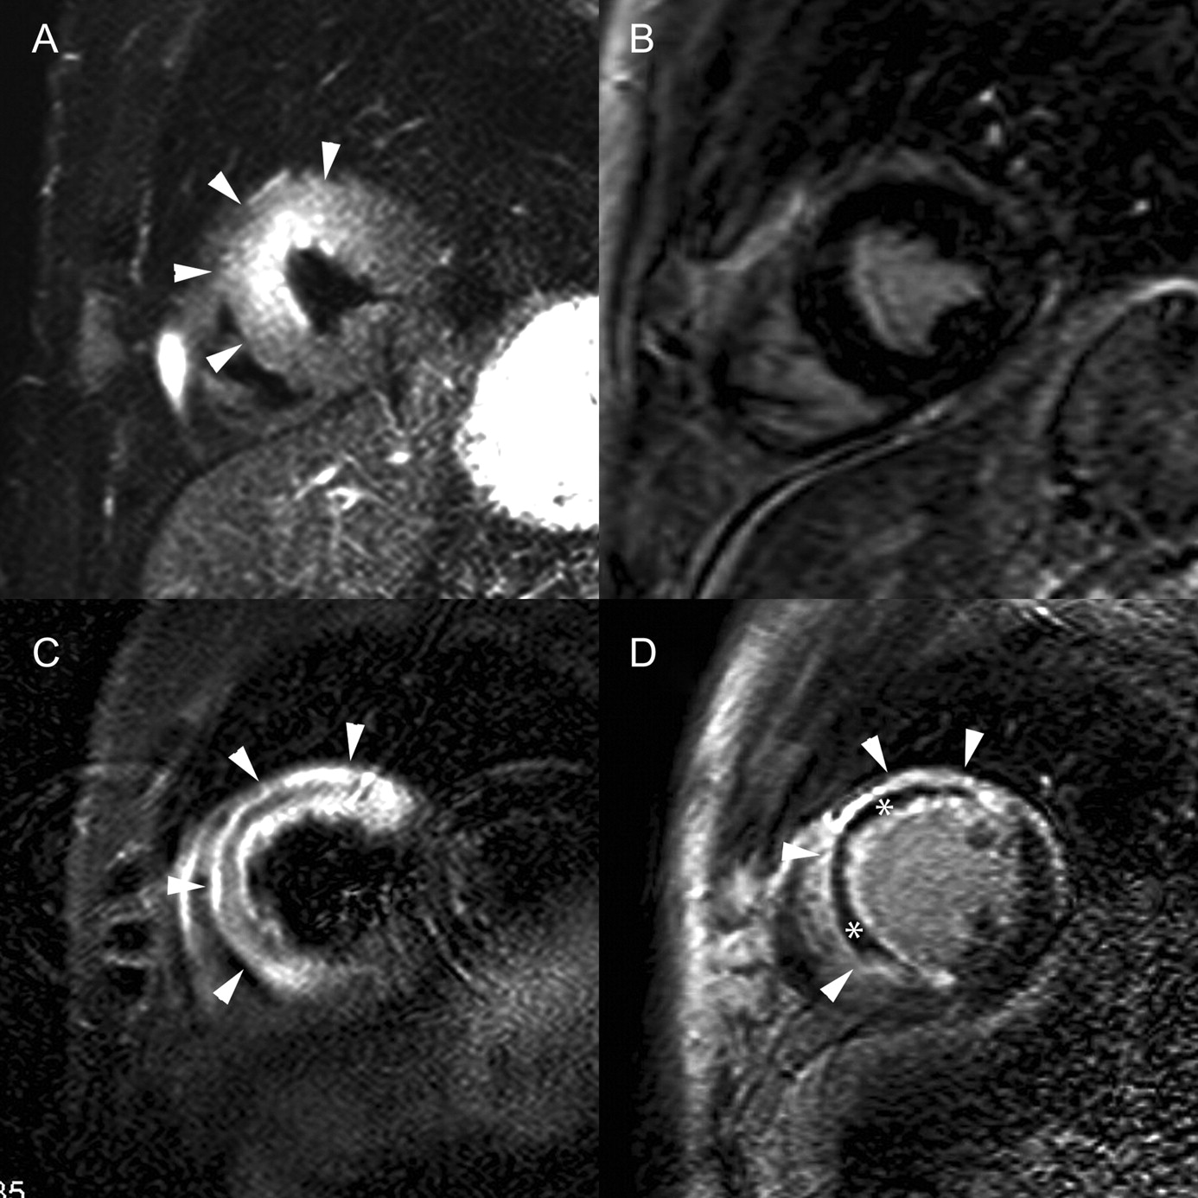
Figure 1 Example of the two extremes of myocardial salvage. Cardiac short axis T₂-weighted (A and C) and ...
Notes:
Figure 1 Example of the two extremes of myocardial salvage. Cardiac short axis T2-weighted (A and C) and contrast-enhanced magnetic resonance imaging (MRI) (B and D). Upper row: myocardial oedema in the anteroseptal LV wall (arrowheads) (A), without evidence of abnormal myocardial enhancement on contrast-enhanced images (B), representing an aborted myocardial infarction. Lower row: extensive myocardial oedema in the anterior and septal left ventricular (LV) wall (arrowheads) (C). On post-contrast enhanced MRI (D), transmural myocardial enhancement (arrowheads) of the anterior and septal LV wall is seen, involving nearly the entire area of myocardial oedema (arrowheads). Note the presence of an important area of microvascular obstruction (MVO)(*).
Unless provided in the caption above, the following copyright applies to the content of this slide: Published on behalf of the European Society of Cardiology. All rights reserved. © The Author 2010. For permissions please email: journals.permissions@oup.com

Slide 2
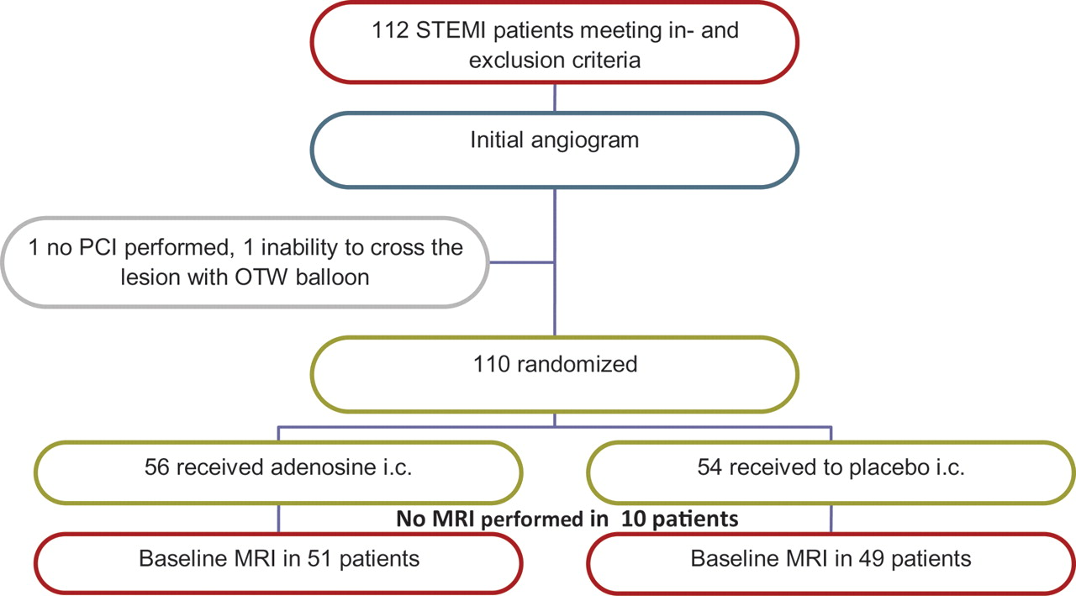
Figure 2 Flow diagram: randomization, treatment, and MRI. OTW indicates over-the-wire; i.c., intracoronary; MRI, ...
Notes:
Figure 2 Flow diagram: randomization, treatment, and MRI. OTW indicates over-the-wire; i.c., intracoronary; MRI, magnetic resonance imaging.
Unless provided in the caption above, the following copyright applies to the content of this slide: Published on behalf of the European Society of Cardiology. All rights reserved. © The Author 2010. For permissions please email: journals.permissions@oup.com

Slide 3
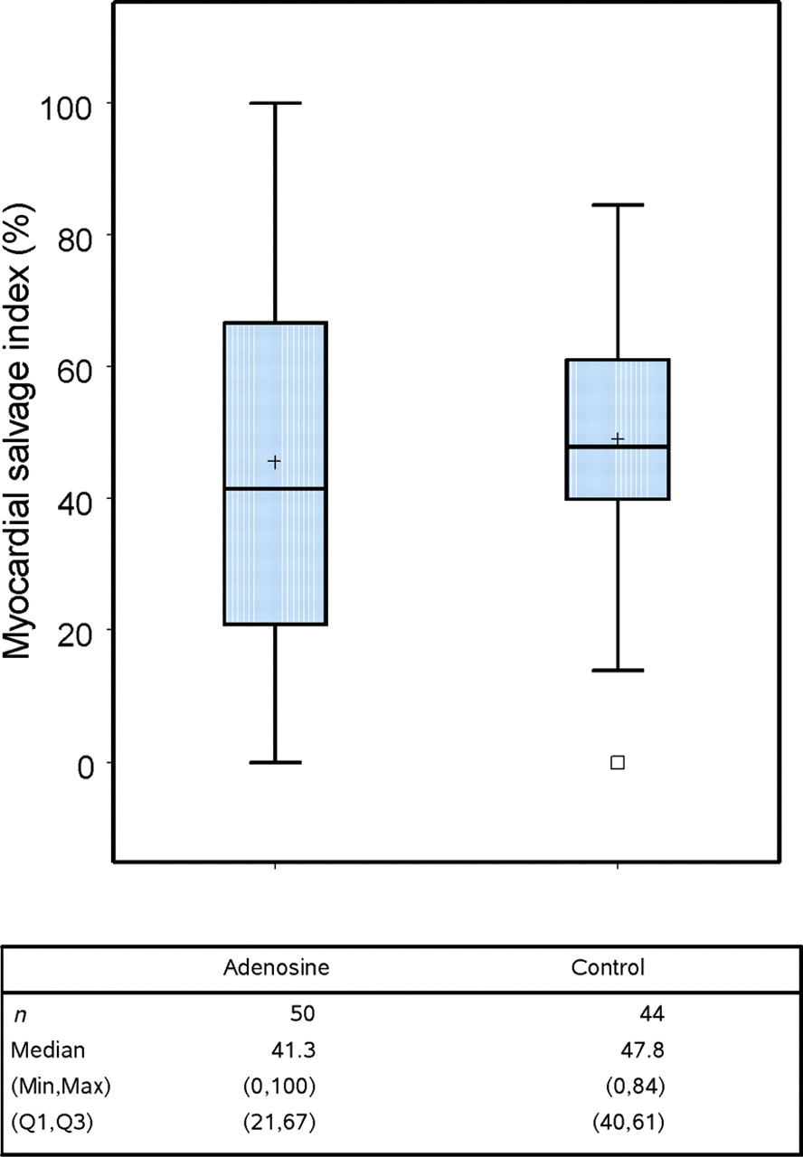
Figure 3 Box plot showing myocardial salvage index (primary endpoint). Box plot shows median and interquartile range. ...
Notes:
Figure 3 Box plot showing myocardial salvage index (primary endpoint). Box plot shows median and interquartile range. Whiskers are drawn at (Q3+1.5*IQR, Q1−1.5*IQR). Q1, Q3 = first and third quartile, IQR = Q3 − Q1. ‘+' sign indicates mean value. Small box indicates outlier.
Unless provided in the caption above, the following copyright applies to the content of this slide: Published on behalf of the European Society of Cardiology. All rights reserved. © The Author 2010. For permissions please email: journals.permissions@oup.com

Slide 4
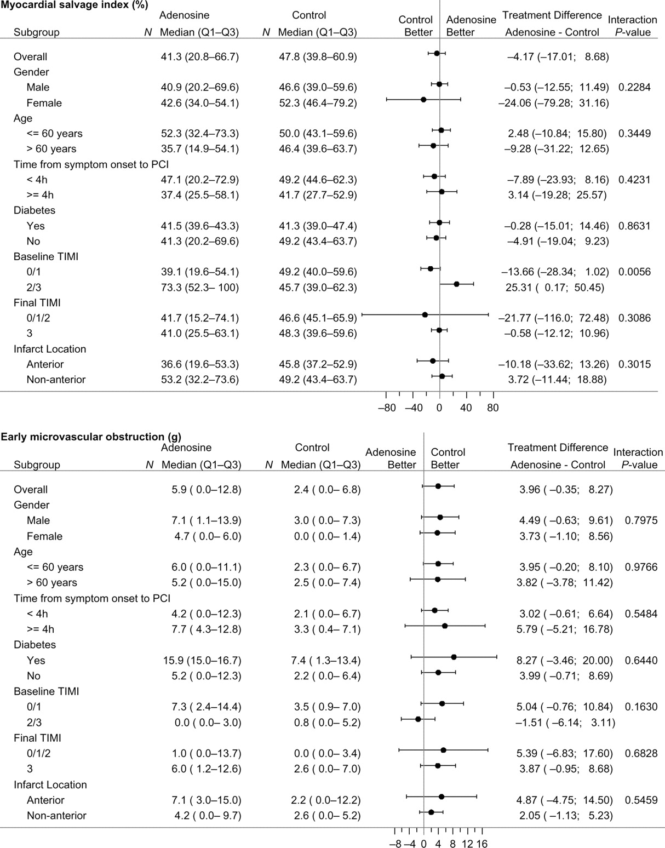
Figure 4 Forest plots of subgroup analyses for myocardial salvage index and microvascular obstruction.
Notes:
Figure 4 Forest plots of subgroup analyses for myocardial salvage index and microvascular obstruction.
Unless provided in the caption above, the following copyright applies to the content of this slide: Published on behalf of the European Society of Cardiology. All rights reserved. © The Author 2010. For permissions please email: journals.permissions@oup.com

Slide 5
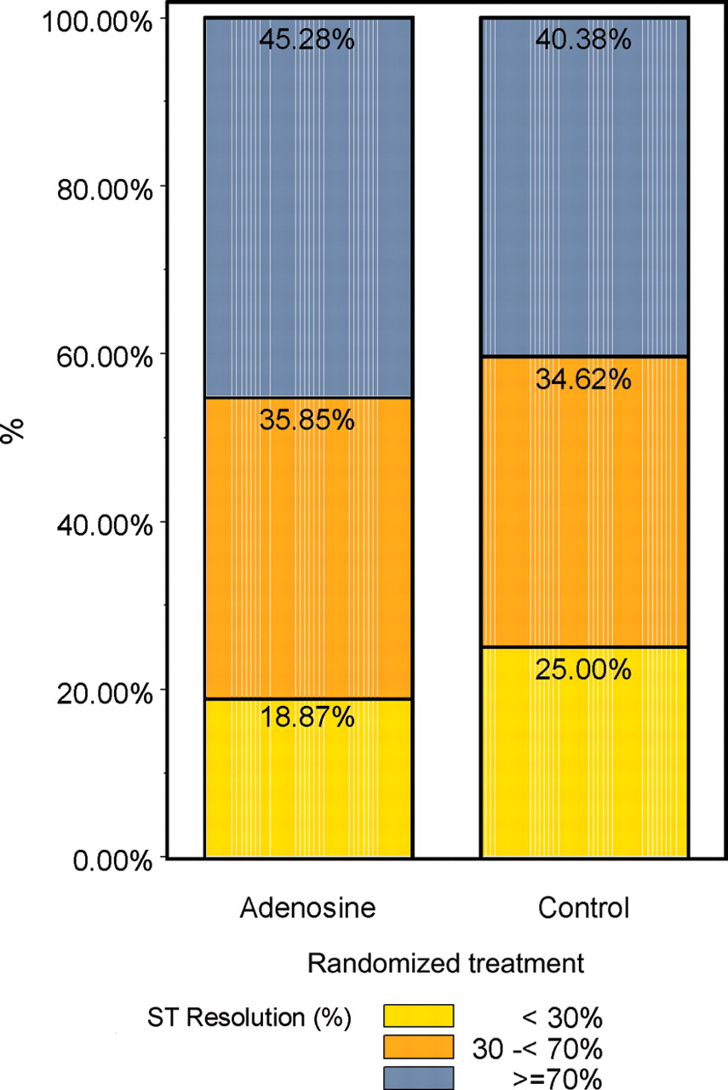
Figure 5 Myocardial reperfusion as assessed by ST-segment resolution.
Notes:
Figure 5 Myocardial reperfusion as assessed by ST-segment resolution.
Unless provided in the caption above, the following copyright applies to the content of this slide: Published on behalf of the European Society of Cardiology. All rights reserved. © The Author 2010. For permissions please email: journals.permissions@oup.com

Slide 6
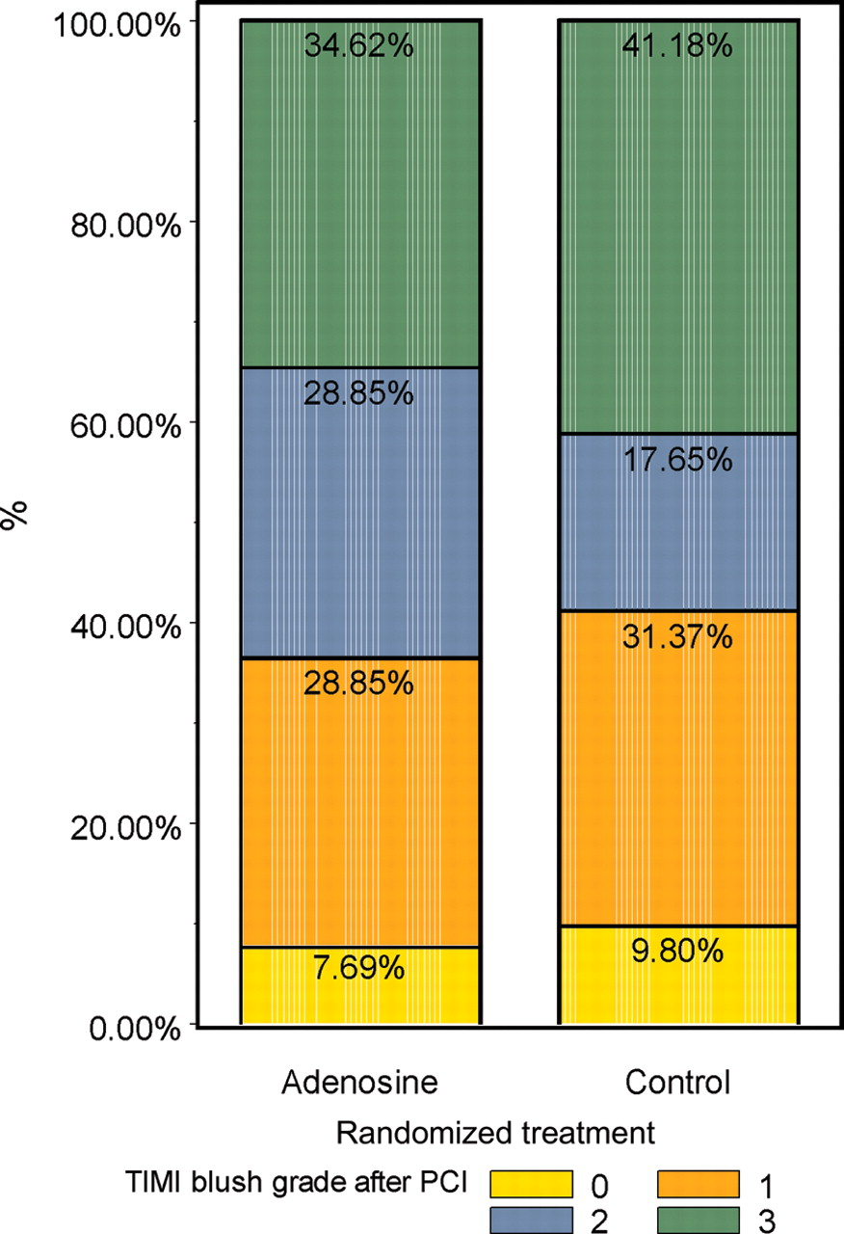
Figure 6 Myocardial reperfusion as assessed by myocardial blush grade.
Notes:
Figure 6 Myocardial reperfusion as assessed by myocardial blush grade.
Unless provided in the caption above, the following copyright applies to the content of this slide: Published on behalf of the European Society of Cardiology. All rights reserved. © The Author 2010. For permissions please email: journals.permissions@oup.com

