Slide 1
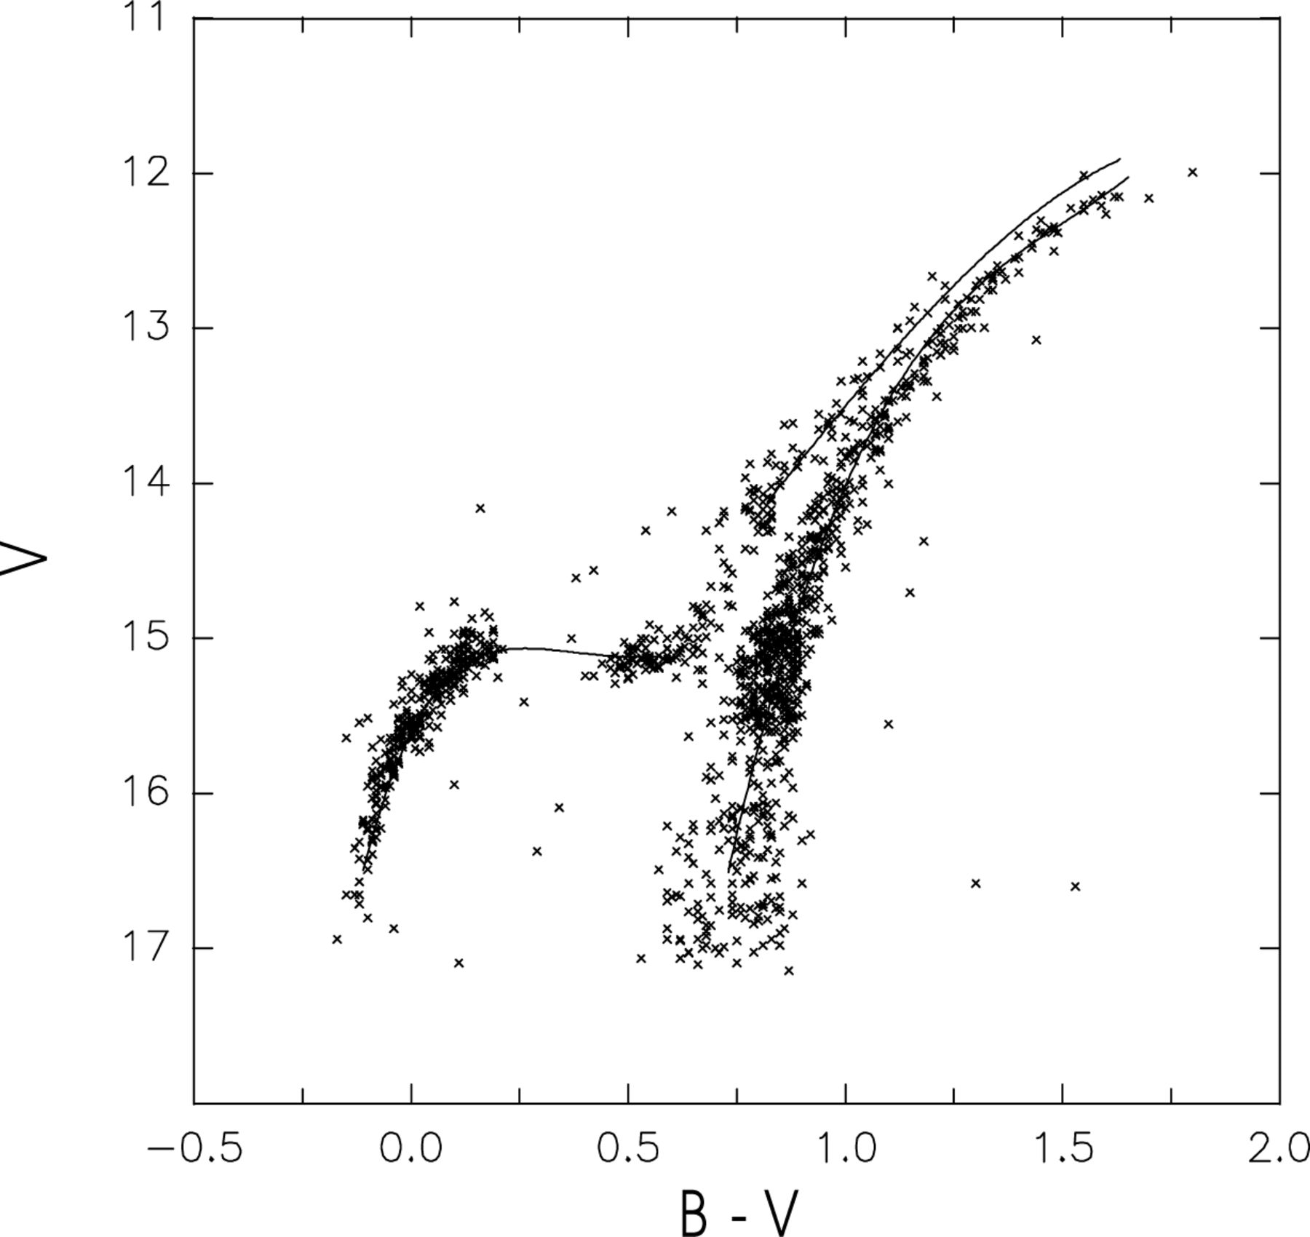
Figure 1. V, diagram for stars measured in the annulus with radius .
Notes:
Figure 1. V, diagram for stars measured in the annulus with radius .
Unless provided in the caption above, the following copyright applies to the content of this slide: © 2001 RAS

Slide 2
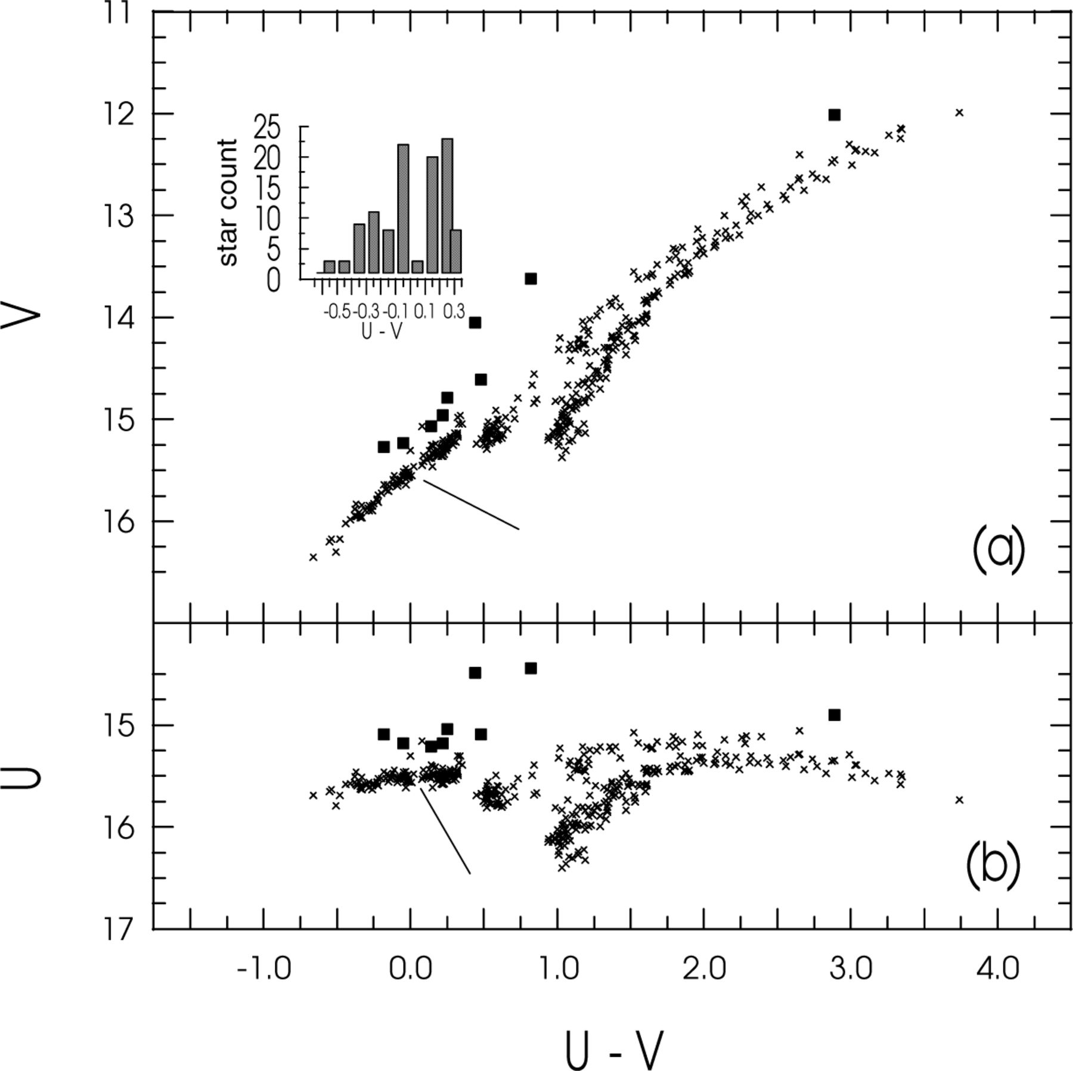
Figure 2. The UV colour–magnitude diagrams. In both diagrams, the place of the suspected gap is indicated by a bar; the ...
Notes:
Figure 2. The UV colour–magnitude diagrams. In both diagrams, the place of the suspected gap is indicated by a bar; the UV-bright stars are marked with squares. In panel (a), above the BHB, the histogram of the stellar counts found in the corresponding colour bins is shown.
Unless provided in the caption above, the following copyright applies to the content of this slide: © 2001 RAS

Slide 3
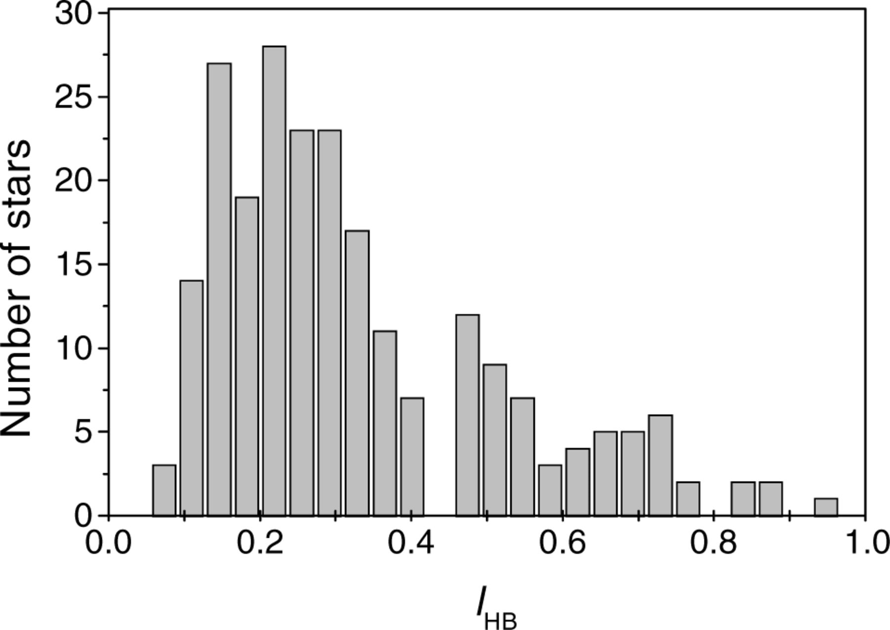
Figure 3. The ℓ_{HB} distribution histogram.
Notes:
Figure 3. The ℓHB distribution histogram.
Unless provided in the caption above, the following copyright applies to the content of this slide: © 2001 RAS

Slide 4
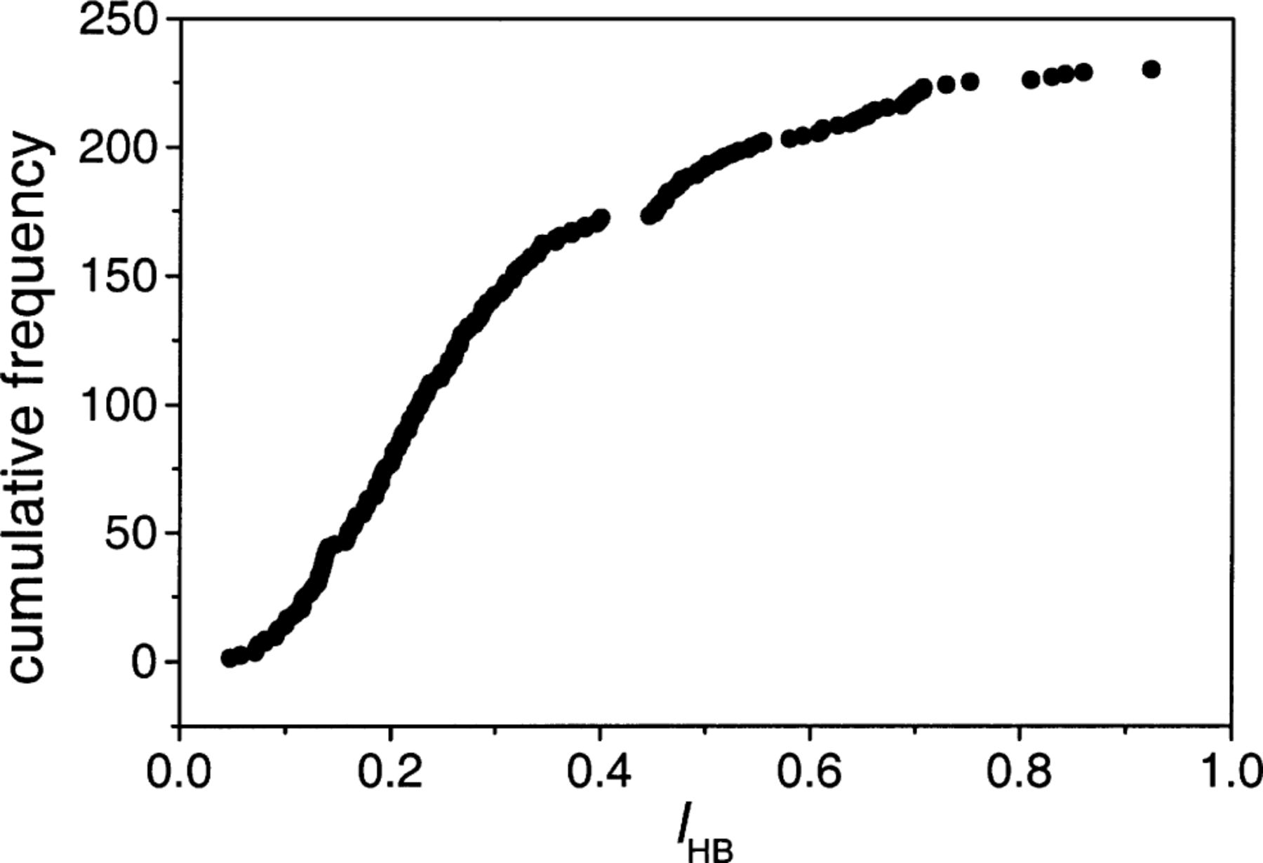
Figure 4. The ℓ_{HB} cumulative distribution function.
Notes:
Figure 4. The ℓHB cumulative distribution function.
Unless provided in the caption above, the following copyright applies to the content of this slide: © 2001 RAS

Slide 5
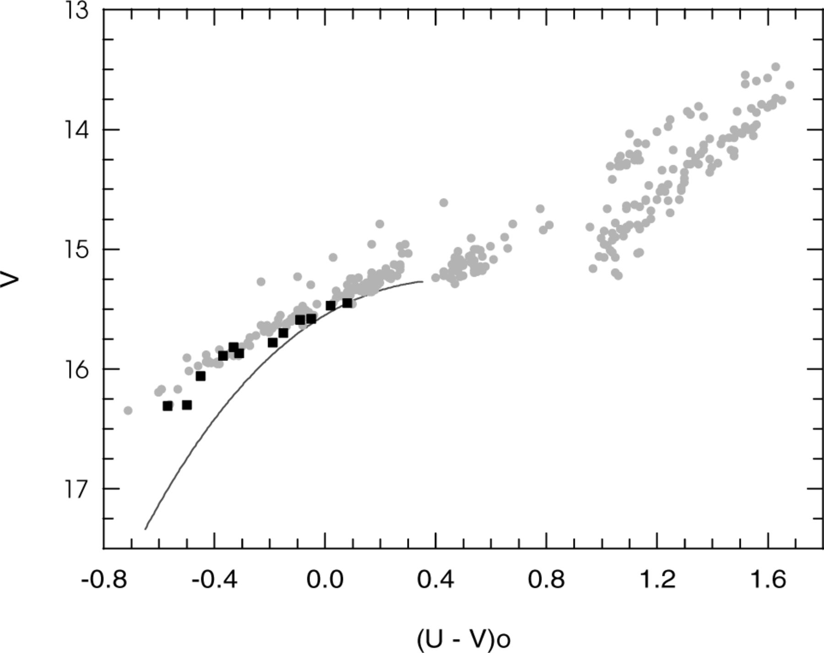
Figure 5. Comparison between the observed BHB (grey points) and the ZAHB (solid line). Note the general discrepancy ...
Notes:
Figure 5. Comparison between the observed BHB (grey points) and the ZAHB (solid line). Note the general discrepancy between observations and theory as well as the more rapidly rising discrepancy for colours below . The squares mark the positions of M5 BHB stars with spectroscopically measured Teffand log g (Crocker et al. 1988).
Unless provided in the caption above, the following copyright applies to the content of this slide: © 2001 RAS

Slide 6
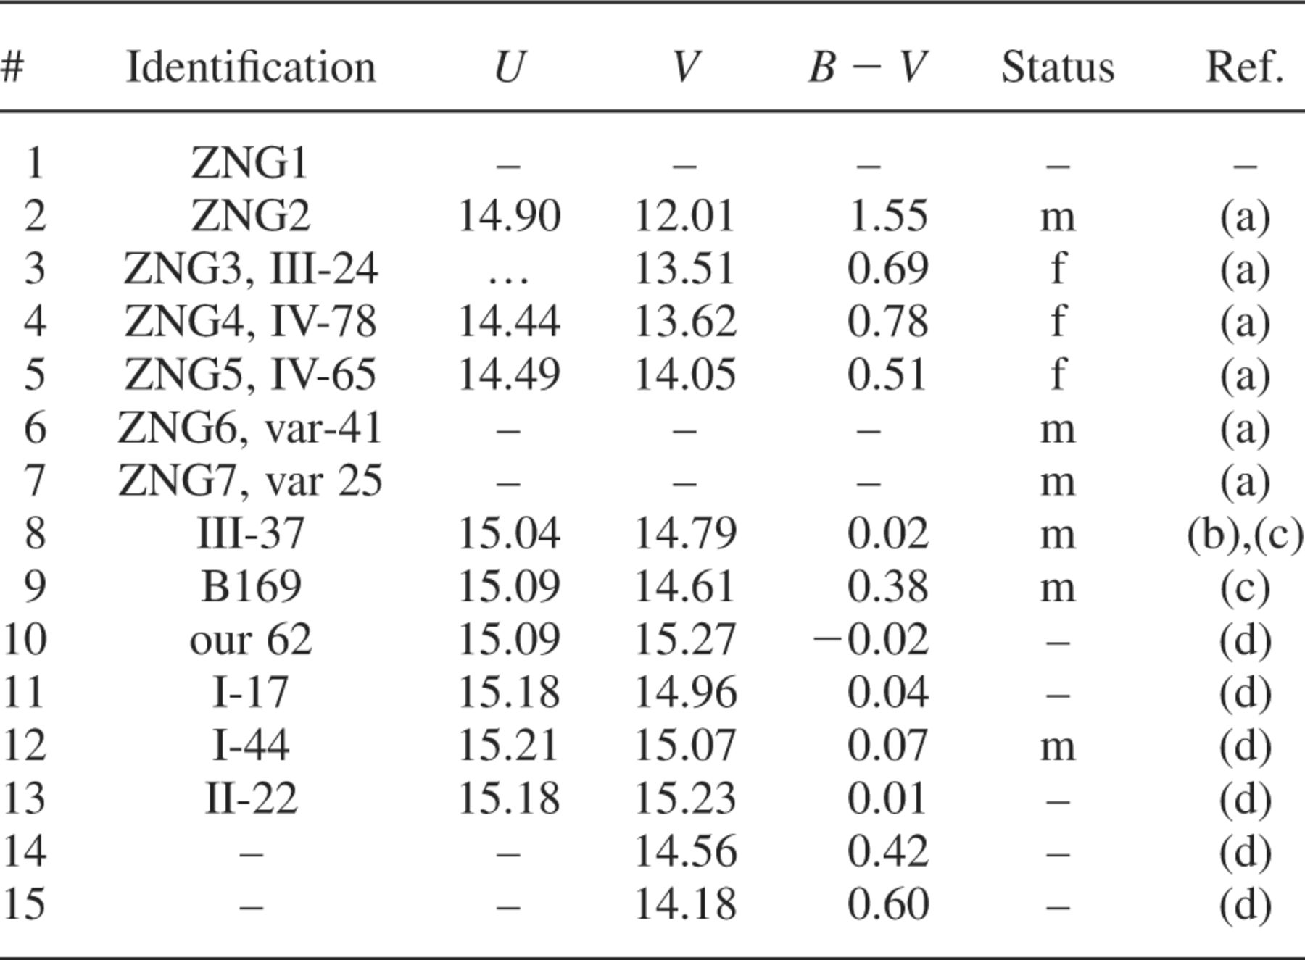
Table 1. Data for UV-bright star candidates detected in GC M5.
Notes:
Table 1. Data for UV-bright star candidates detected in GC M5.
Unless provided in the caption above, the following copyright applies to the content of this slide: © 2001 RAS

Slide 7
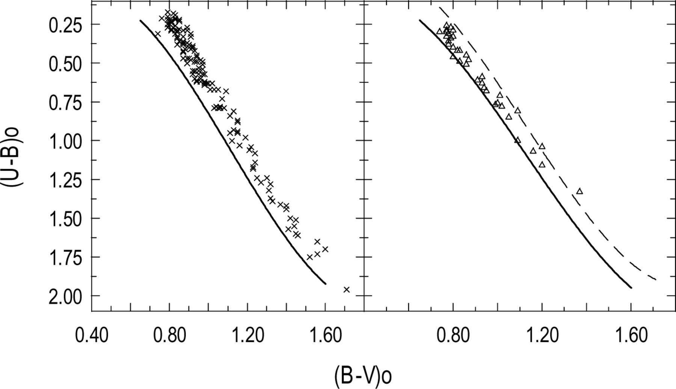
Figure 6. The two-colour diagrams for RGB (left-hand panel) and AGB (right-hand panel) stars. The standard Population I ...
Notes:
Figure 6. The two-colour diagrams for RGB (left-hand panel) and AGB (right-hand panel) stars. The standard Population I line (Allen 1973, solid line) is overlaid on both diagrams. In the right-hand panel, the mean position of the RGB stars is marked with a dashed line.
Unless provided in the caption above, the following copyright applies to the content of this slide: © 2001 RAS

Slide 8
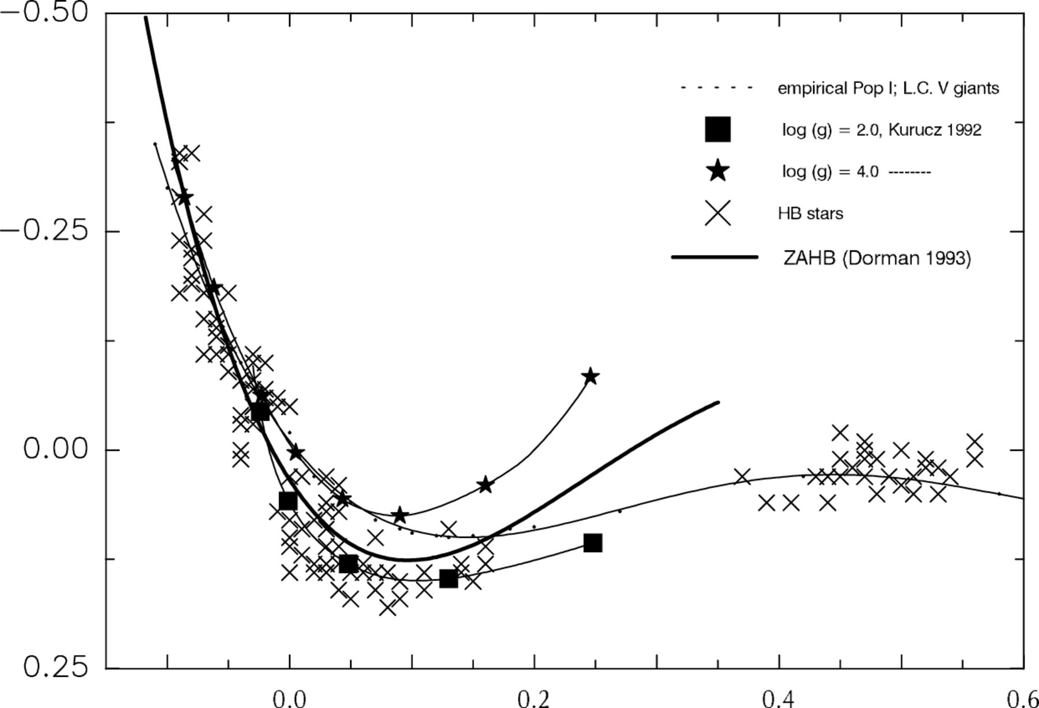
Figure 7. A two-colour diagram for HB stars. The empirical Population I line is marked with a dashed line. ZAHB is also ...
Notes:
Figure 7. A two-colour diagram for HB stars. The empirical Population I line is marked with a dashed line. ZAHB is also overlaid (bold solid line). Two-colour sequences taken from the Kurucz (1992) atmospheric models for two different values of log g are marked with filled stars and squares.
Unless provided in the caption above, the following copyright applies to the content of this slide: © 2001 RAS

Slide 9
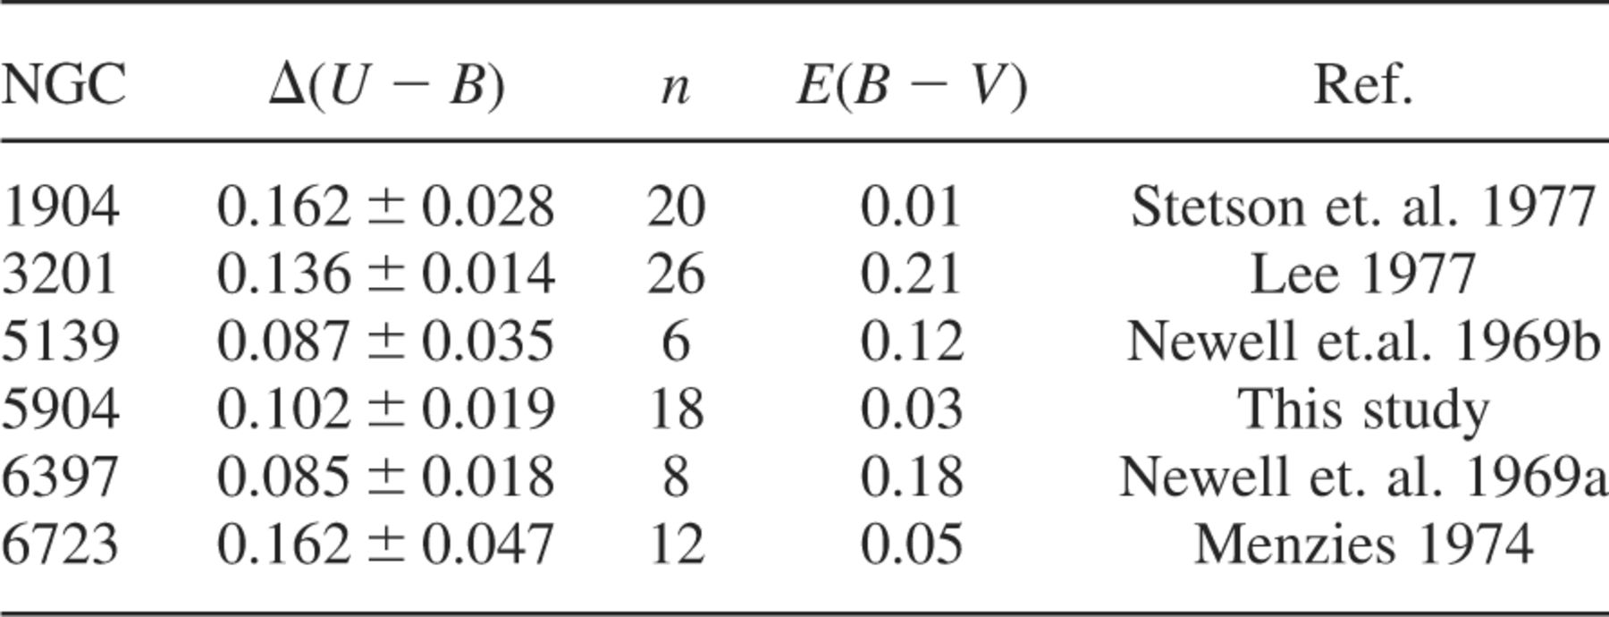
Table 2. The ultraviolet deficiency for cool BHB stars detected in some globulars.
Notes:
Table 2. The ultraviolet deficiency for cool BHB stars detected in some globulars.
Unless provided in the caption above, the following copyright applies to the content of this slide: © 2001 RAS

