Slide 1
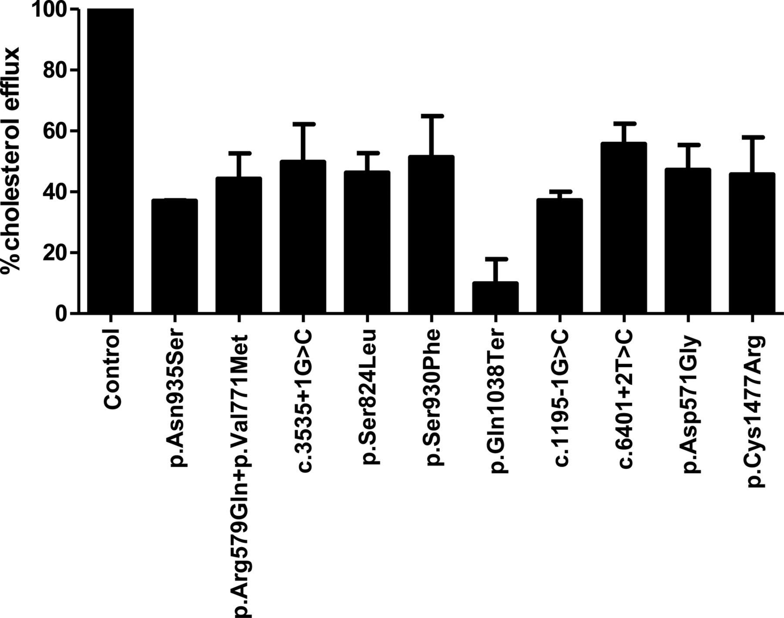
Figure 1 Normalized cholesterol efflux from cultured skin fibroblasts to apoA-I. % Efflux is shown as mean ± SD, n = 3 ...
Notes:
Figure 1 Normalized cholesterol efflux from cultured skin fibroblasts to apoA-I. % Efflux is shown as mean ± SD, n = 3 separate experiments. Fibroblasts from a healthy control were used as a control.
Unless provided in the caption above, the following copyright applies to the content of this slide: Published on behalf of the European Society of Cardiology. All rights reserved. © The Author 2012. For permissions please email: journals.permissions@oup.com

Slide 2
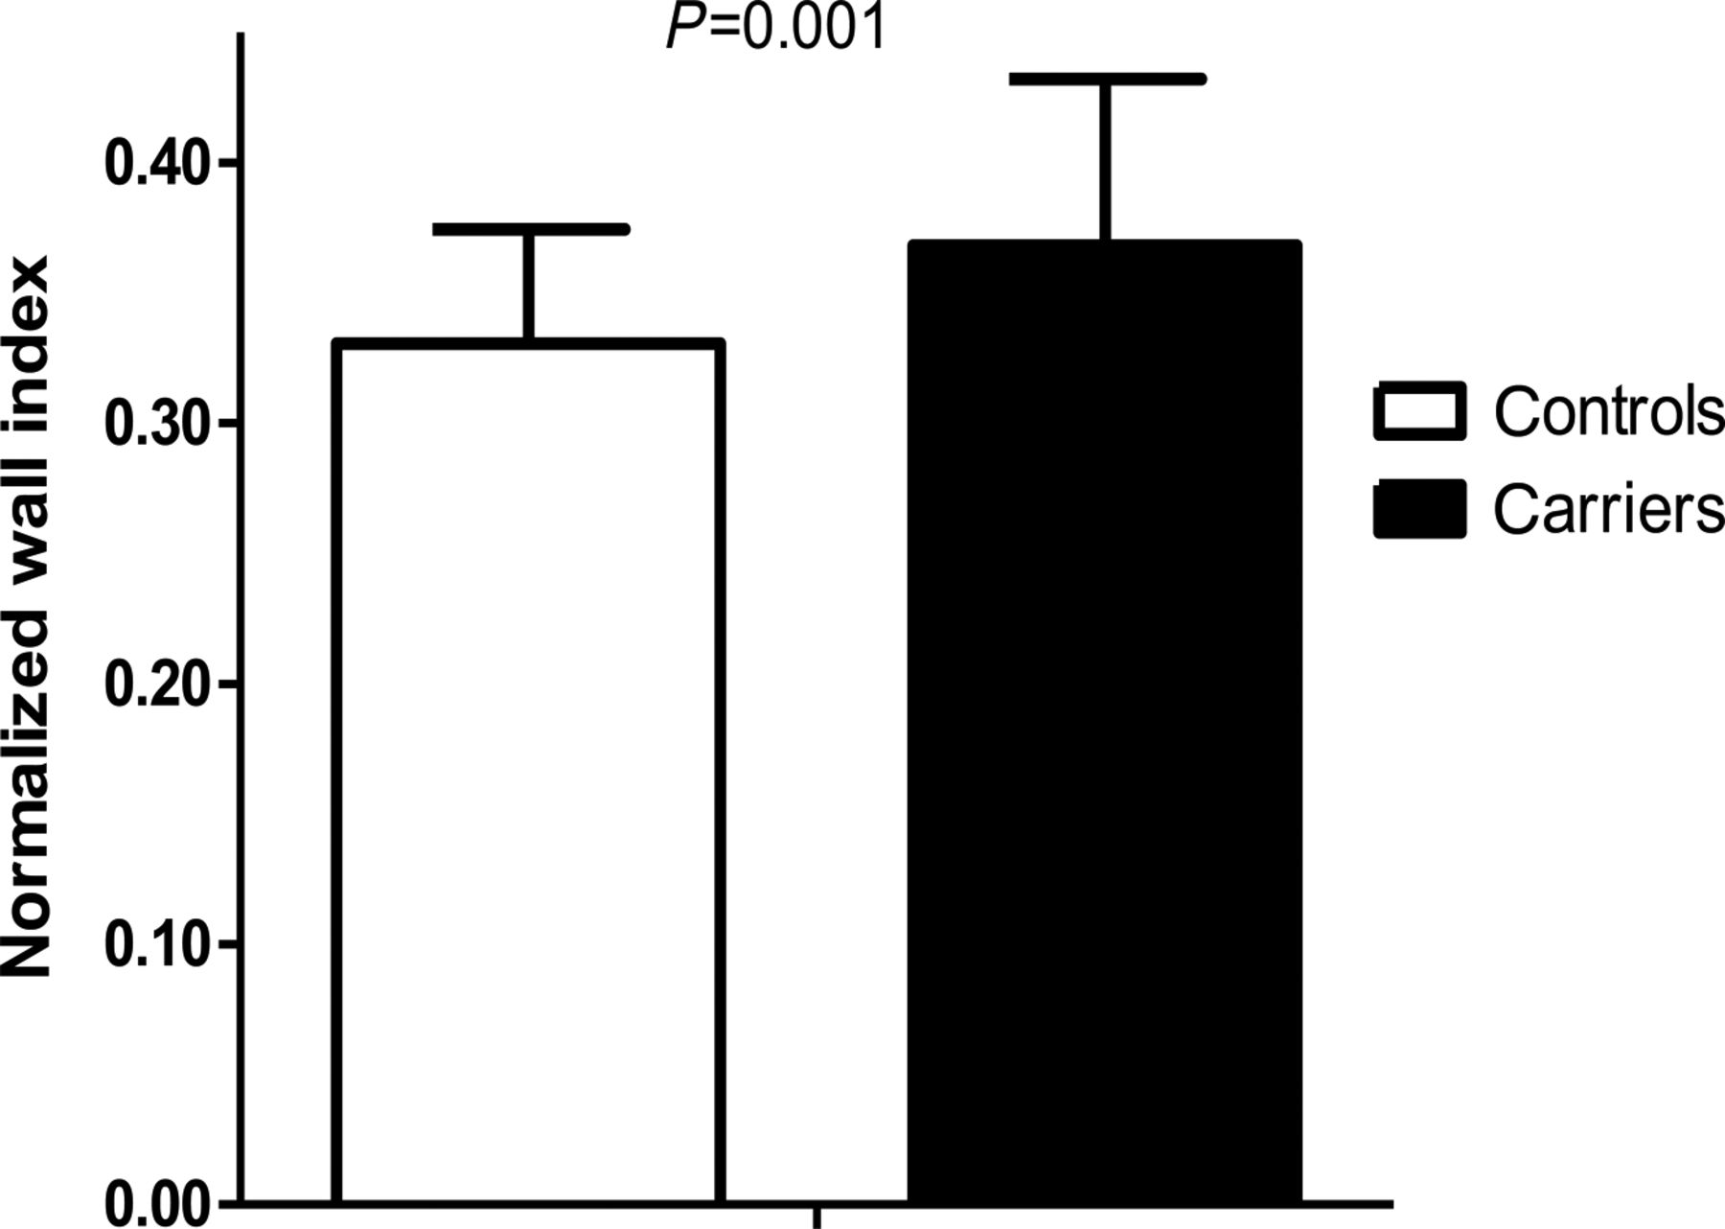
Figure 2 Normalized wall index in ATP-binding cassette transporter A1 mutation carriers vs. controls, corrected for ...
Notes:
Figure 2 Normalized wall index in ATP-binding cassette transporter A1 mutation carriers vs. controls, corrected for smoking, alcohol consumption, systolic blood pressure, diabetes, BMI, history of cardiovascular disease, low-density lipoprotein cholesterol, and statin use. Data are shown as mean ± SD.
Unless provided in the caption above, the following copyright applies to the content of this slide: Published on behalf of the European Society of Cardiology. All rights reserved. © The Author 2012. For permissions please email: journals.permissions@oup.com

Slide 3
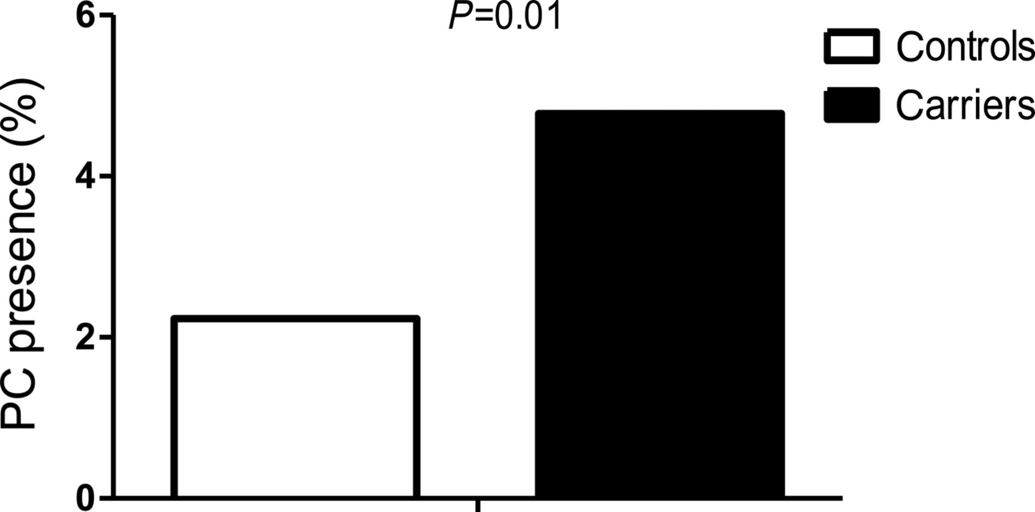
Figure 3 The presence of plaque components expressed as the percentage of slides with plaque components per group.
Notes:
Figure 3 The presence of plaque components expressed as the percentage of slides with plaque components per group.
Unless provided in the caption above, the following copyright applies to the content of this slide: Published on behalf of the European Society of Cardiology. All rights reserved. © The Author 2012. For permissions please email: journals.permissions@oup.com

