Slide 1
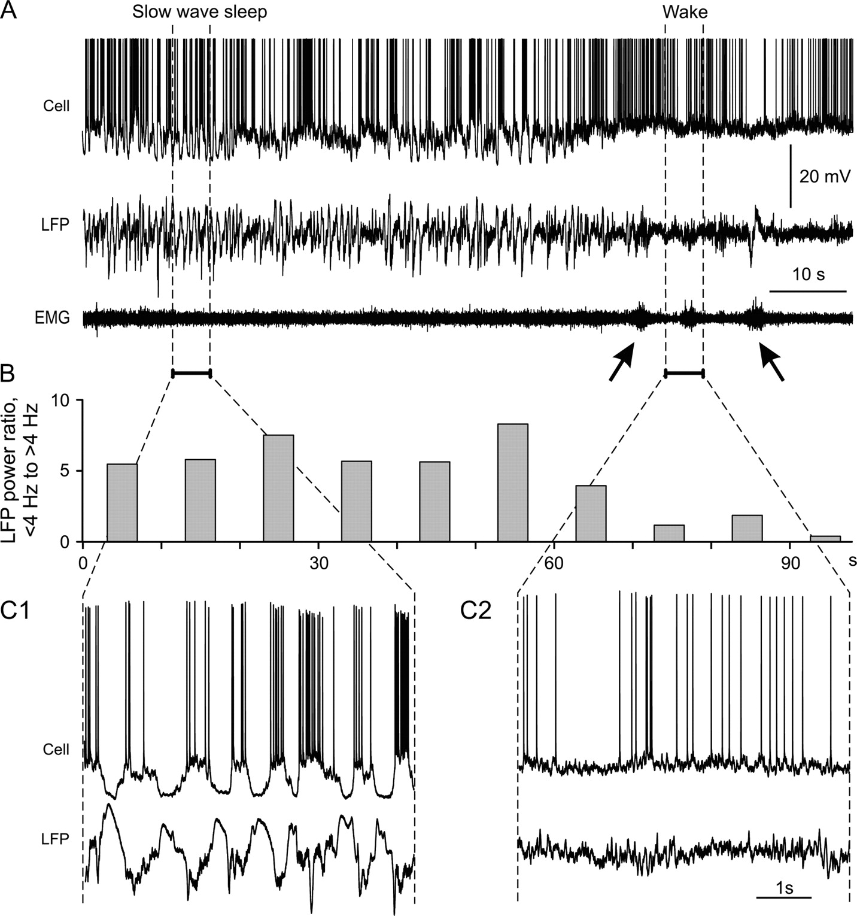
Figure 1 SWS is associated with increased power of the slow components (<4 Hz) in the LFP. (A) Simultaneous ...
Notes:
Figure 1 SWS is associated with increased power of the slow components (<4 Hz) in the LFP. (A) Simultaneous intracellular, LFP, and EMG recording during natural sleep and wakefulness. SWS at the beginning of the recording turns into awake state from about 70 s, as indicated by activations in the EMG (arrows). Action potentials are truncated. (B) Differential spectral composition of the LFP during SWS and wakefulness. For each 10-s period of the LFP recording, power spectra and the ratio of the power at frequencies 4 Hz were calculated. Each bar shows the power ratio during the respective period. Same X-scale as in (A). Note a clear decrease of ratio with awaking of the animal. (C1, C2) Portions from intracellular activity and LFP recording in (A) shown at expanded timescale. Note clear fluctuations of the membrane potential between active and silent states during the SWS but absence of the silent states during the wakefulness.
Unless provided in the caption above, the following copyright applies to the content of this slide: © The Author 2006. Published by Oxford University Press. All rights reserved. For permissions, please e-mail: journals.permissions@oxfordjournals.org

Slide 2
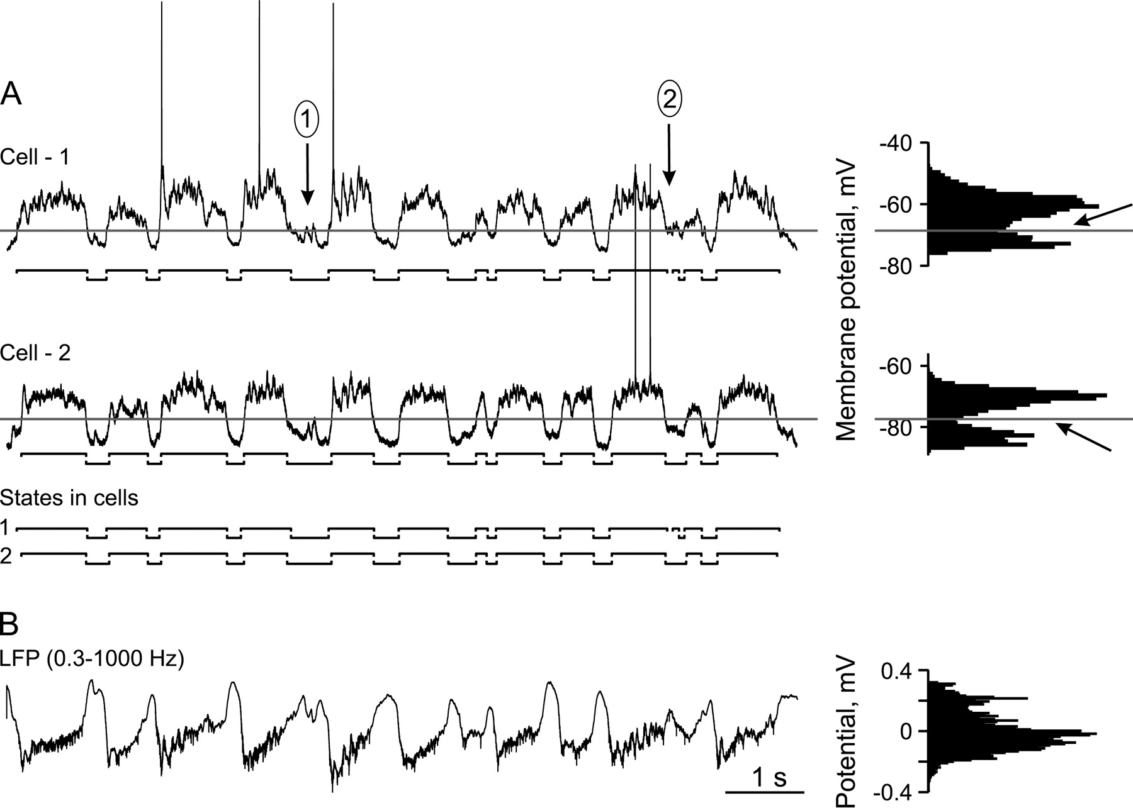
Figure 2 Correlated fluctuations in the membrane potential and LFP. (A) Membrane potential traces of 2 simultaneously ...
Notes:
Figure 2 Correlated fluctuations in the membrane potential and LFP. (A) Membrane potential traces of 2 simultaneously recorded cells. Histograms on the right-hand side show distributions of membrane potential. Oblique arrows point at clear gaps in the bimodal distributions of the membrane potential of each cell. Levels for the separation of active and silent states were positioned in the bottom of these gaps and are shown with horizontal lines. Active and silent states are indicated with horizontal bars under each membrane potential trace. Arrow (1) points at cases when periods above the level were too short (<40 ms) to be considered as an interruption of a state. Arrow (2) points at cases when periods below the level were too short to be interpreted as a state. The sequences of active and silent states in both cells are also shown in the bottom of panel A. Note that occurrence of the states is clearly correlated, but on the fine timescale their synchronization is only loose. (B) LFP recorded with a band-pass filter 0.3–1000 Hz simultaneously with the 2 cells shown in (A). Histogram on the right-hand side shows distribution of LFP values. Note that although the LFP signal correlates with the occurrence of active and silent states in the cells, its amplitude distribution does not express clear bimodality.
Unless provided in the caption above, the following copyright applies to the content of this slide: © The Author 2006. Published by Oxford University Press. All rights reserved. For permissions, please e-mail: journals.permissions@oxfordjournals.org

Slide 3
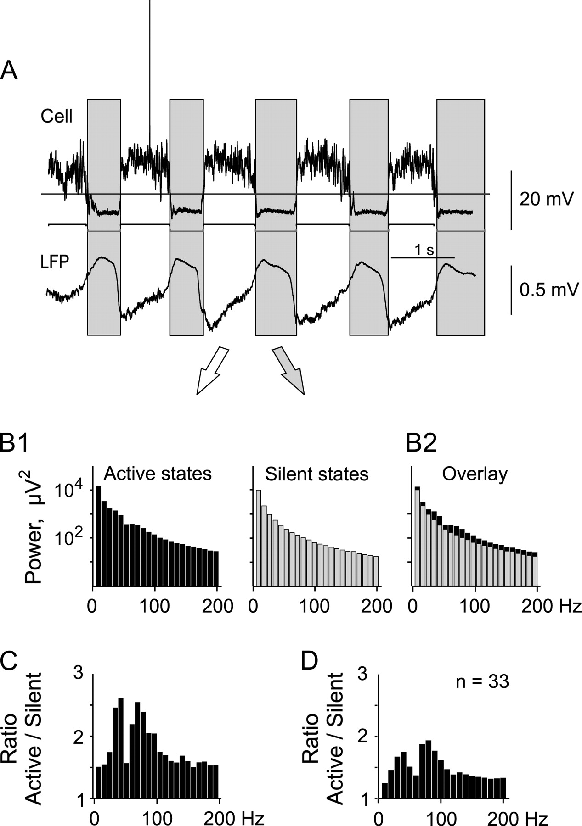
Figure 3 Comparison of power spectrum components in the LFP during the active and silent states in cells. (A) ...
Notes:
Figure 3 Comparison of power spectrum components in the LFP during the active and silent states in cells. (A) Simultaneously recorded membrane potential and LFP signals. Cell has clear active and silent states. The states were detected using a level shown as horizontal line. The detected active and silent states are shown with horizontal bars below the membrane potential trace. Large vertical gray bars mark periods of silent states in the cell. (B) Power spectra of the LFP during periods of the active and silent states in the cell (B1) and superposition of the 2 power spectra (B2). Power spectra are shown with bin width of 10 Hz. Ordinate scaling is logarithmic. Note that all components are smaller during the silent states but the difference is not uniform and depends on frequency. (C) Ratio of the corresponding power spectrum values during active and silent states, calculated for the data from (B). Note that the ratio is maximal in the range between 20 and 100 Hz. A trough around 60 Hz is due to the filtering used during the recording to reduce the contribution of the mains frequency. (D) Same as in (C), but averaged data for 33 cell–LFP pairs. Note that the difference between active and silent states is largest at 20–100 Hz.
Unless provided in the caption above, the following copyright applies to the content of this slide: © The Author 2006. Published by Oxford University Press. All rights reserved. For permissions, please e-mail: journals.permissions@oxfordjournals.org

Slide 4
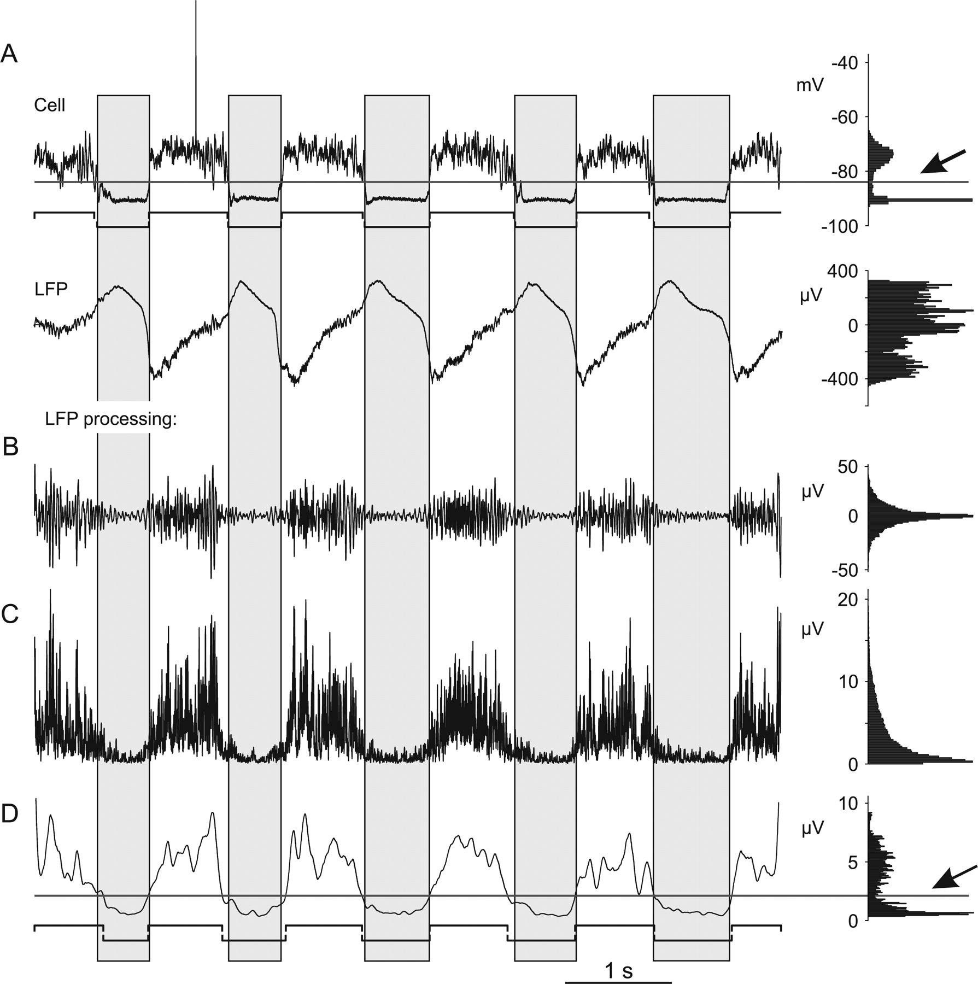
Figure 4 Processing of the LFP signal for detection of active and silent states. Simultaneously recorded membrane ...
Notes:
Figure 4 Processing of the LFP signal for detection of active and silent states. Simultaneously recorded membrane potential and LFP signal (A) and sequential steps of the LFP processing (B–D). (A) Simultaneously recorded membrane potential and LFP signal. Oblique arrow shows a gap in the bimodal distribution of the membrane potential. Horizontal line shows the level for separation of active and silent states in the membrane potential trace. Active and silent states in the cell are marked with horizontal bars below the membrane potential trace. Gray vertical bars mark periods of silent states in the cell. Histograms on the right-hand side show distributions of membrane potential and LFP signal (A) or processed LFP (B–D). (B) Extraction of the frequency components, which are most different between active and silent states, by band-pass filtering in the range 20–100 Hz. (C) Standard deviation of the filtered LFP calculated in a running window of 5-ms length. This operation is equal to root mean square in this case. (D) Linear filtering (50 ms frame) of the signal from (C). The distribution of the processed signal is clearly bimodal; the oblique arrow shows the gap between the modes. The horizontal line shows the level, which was used to separate active and silent states. Detected states are shown with horizontal bars below the trace. Note that the states detected in the LFP correspond, with little deviations, to the states detected from the intracellular recording.
Unless provided in the caption above, the following copyright applies to the content of this slide: © The Author 2006. Published by Oxford University Press. All rights reserved. For permissions, please e-mail: journals.permissions@oxfordjournals.org

Slide 5
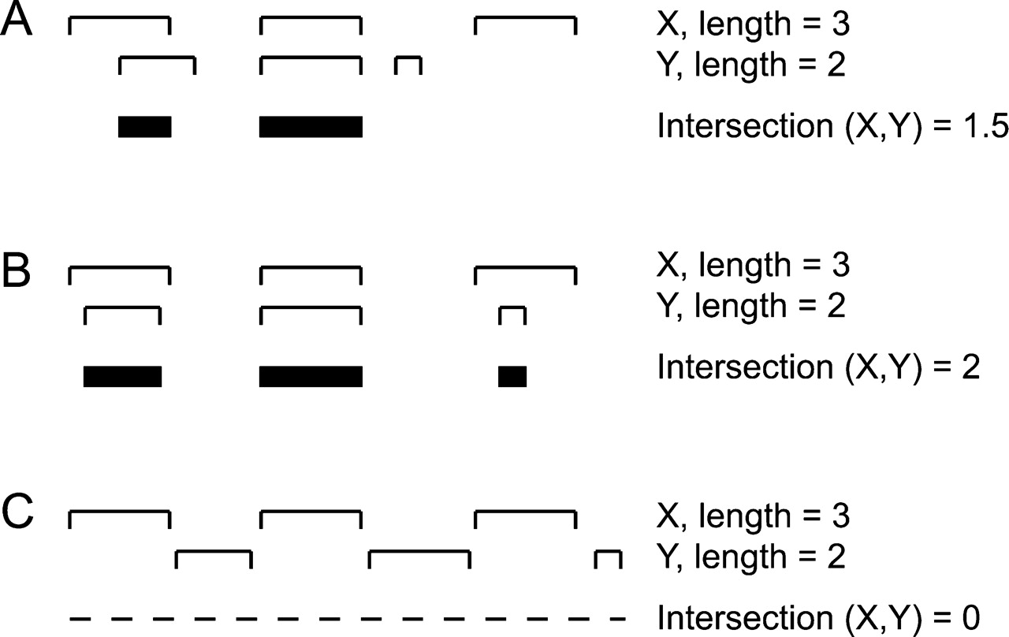
Figure 5 Calculation of CoIn for 3 pairs of hypothetical state sequences. In panel A–C, a pair of sequences of states ...
Notes:
Figure 5 Calculation of CoIn for 3 pairs of hypothetical state sequences. In panel A–C, a pair of sequences of states (X, Y) and their intersection is shown. In the set X, each state has a length of 1. In the set Y, the length of the states is 0.75, 1, 0.25. The 3 examples in A–C differ by relative timing of the states. CoIns, calculated as the ratio of intersection to the mean length, are 60% in (A), 80% in (B), and 0% in (C).
Unless provided in the caption above, the following copyright applies to the content of this slide: © The Author 2006. Published by Oxford University Press. All rights reserved. For permissions, please e-mail: journals.permissions@oxfordjournals.org

Slide 6
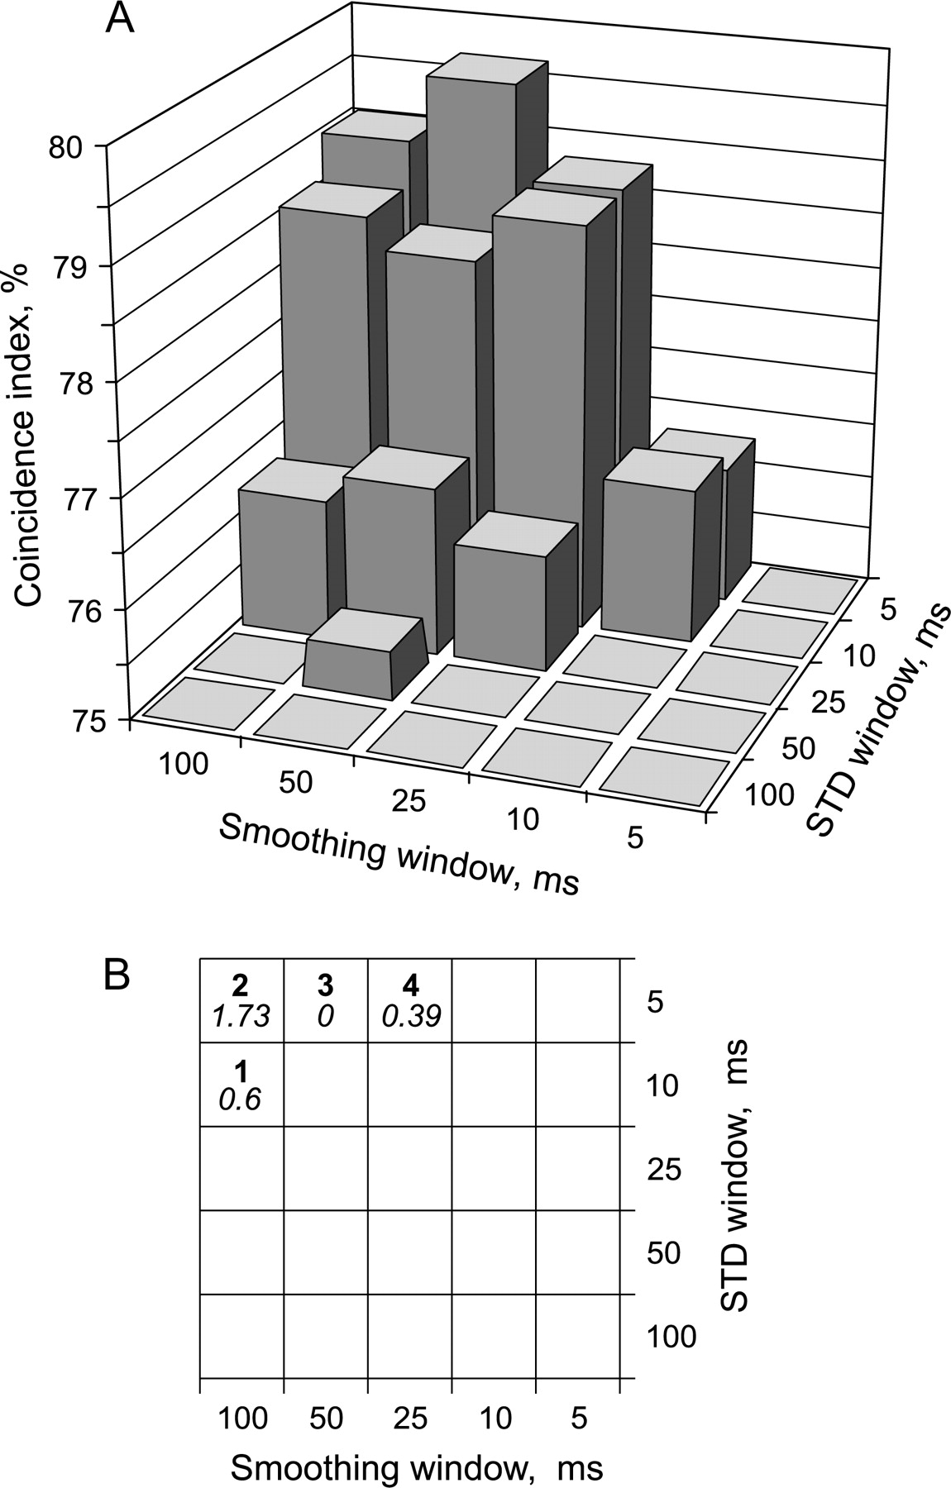
Figure 6 Dependence of the CoIn of the states in data sets consisting of 2 simultaneously recorded neurons and LFP on ...
Notes:
Figure 6 Dependence of the CoIn of the states in data sets consisting of 2 simultaneously recorded neurons and LFP on the length of frames used for calculation of standard deviation and for smoothing. With each combination of the length of the frames, the states were detected in the LFP, and their CoIns with the states in 2 simultaneously recorded cells were calculated. (A) Each bar shows averaged data for 10 data sets. The maximal CoIn and thus optimal detection of states in the LFP were obtained with a 5-ms frame for standard deviation and 50-ms frame for smoothing. (B) For each combination of frame lengths, the number of data sets, for which that combination gave maximal CoIn is shown (bold numbers) together with the mean deviation of the CoIns from those obtained with the sample optimal frames (italic numbers). Note that the CoIns, obtained with the sample optimal frames (5 ms, 50 ms), deviate by less than 2% from the optimal for each data set.
Unless provided in the caption above, the following copyright applies to the content of this slide: © The Author 2006. Published by Oxford University Press. All rights reserved. For permissions, please e-mail: journals.permissions@oxfordjournals.org

Slide 7
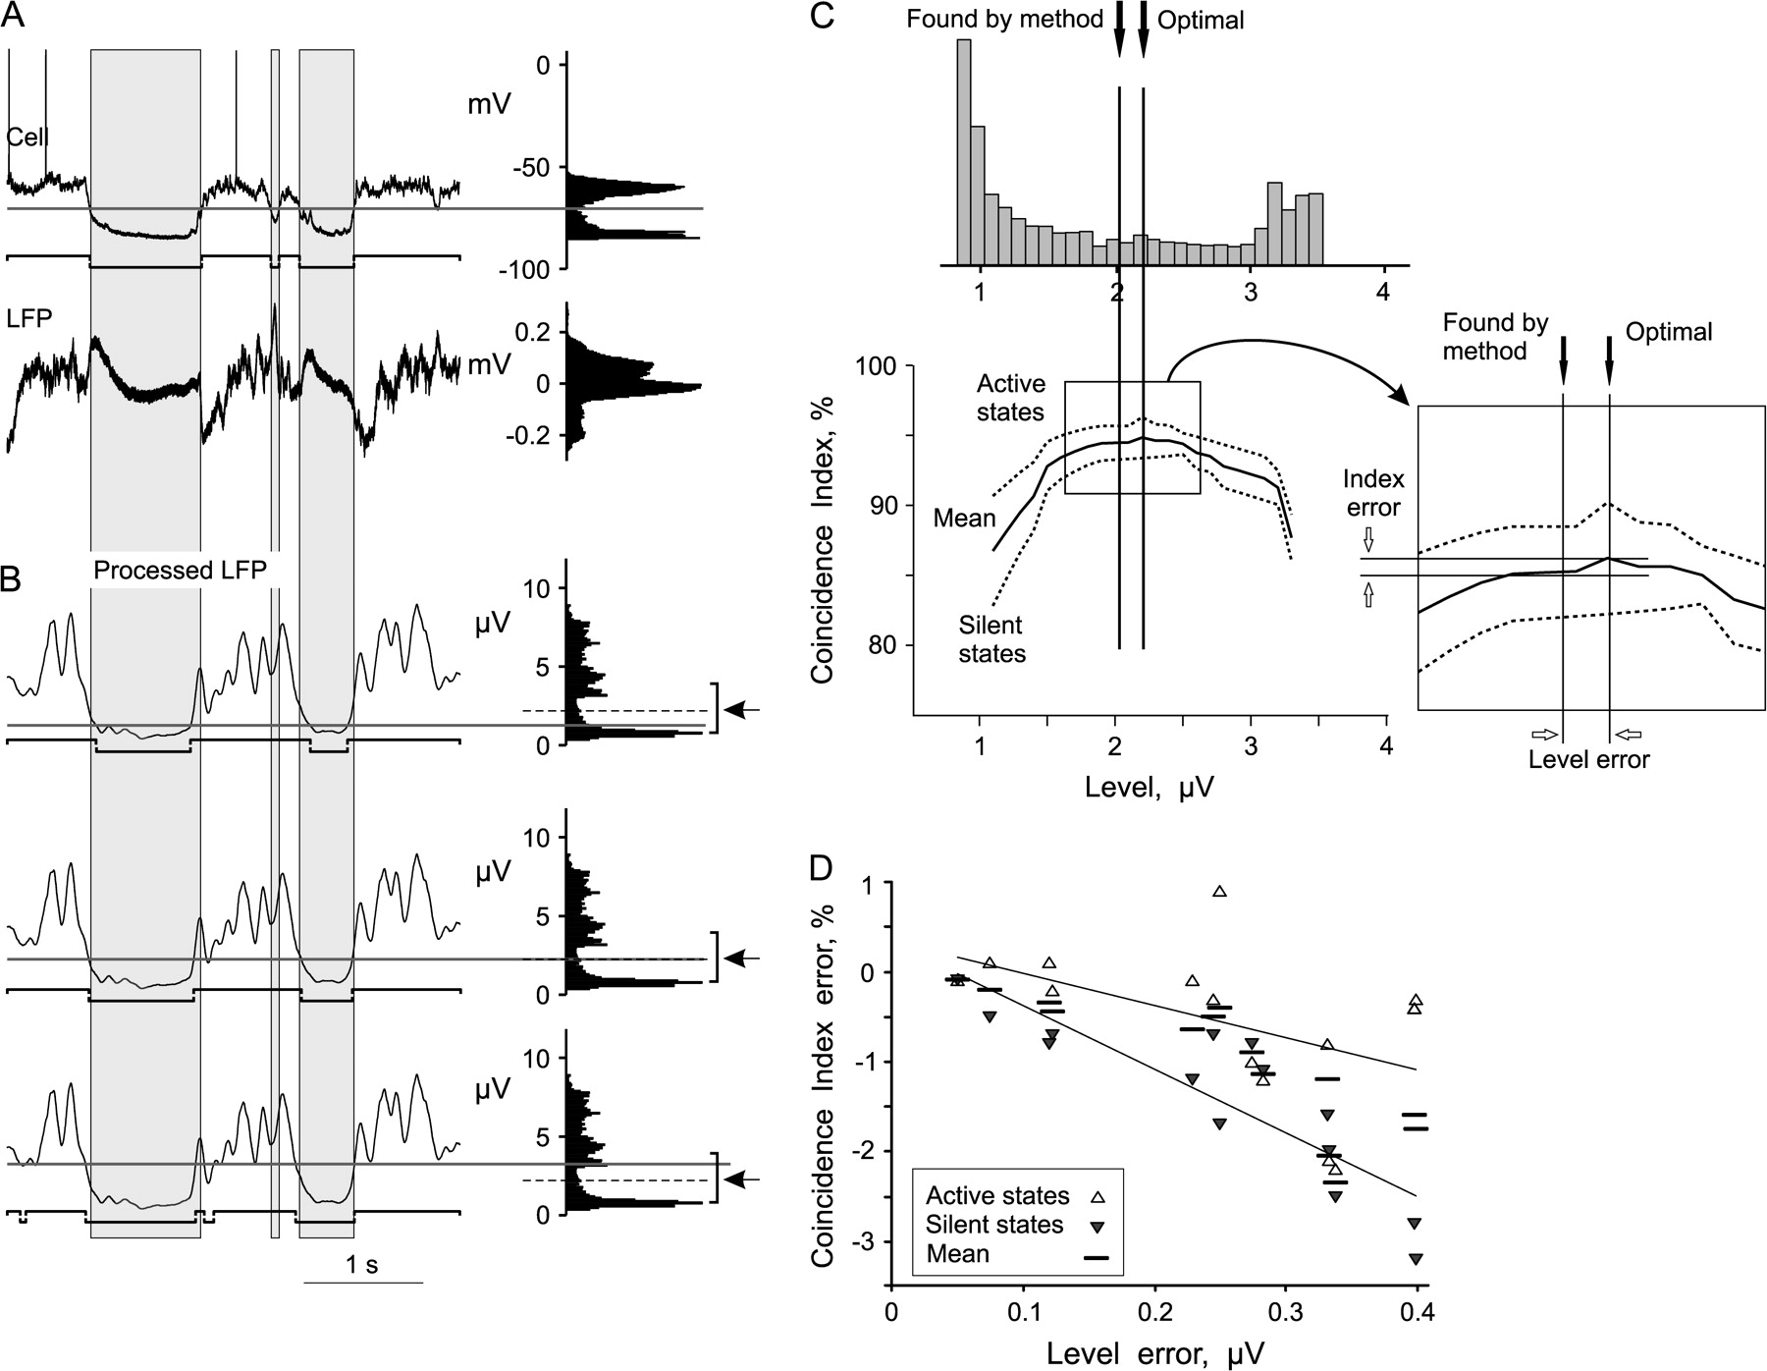
Figure 7 Estimation of the quality of detection of active and silent states in the LFP signal. (A) Simultaneously ...
Notes:
Figure 7 Estimation of the quality of detection of active and silent states in the LFP signal. (A) Simultaneously recorded membrane potential and raw LFP. In the membrane potential trace, solid horizontal line shows the level for the separation of active and silent states, which are marked with horizontal bars below the trace. Gray vertical bars mark periods of silent states in the cell. (B) Three traces of the LFP signal from (A), processed as described before. The 3 panels are identical except for the level used to separate active and silent states and the detected states. The level is indicated with a solid horizontal line, the detected states are shown below each trace. The level was set below the optimum (upper of the 3 panels, level at 1.2 μV), at the optimum (middle panel, level at 2.2 μV), or above it (lower panel, level at 3.2 μV), as indicated. Optimal level for state separation was found by optimization procedure, which maximized the mean of the CoIns (CoInm, coincidence of states in the LFP and in the cell) for active and silent states. In each of the 3 distributions, optimal level is shown with an interrupted line and an arrow. With the level set below the optimal, the active states got excessively enlarged and silent states shrunk (vice versa in case of the level set above the optimum). In either case the coincidence of the states found in the LFP with the states observed in the membrane potential decreases, leading to the smaller values of the CoIns. (C) Coincidence between the states in the cell and the LFP (CoIns) plotted against state separation level (results from the same data as in A, B). The part of the distribution of the potential values of the processed LFP signal, marked by the vertical bars to the right from distributions in (B) is shown above the plot, at the X-scale identical to that of the plot. In the plot, dependence of the CoIns between cell and LFP on the level setting is shown for active and silent states, CoInup and CoIndown (dotted lines), and for the mean CoIn (CoInm) (solid line). Optimal level and the level found by the method are indicated with vertical lines and arrows. In the inset, “Level error” and “Index error” illustrate how the values for the plot in D were calculated. (D) CoIn errors (ordinate) plotted against level errors for 14 cell–LFP pairs. Upward-pointed triangle symbols: active states, downward-pointed triangles: silent states, mean: horizontal bars. Note that in all cases, the CoIns between the states in the cell and the states found in the LFP deviate from the optimum by less than 3%.
Unless provided in the caption above, the following copyright applies to the content of this slide: © The Author 2006. Published by Oxford University Press. All rights reserved. For permissions, please e-mail: journals.permissions@oxfordjournals.org

Slide 8
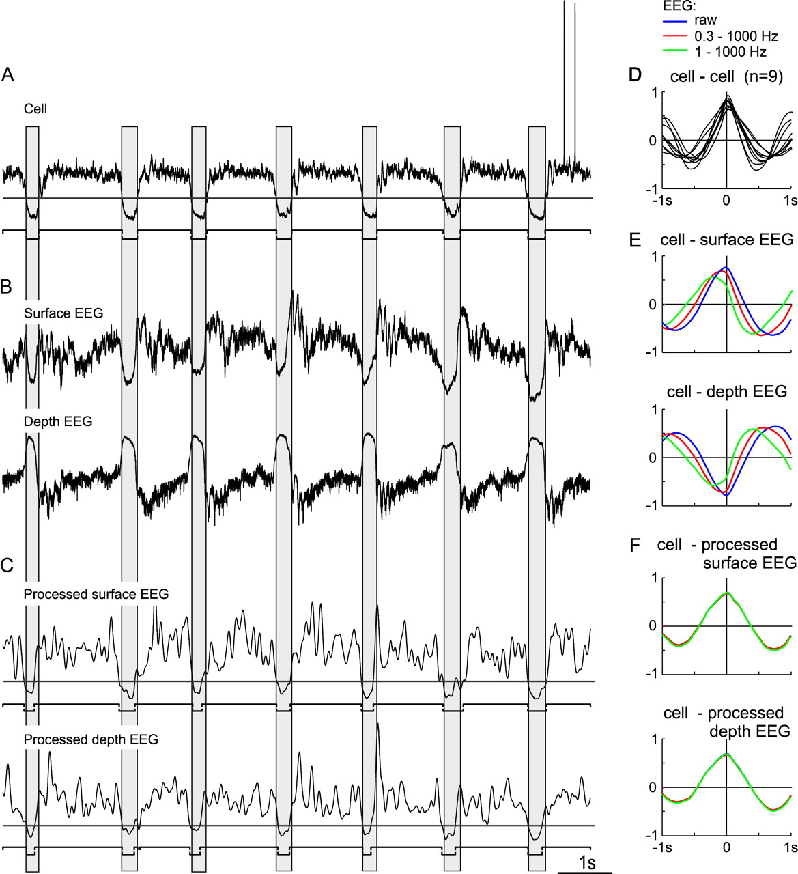
Figure 8 Detection of active and silent states from the EEG recorded with surface and depth electrodes and their ...
Notes:
Figure 8 Detection of active and silent states from the EEG recorded with surface and depth electrodes and their relation to the states in the intracellularly recorded neuron. (A) Membrane potential trace. Active and silent states in the cell are marked with horizontal bars below the trace; horizontal line shows level for their separation. Gray vertical bars mark periods of silent states in the cell. (B) Surface and depth EEG recorded simultaneously with the cell in (A). Note a nearly contraphase relation between the surface and depth EEG. As a result, the slow waves of the membrane potential in the cell in (A) are inphase with the surface EEG but in contraphase to the depth EEG. (C) Processed surface and depth EEG (see Fig. 4B–D for details of the processing). Horizontal lines show levels for the separation of active and silent states. Active and silent states are marked with horizontal bars below the traces. Note that the states detected in both surface and depth LFP corresponds, with little deviations, to the states detected from the membrane potential recording. (D) Correlation between membrane potential changes in pairs of simultaneously recorded cells. Cross-correlograms for 9 pairs are superimposed. Note positive correlation with little phase shift in all 9 pairs of cells. (E) Correlation between membrane potential changes in a cell and the EEG, recorded simultaneously with surface or depth electrodes. The correlograms, computed between membrane potential and raw EEG (blue) and filtered EEG (red and green, band-pass filtered as indicated) are shown superimposed. Note that 1) slow waves in the intracellular activity are in phase with the surface EEG, but in contraphase to the depth EEG, and 2) the phase shift between the intracellular activity and the EEG depends on filtering. (F) Correlation between membrane potential changes in a cell and processed surface and depth EEG, raw or filtered. Same data as in (B) were used. The blue, red, and green correlograms are superimposed and overlap almost completely. Note that the phase relation between the EEG processed with our method and intracellular activity remains the same, irrespective of the location of the recording electrode (surface or depth EEG recording) and filtering of the EEG.
Unless provided in the caption above, the following copyright applies to the content of this slide: © The Author 2006. Published by Oxford University Press. All rights reserved. For permissions, please e-mail: journals.permissions@oxfordjournals.org

Slide 9
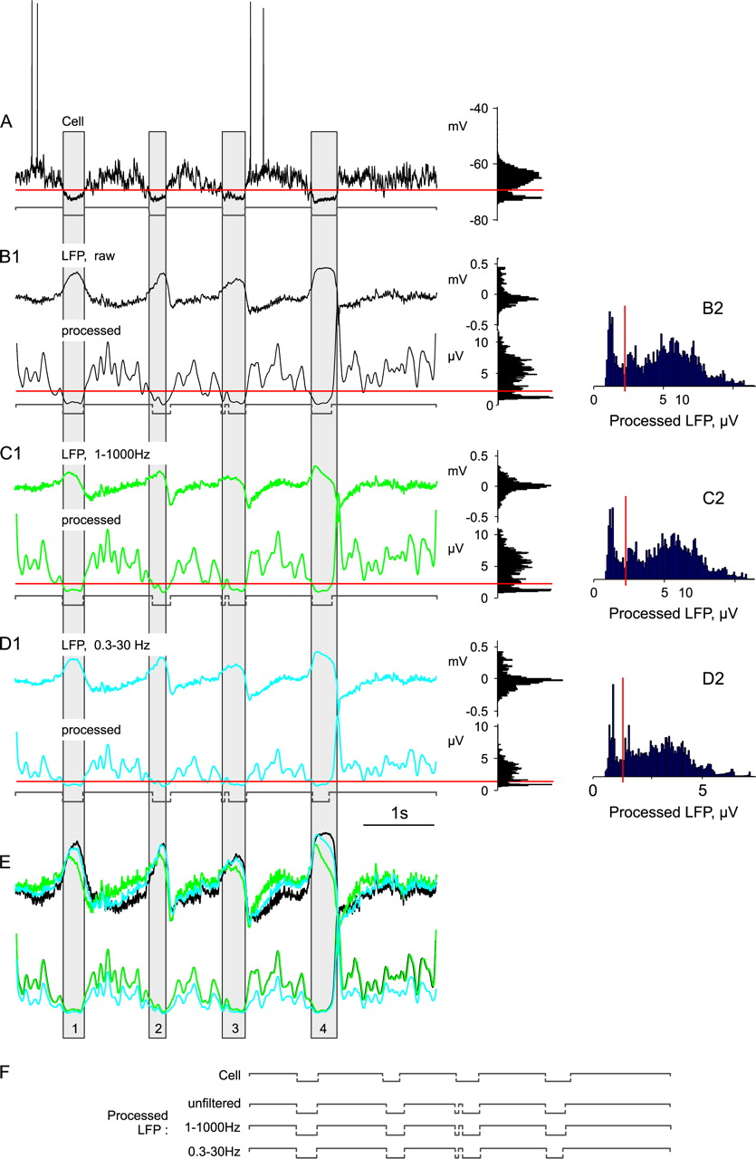
Figure 9 Detection of active and silent states in the filtered LFP signals, and their comparison with the states in a ...
Notes:
Figure 9 Detection of active and silent states in the filtered LFP signals, and their comparison with the states in a cell. Traces of the simultaneously recorded membrane potential in a neocortical neuron (A), LFP (B1), and filtered LFP (C1, D1). Below each LFP trace (B1–D1), processed signal with the level for state separation (horizontal line) and detected active and silent states (horizontal bars below the trace) are shown. Gray vertical bars in (A–E) mark periods of silent states in the cell. Histograms on the right-hand side show distributions of the potential values from the corresponding traces. (B2–D2) show distributions of the processed LFP signal with the levels for state detection at expanded scale and below each other to facilitate the comparison. (E) Superposition of the 3 unprocessed (upper) and processed (lower) LFP traces from (B–D), at expanded Y-scale. Note that filtering introduces a phase shift to the LFP signal and changes its phase relation to the slow waves in the membrane potential trace. In the processed LFP signal, filtering changes only the amplitude but not the phase relation to the membrane potential waves. (F) Sequences of active and silent states, as detected in the cell, unfiltered LFP, and in band-pass filtered LFP. Note that the states detected by our method in the filtered LFP correspond well to the states found in both, the intracellular recording and the raw LFP signal.
Unless provided in the caption above, the following copyright applies to the content of this slide: © The Author 2006. Published by Oxford University Press. All rights reserved. For permissions, please e-mail: journals.permissions@oxfordjournals.org

Slide 10
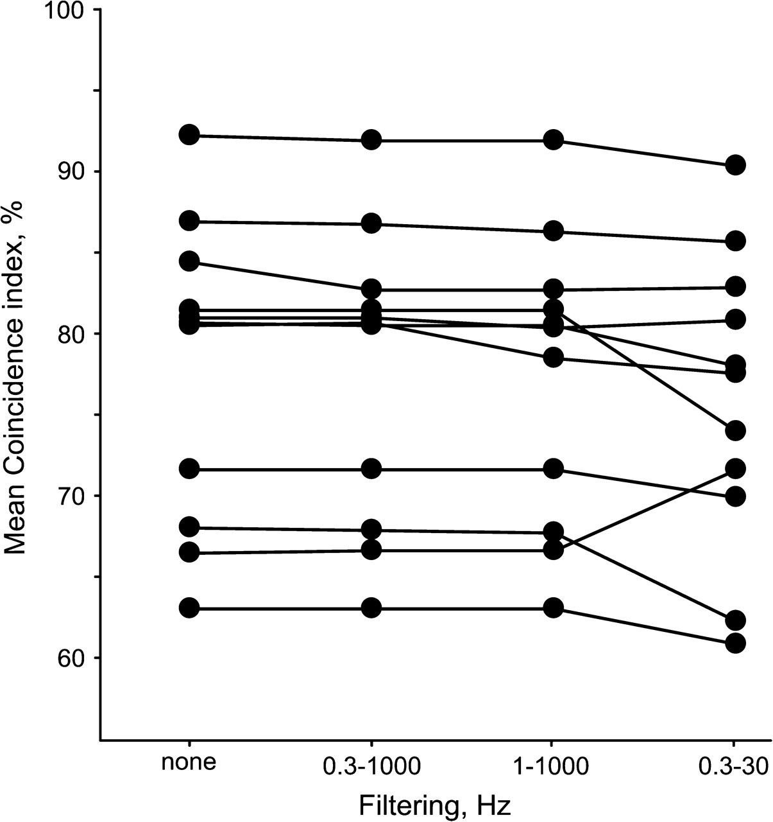
Figure 10 Effect of prefiltering on state detection in the LFP signal, and coincidence of the detected states with the ...
Notes:
Figure 10 Effect of prefiltering on state detection in the LFP signal, and coincidence of the detected states with the states in 2 simultaneously recorded neurons. In each data set, consisting of 2 simultaneously recorded neurons and LFP, active and silent states in the LFP were detected 4 times: in a raw LFP signal, and after prefiltering, as indicated. The CoIns of detected states with the states in 2 simultaneously recorded cells were then calculated. Data for 11 data sets; results for each data set are connected with a line.
Unless provided in the caption above, the following copyright applies to the content of this slide: © The Author 2006. Published by Oxford University Press. All rights reserved. For permissions, please e-mail: journals.permissions@oxfordjournals.org

Slide 11
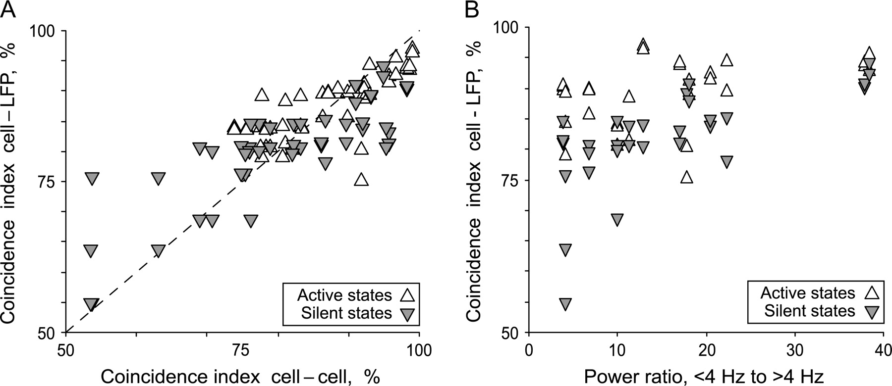
Figure 11 Factors contributing to the variability of the coincidence between the states detected in the LFP signal and ...
Notes:
Figure 11 Factors contributing to the variability of the coincidence between the states detected in the LFP signal and those seen in neurons. (A) Coincidence of active and silent states in pairs cell–cell and cell–LFP. For this plot, data from 2–3 simultaneously recorded cells and the LFP signal were used, allowing to compose several pairs. Each point shows data for simultaneously recorded pairs cell–cell (abscissa) and cell–LFP (ordinate). Note correlated changes of the CoIns between pairs cell–LFP and cell–cell. (B) Dependence of the state coincidence in cells and in the LFP on the spectral composition of the LFP signal. Note that with increasing power of the low-frequency components in the LFP, the coincidence between states in cells and LFP increases and its variability decreases. Upward-pointed triangles: data for the active states; gray downward-pointed: data for the silent states.
Unless provided in the caption above, the following copyright applies to the content of this slide: © The Author 2006. Published by Oxford University Press. All rights reserved. For permissions, please e-mail: journals.permissions@oxfordjournals.org

