Slide 1
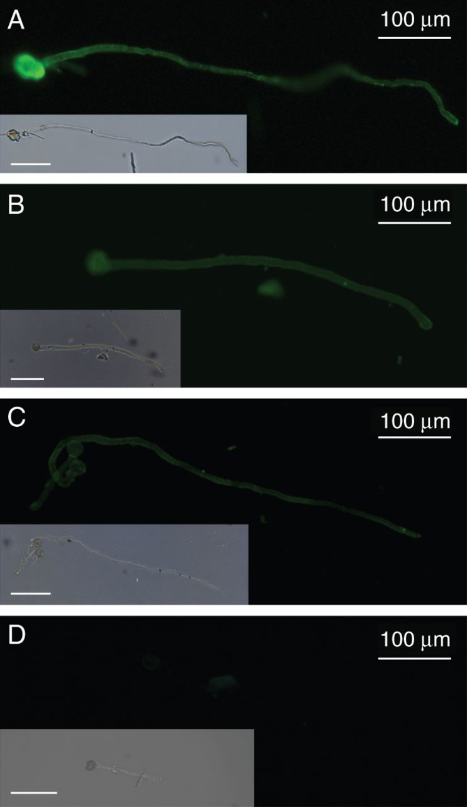
Fig. 2. Immunolocalization of RG-II in the cell wall of pollen tubes using the anti-RG-II antibody described by Matoh ...
Notes:
Fig. 2. Immunolocalization of RG-II in the cell wall of pollen tubes using the anti-RG-II antibody described by Matoh et al. (1998). (A) Arabidopsis thaliana Col-0, (B) Nicotiana benthamiana and (C) Solanum lycopersicum var. cerasiforme WVA 106. (D) Negative control of A. thaliana pollen tubes. Inserts are the bright field images of the same pollen tubes. Scale bars = 100 μm.
Unless provided in the caption above, the following copyright applies to the content of this slide: © The Author 2014. Published by Oxford University Press on behalf of the Annals of Botany Company. All rights reserved. For Permissions, please email: journals.permissions@oup.com

Slide 2
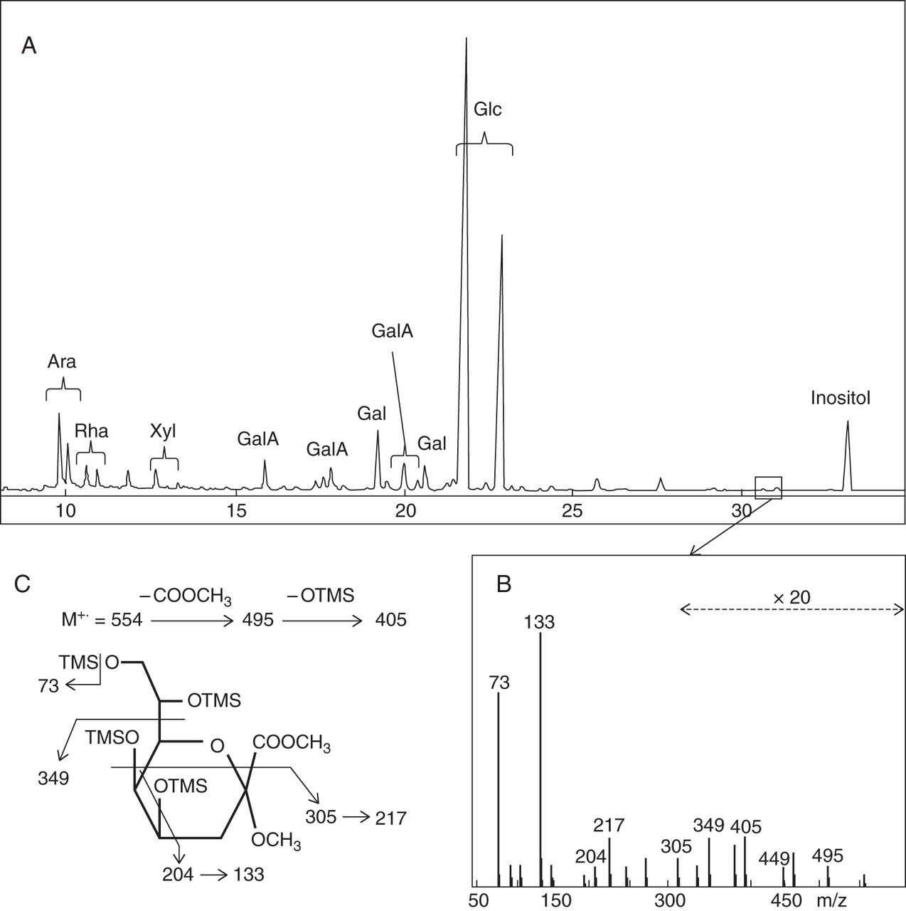
Fig. 3. Identification of Kdo in a hot water extract from 6-hour-old arabidopsis pollen tubes. (A) Gas chromatogram ...
Notes:
Fig. 3. Identification of Kdo in a hot water extract from 6-hour-old arabidopsis pollen tubes. (A) Gas chromatogram of trimethylsilyl (TMS) derivatives of the methyl glycosides, (B) electron impact mass spectrum (EIMS) of the minor peaks boxed in the chromatogram and (C) assignment of EIMS fragmentation ions showing that the minor peaks are Kdo derivatives. Ara, arabinose; Gal, galactose; GalA, galacturonic acid; Glc, glucose; Rha, rhamnose; Xyl, xylose.
Unless provided in the caption above, the following copyright applies to the content of this slide: © The Author 2014. Published by Oxford University Press on behalf of the Annals of Botany Company. All rights reserved. For Permissions, please email: journals.permissions@oup.com

Slide 3
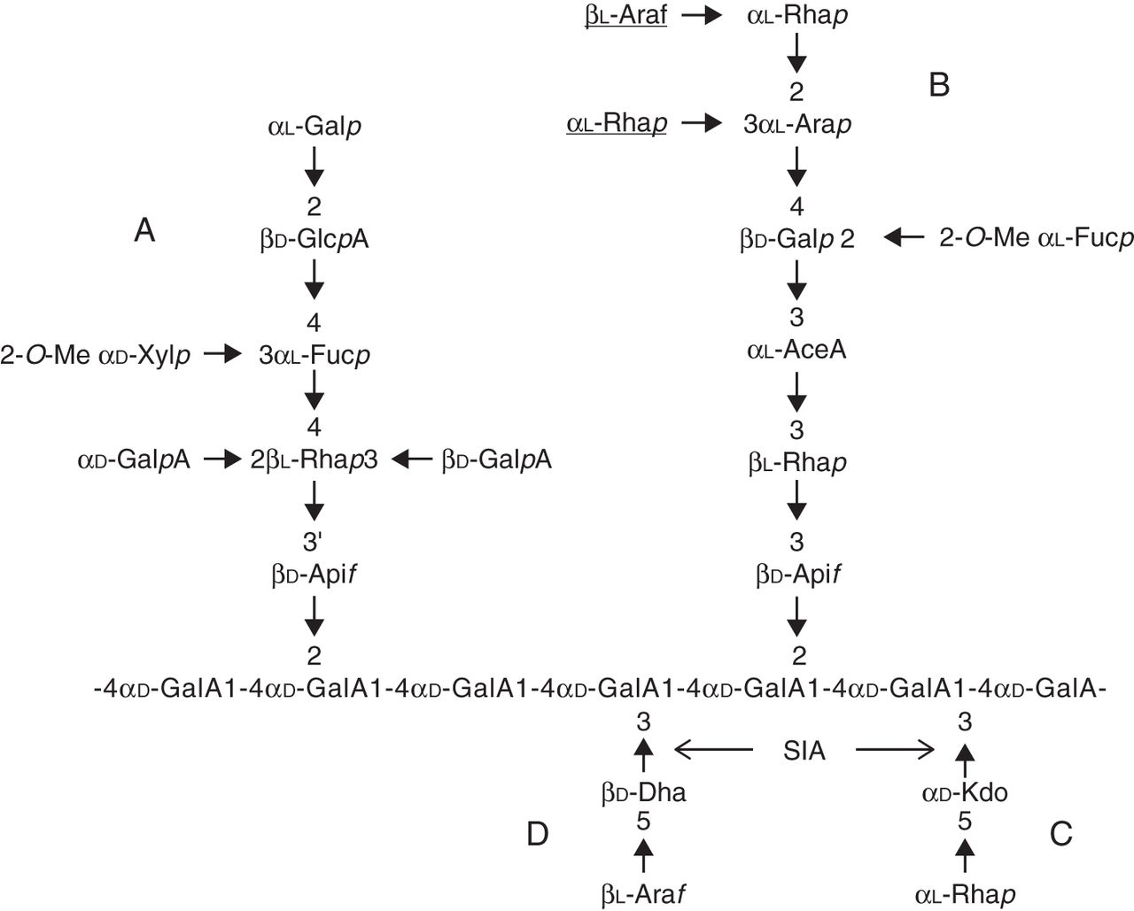
Fig. 1. Structure of RG-II. The sugars underlined are absent in arabidopsis RG-II. Arrows indicate the glycosyl ...
Notes:
Fig. 1. Structure of RG-II. The sugars underlined are absent in arabidopsis RG-II. Arrows indicate the glycosyl linkages that are postulated to result from the action of sialyltransferase-like SIA1 (At1g08660) and SIA2 (At3g48820) proteins.
Unless provided in the caption above, the following copyright applies to the content of this slide: © The Author 2014. Published by Oxford University Press on behalf of the Annals of Botany Company. All rights reserved. For Permissions, please email: journals.permissions@oup.com

Slide 4
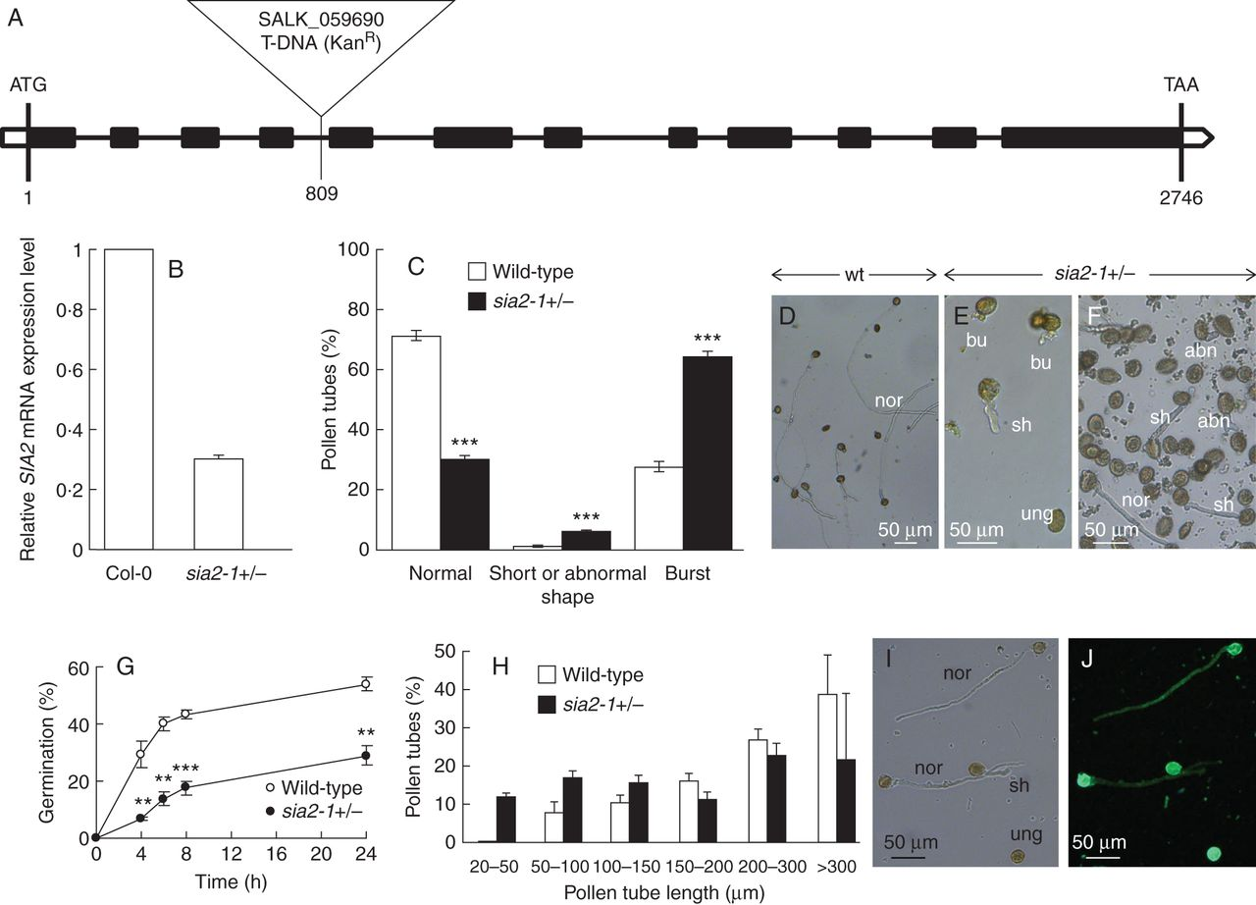
Fig. 4. Characterization of the sia2-1 mutant. (A) Genomic organization of the SIA2–1 gene and location of the T-DNA ...
Notes:
Fig. 4. Characterization of the sia2-1 mutant. (A) Genomic organization of the SIA2–1 gene and location of the T-DNA insertion site. The black boxes indicate the exons. (B) Relative expression levels of SIA2 in Col-0 and sia2-1+/– quantified in inflorescences using three references genes (At3g28750, At3g57690 and At5g59370). Similar variations were observed with the three references genes and the three biological replicates. Only the results obtained with At3g28750 are shown using the SIA2–1-flanking primer pair. (C) In vitro germination of pollen grains from sia2-1+/– and wild-type plants (see key) showing the percentage of normal and abnormal pollen tubes (n >2000) after 6 h of culture. (D) In vitro culture of wild-type pollen tubes. Pollen grains were cultured for 6 h at 22 °C. (E, F) In vitro culture of 6-hour-old sia2-1+/– pollen tubes showing ungerminated pollen grains (ung), normal (nor), short (sh), burst (bu) and abnormal (abn) pollen tubes. (G) Time course of pollen germination from sia2-1+/– and wild-type plants (n >3000). (H) Comparison of sia2-1+/– and wild-type pollen tube length after 6 h of culture (n >300). (I, J) Bright field (I) and epifluorescent (J) images of sia2-1+/– pollen tubes labelled with the anti-RG-II antibody. **P <0·01; ***P <0·001.
Unless provided in the caption above, the following copyright applies to the content of this slide: © The Author 2014. Published by Oxford University Press on behalf of the Annals of Botany Company. All rights reserved. For Permissions, please email: journals.permissions@oup.com

Slide 5
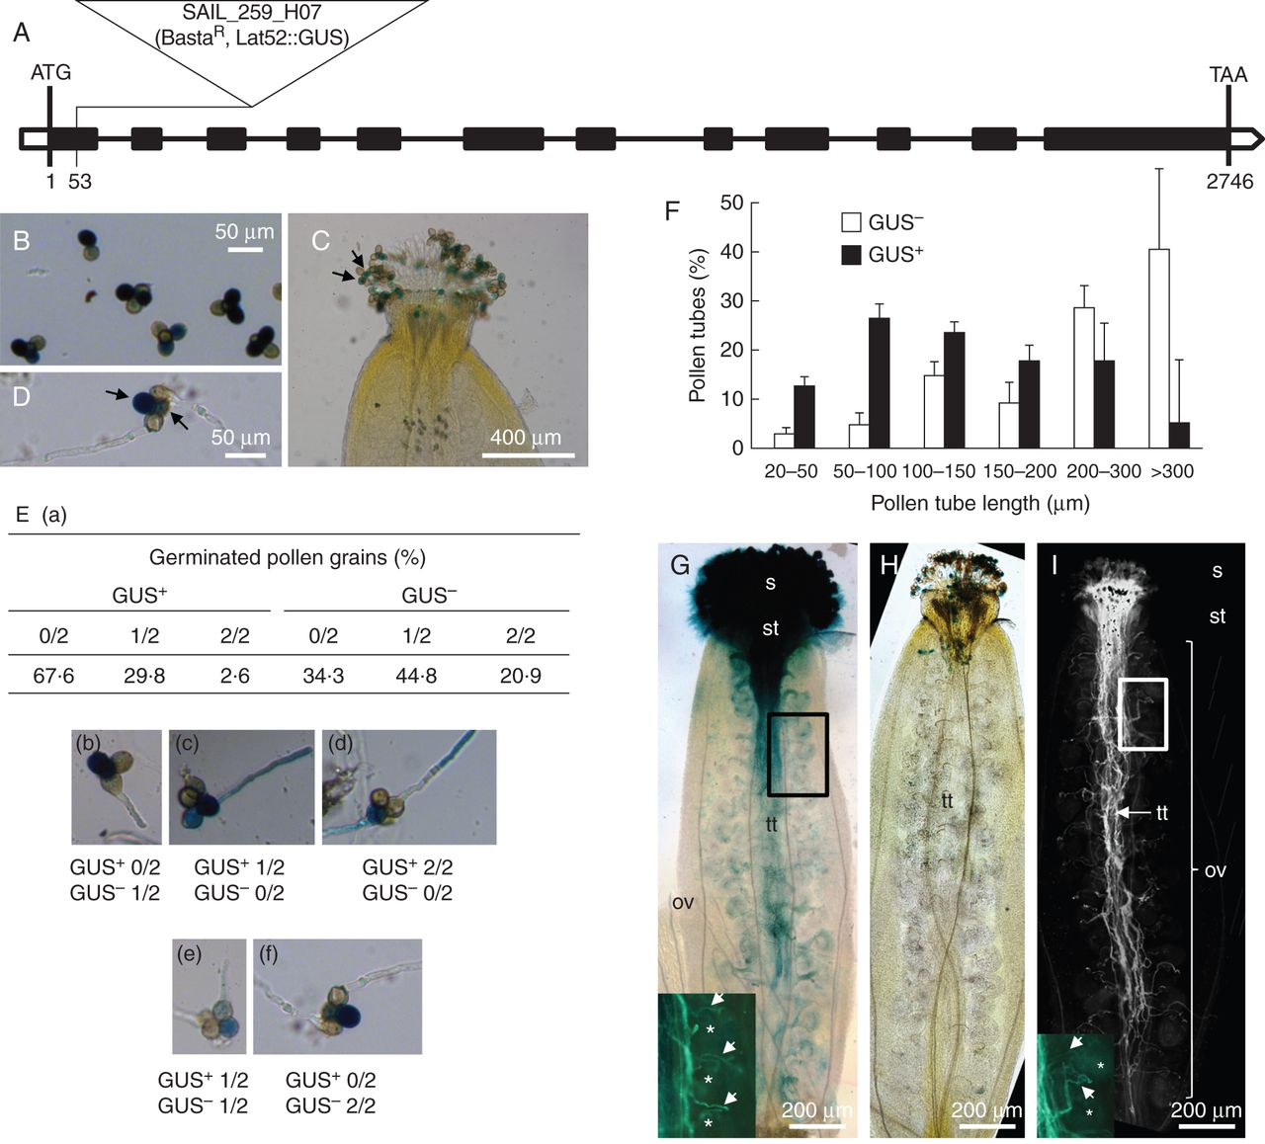
Fig. 5. Characterization of the qrt1 × sia2-2 mutant. (A) Genomic organization of the SIA2–2 gene and location of the ...
Notes:
Fig. 5. Characterization of the qrt1 × sia2-2 mutant. (A) Genomic organization of the SIA2–2 gene and location of the T-DNA insertion site. The black boxes indicate the exons. (B) GUS staining of the qrt1 × sia2-2+/– tetrads showing two GUS+ and two GUS– pollen grains. (C) GUS staining of the qrt1 × sia2-2+/– pollen grains on the stigma. Arrows show the two GUS+ pollen grains in the tetrad. (D) GUS staining of the qrt1 × sia2-2+/– pollen grains and pollen tubes grown for 6 h. Arrows show the two GUS+ pollen grains. (E) Percentages of GUS+ and GUS– germinated pollen grains in qrt1 × sia2-2+/– tetrads (n >800 grains). (a) Table summarizing the percentages of pollen tubes growing from the two GUS+ and the two GUS– pollen grains of the tetrads. (b–f) Images representing the different cases summarized in the table (a). (F) Distribution of the pollen tube length between the GUS+ and GUS– in qrt1 × sia2-2+/– tetrads after 6 h of culture (n >200). (G) GUS staining of a self-pollinated qrt1 plant showing pollen grains on the stigma and the in vivo growth of pollen tubes in the transmitting tract. Pollen tubes have reached the base of the ovary. The close-up picture at the bottom left shows the aniline blue staining of the same pistil. Arrows indicate pollen tubes, and asterisks indicate ovules. (H, I) GUS (H) and aniline blue (I) staining of a self-pollinated qrt1 × sia2-2+/– plant showing GUS+ and GUS– pollen grains on the stigma (H). No GUS+ pollen tubes were visible in the transmitting tract (H) but GUS– pollen tubes were stained with aniline blue and able to produce pollen tubes that reached the base of the ovary (I). The close-up image at the bottom left in (I) shows pollen tubes (arrows) and ovules (asterisks). ov, ovary; s, stigma; st, style; tt, transmitting tract.
Unless provided in the caption above, the following copyright applies to the content of this slide: © The Author 2014. Published by Oxford University Press on behalf of the Annals of Botany Company. All rights reserved. For Permissions, please email: journals.permissions@oup.com

