Slide 1
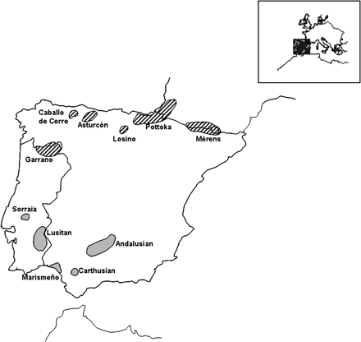
Figure 1. Main geographical location of the Iberian horse breeds sampled in the present study. The Northern Iberian ...
Notes:
Figure 1. Main geographical location of the Iberian horse breeds sampled in the present study. The Northern Iberian breeds (with bars) include Asturcón, Caballo de Corro, Garrano, Losino, Mérens, and Pottoka. Southern Iberian breeds (in gray) include Andalusian, Carthusian, Lusitano, Marismeño, and Sorraia.
Unless provided in the caption above, the following copyright applies to the content of this slide: © The American Genetic Association. 2005. All rights reserved. For permissions, please email: journals.permissions@oxfordjournals.org.

Slide 2
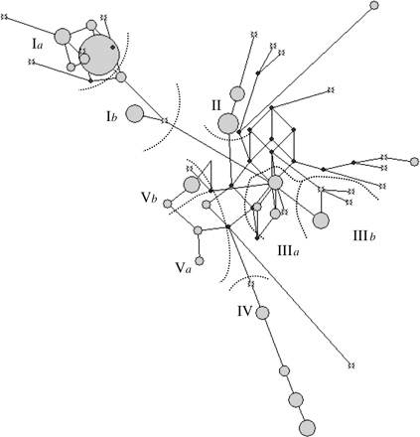
Figure 2. Median-joining tree constructed with maximum parsimony trees. The network has been contracted for character ...
Notes:
Figure 2. Median-joining tree constructed with maximum parsimony trees. The network has been contracted for character conflicts. The number of times in which each haplotype is present in the sample is proportional to the area of the circle. Small black circles indicate missing haplotypes. Sequence motifs defining major mtDNA clusters are as follows: CCG motif from np 15,494 to 15,496 for cluster Ia (whereas the others have TCA in the same positions); A15666 for cluster II; C15617 for cluster IIIa (includes most Exmoors); C15601 for cluster IIIb; T15542 for cluster IV (includes Sorraias); and T15709 for cluster V.
Unless provided in the caption above, the following copyright applies to the content of this slide: © The American Genetic Association. 2005. All rights reserved. For permissions, please email: journals.permissions@oxfordjournals.org.

