Slide 1
Fig. 1. Example of a complete trial of the VSVT. Intervals analyzed in this study are in bold.
Notes:
Fig. 1. Example of a complete trial of the VSVT. Intervals analyzed in this study are in bold.
Unless provided in the caption above, the following copyright applies to the content of this slide: © The Author 2010. Published by Oxford University Press. All rights reserved. For permissions, please e-mail: journals.permissions@oup.com.

Slide 2
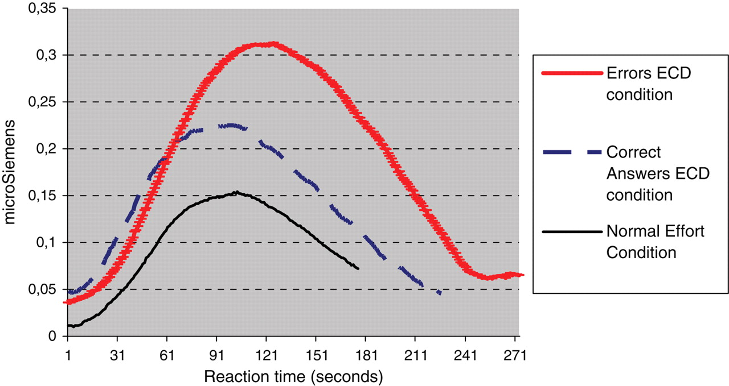
Fig. 2. Example of the psychophysiological response of conductance for a correct item and an error under the ECD ...
Notes:
Fig. 2. Example of the psychophysiological response of conductance for a correct item and an error under the ECD condition and for an item under the NE condition in the phase prior to the response (interval corresponding to phase 4 in Fig. 1; second 0 corresponds to the end of the presentation of the target and distracter numbers; the end of the lines corresponds to the participant's response).
Unless provided in the caption above, the following copyright applies to the content of this slide: © The Author 2010. Published by Oxford University Press. All rights reserved. For permissions, please e-mail: journals.permissions@oup.com.

