Slide 1
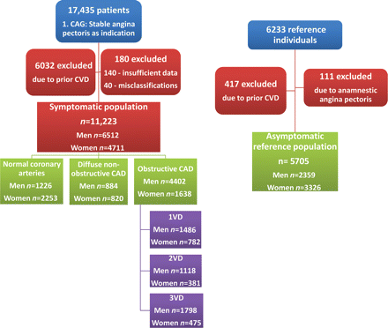
Figure 1 Derivation of the study population. CAG, coronary angiography; CAD, coronary artery disease; VD, vessel ...
Notes:
Figure 1 Derivation of the study population. CAG, coronary angiography; CAD, coronary artery disease; VD, vessel disease (indicates ≥50% stenosis); CVD, cardiovascular disease (i.e. prior stroke, revascularization, myocardial infarction, or unstable angina pectoris).
Unless provided in the caption above, the following copyright applies to the content of this slide: Published on behalf of the European Society of Cardiology. All rights reserved. © The Author 2011. For permissions please email: journals.permissions@oup.com

Slide 2
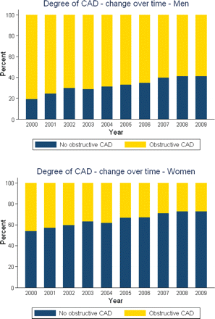
Figure 2 Degree of coronary artery disease by examination year and gender. No obstructive coronary artery disease, ...
Notes:
Figure 2 Degree of coronary artery disease by examination year and gender. No obstructive coronary artery disease, normal coronary arteries or diffuse non-obstructive coronary artery disease. Obstructive coronary artery disease, one or more significant coronary artery stenoses (indicates ≥50% stenosis).
Unless provided in the caption above, the following copyright applies to the content of this slide: Published on behalf of the European Society of Cardiology. All rights reserved. © The Author 2011. For permissions please email: journals.permissions@oup.com

Slide 3
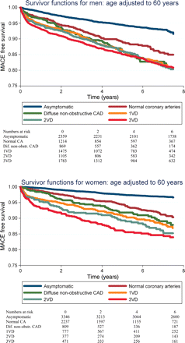
Figure 3 Major adverse cardiovascular event-free survivor functions for men and women. Age adjusted to 60 years. VD, ...
Notes:
Figure 3 Major adverse cardiovascular event-free survivor functions for men and women. Age adjusted to 60 years. VD, vessel disease (indicates ≥50% stenosis).
Unless provided in the caption above, the following copyright applies to the content of this slide: Published on behalf of the European Society of Cardiology. All rights reserved. © The Author 2011. For permissions please email: journals.permissions@oup.com

Slide 4
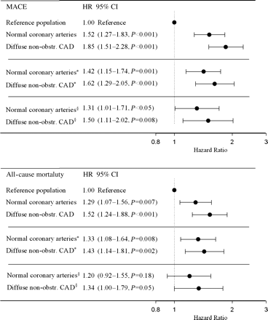
Figure 4 Hazard ratios for major adverse cardiovascular events and all-cause mortality by degree of coronary artery ...
Notes:
Figure 4 Hazard ratios for major adverse cardiovascular events and all-cause mortality by degree of coronary artery disease in pooled Cox's proportional hazards models adjusted for age, gender, body mass index, diabetes, smoking status, and use of antihypertensive and lipid-lowering medication. *Analyses limited to 10 304 individuals with no diagnosis of aortic stenosis, atrial flutter, paroxysmal atrial fibrillation, hypertrophic cardiomyopathy, or myocarditis previously or within 6 months of inclusion. §Analyses limited to 7485 individuals with no diagnosis of aortic stenosis, atrial flutter, paroxysmal atrial fibrillation, hypertrophic cardiomyopathy, or myocarditis previously or within 6 months of inclusion and for the symptomatic population an LVEF of ≥40. Diffuse non-obstr. CAD, diffuse non-obstructive coronary artery disease.
Unless provided in the caption above, the following copyright applies to the content of this slide: Published on behalf of the European Society of Cardiology. All rights reserved. © The Author 2011. For permissions please email: journals.permissions@oup.com

