Slide 1
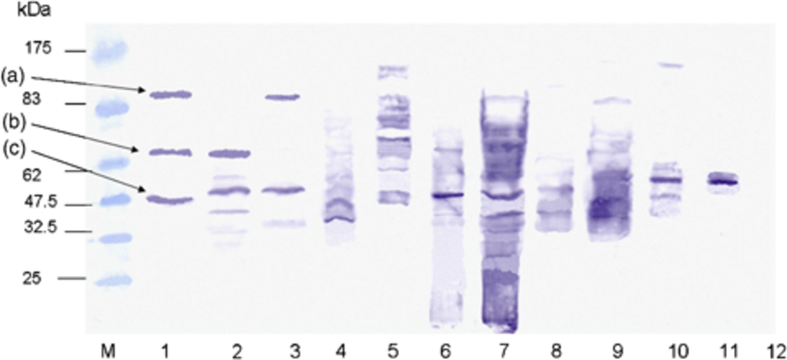
Figure 1 Western blotting analysis of sera from a patient with UC with bacterial protein antigens from Fusobacterium ...
Notes:
Figure 1 Western blotting analysis of sera from a patient with UC with bacterial protein antigens from Fusobacterium varium and other bacteria. Whole bacterial proteins were subjected to electrophoresis in SDS-PAGE gels for each patient and blotted onto PVDF membrane. Bacterial proteins were from F. varium (lane 1), Bacteroides vulgatus (lane 2), Fusobacterium nucleatum (lane 3), Clostridium perfringens (lane 4), Proteus mirabilis (lane 5), Enterococcus faecium (lane 6), Escherichia coli (EPEC O18) (lane 7), Bifidobacterium adolescentis (lane 8), Lactobacillus paracasei (lane 9), Pseudomonas aeruginosa (lane 10), and Pseudomonas putida (lane11). Lane 12 (no bands) is sera without antigen as a negative control. Band A, B, and C show putative ClpB protein, putative mass 97.289 kDa; putative EF-G, putative mass 75.962 kDa; and putative enolase, putative mass 46.651 kDa, respectively.
Unless provided in the caption above, the following copyright applies to the content of this slide: © 2009 Federation of European Microbiological Societies.

Slide 2
Figure 2 Competitive adsorption assay of Fusobacterium varium. Inhibition of binding of the patient's antibodies by ...
Notes:
Figure 2 Competitive adsorption assay of Fusobacterium varium. Inhibition of binding of the patient's antibodies by addition of mouse F. varium antisera is represented by competitive adsorption assay. Lanes: M, protein size marker; 1, the membrane incubated with sera from F. varium-positive patient No. 1 only; 2, the membrane incubated with both sera from F. varium-positive patient No. 1 and mouse F. varium antisera; 3, the membrane incubated with sera from F. varium-positive patient No. 2 only; 4, the membrane incubated with both sera from F. varium-positive patient No. 2 and mouse F. varium antisera; 5, the membrane incubated with sera from F. varium-positive patient No. 3 only; 6, the membrane with both F. varium-positive patient No. 3 and mouse F. varium antisera; 7, the membrane incubated with sera from F. varium-negative patient No. 4 only; 8, the membrane incubated with both sera from F. varium-negative patient No. 4 and mouse F. varium antisera; 9, the membrane incubated with sera from F. varium-negative patient No. 5 only; 10, the membrane incubated with both sera from F. varium-negative patient No. 5 and mouse F. varium antisera.
Unless provided in the caption above, the following copyright applies to the content of this slide: © 2009 Federation of European Microbiological Societies.

