Slide 1
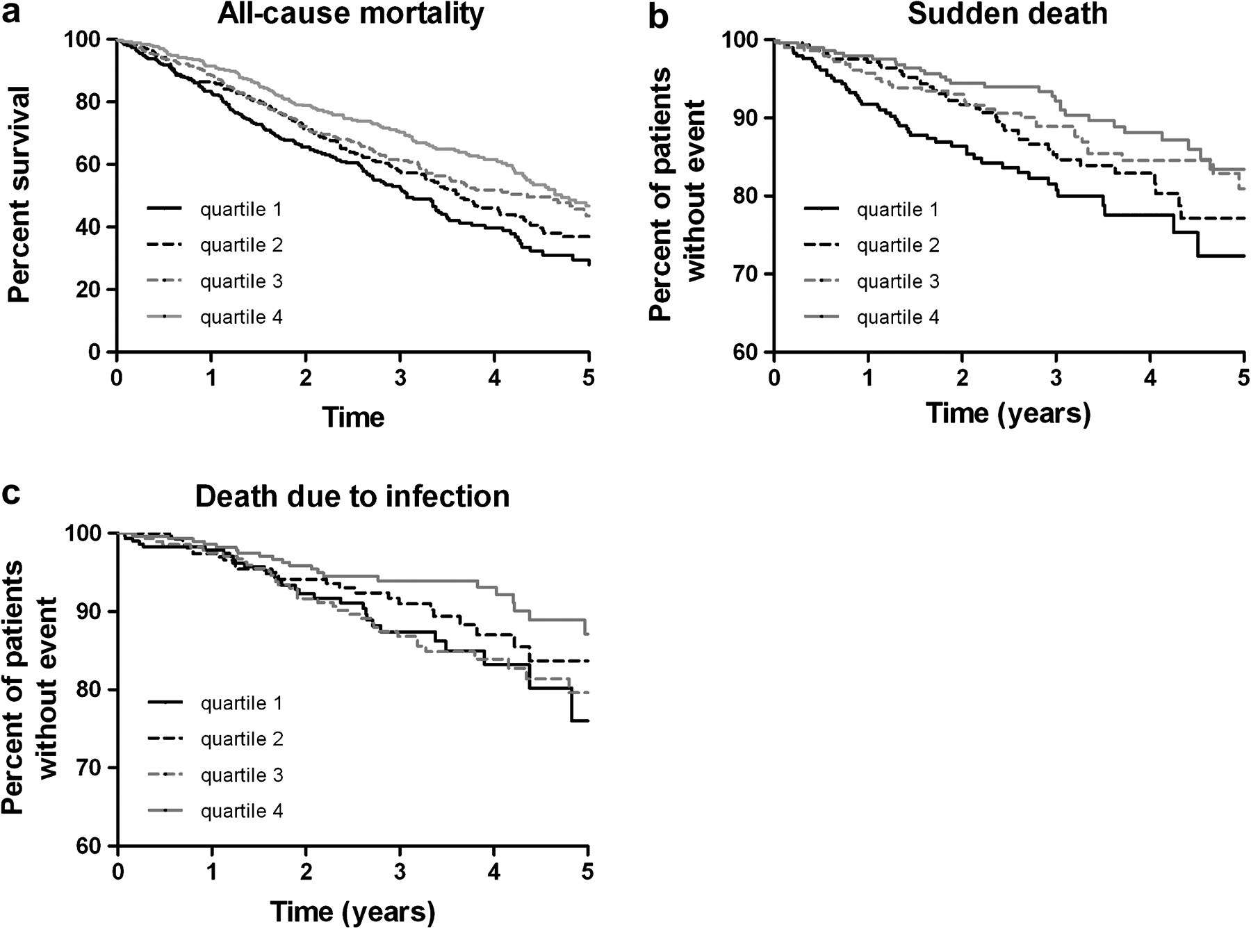
Fig. 1. Kaplan–Meier curves for the time to all-cause mortality ( a ) SCD ( b ) and death due to infection ( c ) in ...
Notes:
Fig. 1. Kaplan–Meier curves for the time to all-cause mortality ( a ) SCD ( b ) and death due to infection ( c ) in subgroups of patients according to baseline retinol plasma concentration (retinol Quartile 1: ≤2.6 μmol/L; Quartile 2: >2.6 ≤ 3.2 μmol/L; Quartile 3: >3.2 ≤ 3.9 μmol/L; Quartile 4: >3.9 μmol/L).
Unless provided in the caption above, the following copyright applies to the content of this slide: © The Author 2011. Published by Oxford University Press on behalf of ERA-EDTA. All rights reserved. For Permissions, please e-mail: journals.permissions@oup.com

Slide 2
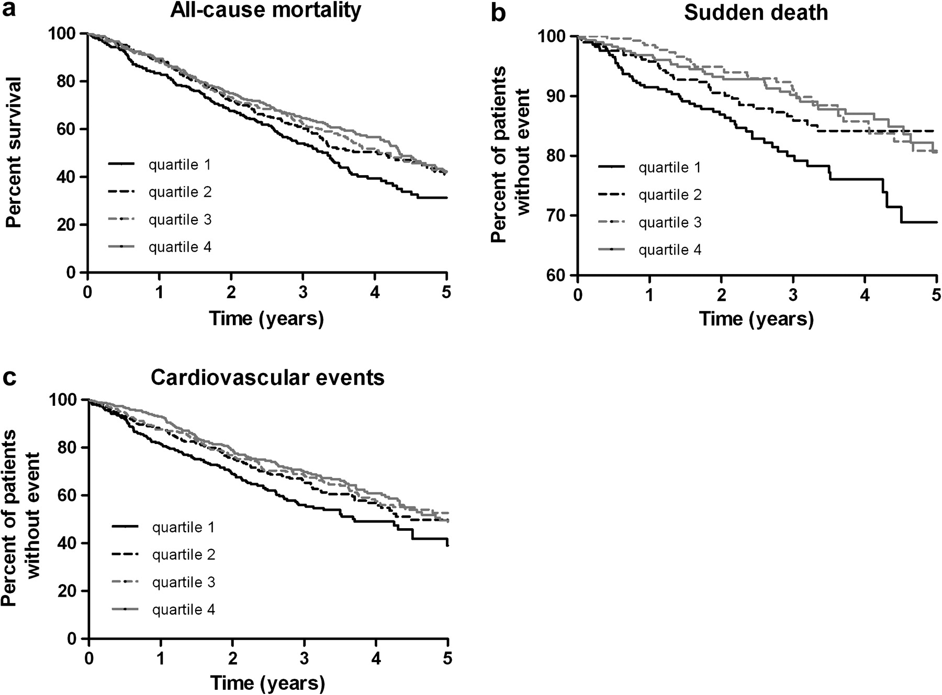
Fig. 2. Kaplan–Meier curves for the time to all-cause mortality ( a ) SCD ( b ) and CVE ( c ) in subgroups of ...
Notes:
Fig. 2. Kaplan–Meier curves for the time to all-cause mortality ( a ) SCD ( b ) and CVE ( c ) in subgroups of patients according to baseline RBP4 plasma concentration (RBP4 Quartile 1: ≤3.0 μmol/L; Quartile 2: >3.0 ≤ 3.8 μmol/L; Quartile 3: >3.8 ≤ 4.9 μmol/L; Quartile 4: >4.9 μmol/L).
Unless provided in the caption above, the following copyright applies to the content of this slide: © The Author 2011. Published by Oxford University Press on behalf of ERA-EDTA. All rights reserved. For Permissions, please e-mail: journals.permissions@oup.com

