Slide 1
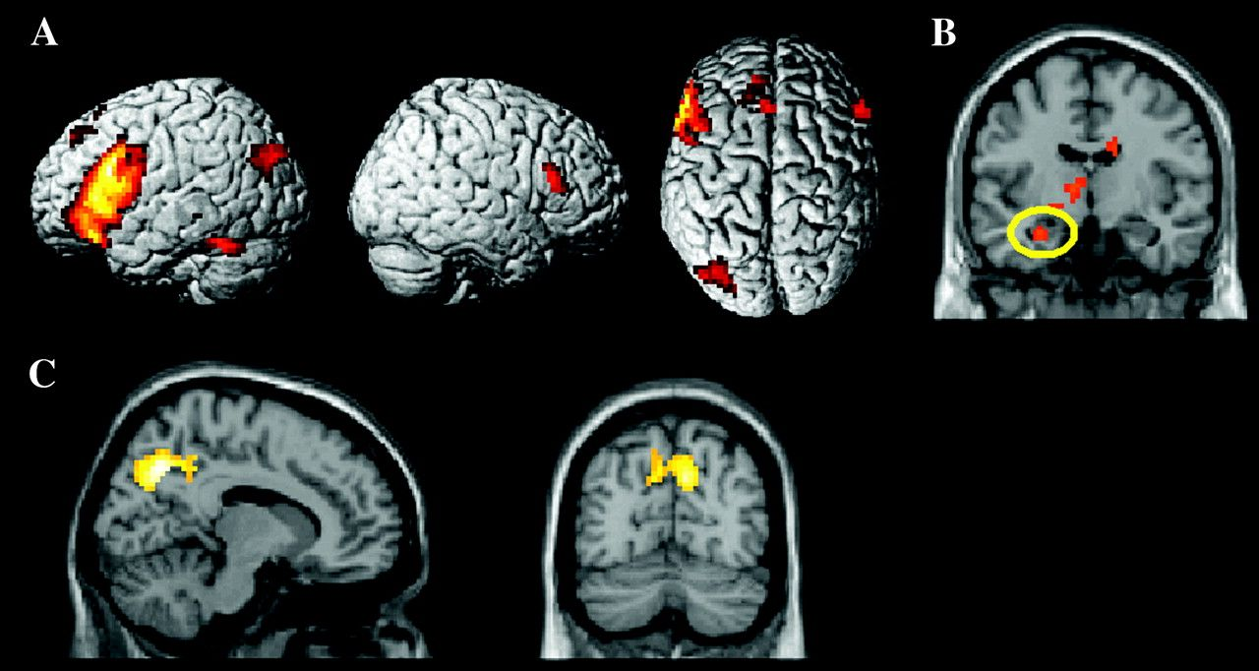
Figure 1. Common subsequent memory effects in young and older adults: (A) Subsequent memory effects (P ≤ 0.0005) ...
Notes:
Figure 1. Common subsequent memory effects in young and older adults: (A) Subsequent memory effects (P ≤ 0.0005) rendered onto the 3-dimensional single-subject MNI reference brain; (B) left hippocampal subsequent memory effect (yellow ellipse; P ≤ 0.005) superimposed on a coronal (y = −9) slice of the single-subject MNI template; and (C) reversed subsequent memory effects (P ≤ 0.0005 superimposed on sagittal (x = 12) and coronal (y = −72) slices of the single-subject MNI template. All effects were exclusively masked with the bidirectional interaction between age and subsequent memory/forgetting effect (P ≤ 0.1).
Unless provided in the caption above, the following copyright applies to the content of this slide: © The Author 2008. Published by Oxford University Press. All rights reserved. For permissions, please e-mail: journals.permissions@oxfordjournals.org

Slide 2
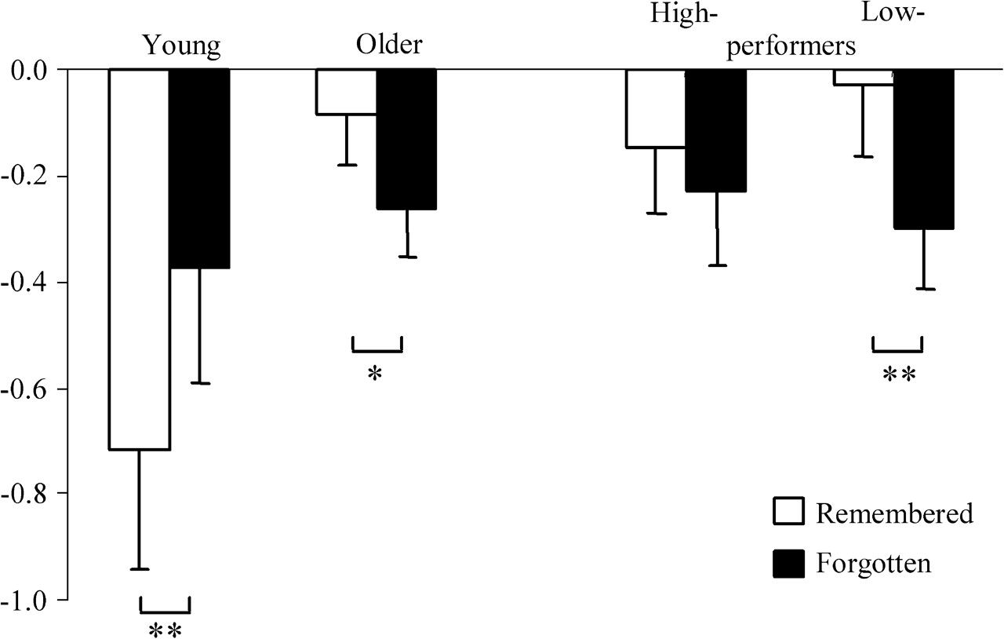
Figure 2. Parameter estimates of the peak voxel in posterior cingulate cortex (co-ordinates −12, −48, 27) showing ...
Notes:
Figure 2. Parameter estimates of the peak voxel in posterior cingulate cortex (co-ordinates −12, −48, 27) showing age-related difference in reversed subsequent memory effect (*P ≤ 0.05; **P ≤ 0.01).
Unless provided in the caption above, the following copyright applies to the content of this slide: © The Author 2008. Published by Oxford University Press. All rights reserved. For permissions, please e-mail: journals.permissions@oxfordjournals.org

Slide 3
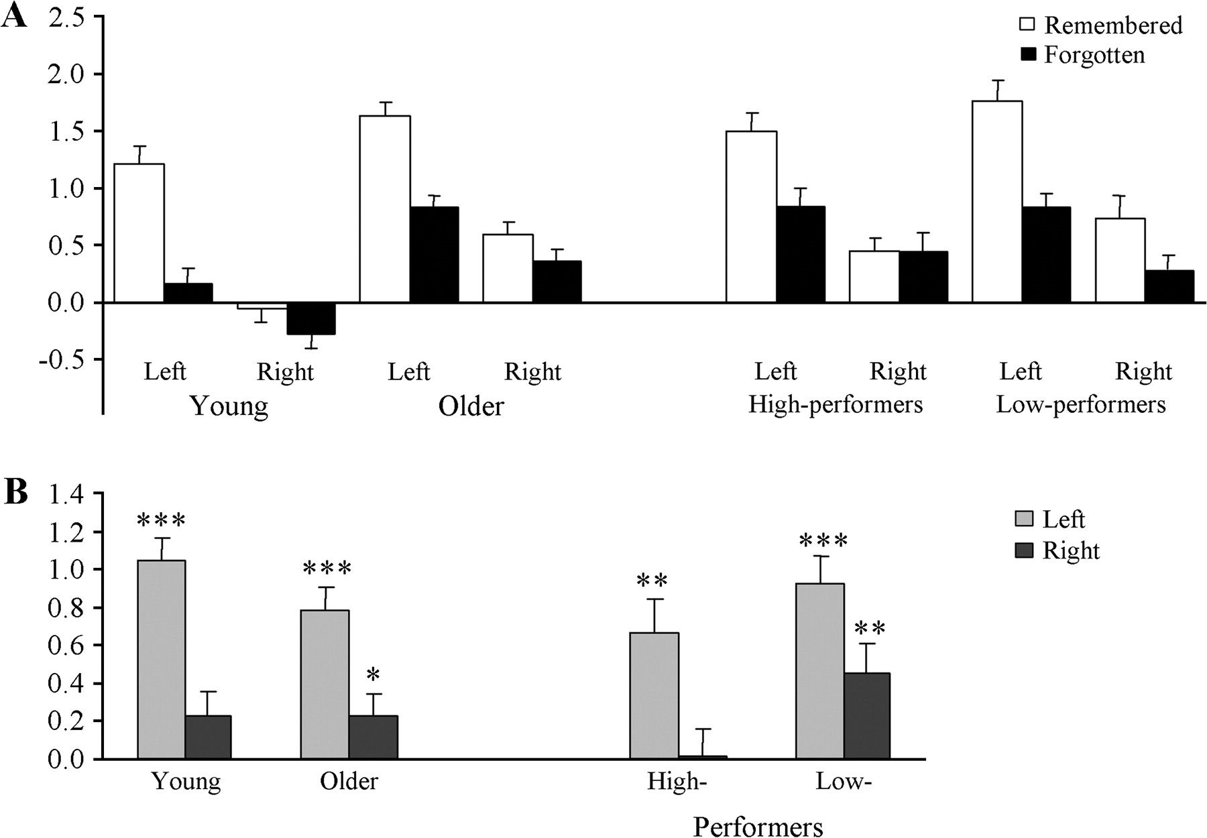
Figure 3. Lateralization of subsequent memory effects in young, older adults, and high- and low-performing older ...
Notes:
Figure 3. Lateralization of subsequent memory effects in young, older adults, and high- and low-performing older adults: (A) averaged parameter estimates for remembered and forgotten items and (B) subsequent memory effects (Remembered minus Forgotten) collapsed across the 5 prefrontal voxels of interest (see text; *P ≤ 0.05; **P ≤ 0.01; ***P ≤ 0.001).
Unless provided in the caption above, the following copyright applies to the content of this slide: © The Author 2008. Published by Oxford University Press. All rights reserved. For permissions, please e-mail: journals.permissions@oxfordjournals.org

