Slide 1
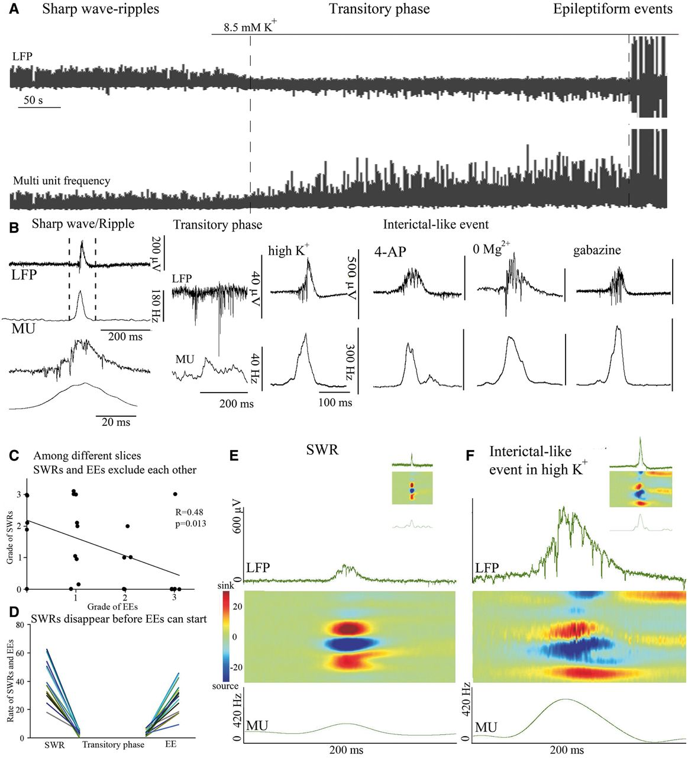
Figure 1 Transition from sharp-wave ripples to epileptiform events and their differences. (A) Interictal events were ...
Notes:
Figure 1 Transition from sharp-wave ripples to epileptiform events and their differences. (A) Interictal events were induced by elevating extracellular K+ concentration. A highly active, desynchronized state separates the physiological, transiently highly active sharp wave-ripple state from the pathological, transiently highly active interictal events. Note that an increase of multi-unit frequency precedes interictal events. Upper traces: local field potential (LFP) of the transitory phase. Lower traces: plot of multi-unit frequency demonstrating network activity during the transition. (B) Enlarged image of a sharp wave-ripple and accompanying multi-unit (MU) activity at two time scales, as well as the transitory phase and interictal events and the underlying multi-unit activities appearing in four different epilepsy models. (C) Physiological and pathological transient high activity events are plotted to compare their correlation. A negative correlation is present in the rate of amplitude of the two types of events (n = 26). (D) The rate of sharp wave-ripples (SWRs) and interictal events (IIEs) at three different phases of the transition from several experiments. During control conditions sharp wave-ripple rate is high [and epileptiform event (EE) rate is zero], but after the pharmacological intervention it disappears completely. After the transitory phase (when the rate of both sharp wave-ripples and interictal events is zero) the rate of interictal events starts to increase, whereas sharp wave-ripple rate remains at zero. Note that for slices able to generate both sharp wave-ripples and interictal events, the interictal events cannot be seen until sharp wave-ripples disappear completely (n = 25). Sharp wave-ripples (E) and early interictal events (F) may seem similar (see insets); however, compared to sharp wave-ripples, interictal events (even early ones) have a larger amplitude, a longer duration (top trace) and are accompanied by several-fold higher multi-unit activity (bottom trace). Analysis of current source densities (centre) showed only minor shifts in the organization of sinks (red) and sources (blue), especially in the second half of an event.
Unless provided in the caption above, the following copyright applies to the content of this slide: © The Author (2014). Published by Oxford University Press on behalf of the Guarantors of Brain. All rights reserved. For Permissions, please email: journals.permissions@oup.com

Slide 2
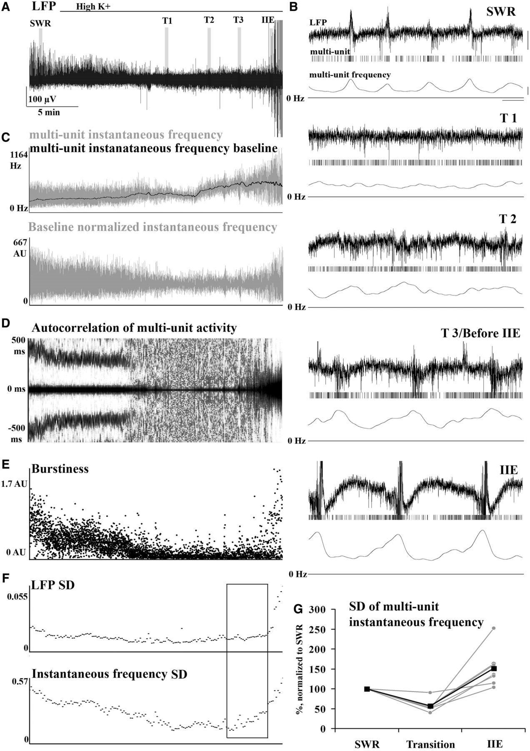
Figure 2 Reorganization of synchrony during sharp-wave ripple to epileptiform event transition induced by high ...
Notes:
Figure 2 Reorganization of synchrony during sharp-wave ripple to epileptiform event transition induced by high K+. During the transition the synchrony of multi-unit activity drops and then builds up again until the network reaches the level of synchrony where interictal events start. (A) Local field potential (LFP) during the transitory phase. Areas emphasized with grey bars [sharp wave-ripple (SWR), T1, T2, T3 and interictal event (IIE)] indicate different phases of the transition and are magnified in B. The raster plot of multi-units and the multi-unit frequency are shown below the local field potential. (C) Upper trace shows how multi-unit frequency (grey) and its low-pass-filtered baseline (black) increases during the transition. The lower graph shows the baseline-normalized instantaneous frequency fluctuation. (D) Time-binned autocorrelogram of multi-unit activity showing that the synchrony of firing during sharp wave-ripples falls apart during the transitory period and reorganizes into a different synchrony during interictal events. (E) A U-shaped curve of ‘burstiness’ of multi-unit frequency shows that during the transition phase, synchrony decreases in the system. (F) A decrease and gradual recovery can be seen both in the standard deviation (SD) of local field potential values and in the SD of instantaneous multi-unit frequency. Note that the SD of multi-unit frequency starts to increase several minutes earlier than the SD of the local field potential signal (framed area), and a high level of synchrony evolves before anything is seen in the local field potential. (G) Changes in the SD of multi-unit instantaneous frequency from sharp wave-ripples to the transition phase and to interictal events in six recordings. Scale bars: B upper = 100 µV, lower = 60 Hz; time scale = 500 ms.
Unless provided in the caption above, the following copyright applies to the content of this slide: © The Author (2014). Published by Oxford University Press on behalf of the Guarantors of Brain. All rights reserved. For Permissions, please email: journals.permissions@oup.com

Slide 3
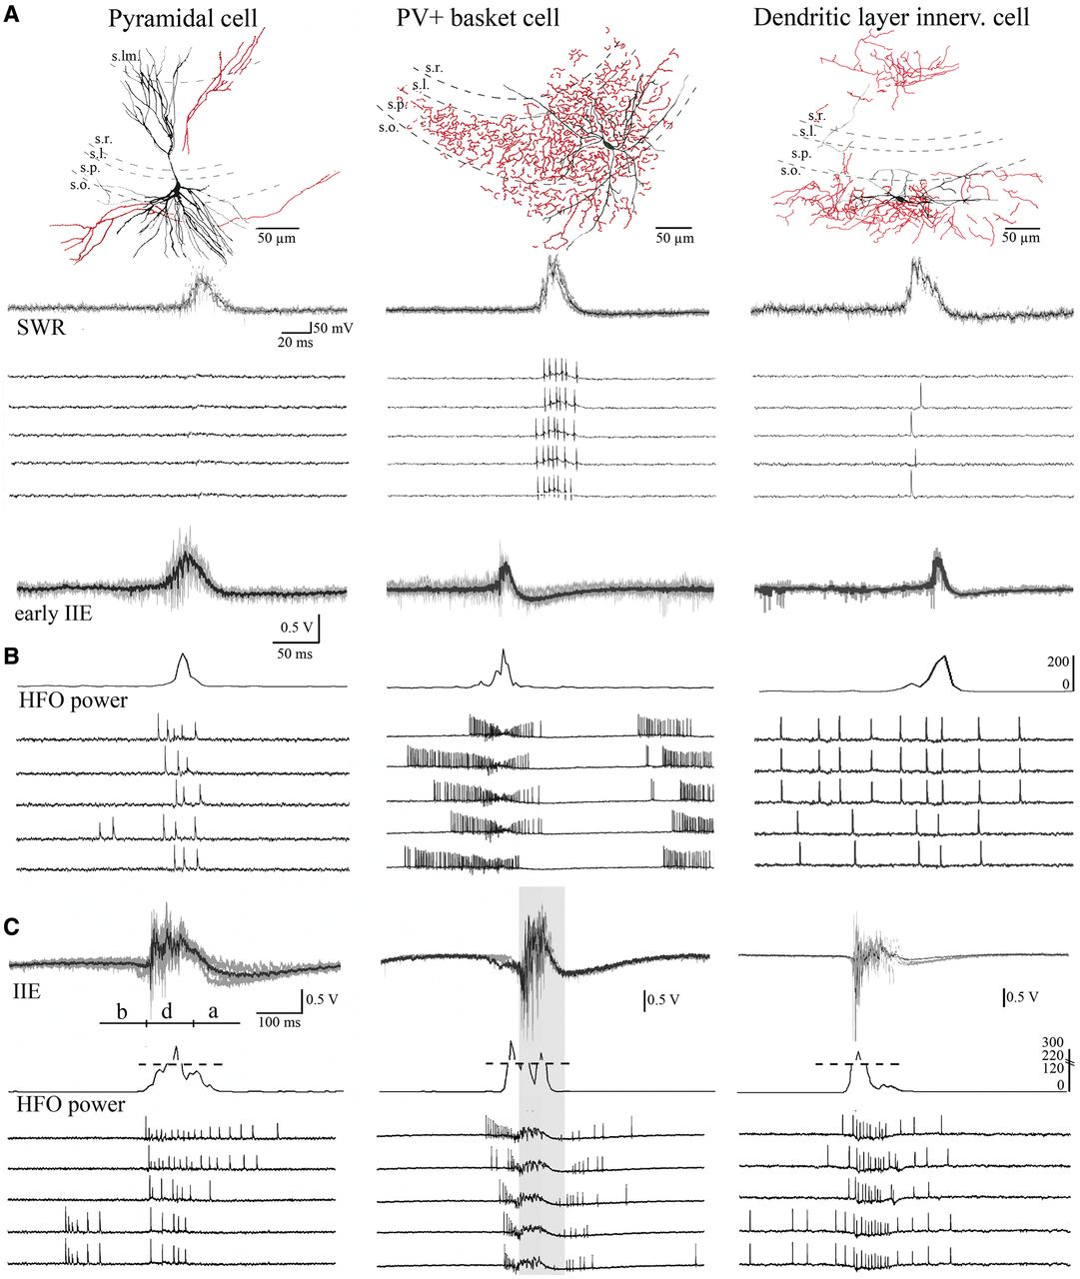
Figure 3 PVBCs stop firing during epileptiform events, whereas other cells increase their firing rate. (A) Firing of ...
Notes:
Figure 3 PVBCs stop firing during epileptiform events, whereas other cells increase their firing rate. (A) Firing of anatomically identified CA3 neurons during sharp wave-ripples (SWRs) recorded in loose patch mode. Somata and dendrites of cells are shown in black, axons in red. Firing of the cells can be seen in the lower rows. (B and C) Firing of neurons during early and late interictal events (IIEs), respectively. All examined neurons increased their firing rate and changed their firing pattern during early interictal events. During late interictal events they increased their firing rate further, and some cells (PVBCs) stopped firing at the peak. Below the local field potential the relative power in the 150–400 Hz band is plotted to show the duration of high-frequency oscillation during the interictal events. High frequency oscillation (HFO) coincided with pyramidal cell firing and the silent phase of PVBCs. For quantification, firing of neurons was separated into three phases of 100 ms: before (b), during (d) and after (a) the peak of the interictal event. PVBCs stopped firing at the peak (grey area, approximately ‘during’ phase) of interictal events. PV+ = parvalbumin-positive.
Unless provided in the caption above, the following copyright applies to the content of this slide: © The Author (2014). Published by Oxford University Press on behalf of the Guarantors of Brain. All rights reserved. For Permissions, please email: journals.permissions@oup.com

Slide 4
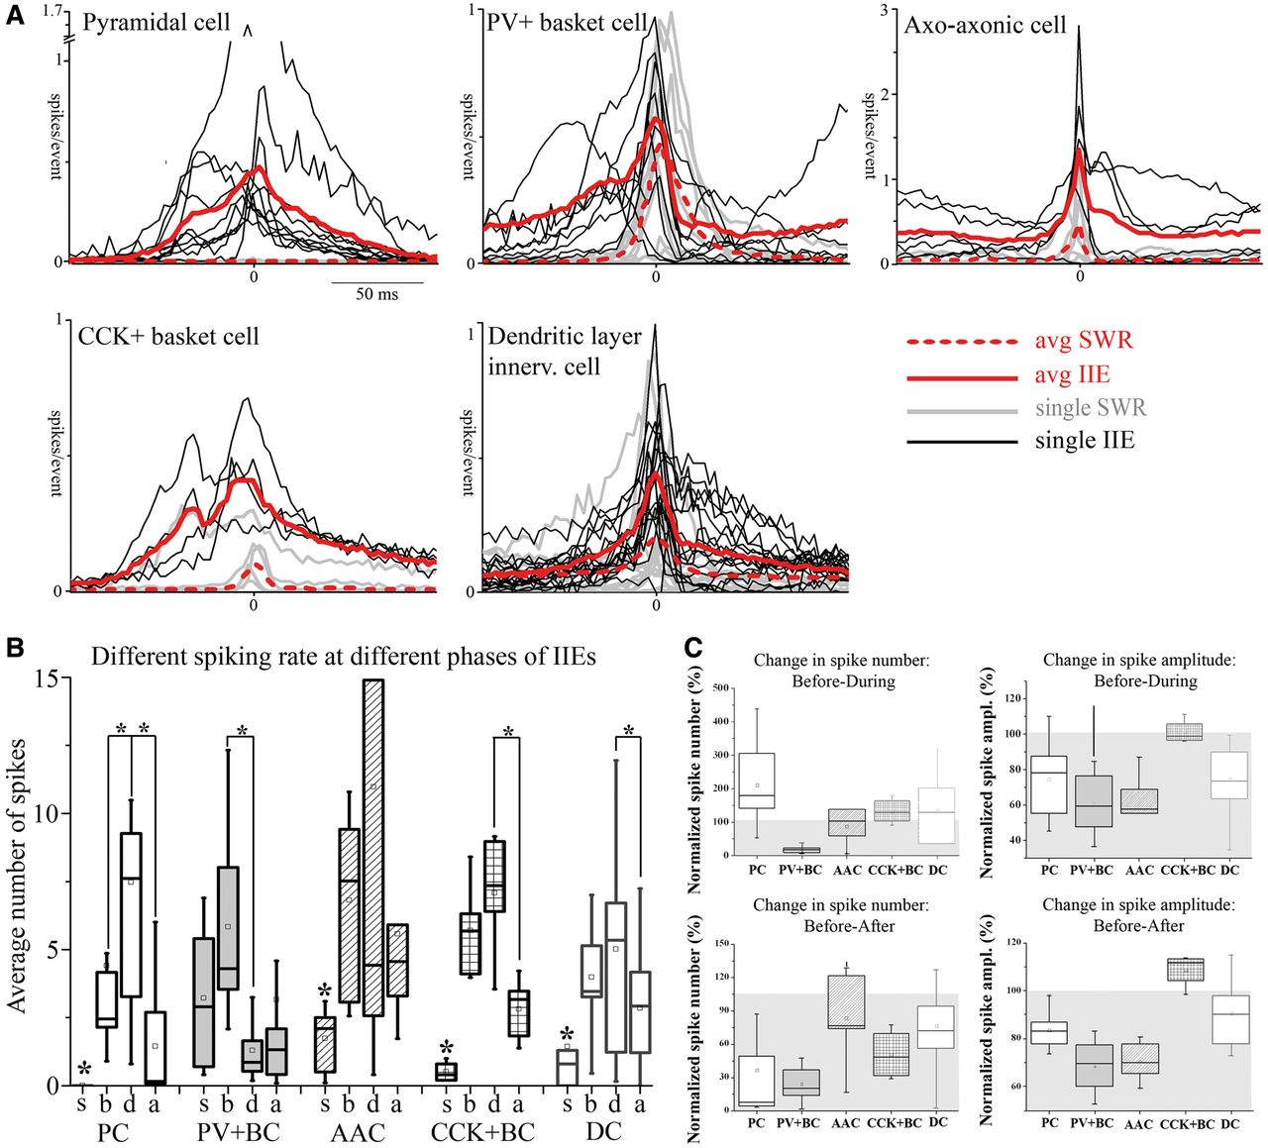
Figure 4 Firing rate varies among different phases of epileptiform events induced by high K⁺. (A) Spike ...
Notes:
Figure 4 Firing rate varies among different phases of epileptiform events induced by high K+. (A) Spike distribution histograms of individual neurons during sharp wave-ripples (SWR; grey: individual traces, dashed red: average) and interictal events (IIE; black: individual traces, red: average) show that the firing pattern becomes altered and the firing rate increases. (B) Statistical comparison of the average number of spikes fired by different neurons during sharp wave-ripples (s), in the ‘before’ (b), ‘during’ (d) and ‘after’ (a) phases. Note that the spike number significantly increases from sharp wave-ripples to interictal events (marked with asterisks). Firing also differs greatly among different phases of interictal events. (C) Changes in normalized firing probability and amplitude for different neuron types (normalized to before phase). Upper graphs compare changes in normalized values between the before and the during phases, whereas lower traces compare changes among the before and after phases. Grey area indicates a decrease (<100%), asterisks indicate significance at P < 0.05). PV+BC = parvalbumin-positive basket cell; CCK+BC = cholecystokinin-positive basket cell; PC = pyramidal cell; AAC = axo-axonic cell; DC = dendritic layer innervating cell.
Unless provided in the caption above, the following copyright applies to the content of this slide: © The Author (2014). Published by Oxford University Press on behalf of the Guarantors of Brain. All rights reserved. For Permissions, please email: journals.permissions@oup.com

Slide 5
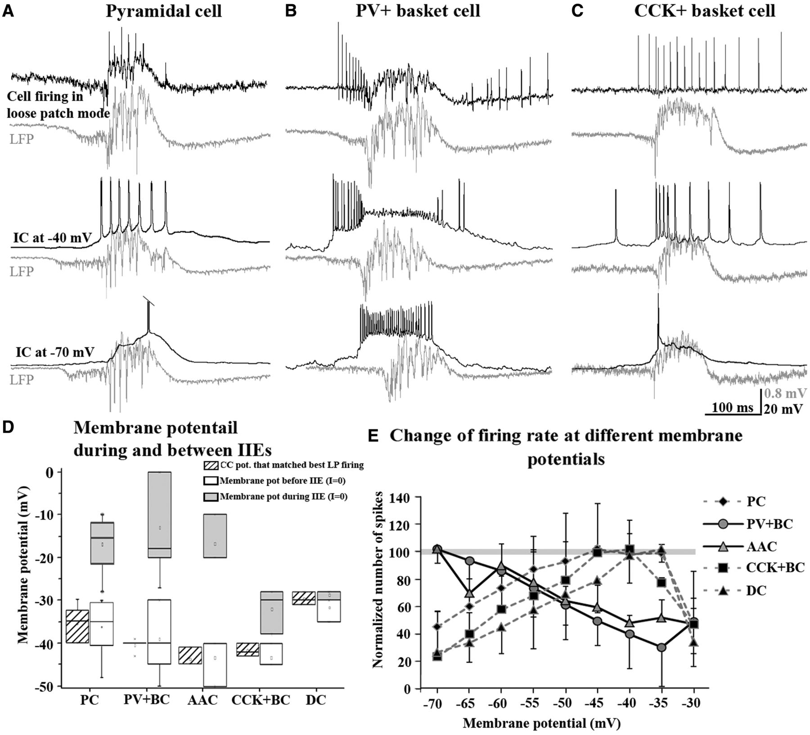
Figure 5 PVBC firing is blocked as a result of strong depolarization. (A–C) Three examples show that in the ...
Notes:
Figure 5 PVBC firing is blocked as a result of strong depolarization. (A–C) Three examples show that in the epileptogenic artificial CSF the membrane potential of neurons is approximately −40 mV before interictal events (IIEs, baseline), as their loose-patch-recorded spiking matches the firing pattern recorded at −40 mV in current clamp during interictal events. Upper pair of traces show loose-patch-recorded firing (black) during an epileptiform event (grey: local field potential). Similar sequences of spikes were recorded from the neuron at −40 mV (middle traces), but not at −70 mV (lower traces). The similarity to the −40 mV potential was true for all examined cell types. A pyramidal cell (A), a PVBC (B) and a CCK+ basket cell (C) are shown. (D) The membrane potential where neurons fired with a similar pattern to that seen in loose patch mode is indicated with the lower striped grey box and whiskers (baseline), whereas the membrane potential recorded immediately after break-in (in I = 0 mode) is shown with white box and whiskers. Higher grey box and whiskers plots indicate the membrane potential recorded during the interictal event peak. This value was markedly higher compared to the former two time points, and was more variable among cells. (E) Change in spiking rate as a function of depolarization is shown for CA3 neurons. Some neurons increase their firing rate upon depolarization [pyramidal cell (PC), CCK+ basket cell (BC), dendritic layer innervating cell) whereas others decrease it (PVBC, axo-axonic cell). To compare neurons with inherently different spiking rates, membrane potential-dependent changes were normalized to the peak firing rate of individual neurons. Grey line indicates 100% as maximal firing. The figure shows that PVBCs and axo-axonic cells fire already maximally close to normal resting potential (note that PVBCs may completely stop firing, whereas, axo-axonic cells only drop their firing rate until a certain point). Other neurons, most importantly pyramidal cells, can increase their firing rate with depolarization. PV+BC = parvalbumin-positive basket cell; CCK+BC = cholecystokinin-positive basket cell; AAC = axo-axonic cell; DC = dendritic layer innervating cell; CC pot = membrane potential in current clamp mode; LP = loose patch.
Unless provided in the caption above, the following copyright applies to the content of this slide: © The Author (2014). Published by Oxford University Press on behalf of the Guarantors of Brain. All rights reserved. For Permissions, please email: journals.permissions@oup.com

Slide 6
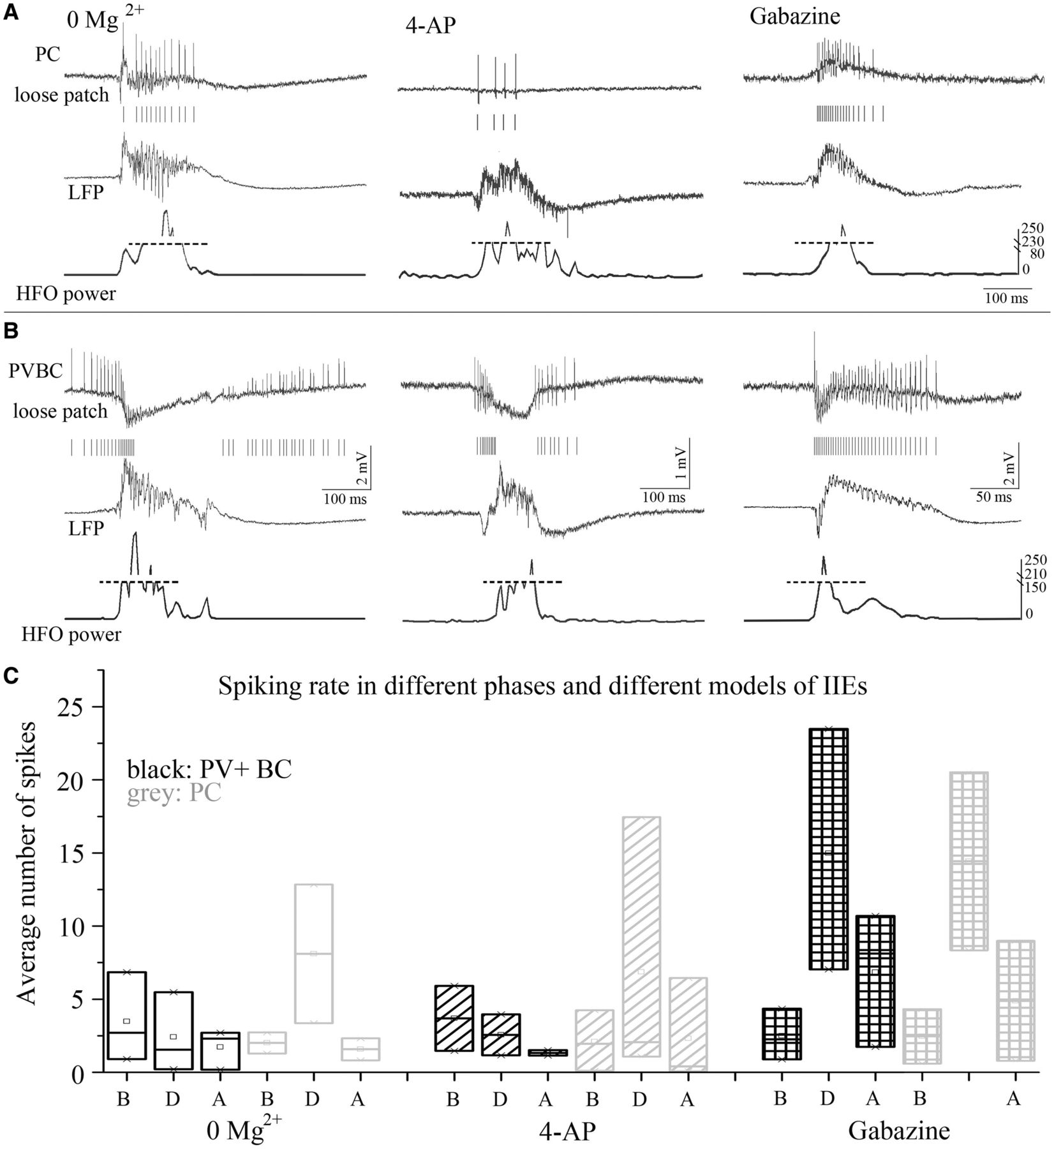
Figure 6 Firing pattern of pyramidal cells and parvalbumin-positive basket cells in other models. The firing of ...
Notes:
Figure 6 Firing pattern of pyramidal cells and parvalbumin-positive basket cells in other models. The firing of pyramidal cells (A) and PVBCs (B) was recorded in loose patch mode (upper rows) simultaneously with local field potential recordings (middle rows) in three further models of interictal events (IIEs). The relative power in the 150–400 band (base-normalized to the period before the interictal events) was also calculated and plotted (lower trace) to indicate the period when high frequency oscillation (Boksa et al., 1998) was present in the local field potential (LFP). Pyramidal cells mostly fired at (and after) the peak of interictal events. PVBCs cease to fire (similarly to the high K+ model) at this stage in the 4-aminopyridine (4-AP) and zero Mg2+ models (suggesting they received strong depolarization), but only decrease their spike amplitude in the gabazine model with a continued firing. The high-frequency oscillation in the local field potential coincided with strong pyramidal cell firing in all models. (C) The firing frequencies in the different models during different phases for the two cell types. HFO = high frequency oscillation; PC = pyramidal cell; PV+BC = parvalbumin-positive basket cell.
Unless provided in the caption above, the following copyright applies to the content of this slide: © The Author (2014). Published by Oxford University Press on behalf of the Guarantors of Brain. All rights reserved. For Permissions, please email: journals.permissions@oup.com

Slide 7
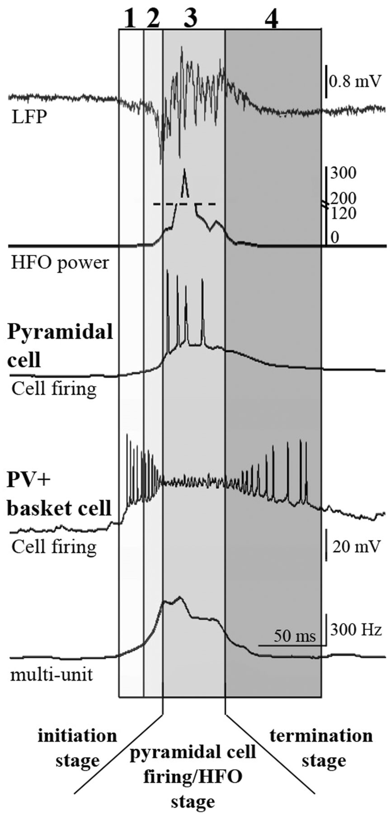
Figure 7 Build-up of depolarization during epileptiform events and its effect on neuronal firing: pyramidal cells ...
Notes:
Figure 7 Build-up of depolarization during epileptiform events and its effect on neuronal firing: pyramidal cells start to fire massively when inhibition from PVBCs collapses. During the late interictal events we studied, four phases can be distinguished: (1) Primary depolarization, PVBCs depolarize and start firing, pyramidal cells start to depolarize, multi-unit activity starts to increase. There is a slow negative deflection in the local field potential. (2) Secondary depolarization, the frequency of PVBC firing further increases while the amplitude drops as the cell depolarizes even further, pyramidal cells depolarize further but do not fire yet, multi-unit activity increases heavily, steep negative drop in local field potential appears (LFP). (3) Interictal event builds up, the power in the 150–400 Hz band increases, PVBCs cease to fire (depolarization block) and pyramidal cells start firing as a result of the additional depolarization due to loss of inhibition, multi-unit activity stagnates and starts to drop. A high frequency, large amplitude component (most probably pyramidal cell extracellular spikes, units) appears in the local field potential, accompanied by a positive envelope. (4) The local field potential normalizes, PVBC firing gradually recovers as cells exit the depolarization block, pyramidal cells stop firing and multi-unit activity drops. The figure illustrates the behaviour of the two cell types to compare them; the local field potential was recorded simultaneously with the PVBC, whereas the pyramidal cell was recorded in another experiment. However, in our experiments, pyramidal cells and PVBCs fired during the given phases as illustrated. HFO = high frequency oscillation; PV+ = parvalbumin-positive.
Unless provided in the caption above, the following copyright applies to the content of this slide: © The Author (2014). Published by Oxford University Press on behalf of the Guarantors of Brain. All rights reserved. For Permissions, please email: journals.permissions@oup.com

Slide 8
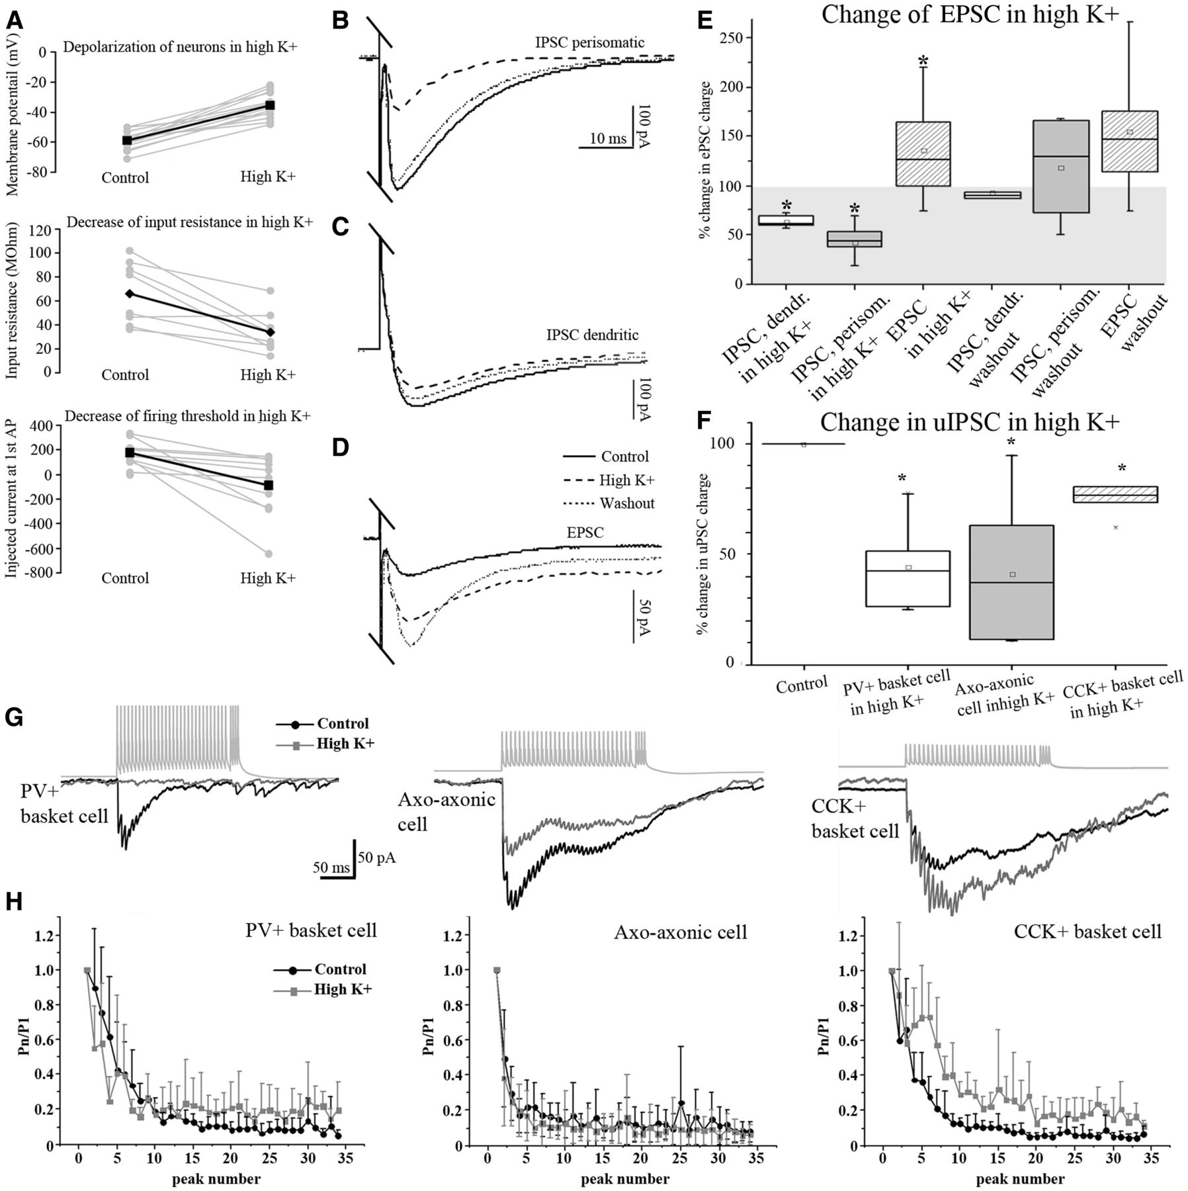
Figure 8 High K+ increases excitability, and decreases inhibitory transmission relative to excitatory transmission. ...
Notes:
Figure 8 High K+ increases excitability, and decreases inhibitory transmission relative to excitatory transmission. (A) When the extracellular K+ concentration is increased, pyramidal cells become more depolarized (top), input resistance of cells drops to 49 ± 4% (middle), and excitability increases (bottom), as cells fire the first action potential at a smaller membrane current in high K+ compared with control conditions (n = 7). (B–E) shows the increase in the ratio of excitatory to inhibitory transmission in high K+. The charge of inhibitory postsynaptic currents (IPSCs) evoked by stimulating perisomatic inhibitory axons (stratum lucidum/pyramidale) dropped after high K+ application (B). Similarly, in the case of dendritic inhibitory postsynaptic currents evoked by stimulating stratum radiatum the charge decreased in high K+ (C). However, when excitatory postsynaptic currents (EPSCs) were evoked in high K+ the charge increased (D). (E) Summary of the effects on synaptic transmission. (F and G) Paired recordings show that inhibitory charge decreases in high K+ in the case of PVBCs (n = 7) and axo-axonic cells (n = 7), but remains fairly intact in the case of CCK-positive basket cells (n = 5). H) Compared with control conditions (black), short-term depression becomes more pronounced in high K+ (grey) for the first 10 peaks (afterwards the synapse efficacy drops greatly) for PVBCs, whereas it does not change in the case of axo-axonic cells. In the case of CCK-positive basket cells, in high K+ the depression was less pronounced. Moreover plasticity could transiently switch from depression to facilitation. Asterisks illustrate significance at P < 0.05. AP = action potential; PV+ = parvalbumin-positive; uIPSC = unitary IPSC.
Unless provided in the caption above, the following copyright applies to the content of this slide: © The Author (2014). Published by Oxford University Press on behalf of the Guarantors of Brain. All rights reserved. For Permissions, please email: journals.permissions@oup.com

