Slide 1
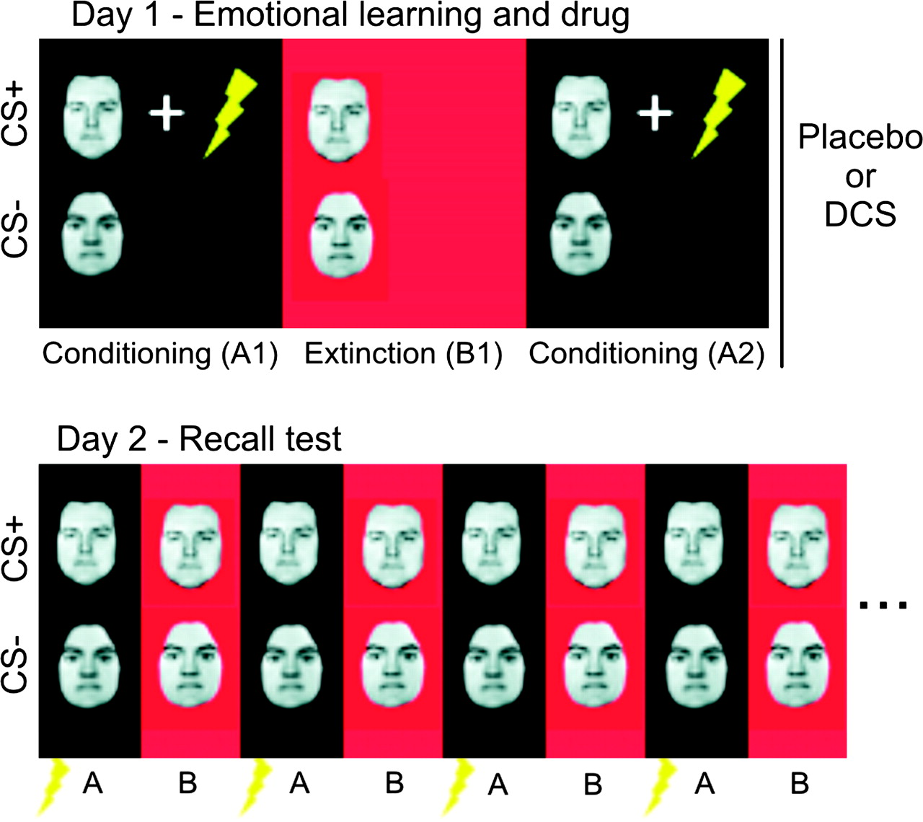
Figure 1. Fear and extinction recall paradigm. On day 1, subjects (n = 31 healthy female volunteers) were fear ...
Notes:
Figure 1. Fear and extinction recall paradigm. On day 1, subjects (n = 31 healthy female volunteers) were fear conditioned to a CS+ (a face) through multiple pairings with an UCS (electric shock) in context A (conditioning context, block A1). Fear responses were then extinguished in context B (extinction context, block B1) through multiple CS+ presentations in the absence of the UCS. To ascertain retention of fear memories until a recall test 72 h later (see below), conditioning was repeated in a further block (A2). As a control for nonassociative effects, we also employed a nonpredictive CS− (a face of opposite gender) that was never paired with the UCS and presented intermixed with the CS+. Contexts were defined by screen color and auditory input. It was assumed that this procedure would create a CS-associated fear memory. Based on an earlier study by our group (Kalisch et al. 2006a), it was also assumed that the procedure would create an (extinction) context-dependent extinction memory. Learning was followed by administration of either placebo (n = 16) or 500-mg DCS (n = 15). On day 2 (72 h later), CSs were presented in both contexts A and B to test for CS-evoked fear and extinction memory recall, respectively. To this purpose, each context was presented 16 times in alternating order. Recall of fear memory in context A on day 2 was facilitated by additionally presenting 1 unpaired shock at the beginning of each context A block, thus again firmly associating context A with the UCS. The task was a speeded gender decision task in response to the face stimuli. Gender of faces and conditioning and extinction contexts were counterbalanced between groups. The design was randomized, double blind, and between subject. Flash denotes electric shock.
Unless provided in the caption above, the following copyright applies to the content of this slide: © 2008 The AuthorsThis is an Open Access article distributed under the terms of the Creative Commons Attribution Non-Commercial License (http://creativecommons.org/licenses/by-nc/2.0/uk/) which permits unrestricted non-commercial use, distribution, and reproduction in any medium, provided the original work is properly cited.

Slide 2
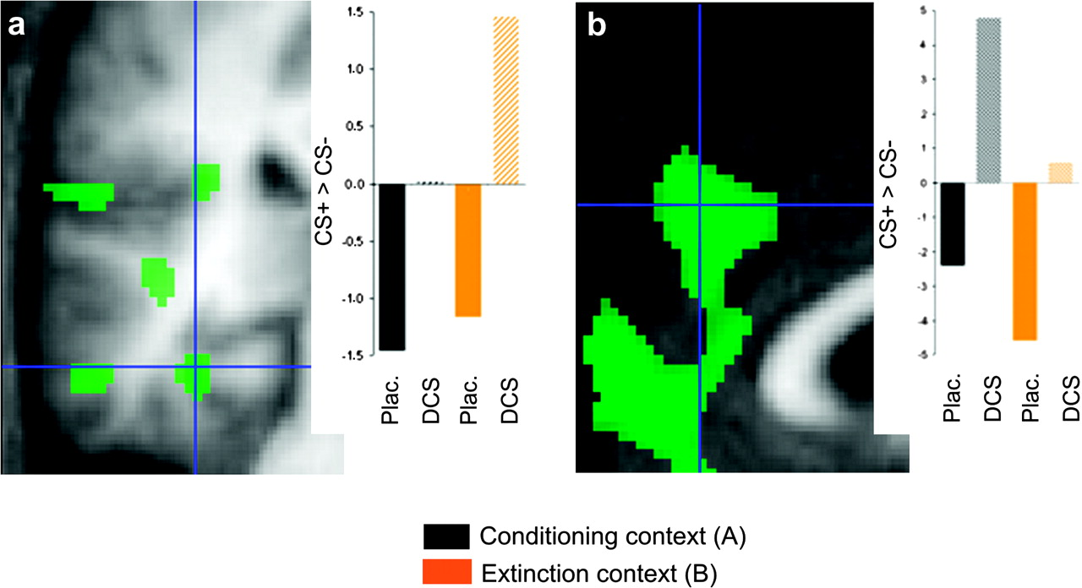
Figure 3. Effects of postlearning DCS on fMRI correlates of recall of fear memory on day 2. Activations associated with ...
Notes:
Figure 3. Effects of postlearning DCS on fMRI correlates of recall of fear memory on day 2. Activations associated with recall of fear memory on day 2 in left posterior hippocampus/collateral sulcus (x = −34, y = −32, z = −16) (a) and right MPFC/ACC (x = 2, y = 46, z = 34) (b) were larger in the DCS than in the placebo group. Images show the parametric contrast (CS+ > CS−)DCS > (CS+ > CS−)placebo, display threshold P ≤ 0.01. Hair cross denotes activation peak surviving SVC at P ≤ 0.05. Activations are superimposed on the mean structural image. The bar graphs show average contrast estimates for the parametric CS+ > CS− contrasts in both groups and contexts.
Unless provided in the caption above, the following copyright applies to the content of this slide: © 2008 The AuthorsThis is an Open Access article distributed under the terms of the Creative Commons Attribution Non-Commercial License (http://creativecommons.org/licenses/by-nc/2.0/uk/) which permits unrestricted non-commercial use, distribution, and reproduction in any medium, provided the original work is properly cited.

Slide 3
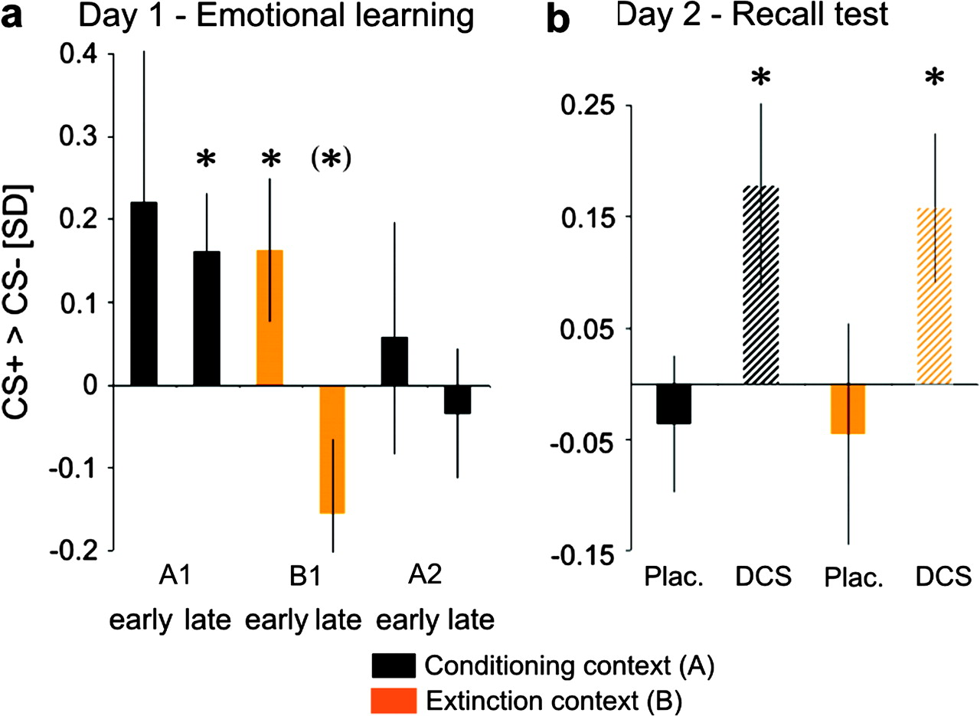
Figure 2. SCRs showing facilitated fear memory consolidation by DCS. (a) Day 1: Significantly larger SCRs to the CS+ ...
Notes:
Figure 2. SCRs showing facilitated fear memory consolidation by DCS. (a) Day 1: Significantly larger SCRs to the CS+ than to the CS− during late fear conditioning in context A indicate learning of the CS+−UCS contingency (fear memory) in context A on day 1. A reversal of the conditioning effect during late extinction in context B indicates learning of the CS+−noUCS contingency (extinction memory) in context B. (b) Day 2: SCRs to the CS+ in the conditioning context were again significantly larger than to the CS− on day 2, but only in those subjects receiving DCS after learning on day 1. A similar effect was apparent in the extinction context, that is, there was no evidence for extinction memory recall. Scale: z scores (unit: standard deviations [SDs]). *P < 0.05, (*)P < 0.1, 1-tailed t-test versus 0.
Unless provided in the caption above, the following copyright applies to the content of this slide: © 2008 The AuthorsThis is an Open Access article distributed under the terms of the Creative Commons Attribution Non-Commercial License (http://creativecommons.org/licenses/by-nc/2.0/uk/) which permits unrestricted non-commercial use, distribution, and reproduction in any medium, provided the original work is properly cited.

