Slide 1
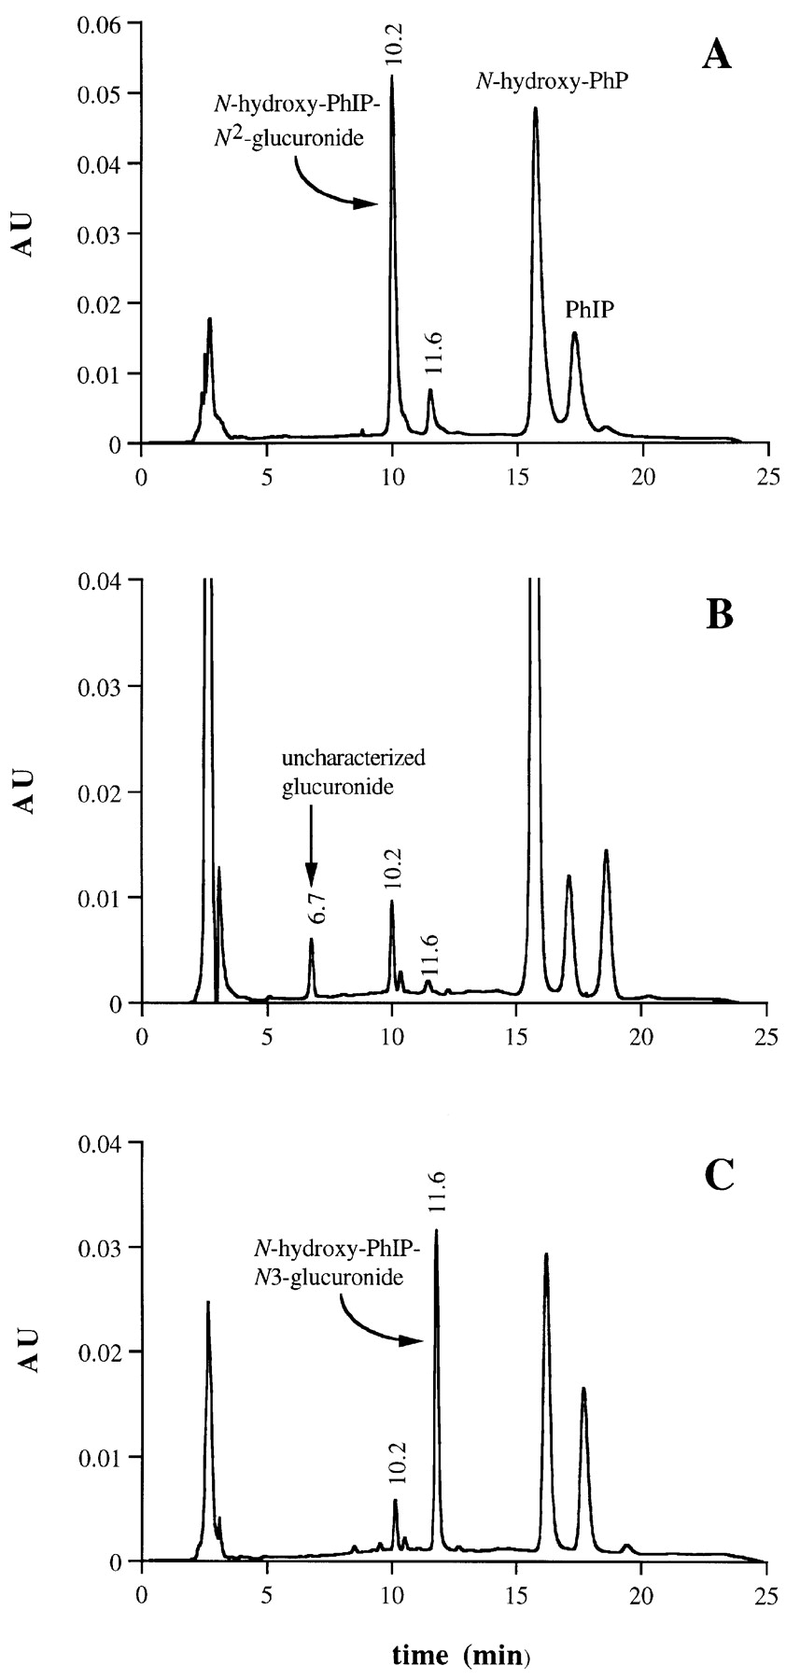
Fig. 1. Representative chromatograph of N-hydroxy-PhIP glucuronidation from incubations of microsomes expressing ...
Notes:
Fig. 1. Representative chromatograph of N-hydroxy-PhIP glucuronidation from incubations of microsomes expressing human UGT1A1 (A), UGT1A4 (B) and UGT1A9 (C). N-Hydroxy-PhIP concentration was 5.0 μM.
Unless provided in the caption above, the following copyright applies to the content of this slide: © Oxford University Press

Slide 2
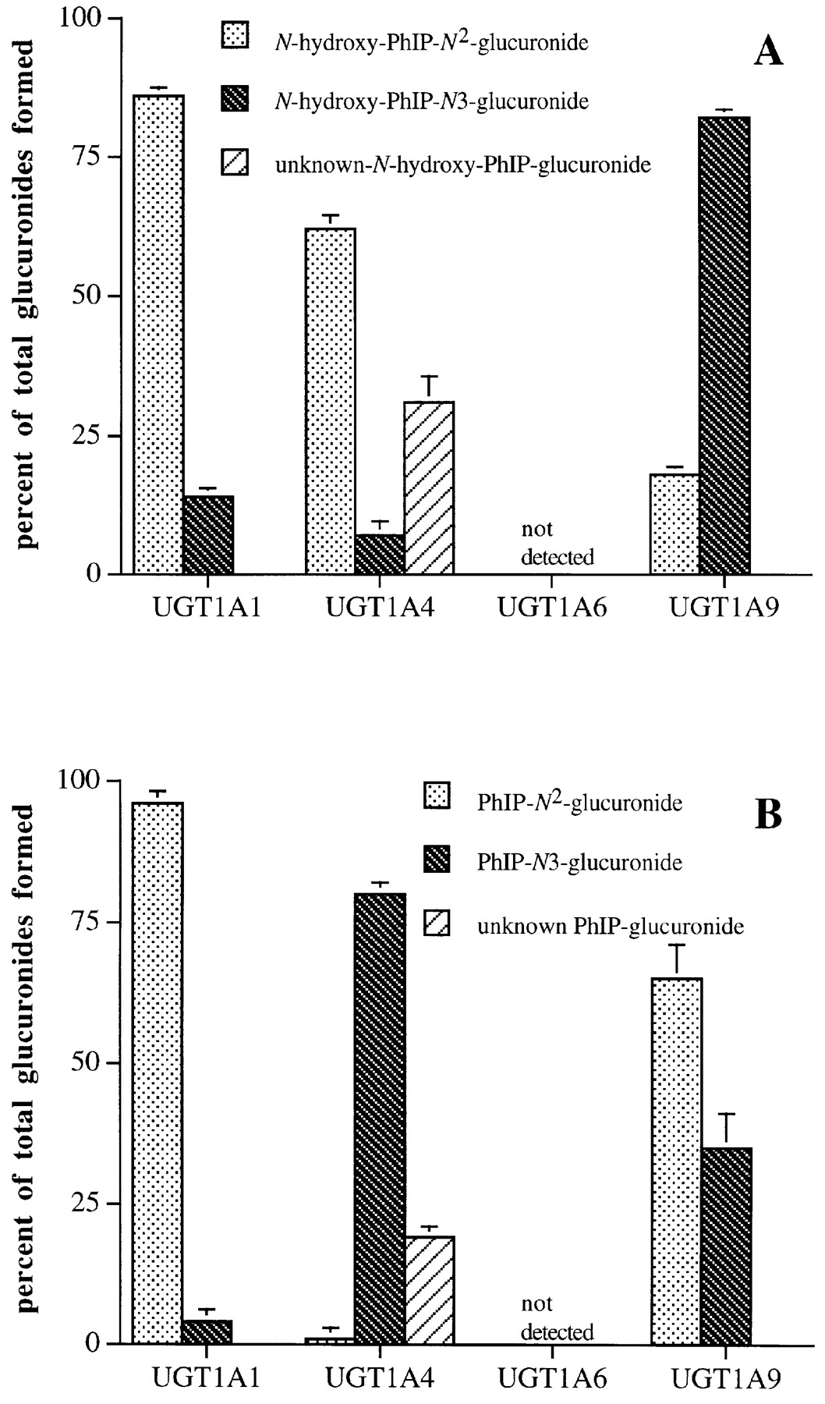
Fig. 2. Formation of N-hydroxy-PhIP-N-glucuronides (A) and PhIP-N-glucuronides (B) by microsomes expressing specific ...
Notes:
Fig. 2. Formation of N-hydroxy-PhIP-N-glucuronides (A) and PhIP-N-glucuronides (B) by microsomes expressing specific human UDP-glucuronosyltransferases incubated with 50 μM N-hydroxy-PhIP and PhIP, respectively. Data are represented as the percent of total glucuronides formed within each UGT isozyme, expressed as the mean ± standard deviation of three incubations.
Unless provided in the caption above, the following copyright applies to the content of this slide: © Oxford University Press

Slide 3
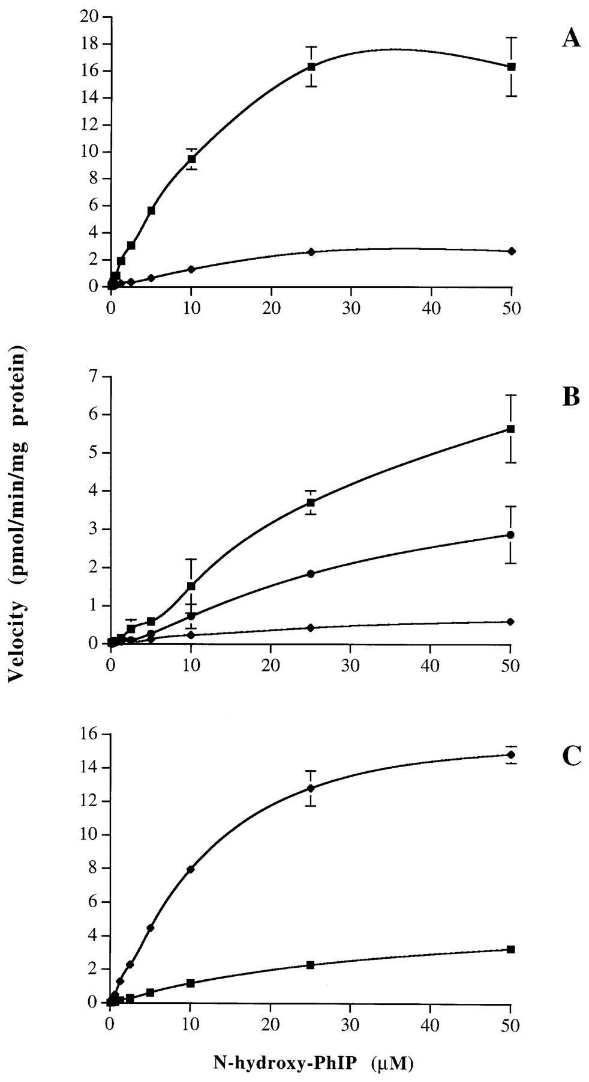
Fig. 3. Rate of N-hydroxy-PhIP glucuronidation by microsomes expressing human UGT1A1 (A), UGT1A4 (B) and UGT1A9 (C). ...
Notes:
Fig. 3. Rate of N-hydroxy-PhIP glucuronidation by microsomes expressing human UGT1A1 (A), UGT1A4 (B) and UGT1A9 (C). N-hydroxy-PhIP concentration was 0.08, 0.16, 0.32, 0.63, 1.25, 2.5, 5.0, 10, 25 and 50 μM. ▪, N-hydroxy-PhIP-N2-glucuronide; ⧫, N-hydroxy-PhIP-N3-glucuronide; •, unknown N-hydroxy-PhIP-glucuronide. Data are expressed as the mean ± standard deviation of three incubations.
Unless provided in the caption above, the following copyright applies to the content of this slide: © Oxford University Press

Slide 4
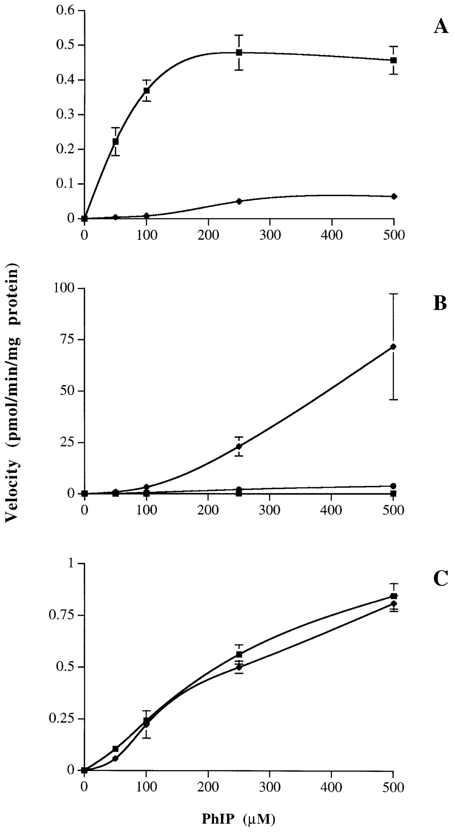
Fig. 4. Rate of PhIP glucuronidation by microsomes expressing human UGT1A1 (A), UGT1A4 (B) and UGT1A9 (C). PhIP ...
Notes:
Fig. 4. Rate of PhIP glucuronidation by microsomes expressing human UGT1A1 (A), UGT1A4 (B) and UGT1A9 (C). PhIP concentration was 50, 100, 250 and 500 μM. ▪, PhIP-N2-glucuronide; ⧫, PhIP-N3-glucuronide; •, unknown PhIP-glucuronide. Data are expressed as the mean ± standard deviation of five incubations.
Unless provided in the caption above, the following copyright applies to the content of this slide: © Oxford University Press

