Slide 1
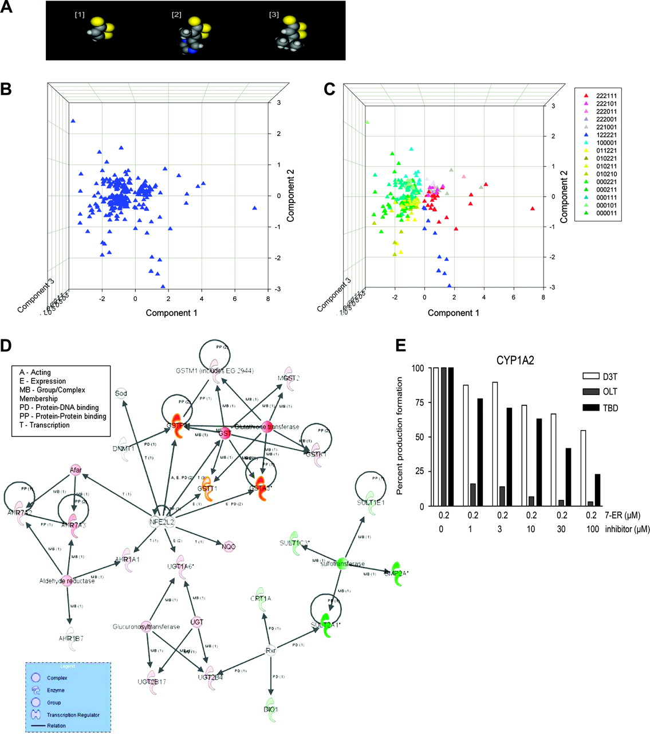
Fig. 1. ( A ) Space filling models of the three dithiolethiones: [1] D3T, [2] OLT and [3] TBD. The atoms are ...
Notes:
Fig. 1. ( A ) Space filling models of the three dithiolethiones: [1] D3T, [2] OLT and [3] TBD. The atoms are identified by colors: sulfur, yellow; carbon, dark gray; hydrogen, light gray; nitrogen, blue. ( B ) PCA of gene expression using the treatments as variables. The Eigen values of the principal component 1, 2, 3 and 4 are 17.513, 9.863, 5.196 and 0, respectively. The first three principal components contain over 98% of the total variance in the data. ( C ) PCA of gene expression color coded for the patterns identified in Table I , containing greater than six genes (right box). ( D ) Biological network common to D3T, OLT and TBD treatments. The intensity of the node color indicates the degree of upregulation (red) or downregulation (green). The lower legend box (blue) indicates the node shapes in order of complex, enzyme, group, transcription regulator and relation. The upper legend box indicates the relationships between two nodes. ( E ) Inhibition of CYP1A2 catalyzed 7-ethoxyresorufin- O -deethylase by D3T, OLT and TBD. The concentrations of the substrate (7-ER, 7-ethoxyresorufin) and the inhibitors are shown at the bottom.
Unless provided in the caption above, the following copyright applies to the content of this slide: © The Author 2009. Published by Oxford University Press. All rights reserved. For Permissions, please email: journals.permissions@oxfordjournals.orgThe online version of this article has been published under an open access model. Users are entitled to use, reproduce, disseminate, or display the open access version of this article for non-commercial purposes provided that: the original authorship is properly and fully attributed; the Journal and Oxford University Press are attributed as the original place of publication with the correct citation details given; if an article is subsequently reproduced or disseminated not in its entirety but only in part or as a derivative work this must be clearly indicated. For commercial re-use, please contact journals.permissions@oxfordjournals.org

