Slide 1
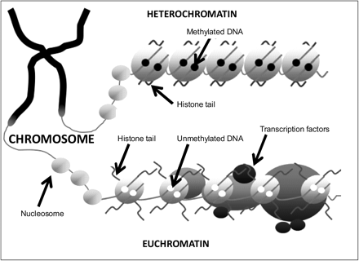
Fig. 1. The Main Components of the Epigenetic Code. The 2 main components of the epigenetic code comprise DNA ...
Notes:
Fig. 1. The Main Components of the Epigenetic Code. The 2 main components of the epigenetic code comprise DNA methylation and histone modifications. The addition of methyl groups to CpG dinucleotides acts to repress gene activity by blocking the binding of transcription factors and attracting methyl-binding proteins. A combination of different modifications to the “tails” of histones can alter the activity of genes via structural changes to the DNA molecule.
Unless provided in the caption above, the following copyright applies to the content of this slide: © The Author 2009. Published by Oxford University Press on behalf of the Maryland Psychiatric Research Center. All rights reserved. For permissions, please email: journals.permissions@oxfordjournals.org.

Slide 2
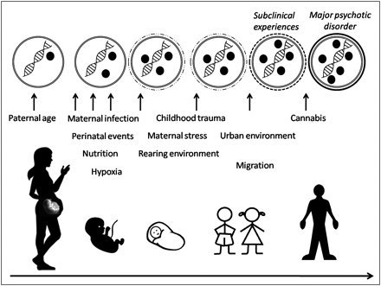
Fig. 2. Epigenetic Mediation of Environmental Factors During Development. Model of epigenetic mediation of ...
Notes:
Fig. 2. Epigenetic Mediation of Environmental Factors During Development. Model of epigenetic mediation of environmental influences during development and the relation with the phenotypic pathway leading to major psychotic disorders. From the epigenetic perspective, environmental exposures can have long-lasting effects on gene expression and phenotype (ie, major psychotic disorders) through epigenetic mechanisms such as DNA methylation. Black circles represent epigenetic modifications to DNA (eg, methylated cytosines or histone modifications). The top row represents a nucleus of a postmitotic cells with dynamic changes to DNA modifications that may accumulate within the individual throughout development as a consequence of the synergistical combination of multiple exposures. These dynamic changes in DNA methylation may be associated with the appearance of subclinical psychotic symptoms (reflected by dashed line around the nucleus in the top row) that can become abnormally persistent and ultimately lead to the onset of a major psychotic disorder (reflected by black line around the nucleus in the top row). While this figure illustrates that major psychotic disorders are associated with accumulation of DNA modifications of a gene, scenarios are equally possible where the gene is associated with the removal of epigenetic modifications.
Unless provided in the caption above, the following copyright applies to the content of this slide: © The Author 2009. Published by Oxford University Press on behalf of the Maryland Psychiatric Research Center. All rights reserved. For permissions, please email: journals.permissions@oxfordjournals.org.

