Slide 1
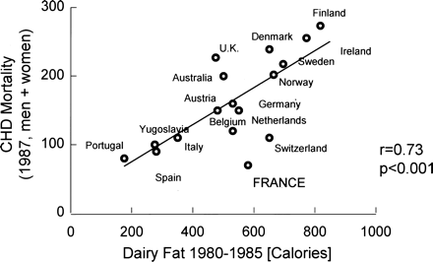
Fig. 1. Relation between coronary mortality (ordinate) and intake of dairy fat (abscissa) in different countries. The ...
Notes:
Fig. 1. Relation between coronary mortality (ordinate) and intake of dairy fat (abscissa) in different countries. The relative risk of France and Switzerland is low and deviates from the regression line. Modified from [10].
Unless provided in the caption above, the following copyright applies to the content of this slide: © ERA–EDTA 2003; all rights reserved

Slide 2
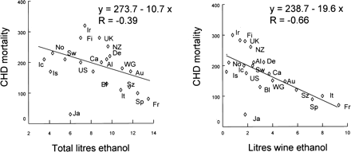
Fig. 2. Relation between coronary mortality (ordinate) and intake of ethanol (left) or wine ethanol (right) in ...
Notes:
Fig. 2. Relation between coronary mortality (ordinate) and intake of ethanol (left) or wine ethanol (right) in different countries. The intake of wine ethanol correlates more closely to coronary mortality than intake of total ethanol. Modified from [11]. Al, Australia; Au, Austria; Bl, Belgium; Ca, Canada; De, Denmark; Fi, Finland; Fr, France; Ic, Iceland; Ir, Ireland; Is, Israel; It, Italy; Ja, Japan; No, Norway; NZ, New Zealand; Sp, Spain; Sw, Sweden; Sz, Switzerland; US, USA; WG, West Germany.
Unless provided in the caption above, the following copyright applies to the content of this slide: © ERA–EDTA 2003; all rights reserved

Slide 3
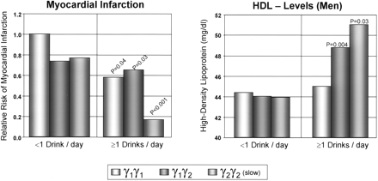
Fig. 3. Relation of the genetic variation of alcohol dehydrogenase to the relative risk of myocardial infarction ...
Notes:
Fig. 3. Relation of the genetic variation of alcohol dehydrogenase to the relative risk of myocardial infarction (left) and HDL level (right) at different amounts of alcohol intake per day. The γ2γ2 genotype mediates a slow metabolism of alcohol. In these individuals the myocardial infarction rate at higher levels of intake is remarkably reduced. This correlates well with the increase of HDL concentrations. Modified from [18].
Unless provided in the caption above, the following copyright applies to the content of this slide: © ERA–EDTA 2003; all rights reserved

Slide 4
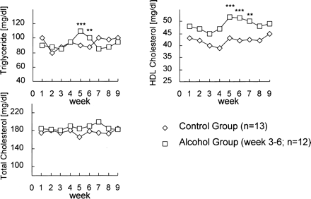
Fig. 4. Time-dependent effect of alcohol intake on blood lipids (triglycerides, total cholesterol and HDL ...
Notes:
Fig. 4. Time-dependent effect of alcohol intake on blood lipids (triglycerides, total cholesterol and HDL cholesterol) in individuals who consumed alcohol, compared with an abstinent control group. Modified from [26].
Unless provided in the caption above, the following copyright applies to the content of this slide: © ERA–EDTA 2003; all rights reserved

Slide 5
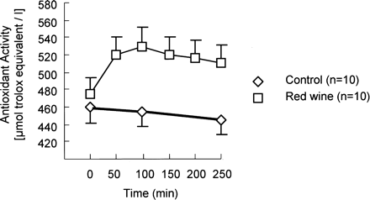
Fig. 5. Time-dependent increase of serum antioxidant activity in individuals who consumed a standard meal together ...
Notes:
Fig. 5. Time-dependent increase of serum antioxidant activity in individuals who consumed a standard meal together with a red wine (Bordeaux) compared with individuals with non-alcoholic fluid intake. Modified from [31].
Unless provided in the caption above, the following copyright applies to the content of this slide: © ERA–EDTA 2003; all rights reserved

Slide 6
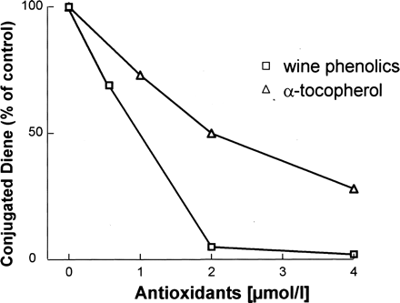
Fig. 6. Inhibition of human LDL-oxidation in vitro by wine phenolics or α-tocopherol. Please note that the effect of ...
Notes:
Fig. 6. Inhibition of human LDL-oxidation in vitro by wine phenolics or α-tocopherol. Please note that the effect of wine phenolics are more efficacious than the effects of α-tocopherol. Modified from [33].
Unless provided in the caption above, the following copyright applies to the content of this slide: © ERA–EDTA 2003; all rights reserved

Slide 7
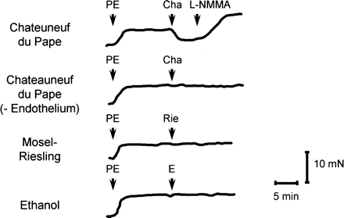
Fig. 7. Original recordings of the tension of human coronary arteries exposed to different wines (red wine: ...
Notes:
Fig. 7. Original recordings of the tension of human coronary arteries exposed to different wines (red wine: Chateauneuf du Pape; white wine: Mosel-Riesling) with or without endothelium. The effect of ethanol is shown for comparison. Please note that Chateauneuf du Pape (barrique harvested, very rich in phenolic compounds) relaxes coronary arteries. This effect was abolished by the removal of endothelium and was inhibited by application of the NO synthase inhibitor l-NMMA. Mosel-Riesling and ethanol had no effects. Modified from [42].
Unless provided in the caption above, the following copyright applies to the content of this slide: © ERA–EDTA 2003; all rights reserved

