Slide 1
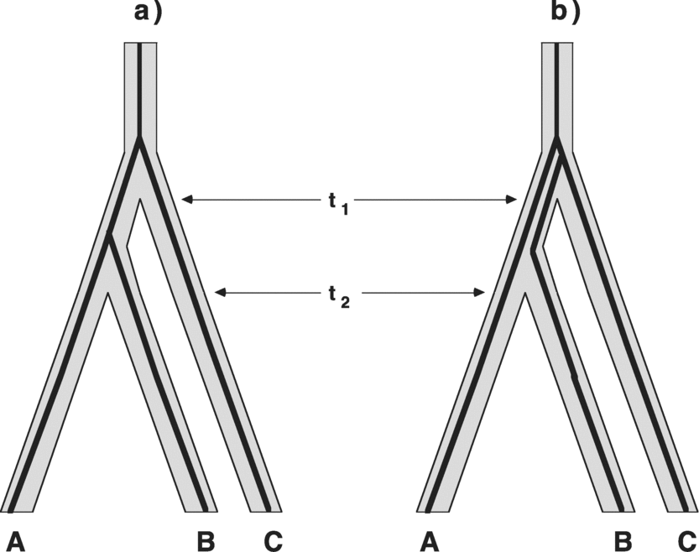
Figure 1 Gene genealogies within a three-species phylogeny (after Avise, 2004). Shown are two possible gene trees ...
Notes:
Figure 1 Gene genealogies within a three-species phylogeny (after Avise, 2004). Shown are two possible gene trees (thin dark lines), with the gene tree in (b) showing a qualitative topological discordance with the species tree.
Unless provided in the caption above, the following copyright applies to the content of this slide: © 2008 Society of Systematic Biologists

Slide 2
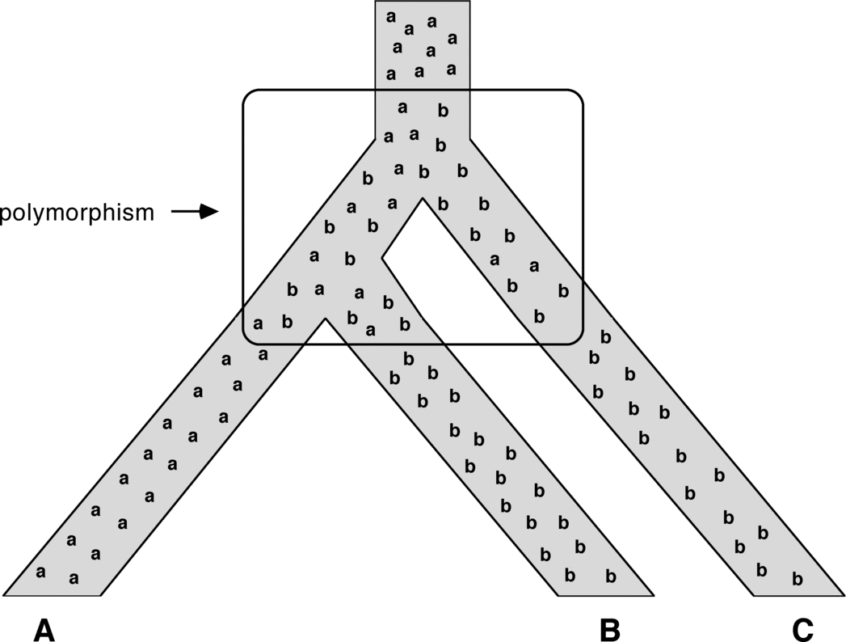
Figure 2 Another depiction of how alleles at a gene (or alternative states of any polymorphic trait) can be misleading ...
Notes:
Figure 2 Another depiction of how alleles at a gene (or alternative states of any polymorphic trait) can be misleading with respect to the tree topology for the species in which the alleles are housed. Shown is a polymorphism that traversed successive speciation nodes only to sort idiosyncratically and later become fixed in the descendant species in a pattern that at face value would appear to be discordant with the species phylogeny.
Unless provided in the caption above, the following copyright applies to the content of this slide: © 2008 Society of Systematic Biologists

Slide 3
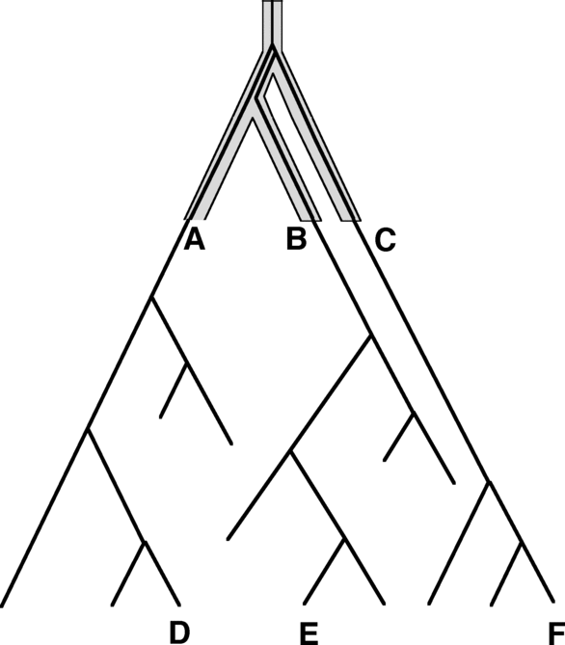
Figure 3 Diagrammatic representation of how an ancient discordance between a gene tree and a species tree can be ...
Notes:
Figure 3 Diagrammatic representation of how an ancient discordance between a gene tree and a species tree can be perpetuated indefinitely and thereby retained as a permanent incongruity between the gene tree and the species tree of descendant taxa (after Avise, 2000).
Unless provided in the caption above, the following copyright applies to the content of this slide: © 2008 Society of Systematic Biologists

