Slide 1
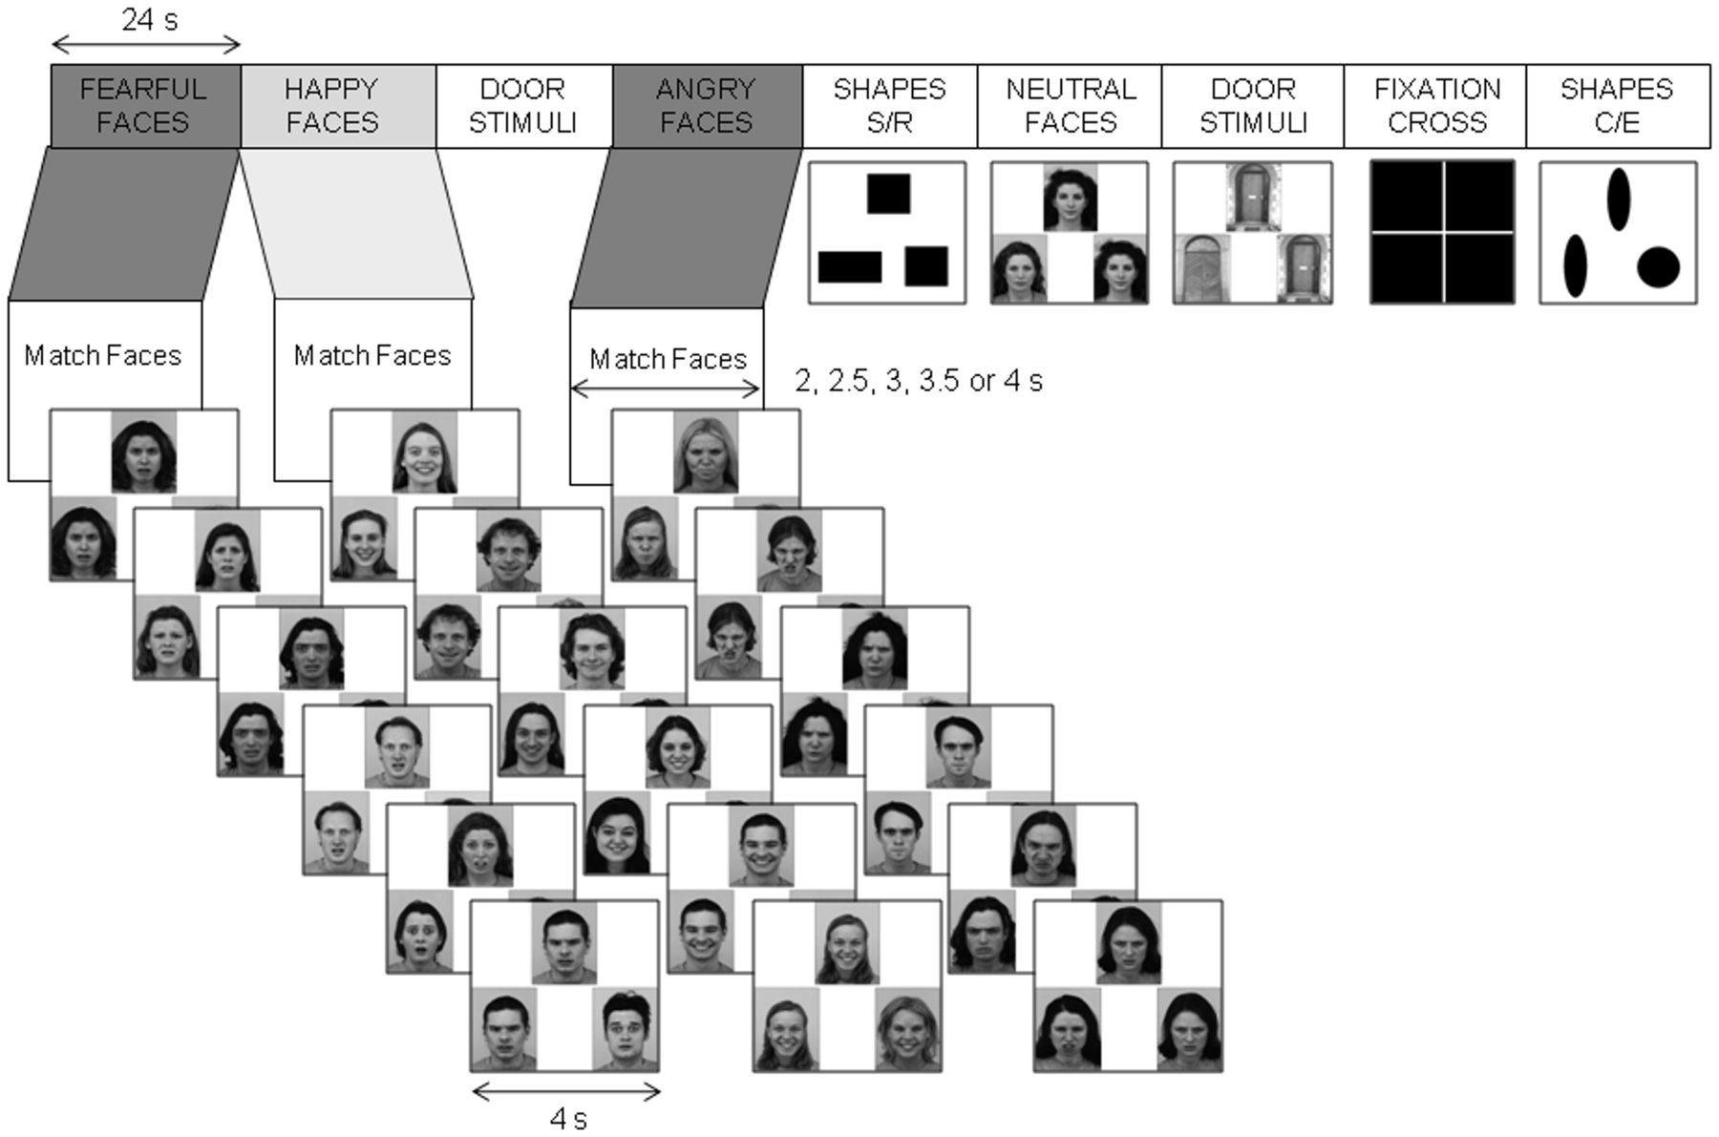
Fig. 1 Schematic diagram of the Emotional Face Processing Task (Hariri et al., 2002). The diagram shows the first 9 ...
Notes:
Fig. 1 Schematic diagram of the Emotional Face Processing Task (Hariri et al., 2002). The diagram shows the first 9 blocks of one of the task runs. Each 24-s block consisted of 6 (4-s) matching trials, and for each trial participants were required to indicate which of two probes presented at the bottom of the image (left or right) was identical to the target (centre top) image. Duration of the ‘match instructions’ was jittered between 2 and 4 s (2, 2.5, 3, 3.5 or 4 s). The contrast of interest was angry/fearful face processing minus happy face processing. Examples of the stimuli presented in the blocks of matching neutral faces, simple shapes (C/E, circles/ellipses; S/R, squares/rectangles) and doors are shown. The fixation cross is also shown.
Unless provided in the caption above, the following copyright applies to the content of this slide: © The Author(s) (2011). Published by Oxford University Press.This is an Open Access article distributed under the terms of the Creative Commons Attribution Non-Commercial License (http://creativecommons.org/licenses/by-nc/4.0/), which permits non-commercial re-use, distribution, and reproduction in any medium, provided the original work is properly cited. For commercial re-use, please contact journals.permissions@oup.com

Slide 2
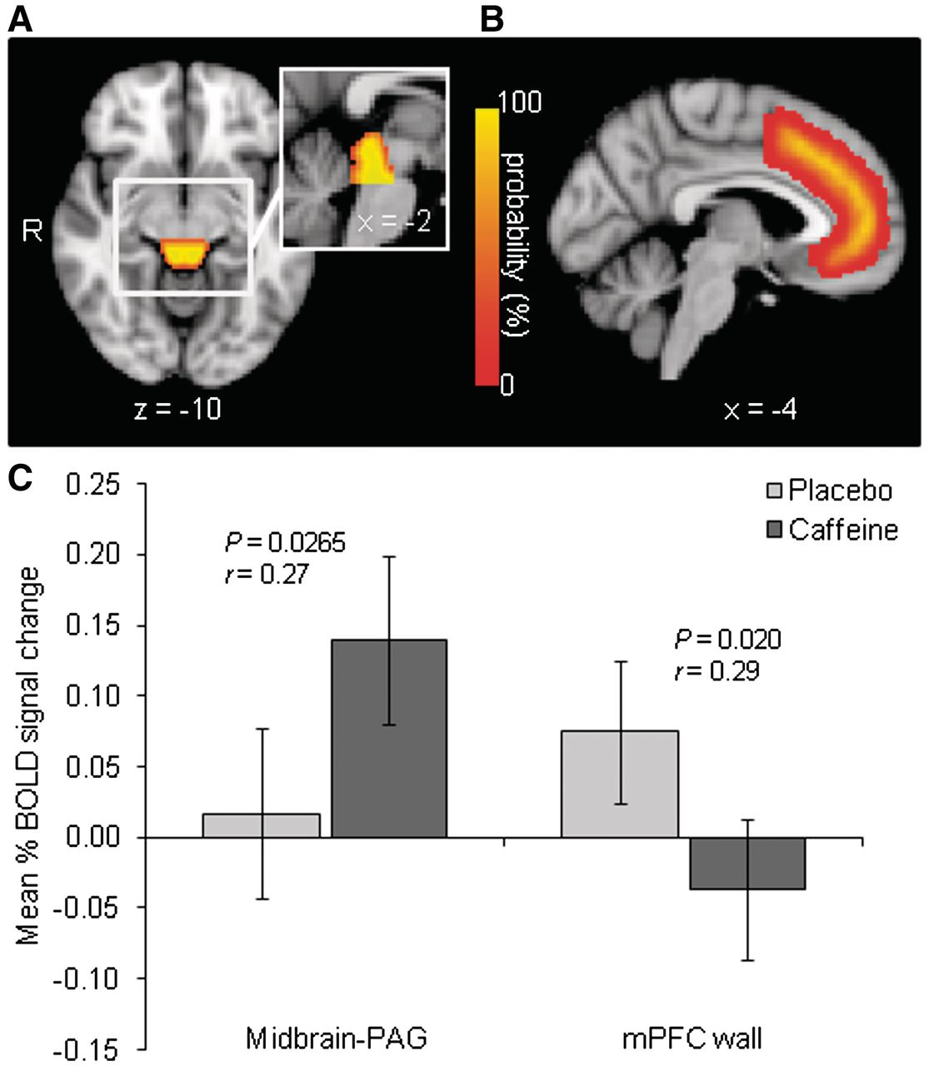
Fig. 2 Colored regions represent the probabilistic maps of (A) the midbrain-PAG ROI displayed on an axial and ...
Notes:
Fig. 2 Colored regions represent the probabilistic maps of (A) the midbrain-PAG ROI displayed on an axial and sagittal slice and (B) the mPFC wall ROI displayed on a sagittal slice. All slices are T1-weighted MNI templates and all coordinates are in MNI space. Colorbar represents probability levels coded by different colors; yellow color marks those voxels that are included in the ROI with 100% probability (C) Effects of caffeine on mean percent (%) BOLD signal change for the threat (angry/fearful faces) minus non-threat (happy faces) contrast in a priori ROIs. Error bars show 95% within-subject confidence intervals (Loftus and Masson, 1994). Effect size is indicated by r (Rosnow and Rosenthal, 2003).
Unless provided in the caption above, the following copyright applies to the content of this slide: © The Author(s) (2011). Published by Oxford University Press.This is an Open Access article distributed under the terms of the Creative Commons Attribution Non-Commercial License (http://creativecommons.org/licenses/by-nc/4.0/), which permits non-commercial re-use, distribution, and reproduction in any medium, provided the original work is properly cited. For commercial re-use, please contact journals.permissions@oup.com

Slide 3
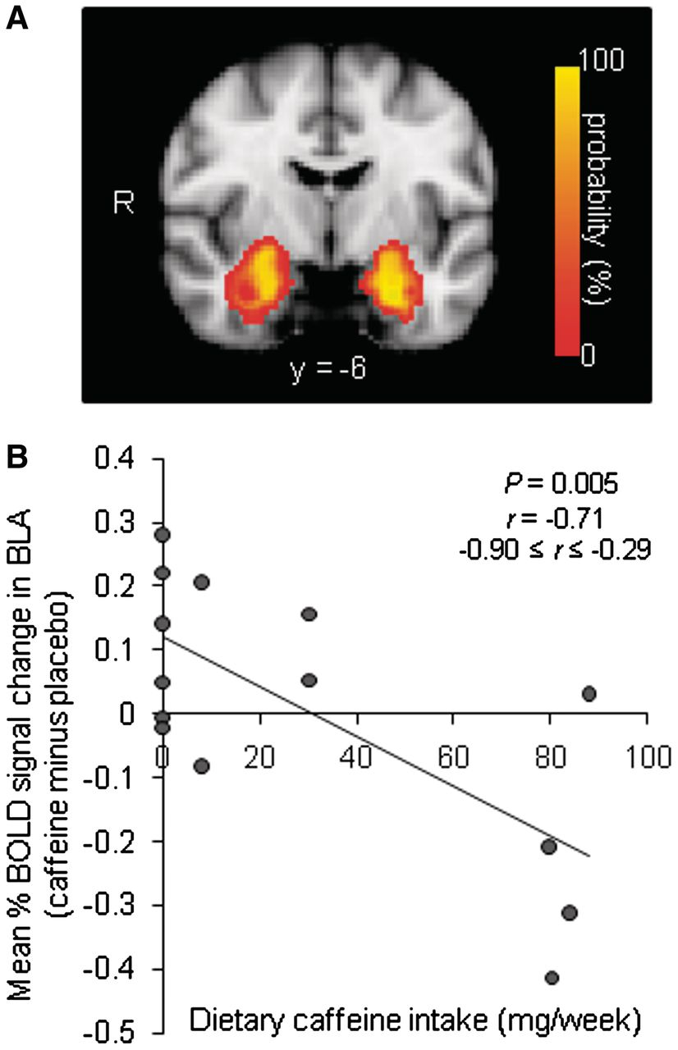
Fig. 3 (A) Colored region represents the probabilistic map of the BLA ROI displayed on a coronal slice of a single ...
Notes:
Fig. 3 (A) Colored region represents the probabilistic map of the BLA ROI displayed on a coronal slice of a single T1-weighted template in MNI space (MNI y = −6). Colorbar represents probability levels coded by different colors; yellow color marks those voxels that are included in the ROI with 100% probability (B) Scatterplot of effects of caffeine on mean percent (%) BOLD signal change for the threat (angry/fearful faces) minus non-threat (happy faces) contrast in the a priori BLA ROI as a function of level of dietary caffeine intake. Data are signal change meaned across the left and right BLA ROIs. The 95% confidence interval for r based on Fisher’s r–z transformation is displayed. The bootstrap 95% confidence interval (5000 iterations) for r was −0.90 ≤ r ≤ −0.17 (Efron, 1988).
Unless provided in the caption above, the following copyright applies to the content of this slide: © The Author(s) (2011). Published by Oxford University Press.This is an Open Access article distributed under the terms of the Creative Commons Attribution Non-Commercial License (http://creativecommons.org/licenses/by-nc/4.0/), which permits non-commercial re-use, distribution, and reproduction in any medium, provided the original work is properly cited. For commercial re-use, please contact journals.permissions@oup.com

