Slide 1
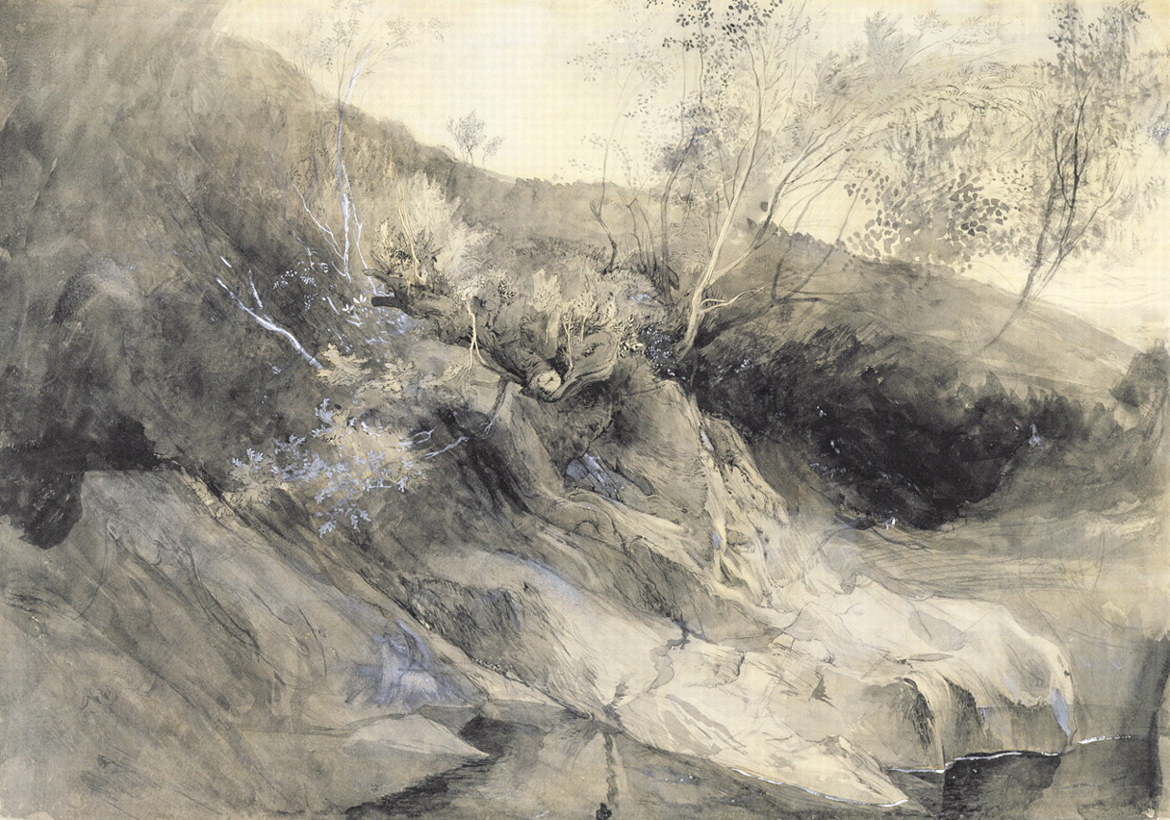
Fig 1. John Ruskin, The Rocky Bank of a River–Verso: Sketch of Foliage, c. 1853, grey wash with pen and ink over ...
Notes:
Fig 1. John Ruskin, The Rocky Bank of a River–Verso: Sketch of Foliage, c. 1853, grey wash with pen and ink over graphite heightened with white bodycolour on heavy off-white wove paper, 32.5 × 47.3 cm, Yale Center for British Art, Paul Mellon Collection, New Haven, CT. Image courtesy of Bridgeman Art Library.
Unless provided in the caption above, the following copyright applies to the content of this slide: © British Society of Aesthetics 2011. Published by Oxford University Press on behalf of the British Society of Aesthetics. All rights reserved. For Permissions, please email: journals.permissions@oup.com

Slide 2
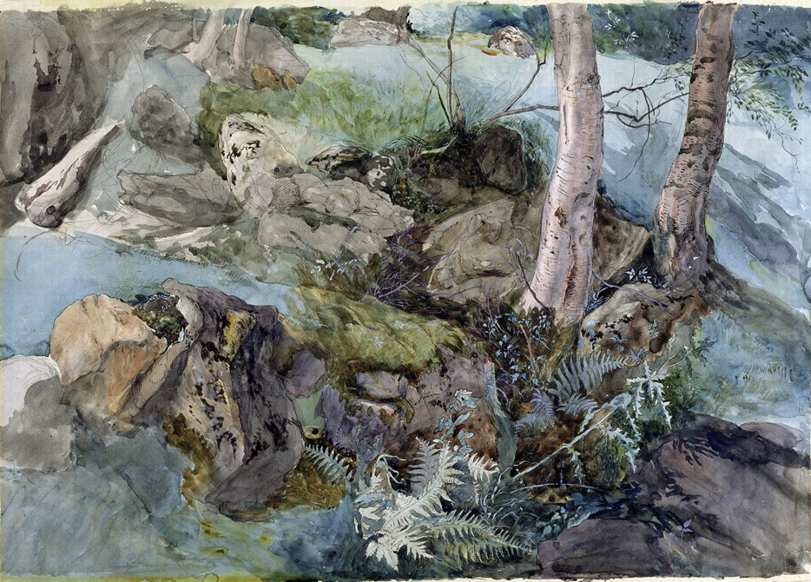
Fig 2. John Ruskin, Study of Rocks and Ferns in a Wood at Crossmount, Perthshire, 1847, pen and ink, watercolour and ...
Notes:
Fig 2. John Ruskin, Study of Rocks and Ferns in a Wood at Crossmount, Perthshire, 1847, pen and ink, watercolour and bodycolour on paper, 32.3 × 46.5 cm, Abbot Hall Art Gallery, Kendal, Cumbria. Image courtesy of Bridgeman Art Library.
Unless provided in the caption above, the following copyright applies to the content of this slide: © British Society of Aesthetics 2011. Published by Oxford University Press on behalf of the British Society of Aesthetics. All rights reserved. For Permissions, please email: journals.permissions@oup.com

Slide 3
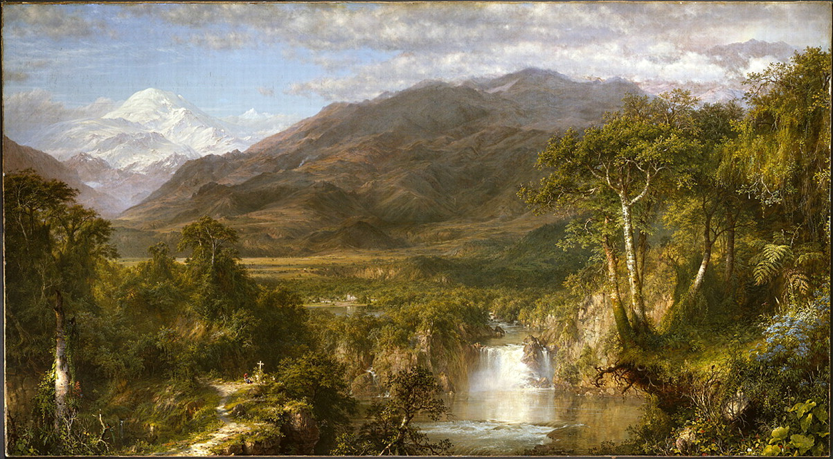
Fig 3. Frederic Edwin Church, Heart of the Andes, 1859, oil on canvas, 168 × 302.9 cm, The Metropolitan Museum of ...
Notes:
Fig 3. Frederic Edwin Church, Heart of the Andes, 1859, oil on canvas, 168 × 302.9 cm, The Metropolitan Museum of Art, New York, NY. Image courtesy of The Metropolitan Museum of Art/Art Resource, NY.
Unless provided in the caption above, the following copyright applies to the content of this slide: © British Society of Aesthetics 2011. Published by Oxford University Press on behalf of the British Society of Aesthetics. All rights reserved. For Permissions, please email: journals.permissions@oup.com

Slide 4
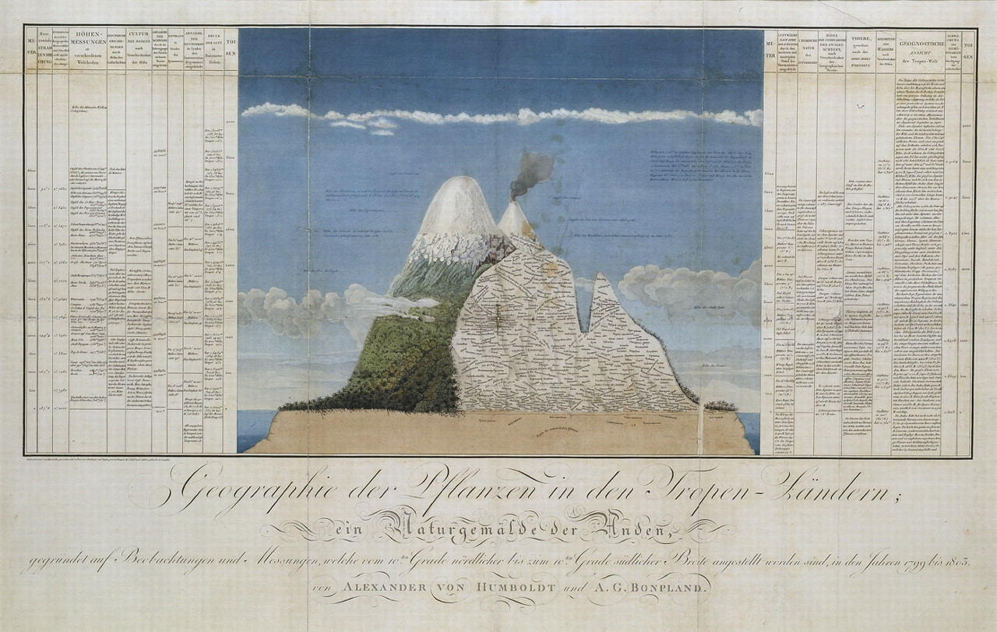
Fig 4. Drawing by Lorenz Schönberger and Pierre Turpin, 1805. After a sketch by Alexander von Humboldt. Engraving ...
Notes:
Fig 4. Drawing by Lorenz Schönberger and Pierre Turpin, 1805. After a sketch by Alexander von Humboldt. Engraving with watercolour by Louis Bouquet, Cross Section of the Volcano Chimborazo, Ecuador (Geographie der Pflanzen in den Tropen-Ländern, ein Naturgemälde der Anden) (Géographie des plantes équinoxiales/Tableau physique des Andes et Pays voisins …), from Essai sur la Géographie des Plantes Equinoxiale (Paris, 1805). Hamburger Kunsthalle, Hamburg. Image courtesy of Bildarchiv Preussischer Kulturbesitz/Art Resource, NY.
Unless provided in the caption above, the following copyright applies to the content of this slide: © British Society of Aesthetics 2011. Published by Oxford University Press on behalf of the British Society of Aesthetics. All rights reserved. For Permissions, please email: journals.permissions@oup.com

