Slide 1
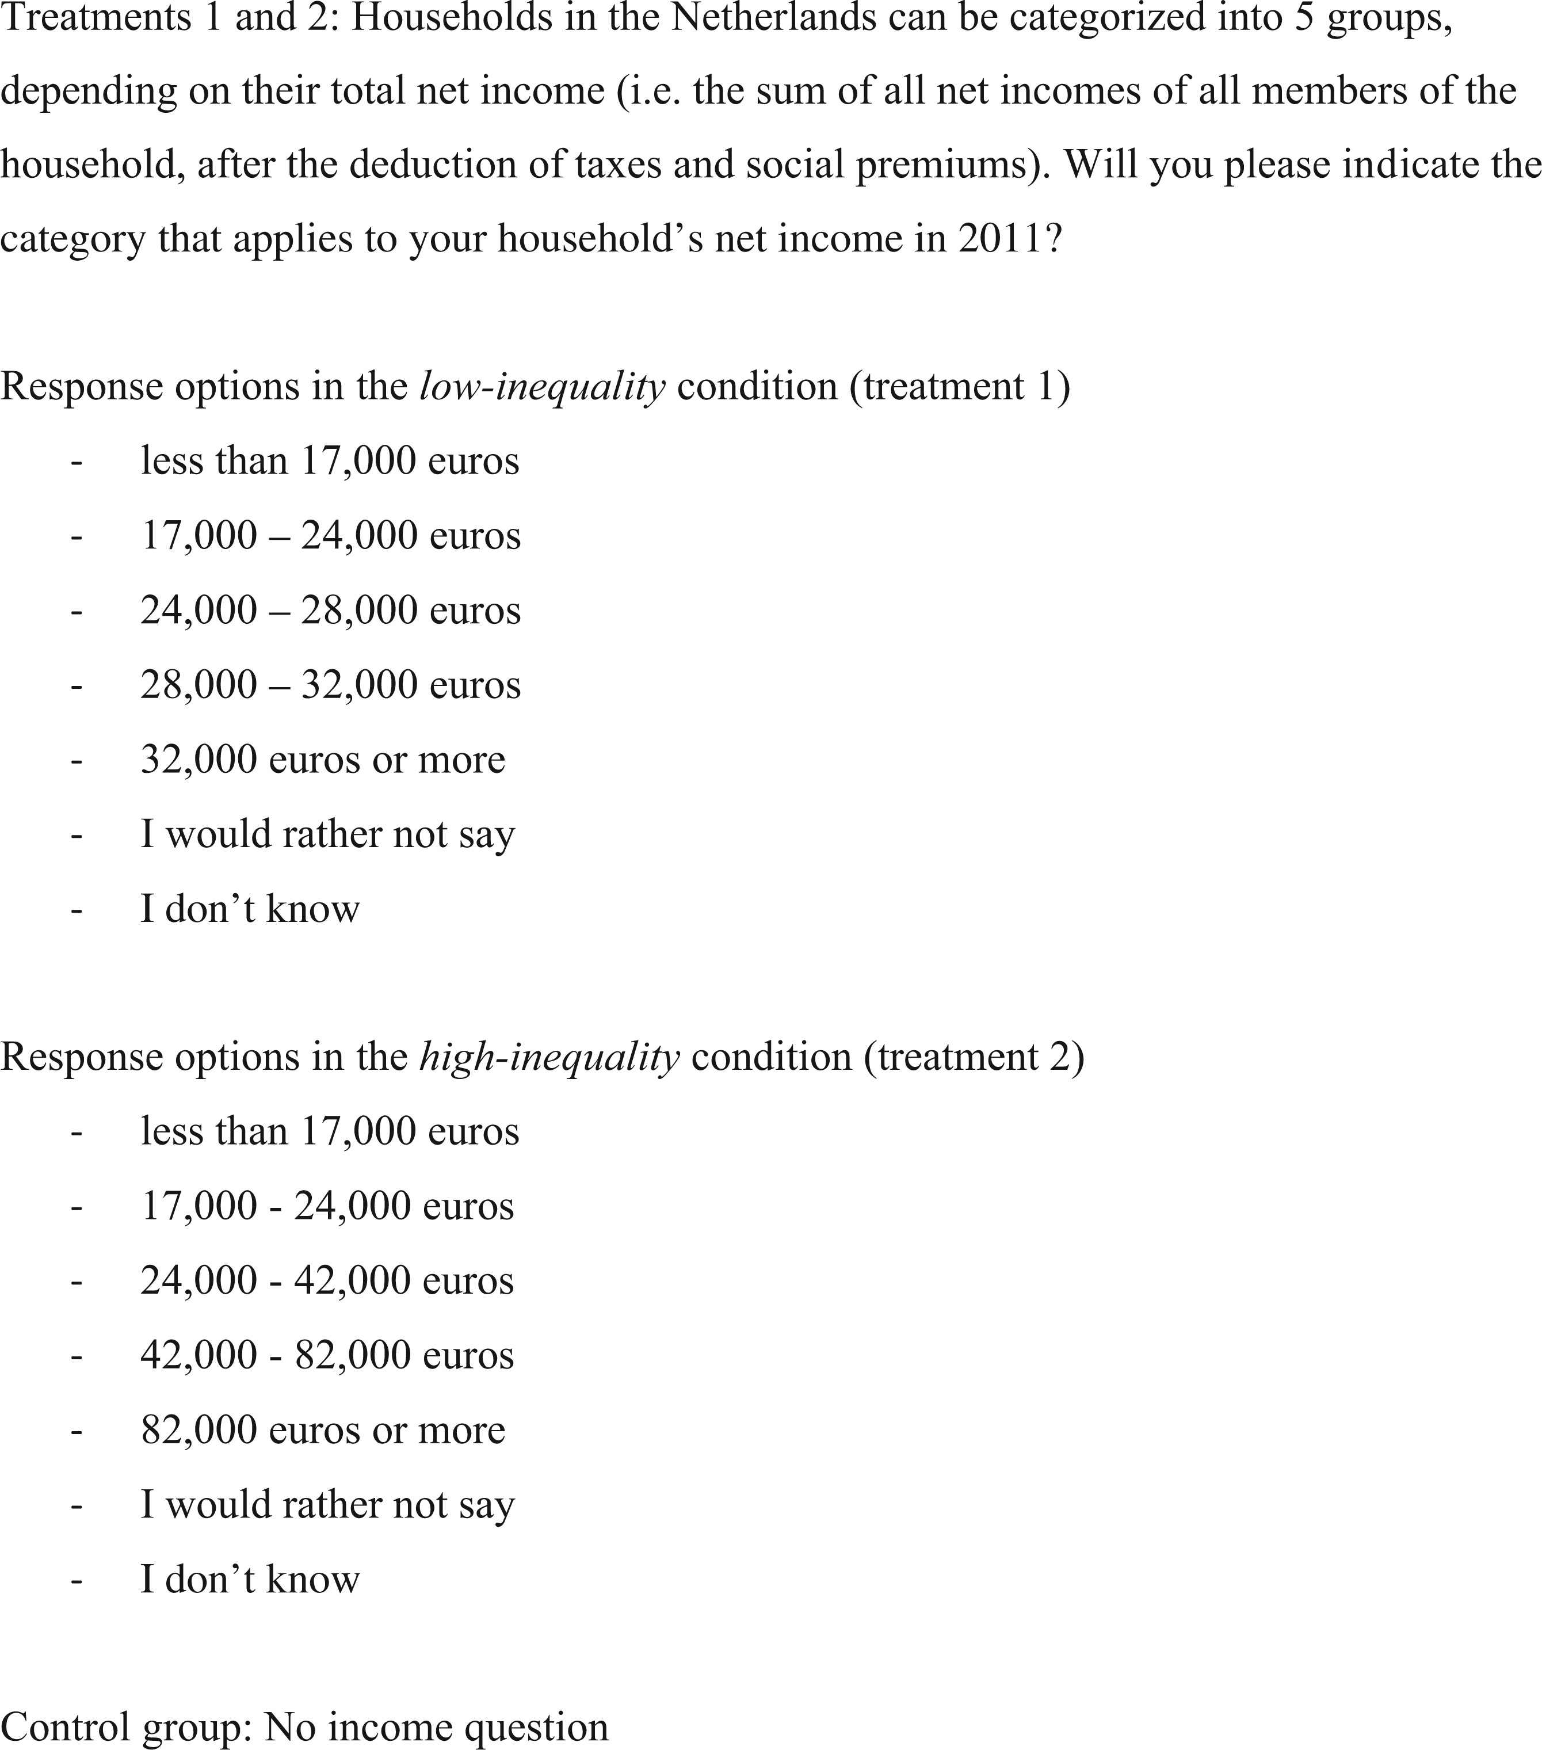
Figure 1 Question wording of the survey experiment
Notes:
Figure 1 Question wording of the survey experiment
Unless provided in the caption above, the following copyright applies to the content of this slide: ©The Author 2016. Published by Oxford University Press and the Society for the Advancement of Socio-Economics. All rights reserved. For Permissions, please email: journals.permissions@oup.com

Slide 2
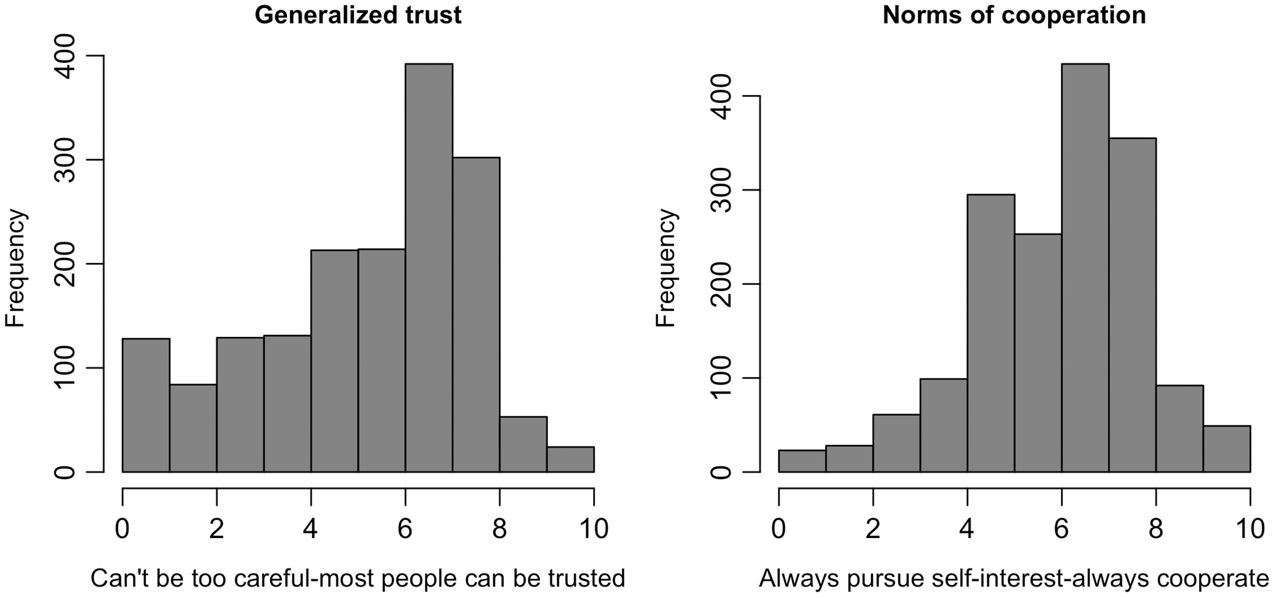
Figure 2 The distribution of prosocial attitudes.
Notes:
Figure 2 The distribution of prosocial attitudes.
Unless provided in the caption above, the following copyright applies to the content of this slide: ©The Author 2016. Published by Oxford University Press and the Society for the Advancement of Socio-Economics. All rights reserved. For Permissions, please email: journals.permissions@oup.com

Slide 3
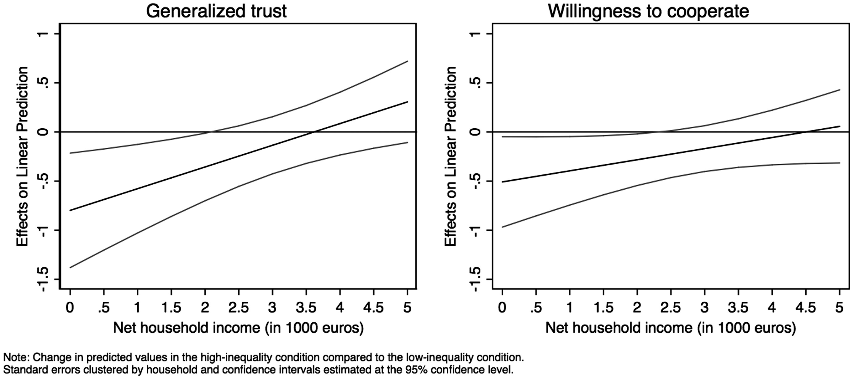
Figure 3 Marginal effects of the high-inequality treatment by net household income.
Notes:
Figure 3 Marginal effects of the high-inequality treatment by net household income.
Unless provided in the caption above, the following copyright applies to the content of this slide: ©The Author 2016. Published by Oxford University Press and the Society for the Advancement of Socio-Economics. All rights reserved. For Permissions, please email: journals.permissions@oup.com

