Slide 1
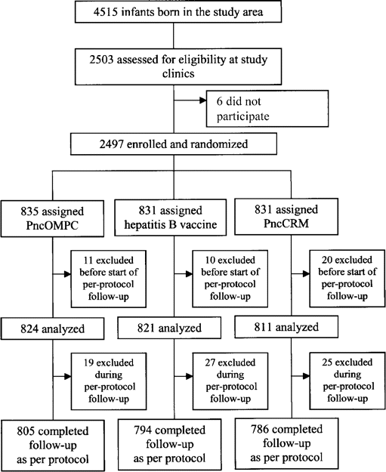
Figure 1 Demographic characteristics and risk factors for infants and children who received pneumococcal ...
Notes:
Figure 1 Demographic characteristics and risk factors for infants and children who received pneumococcal polysaccharide-meningococcal outer membrane protein complex conjugate vaccine (PncOMPC) or control vaccine (hepatitis B vaccine; HBV) for acute otitis media.
Unless provided in the caption above, the following copyright applies to the content of this slide: © 2003 by the Infectious Diseases Society of America

Slide 2
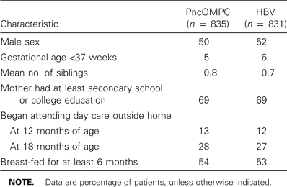
Table 1 Characteristics of cases of invasive meningococcal disease in residents of Abbotsford, British Columbia, ...
Notes:
Table 1 Characteristics of cases of invasive meningococcal disease in residents of Abbotsford, British Columbia, Canada.
Unless provided in the caption above, the following copyright applies to the content of this slide: © 2003 by the Infectious Diseases Society of America

Slide 3
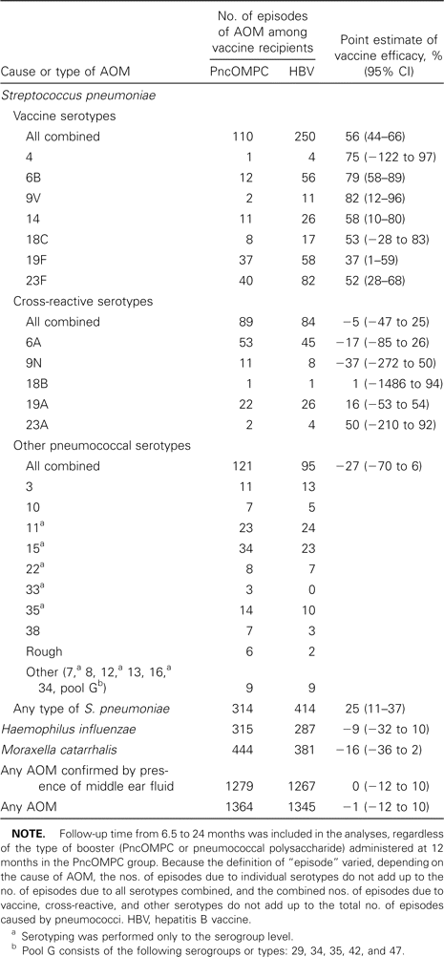
Table 2 Protective efficacy of a pneumococcal polysaccharide-meningococcal outer membrane protein complex conjugate ...
Notes:
Table 2 Protective efficacy of a pneumococcal polysaccharide-meningococcal outer membrane protein complex conjugate vaccine (PncOMPC) for acute otitis media (AOM) in infants and children during per-protocol follow-up.
Unless provided in the caption above, the following copyright applies to the content of this slide: © 2003 by the Infectious Diseases Society of America

Slide 4
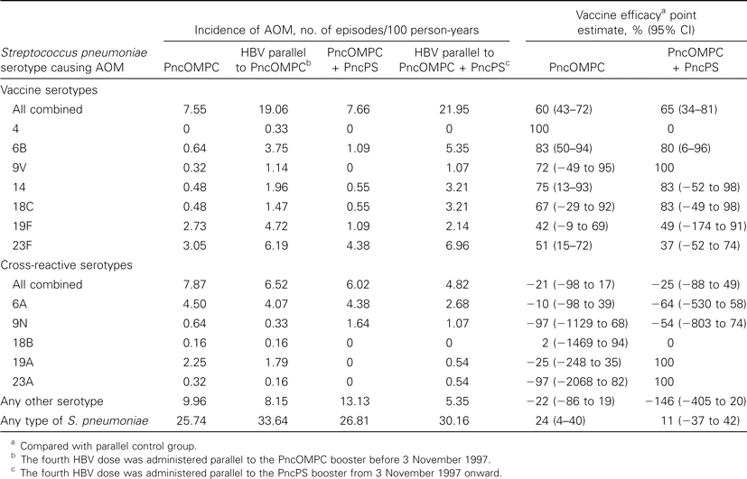
Table 3 Incidence of various types of pneumococcal acute otitis media (AOM) among children who received pneumococcal ...
Notes:
Table 3 Incidence of various types of pneumococcal acute otitis media (AOM) among children who received pneumococcal polysaccharide-meningococcal outer membrane protein complex conjugate vaccine (PncOMPC), pneumococcal polysaccharide vaccine (PncPS), or hepatitis B vaccine (HBV) booster during a follow-up period lasting from 12 to 24 months of age.
Unless provided in the caption above, the following copyright applies to the content of this slide: © 2003 by the Infectious Diseases Society of America

Slide 5
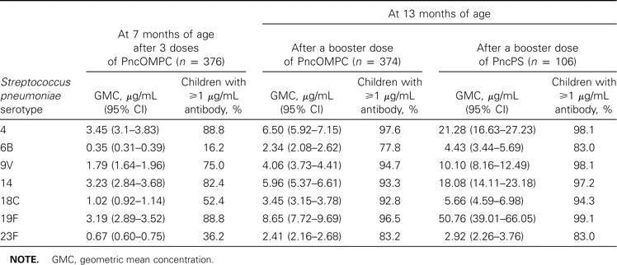
Table 4 Serum concentrations of pneumococcal anticapsular antibodies at 7 and 13 months of age among children who ...
Notes:
Table 4 Serum concentrations of pneumococcal anticapsular antibodies at 7 and 13 months of age among children who received pneumococcal polysaccharide-meningococcal outer membrane protein complex conjugate vaccine (PncOMPC) or pneumococcal polysaccharide vaccine (PncPS) for acute otitis media.
Unless provided in the caption above, the following copyright applies to the content of this slide: © 2003 by the Infectious Diseases Society of America

Slide 6
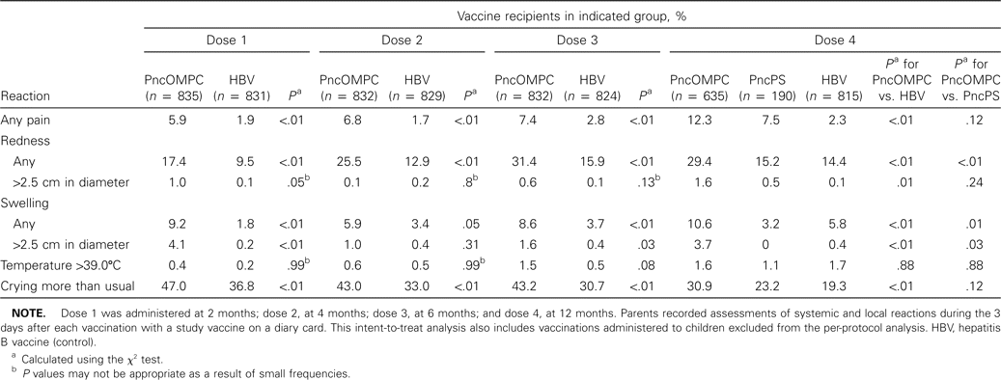
Table 5 Adverse reactions that occurred within 3 days after immunization at 2, 4, 6, and 12 months of age among ...
Notes:
Table 5 Adverse reactions that occurred within 3 days after immunization at 2, 4, 6, and 12 months of age among children vaccinated with pneumococcal polysaccharide-meningococcal outer membrane protein complex conjugate vaccine (PncOMPC) or pneumococcal polysaccharide vaccine (PncPS) for acute otitis media.
Unless provided in the caption above, the following copyright applies to the content of this slide: © 2003 by the Infectious Diseases Society of America

