Slide 1
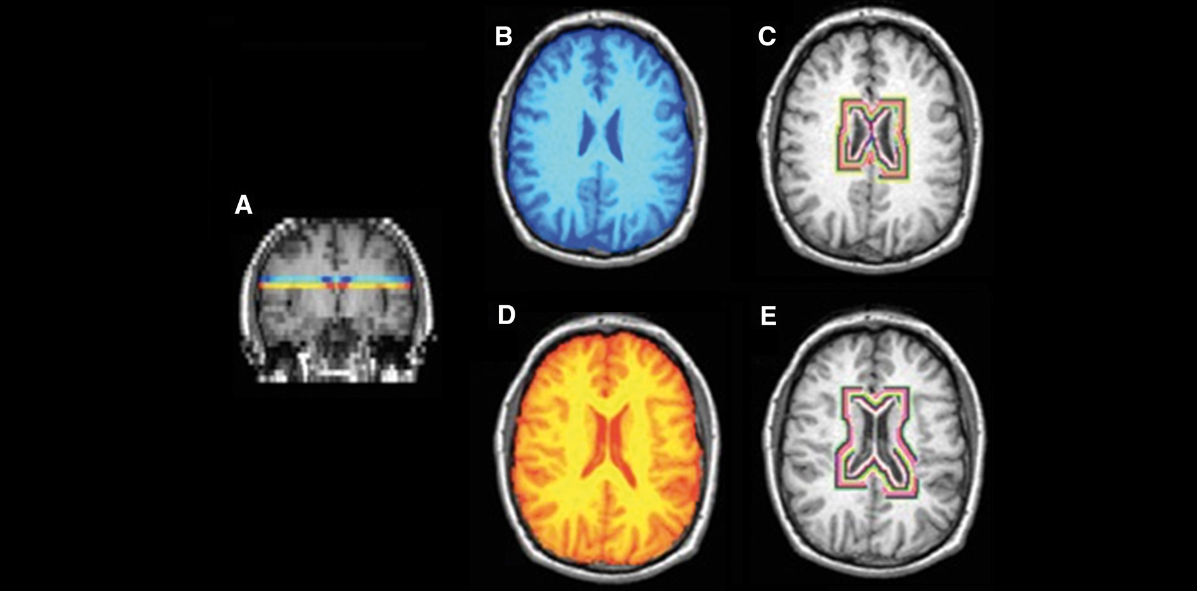
Figure 1 MTR image processing. (A) NAWM from two 5 mm axial slices were extracted at (B) and immediately below (C) the ...
Notes:
Figure 1 MTR image processing. (A) NAWM from two 5 mm axial slices were extracted at (B) and immediately below (C) the level of the insula. Rings of concentric MTR values from the NAWM around the ventricles were then extracted (D and E). The first two rings were excluded to minimize partial volume effects.
Unless provided in the caption above, the following copyright applies to the content of this slide: © The Author (2016). Published by Oxford University Press on behalf of the Guarantors of Brain. All rights reserved. For Permissions, please email: journals.permissions@oup.com

Slide 2
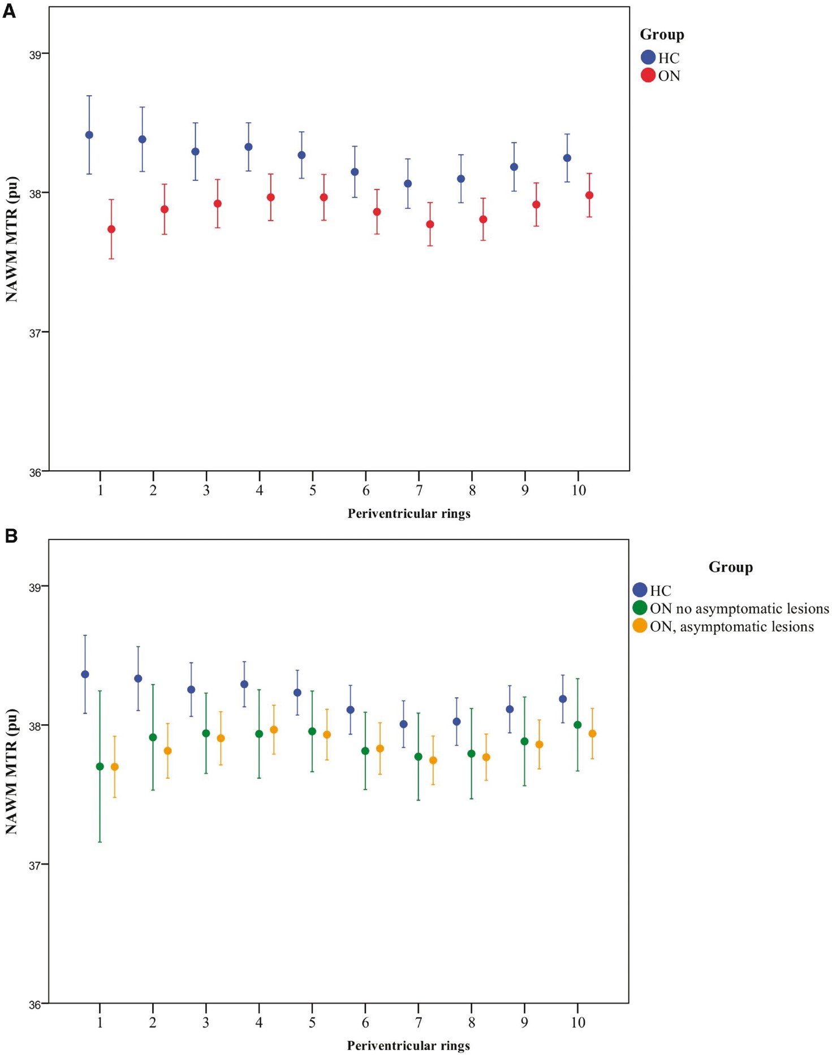
Figure 2 Periventricular NAWM MTR in healthy control and optic neuritis groups. (A) NAWM MTR of rings in healthy ...
Notes:
Figure 2 Periventricular NAWM MTR in healthy control and optic neuritis groups. (A) NAWM MTR of rings in healthy controls (HC, blue) and patients with optic neuritis 4.6 months after symptom onset (ON, red). Mean ± 2 SE. MTR is expressed as percentage units (pu). Ring 1 is closest to the ventricular surface. (B) NAWM MTR in healthy controls (HC, blue) and patients with optic neuritis 4.6 months after symptom onset (ON), divided into those with (yellow) and without (green) asymptomatic lesions on their baseline scan. Mean ± 2 SE is shown. MTR is expressed as percentage units (pu). Ring 1 is closest to the ventricular surface. (C) NAWM MTR in patients with optic neuritis 4.6 months after symptom onset (ON) plus asymptomatic lesions, divided into those with (n = 46, yellow circles) and without (n = 9, green circles) periventricular lesions. Mean ± 2 SE. MTR is expressed as percentage units (pu). Ring 1 is closest to the ventricular surface. (D) NAWM MTR in healthy controls (HC, blue) and patients with optic neuritis 4.6 months after symptom onset (ON), divided into those who did convert to CDMS within 2 years (yellow) and those that did not (green). Mean ± 2 SE is shown. MTR is expressed as percentage units (pu). Ring 1 is closest to the ventricular surface.
Unless provided in the caption above, the following copyright applies to the content of this slide: © The Author (2016). Published by Oxford University Press on behalf of the Guarantors of Brain. All rights reserved. For Permissions, please email: journals.permissions@oup.com

Slide 3
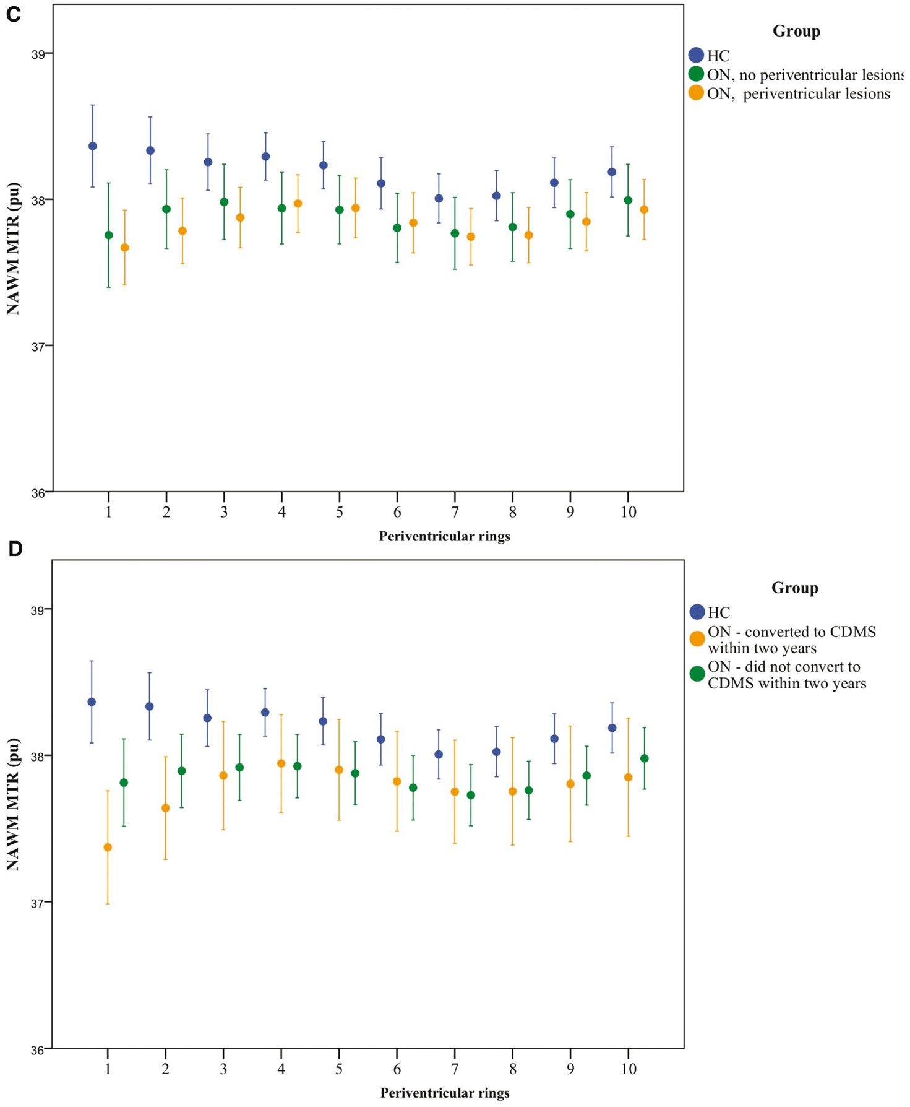
Figure 2 Periventricular NAWM MTR in healthy control and optic neuritis groups. (A) NAWM MTR of rings in healthy ...
Notes:
Figure 2 Periventricular NAWM MTR in healthy control and optic neuritis groups. (A) NAWM MTR of rings in healthy controls (HC, blue) and patients with optic neuritis 4.6 months after symptom onset (ON, red). Mean ± 2 SE. MTR is expressed as percentage units (pu). Ring 1 is closest to the ventricular surface. (B) NAWM MTR in healthy controls (HC, blue) and patients with optic neuritis 4.6 months after symptom onset (ON), divided into those with (yellow) and without (green) asymptomatic lesions on their baseline scan. Mean ± 2 SE is shown. MTR is expressed as percentage units (pu). Ring 1 is closest to the ventricular surface. (C) NAWM MTR in patients with optic neuritis 4.6 months after symptom onset (ON) plus asymptomatic lesions, divided into those with (n = 46, yellow circles) and without (n = 9, green circles) periventricular lesions. Mean ± 2 SE. MTR is expressed as percentage units (pu). Ring 1 is closest to the ventricular surface. (D) NAWM MTR in healthy controls (HC, blue) and patients with optic neuritis 4.6 months after symptom onset (ON), divided into those who did convert to CDMS within 2 years (yellow) and those that did not (green). Mean ± 2 SE is shown. MTR is expressed as percentage units (pu). Ring 1 is closest to the ventricular surface.
Unless provided in the caption above, the following copyright applies to the content of this slide: © The Author (2016). Published by Oxford University Press on behalf of the Guarantors of Brain. All rights reserved. For Permissions, please email: journals.permissions@oup.com

Slide 4
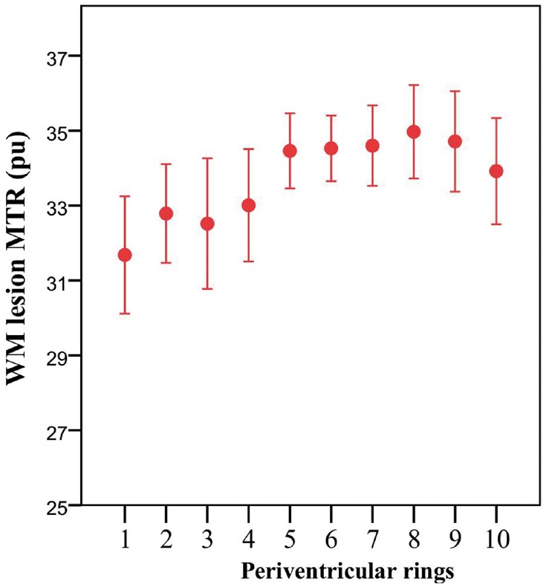
Figure 3 Periventricular white matter lesional MTR. Mean MTR of white matter (WM) lesional voxels in patients with ...
Notes:
Figure 3 Periventricular white matter lesional MTR. Mean MTR of white matter (WM) lesional voxels in patients with optic neuritis 4.6 months after symptom onset (ON). Mean ± 2 SE. MTR is expressed as percentage units (pu). Ring 1 is closest to the ventricular surface.
Unless provided in the caption above, the following copyright applies to the content of this slide: © The Author (2016). Published by Oxford University Press on behalf of the Guarantors of Brain. All rights reserved. For Permissions, please email: journals.permissions@oup.com

Slide 5
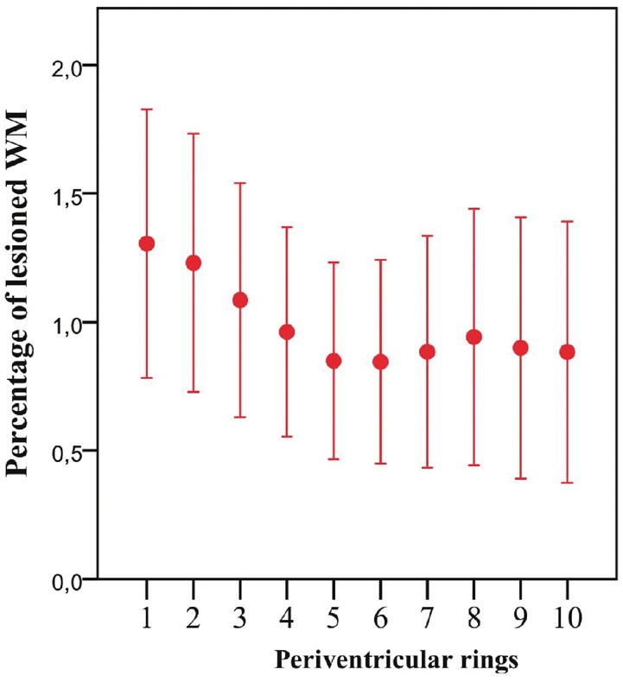
Figure 4 Percentage periventricular lesional white matter. Percentage of lesional white matter (WM) per ring in ...
Notes:
Figure 4 Percentage periventricular lesional white matter. Percentage of lesional white matter (WM) per ring in patients with optic neuritis 4.6 months after symptom onset (ON). Mean ± 2 SE. Ring 1 is closest to the ventricular surface.
Unless provided in the caption above, the following copyright applies to the content of this slide: © The Author (2016). Published by Oxford University Press on behalf of the Guarantors of Brain. All rights reserved. For Permissions, please email: journals.permissions@oup.com

