Slide 1
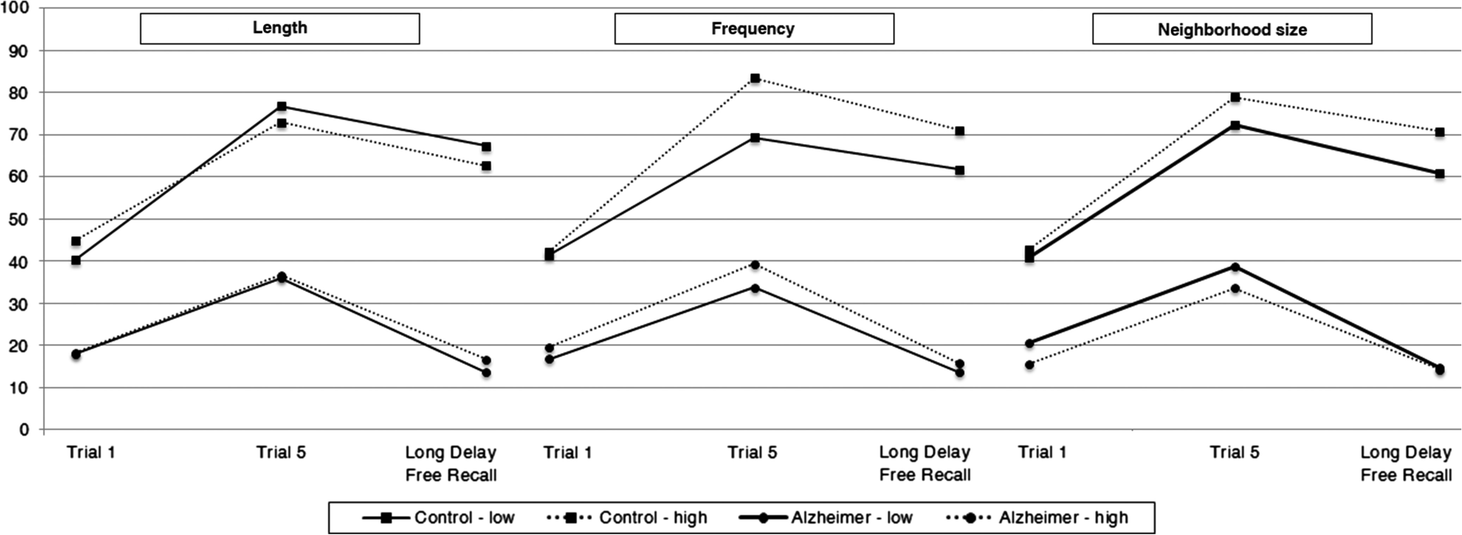
Fig. 1. Mean recall rates at Trial 1, Trial 5, and Long Delay Free Recall according to diagnosis as well as word ...
Notes:
Fig. 1. Mean recall rates at Trial 1, Trial 5, and Long Delay Free Recall according to diagnosis as well as word length, frequency, and neighborhood size.
Unless provided in the caption above, the following copyright applies to the content of this slide: © The Author 2016. Published by Oxford University Press. All rights reserved. For permissions, please e-mail: journals.permissions@oup.com.

