Slide 1
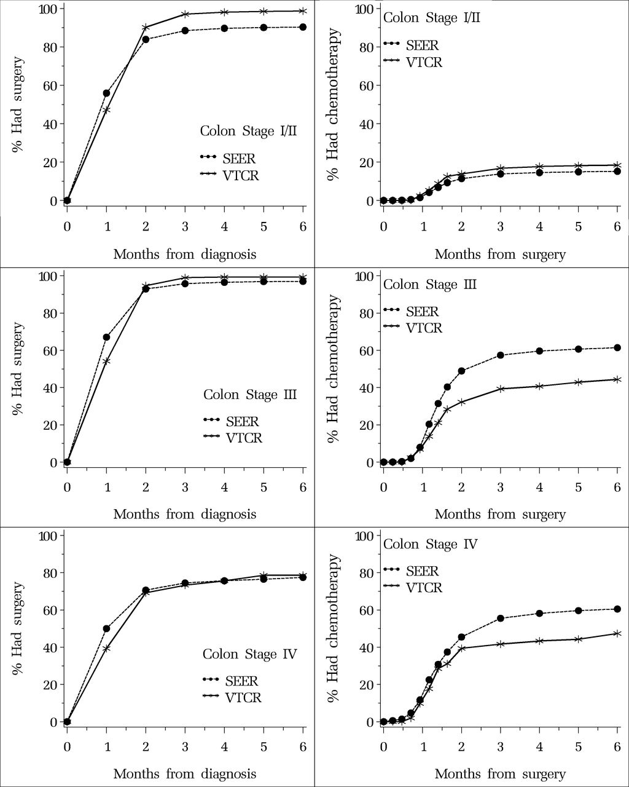
Figure 1. Percent having surgery by time since diagnosis and percent having chemotherapy by time since surgery. ...
Notes:
Figure 1. Percent having surgery by time since diagnosis and percent having chemotherapy by time since surgery. Patients diagnosed with colon cancer in Surveillance, Epidemiology, and End Results (SEER)–Medicare and Veneto–Tuscany Cancer Registry (VTCR) by stage.
Unless provided in the caption above, the following copyright applies to the content of this slide: © The Author 2013. Published by Oxford University Press. All rights reserved. For Permissions, please e-mail: journals.permissions@oup.com.

Slide 2
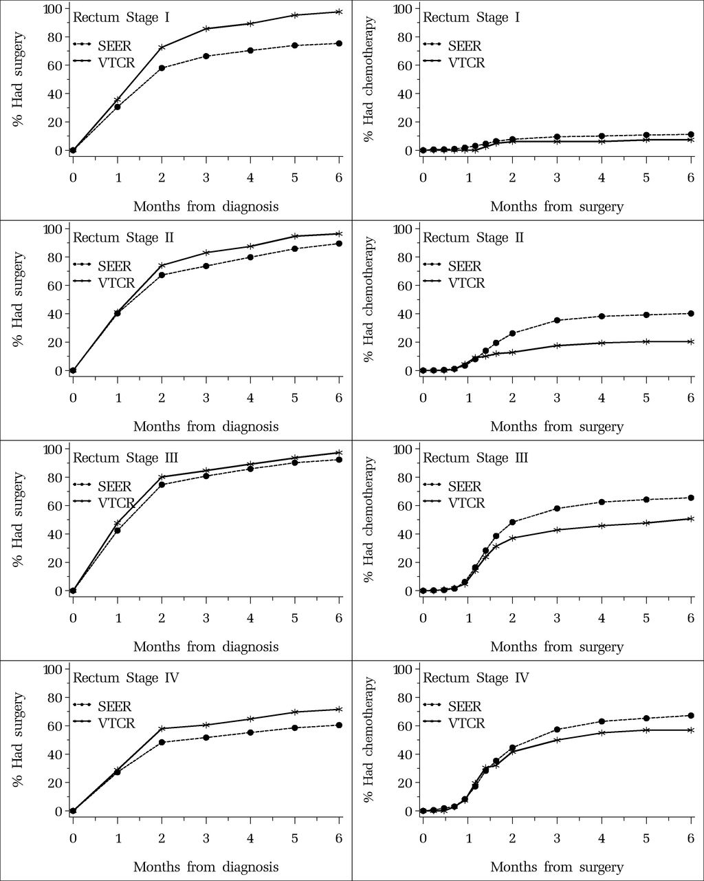
Figure 2. Percent having surgery by time since diagnosis and percent having chemotherapy (with or without radiotherapy) ...
Notes:
Figure 2. Percent having surgery by time since diagnosis and percent having chemotherapy (with or without radiotherapy) by time since surgery. Patients diagnosed with rectal cancer in Surveillance, Epidemiology, and End Results (SEER)–Medicare and Veneto–Tuscany Cancer Registry (VTCR) by stage.
Unless provided in the caption above, the following copyright applies to the content of this slide: © The Author 2013. Published by Oxford University Press. All rights reserved. For Permissions, please e-mail: journals.permissions@oup.com.

