Slide 1
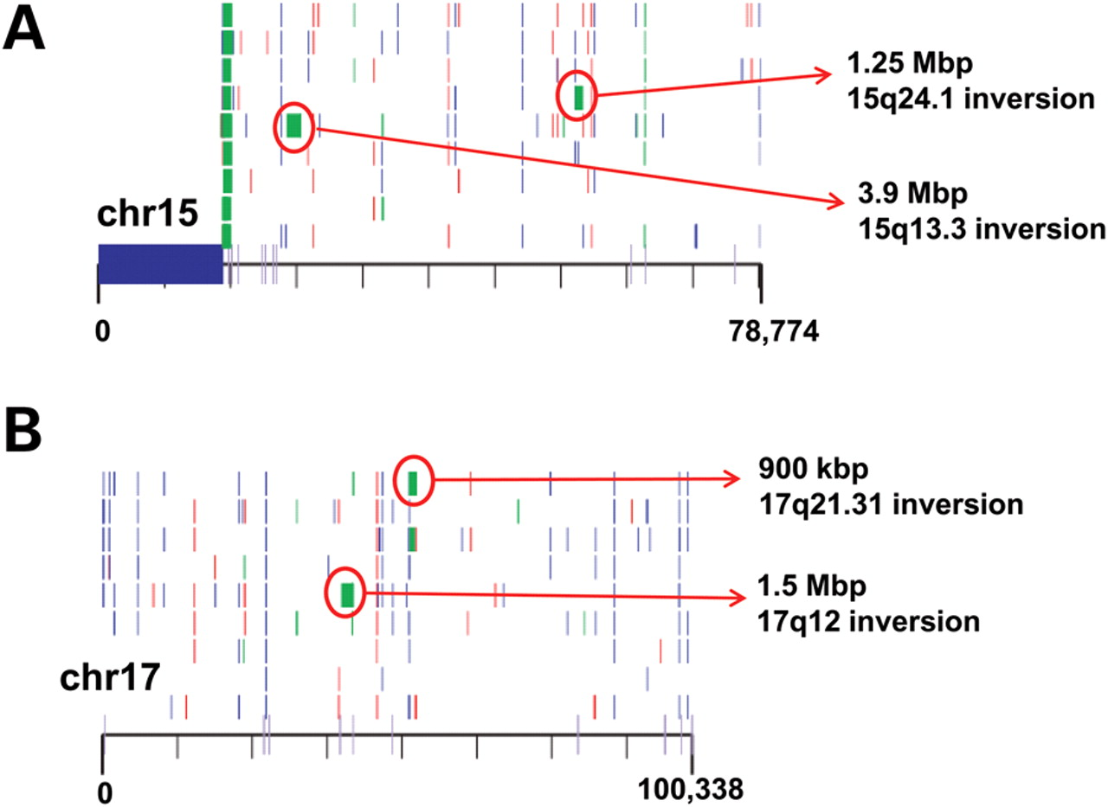
Figure 1. Rare CNVs and inversion polymorphisms. A structural variation map for chromosome 15 (A) and chromosome 17 (B) ...
Notes:
Figure 1. Rare CNVs and inversion polymorphisms. A structural variation map for chromosome 15 (A) and chromosome 17 (B) is shown (15). Of relevance to this review, inversion polymorphisms (green blocks) associated with genomic disorders for both the chromosomes are shown. Of note, these inversions likely harbor the directly orientated segmental duplication and such inversions are usually identified in the parents of probands carrying a CNV for the intervening region. This image is modified from Kidd et al. (15).
Unless provided in the caption above, the following copyright applies to the content of this slide: © The Author 2010. Published by Oxford University Press. All rights reserved. For Permissions, please email: journals.permissions@oxfordjournals.org

Slide 2
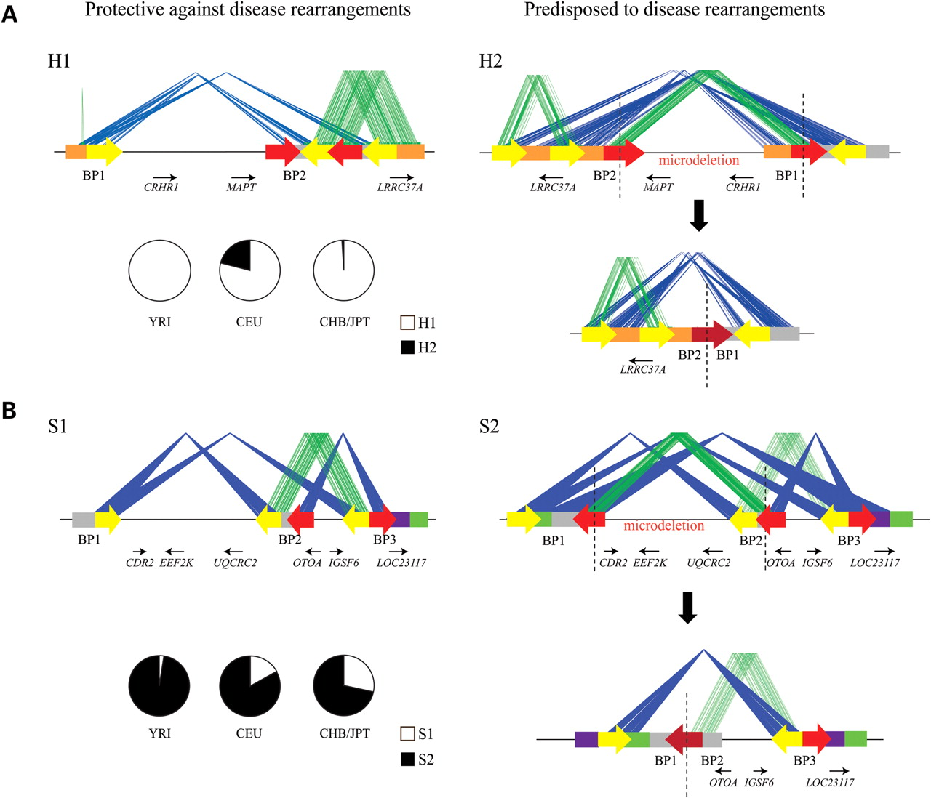
Figure 2. Genomic predisposition to disease rearrangements. The schematic depicts the common structural configurations ...
Notes:
Figure 2. Genomic predisposition to disease rearrangements. The schematic depicts the common structural configurations for 17q21.31 (A) and 16p12.1 (B), with block arrows depicting the orientation of the segmental duplication blocks. The blue lines connect the identical segmental duplications in the inverted orientation, and green lines connect those in the direct orientation. The red arrows are the segmental duplications that participate in the NAHR events resulting in the microdeletion with the fusion of the two segmental duplication blocks (dark red arrow). The genes lying within these regions are also shown, with small arrows depicting the transcriptional orientation. H1 represents the direct configuration wherein the predisposing duplications are not in the same orientation. H2 represents a vulnerable structure with directly oriented duplication blocks. S1 is the protective structure and S2 has the predisposing structure. Note the orientation of both S1 and S2 is correct but inverted compared with the current version (build36) of the human genome (see Antonacci et al. (22) for more details). Also shown is the frequency of H1 and H2 (for 17q21.31) and S1 and S2 (for 16p12.1) in the HapMap populations.
Unless provided in the caption above, the following copyright applies to the content of this slide: © The Author 2010. Published by Oxford University Press. All rights reserved. For Permissions, please email: journals.permissions@oxfordjournals.org

Slide 3
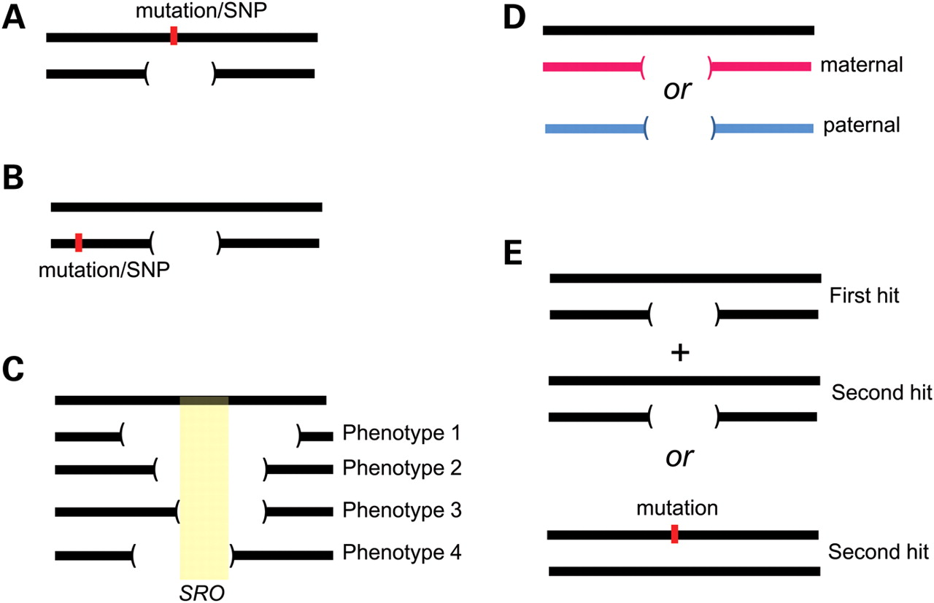
Figure 3. Phenotypic variability in genomic disorders. Possible causes for phenotypic variability are shown: (A) ...
Notes:
Figure 3. Phenotypic variability in genomic disorders. Possible causes for phenotypic variability are shown: (A) unmasking of recessive mutations or functional polymorphism within the CNV region, (B) a single-nucleotide change in close proximity to the CNV altering the expression pattern of the genes in the region, and (C) different sizes of the CNV leads to different phenotypes, as in Williams syndrome (61). Sometimes, a ‘core’ gene is responsible for a majority of the phenotypes, whereas other genes within the region contribute to the variability and severity, as in Smith–Magenis syndrome (57). (D) Parent-of-origin effects or imprinting of the paternal or maternal derived allele/genes as in Prader-Willi or Angelman syndrome and (E) the two-hit model wherein the severity and variability are due to alteration (CNV or a point mutation) of multiple functionally relevant genes.
Unless provided in the caption above, the following copyright applies to the content of this slide: © The Author 2010. Published by Oxford University Press. All rights reserved. For Permissions, please email: journals.permissions@oxfordjournals.org

Slide 4
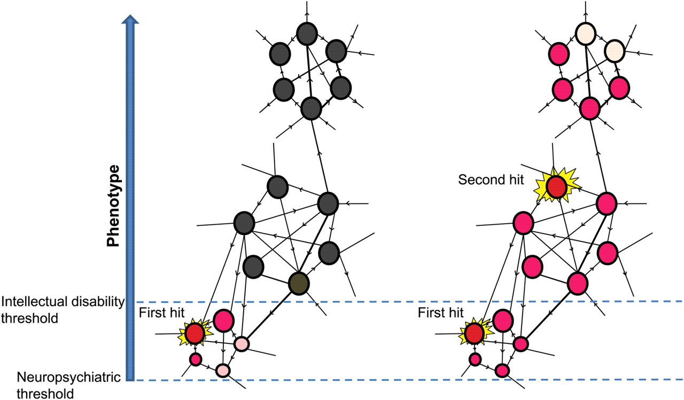
Figure 4. A model to explain the functional impact of two hits. The schematic depicts a network of genes in a ...
Notes:
Figure 4. A model to explain the functional impact of two hits. The schematic depicts a network of genes in a phenotype-associated pathway. A single hit disrupts the pathway, which is just sufficient to reach a threshold to induce neuropsychiatric features (left). A second hit pushes the threshold of the resultant phenotype toward intellectual disability (right). Two hits can therefore generate a more severe phenotype, a distinct phenotype or an additional phenotype (comorbidity) compared with the outcome from the either the first or second hit.
Unless provided in the caption above, the following copyright applies to the content of this slide: © The Author 2010. Published by Oxford University Press. All rights reserved. For Permissions, please email: journals.permissions@oxfordjournals.org

Slide 5
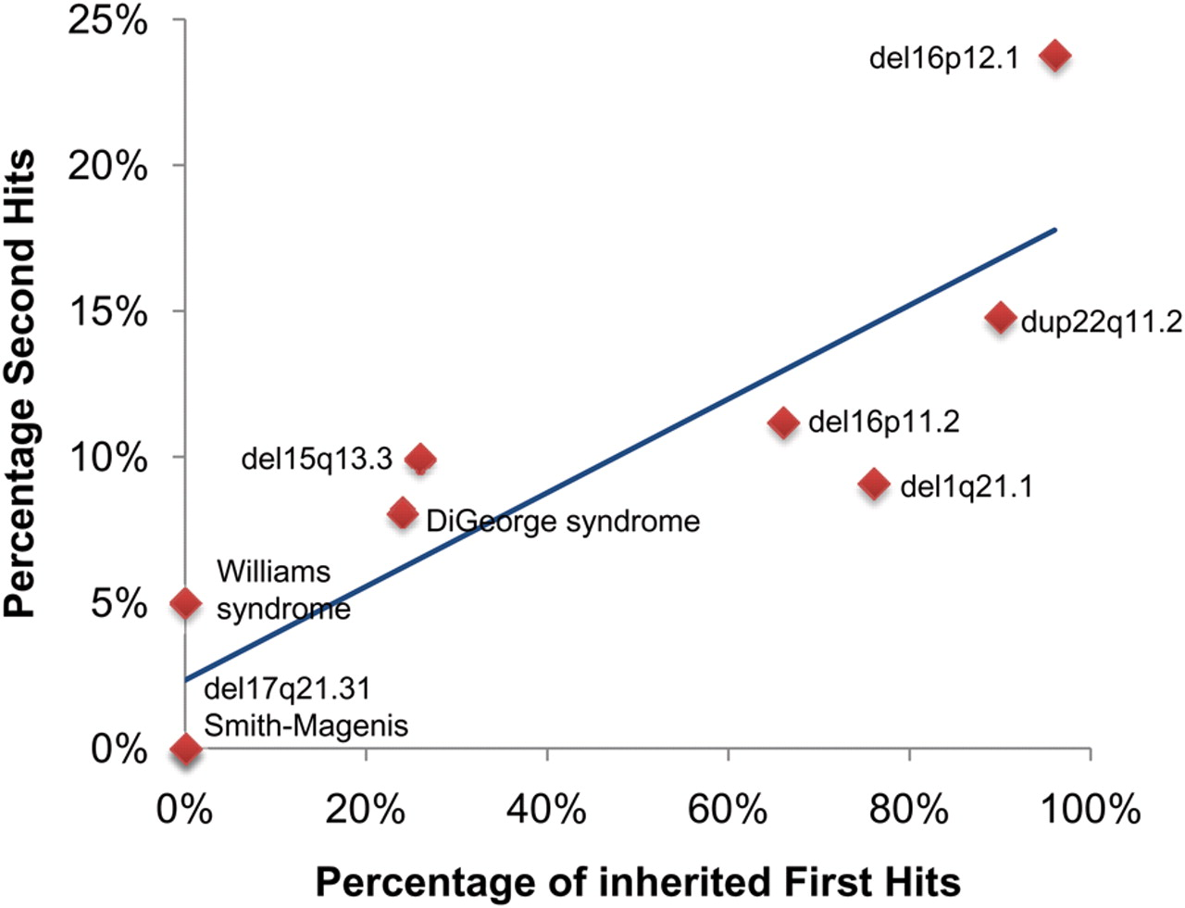
Figure 5. The two-hit model for variable expressivity and comorbidity. The graph plots the percentage of second hits ...
Notes:
Figure 5. The two-hit model for variable expressivity and comorbidity. The graph plots the percentage of second hits and the frequency of inherited first hits for nine genomic disorders. Regression analysis suggests a significant correlation (r = 0.87, P < 0.01). See text for more details.
Unless provided in the caption above, the following copyright applies to the content of this slide: © The Author 2010. Published by Oxford University Press. All rights reserved. For Permissions, please email: journals.permissions@oxfordjournals.org

Slide 6
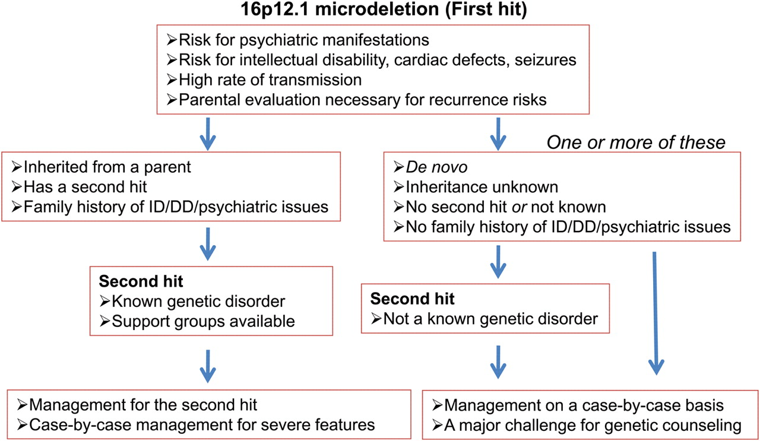
Figure 6. Management of genomic disorders with two hits. An example management flow chart for 16p12.1 microdeletion is ...
Notes:
Figure 6. Management of genomic disorders with two hits. An example management flow chart for 16p12.1 microdeletion is shown. It is important to note that there is a high risk for recurrence given that several genomic disorders associated with two hits are also highly inherited.
Unless provided in the caption above, the following copyright applies to the content of this slide: © The Author 2010. Published by Oxford University Press. All rights reserved. For Permissions, please email: journals.permissions@oxfordjournals.org

