Slide 1
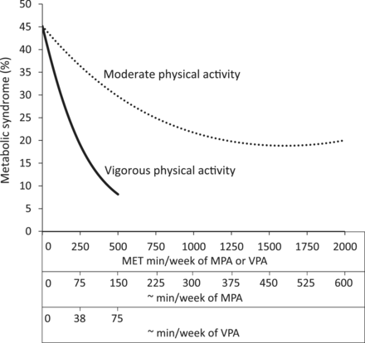
Figure 1 Estimated prevalence of the MetS according to MET min/week of MPA and VPA. Prevalence estimates were adjusted ...
Notes:
Figure 1 Estimated prevalence of the MetS according to MET min/week of MPA and VPA. Prevalence estimates were adjusted for age, sex, ethnicity, socio-economic status, smoking, alcohol, dietary fat, saturated fat and sodium. Minutes per week of MPA and VPA are approximations and were determined by dividing the corresponding MET min/week values by 3.33 and 6.67, respectively. Prevalence estimates were plotted from MPA and VPA MET min/week values of 0 to values that corresponded to the 98th percentile of the sample
Unless provided in the caption above, the following copyright applies to the content of this slide: Published by Oxford University Press on behalf of the International Epidemiological Association © The Author 2012; all rights reserved.This is an Open Access article distributed under the terms of the Creative Commons Attribution Non-Commercial License (http://creativecommons.org/licenses/by-nc/3.0/), which permits non-commercial re-use, distribution, and reproduction in any medium, provided the original work is properly cited. For commercial re-use, please contact journals.permissions@oup.com

